Slide 1
IENG 475 - Lecture 15
Robot Programming in ACL

Slide 2
Assignment
Last Lab (this period)
Write program to do the 12” Pick and Place Cycle in ACL commands for a total of 5 cycles. (Assume a new payload magically appears each time)
Remaining Laboratory Periods
Teach positions and run Robot Program
Complete NC Programming
Estimate times, plan for production

Slide 3
Programming
Teach Pendant
Lead-through / Walk-through / Dummy Robot
Languages:
AML, AML/2
ARMBASIC
Karel
RAIL
RAPL
SCORBASE
VAL, VAL II
Wave ...

Slide 4
Programming
Documentation:
Position Diagram(s)
Position Table
I/O Signal Table(s)
Program Listing
Well Commented
Operating Instructions / Safety Procedures
Program Metrics
Cycle Times
Program Size
Bill of Materials (Parts List)
Wiring Diagram(s)

Slide 5
Robot Programming
Good Programming Practices:
Always start a program with motion(s) from the HOME position
Always signal the start of automated operations by triggering a warning output
Always have an interrupt signal for critical error conditions
Always design programs to be “fail-safe” - to fail in a safe condition
Generously comment your programs

Slide 6
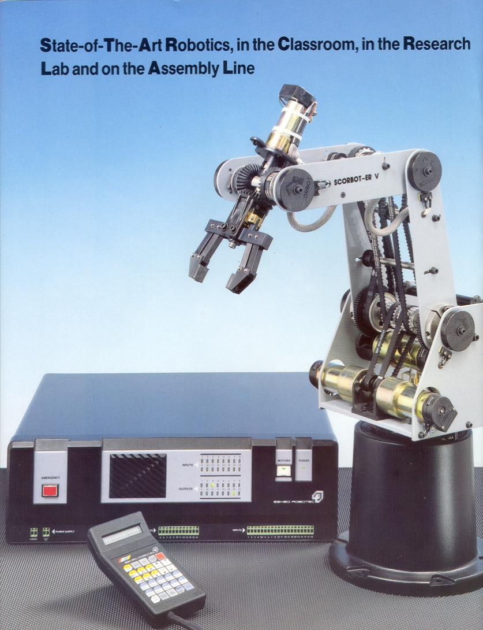
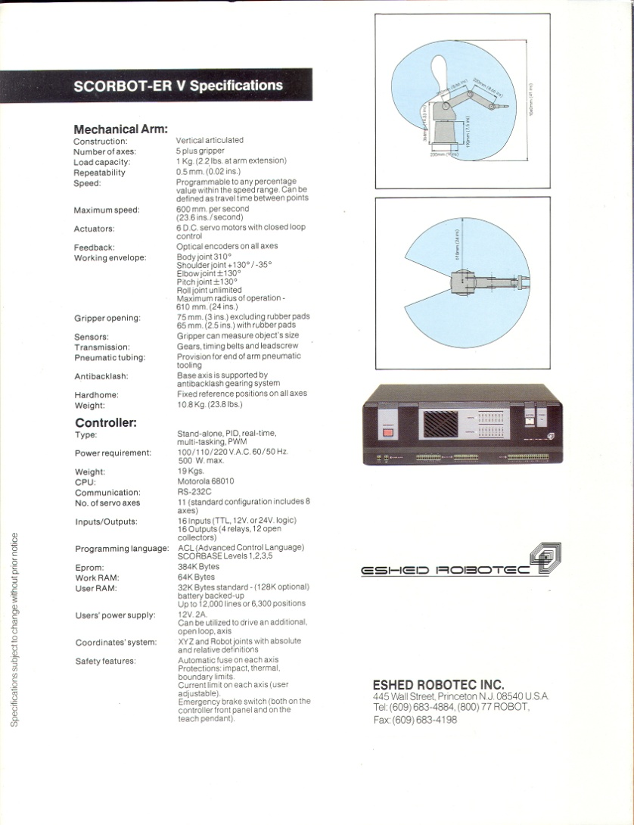
Anthropomorphic Spec Sheet

Slide 7
ACL Programming – ER V+ Robot
Advanced Command Language
Similar to BASIC
Programmed at keyboard in EDIT mode
Positions can be taught with teach pendant, or with keyboard in DIRECT mode
Programming Sequence:
Teach positions
Sketch positions
Program
Motions & Logic & I/O
Verify (slow speed) & Edit as necessary
Save program

Slide 8
Program Editing Commands
Edit starts a new program
EDIT program_name
S goes to the start of the program / line
S line_n
L lists the lines of a program
L n1 n2
Del erases the current line of a program
* precedes a comment line
Exit quits the editor and validates
Copy copies a program to program2
COPY program1 program2
Rename changes the name to program2
RENAME program1 program2
Remove deletes a program from RAM

Slide 9
Operation Commands
Run executes a saved program
Run program1
A aborts program & motions
A - or - Ctrl+A from keyboard
Stop aborts running program(s)
STOP program1
STOP
Suspend halts program execution
SUSPEND program1
Continue continues program execution
CONTINUE program1

Slide 10
Motion Commands
Home sends the robot to known position
Use this as the start and end of every program
Open opens the gripper
Close closes the gripper
Speed sets the speed for the axes of motion
SPEED value(1..100)
Move moves robot in point to point
MOVE position
MoveL moves robot in linear motion
MOVEL position
MoveC moves robot in circular motion
MOVEC position1 position2
NOTE: adding a D at the end of a move command allows the robot to delay the next axis motion until all movement is complete
Ex. MoveD position, MoveLD position, MoveCD position

Slide 11
Location Commands
Here Stores the position as joint coordinates
HERE position1
HereR Stores the position as relative to last in joint coords
HERER position2 position1
Teach Stores the position as cartesian coordinates
TEACH position
TeachR Stores the position as relative to last in cartesian
TEACHR position2 position1
SetP Transfers positions as variables
SET P position1 = position2
SetPV Changes a joint coordinate value
SETPV position axis value
SetPVC Changes a cartesian coordinate value
SETPVC position coord value

Slide 12
Program Control Loop Commands
If checks condition of two variables
IF variable1 condition variable2
AndIf combines If conditions
ANDIF variable1 condition variable2
OrIf combines If conditions
ORIF variable1 condition variable2
Else subroutine for false If condition
ELSE
EndIf ends an If routine
ENDIF
For looping command
FOR variable1 = variable 2 TO variable3
EndFor end of looping command
ENDFOR

Slide 13
Program / Branching Commands
Label sets a label for branching to
LABEL number(0..9999)
Goto sends program to a branch
GOTO label_n
Gosub transfers control to another program, suspending current until subprogram is completed
GOSUB program2

Slide 14
Programming Variables Commands
Global creates global variables
(all programs can use any global variables)
GLOBAL variable1 … variable2
Define creates local variables
(only current program can use local variables)
DEFINE variable1 … variable2
DimG dimensions an array of size n global variables
DIMG variable[n]
Dim dimensions an array of size n local vars
DIMG variable[n]
Set assigns value to variable1
SET variable1= variable2 operation variable3
Operations can be + - * / SIN COS TAN ATAN EXP LOG MOD OR AND

Slide 15
Programming Variables Commands
Print Displays text on screen
PRINT “string”
PrintLn Starts a new line & displays text on screen
PRINTLN “string”
Read Displays a prompt string & gets input
READ “prompt” variable
Get Waits for one keyboard character press
GET variable

Slide 16
Robotics Lab
Initial Position
Inking Mask & Pad
Inking Mask on Pad
Base & Pallets
Final Position
Fixture Pins

Slide 17
Questions & Issues
Finish producing your lid corners & monikers this week.
Finish your chess piece program verifications
Verify on CNC Lathe
Watch for tool interference
Watch for chuck interference
Detail handling of workpiece origin & running program(s)
Finalize design & select production methods
Consolidate programs in Team Folders
Organization for production – personnel, tools
Schedule time for last week’s demo
– by the end of this week
No lab next week – Monday will be last exam
In-class review & class assessment this Wednesday

