Slide 1
IENG 475 - Lecture 14
Automation Ethics

Slide 2
Automation Ethics: Three Laws and Four D’s
Asimov’s Three Laws (automated):
Automation must not harm a human being, nor through inaction allow one to come to harm.
Automation must always obey human beings, unless that is in conflict with the first law.
Automation must protect itself from harm, unless that is in conflict with the first two laws.
Applications (Four D’s of Automation):
Dirty
Dull
Difficult
Dangerous (in which order – priority?)

Slide 3
Automation Ethics: Stakeholders
Who has a stake in automation?
Manufacturing Firms
End Customers
Engineers and Managers
Production Employees
Direct Labor
Indirect Labor
Society:
Local, Regional, National, Global

Slide 4
Automation Ethics: Justification of Automation
How is automated manufacturing justified from the perspective of:
Manufacturing Firms
End Customers
Engineers and Managers
Production Employees
Direct Labor
Indirect Labor
Society:
Local, Regional, National, Global

Slide 5
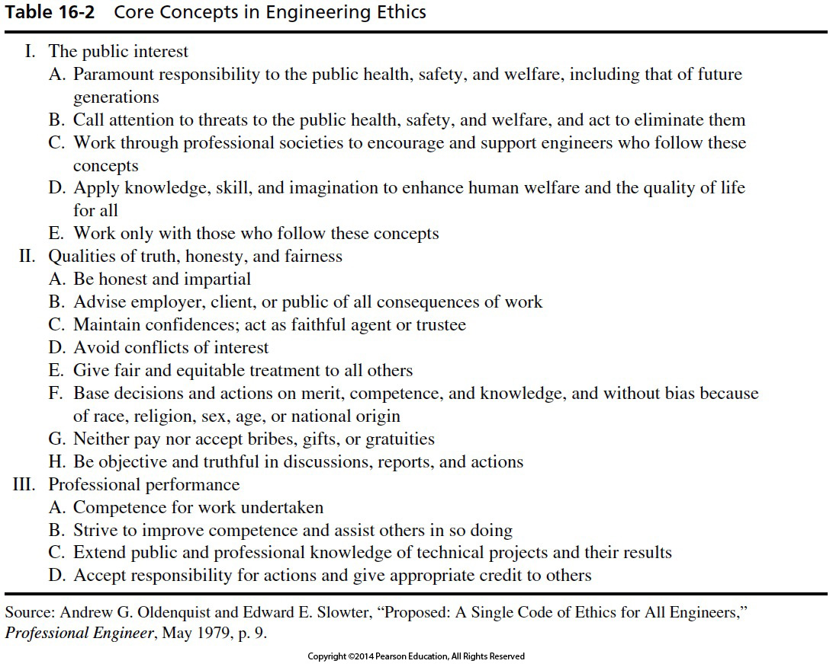

Slide 6
Automation Ethics: Responsibilities
What responsibilities does ethical automated manufacturing demand from:
Manufacturing Firms
End Customers
Engineers and Managers
Production Employees
Direct Labor
Indirect Labor
Society:
Local, Regional, National
Global

Slide 7
Questions & Issues
Lecture(s) on Tuesday – Review & HW Solutions
Exam Materials:
Engineering Notebook & Scientific Calculator
Course Materials – Website, including slides, solns & lectures
Midterm Exam II:
Available by 11:00 AM on 23 APR
Suggest STARTING no later than 8:00 AM on 28 APR
Due by 5:00 PM MDT on 30 APR
Optional Final Exam:
Available by 8:00 AM on 02 MAY
Due by 12:00 PM (noon) on 08 MAY – along with anything else

