Slide 1
IENG 475 - Lecture 13
Introduction to Robotics

Slide 2
Three Laws for Robots
Asimov’s Three Laws:
A robot must not harm a human being, nor through inaction allow one to come to harm.
A robot must always obey human beings, unless that is in conflict with the first law.
A robot must protect itself from harm, unless that is in conflict with the first two laws.
Applications (Four D’s of Robotics):
Dirty
Dull
Difficult
Dangerous

Slide 3
Robotics Technology I
Definition of a Robot (RIA):
A robot is a reprogrammable, multi-functional manipulator designed to move material, parts, tools, or specialized devices through programmed motions for the performance of a variety of tasks.
Key Aspects:
Reprogrammability
Multiple functions
FLEXIBILITY

Slide 4
Degrees of Freedom
A Degree Of Freedom (DOF) is another means to affect a workpiece - one more way to accomplish a task.
Each joint on a robot is a DOF:
Rotational joints
Prismatic (linear) joints
Robot DOF:
Number of different joints from base through wrist
Does NOT include the end-effector (gripper, tool)
Purchase price of a robot does not include an end-effector

Slide 5
Degrees of Freedom
Wrist DOF (similar to an airplane):
Roll: axial rotational motion
Pitch: radial rotational motion (up/down)
Yaw: radial rotational motion (left/right)
Many robots do not have yaw - it can be faked if the joints align properly with the workpiece!

Slide 6
End-Effectors
Two kinds of end of arm manipulators:
Grippers (hold an object)
Vacuum cups
Hooks, forks
Inflatable
RCC
Remote Center Compliance
Tools (perform work on an object)
Spray applicators
Welding tools
Lasers, water jets
Extruders
Electromagnetic
Adhesive
Scoops, ladles
Fingered grippers
Drills, routers
Grinders
Screw drivers, riveters
Test equipment

Slide 7
Drives and Motion Controls
Typical Drives (sound familiar?)
Hydraulic
Pneumatic
Electric
Typical Motion Control (sound familiar?)
Hard Automation (mechanical cams)
Axis Limit (bang-bang / mechanical stops)
Point-to-Point (Pick and Place)
Contouring (Continuous Path)
Linear Interpolation
Circular Interpolation

Slide 8
Work Envelope
The work envelope is the set of all points that the end-effector can reach.
The selection of a robot depends on many things, but configuration and envelope are important first cut criteria:
Positions that must be reached must fall within the work envelope
Obstacles that must be avoided are addressed by the configuration
ex: cylindrical robots cannot reach around an obstacle, but they are best suited for tending many casting / molding / milling machines

Slide 9
Five Industrial Robot Configurations
Cartesian
Gantry crane is an inverted Cartesian configuration
Cylindrical
Polar
Articulated / Anthropomorphic / Revolute
SCARA
Selective Compliance Assembly Robot Arm
Primary rotary joints have vertical axes
Important for Pick and Place (ie: electronic assembly applications)

Slide 10
Work Envelope - Cartesian

Slide 11
Cartesian
Three linear axes (x, y, z)
Base travel, Reach, Height
Advantages:
Easy to visualize
Rigid structure
Easy to program off-line
Disadvantages:
Can only reach in front of itself
Requires large floor space for envelope size
Axes are hard to seal against debris

Slide 12
Work Envelope - Cylindrical

Slide 13
Cylindrical
One rotational, two linear axes (θ, r, z)
Base rotation, Reach, Height
Advantages:
Can reach all around itself
Reach and height axes rigid
Rotational axis easy to seal against debris
Disadvantages:
Cannot reach above itself
Rotation axis is less rigid, linear axes hard to seal
Can’t reach around obstacles
Horizontal motion is circular

Slide 14
Spherical (Polar)
One linear, two rotational axes (θ, r, β)
Base rotation, Reach, Elevation angle
Advantages:
Long horizontal reach
Can usually reach above itself
Disadvantages:
Can’t reach around obstacles
Generally has short vertical reach
Horizontal and vertical motion is circular

Slide 15
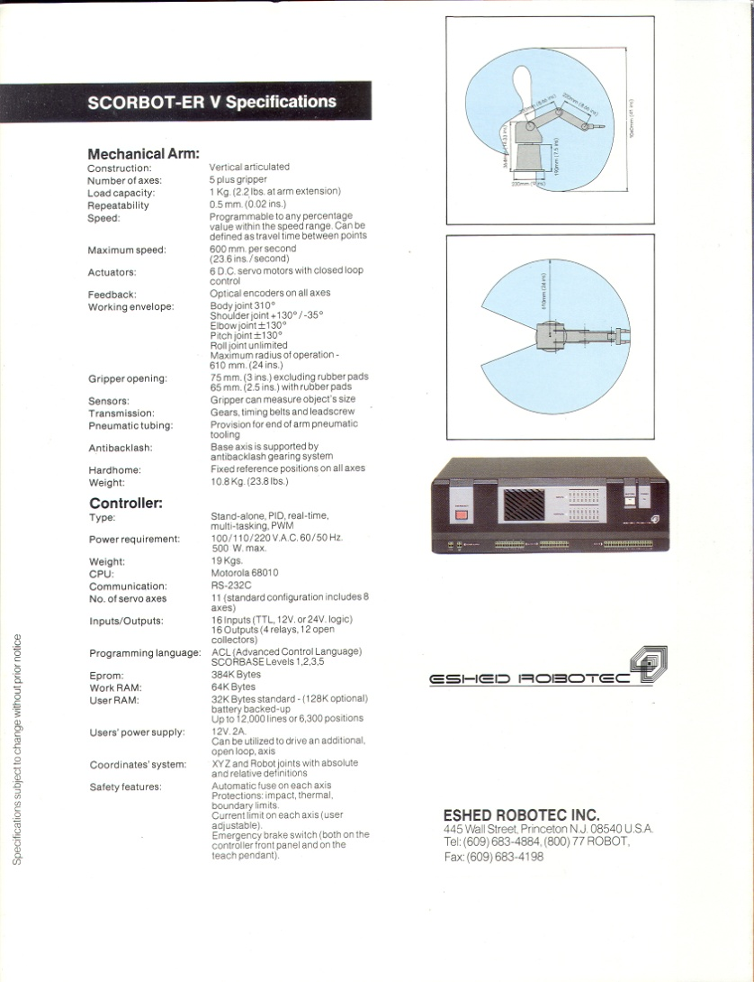
Anthropomorphic/Articulated Envelope

Slide 16
Anthropomorphic / Articulated
Three (or more) rotational axes (θ, β, α)
Base rotation, Elevation angle, Reach angle
Advantages:
Can reach above or below obstacles
Largest envelope for least floor space
Disadvantages:
Difficult to program off-line
Two or more ways to reach a point
Most complex configuration (construction)
Horizontal motion is circular

Slide 17
Work Envelope - SCARA

Slide 18
SCARA
Two rotational, one linear axes (θ, Φ, z)
Base rotation, Reach angle, Height
Advantages:
Height axis is rigid
Large envelope for floor space
Can reach around horizontal obstacles
Disadvantages:
Two ways to reach a position
Difficult to program off-line
Highly complex arm
Horizontal motion is circular

Slide 19
Robot Components
Robot Arm
End-effector
Controller
Power Supply
Programming Device
On-line Devices:
Teach Pendant
Lead-through / Walk-through
Dumb Terminal
Off-line Devices:
Computer (PC)

Slide 20
Ex. Anthropomorphic Spec Sheet

Slide 21
Performance Specifications
Payload
Maximum Payload is the maximum mass that the arm can move at reduced speed at the rated precision
Nominal Payload is the maximum mass that the arm can move at maximum speed at the rated precision
Effective Payload is the mass that may be moved after the mass of the end-effector has been subtracted
Ratings are highly dependant on the size and shape of the payload

Slide 22
Performance Specifications
Speed
Maximum speed is that of the tip of the arm at full extension with all joints moving simultaneously
The maximum speed must NOT be used to estimate cycle times
Use the “standard” 12 in. pick and place cycle time for rough estimates
Use a physical simulation for critical estimates
May require motion to a lower inertia posture
Repeatability
Resolution
Accuracy

Slide 23
Performance Specifications
“Standard” 12 in. Pick and Place Cycle
The time to execute the following motion sequence (seconds):
Move down one inch
Grasp rated payload
Move up one inch
Move across twelve inches
Move down one inch
Release the payload
Move up one inch
Return to starting location

Slide 24
Positioning
Envelope Coordinates
World Frame
Usually expressed in terms of workcell’s coordinate axes
Often include cartesian coordinates
Tool Center Coordinates
Tool Frame
Usually expressed in terms of tool’s coordinate axes
May include world cartesian coordinates
Joint Coordinates
Robot Frame
(Encoder) values of the joint positions at each programmed point

Slide 25
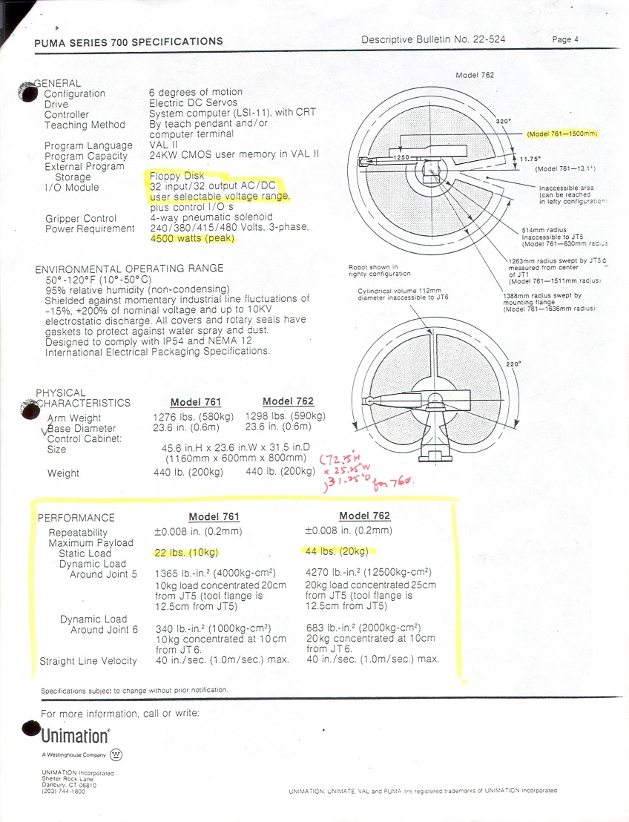
Example Spec Sheet

Slide 26
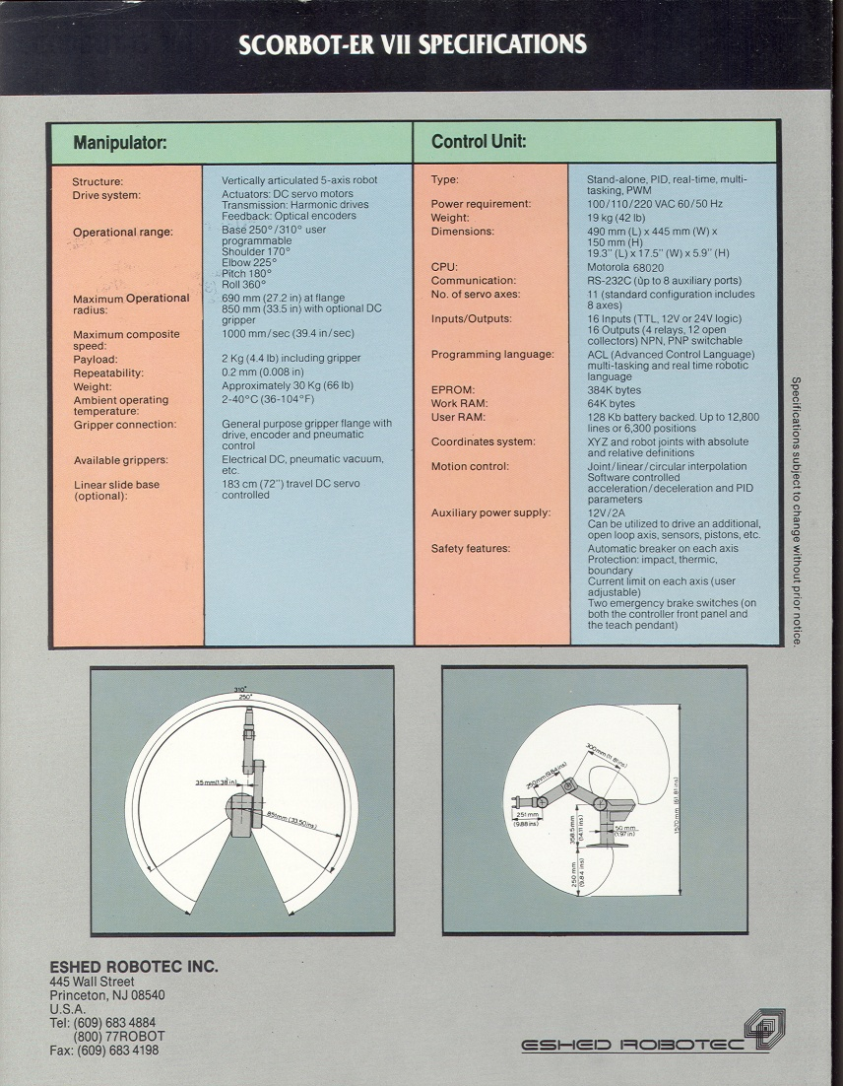
Example Articulated Spec Sheet

Slide 27
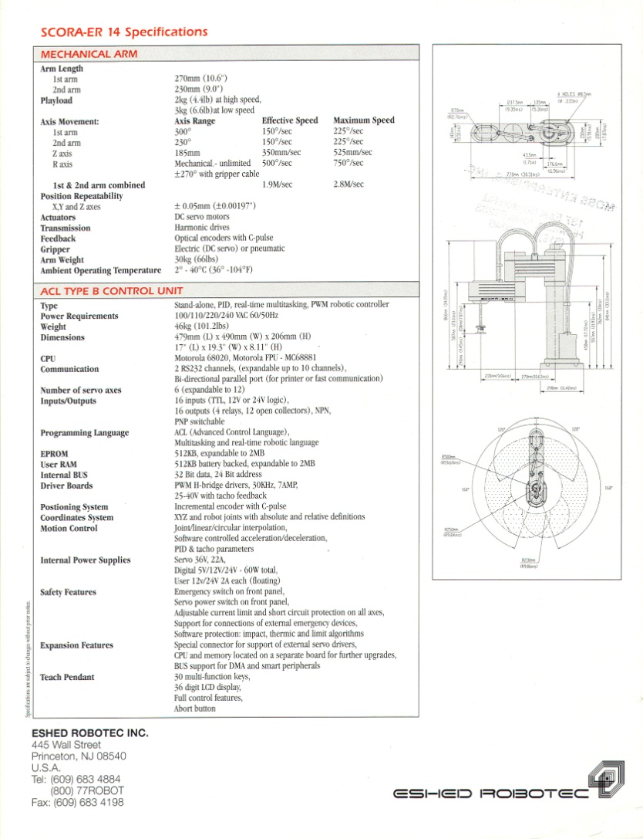
Example SCARA Spec Sheet

