Slide 1
IENG 475 - Lecture 7
CNC Programming –
NC Coding & APT

Slide 2
NC and CAD/CAM
Advantages of NC (vs. manual or fixed automation)
Flexibility
Easily reprogrammed (vs. fixed automation)
Capability for complex work pieces
Control more than two axes simultaneously (vs. manual)
Programmed for sequences of operations
Tool changing capability
Single head accepting multiple tools from a magazine
Reduced fixturing costs
More axes, more tools fewer machine setups
Repeatability (Quality)
Reduced number of variability sources (vs. manual)

Slide 3
NC Impact
Impact on Labor (vs. manual production)
Skills change
Manual capability Knowledge capability
Increased wages
Seniority tradition
Not just a labor union tradition
Increased operator responsibility
Put the best people where the money is
Increased productivity
Fewer people needed to achieve output
Lower cost for the product when produced in volume

Slide 4
NC Axes of Motion
Conventions:
Z-axis
Brings tool in contact with the part
– Z motion puts tool into part
+ Z motion takes tool out of part
X-axis
Direction of greatest travel
+ X follows right hand coordinate system rule
Y-Axis
Remaining primary axis
+ Y follows right hand coordinate system rule
Remaining Axes
Various degrees of freedom - ways to affect the part

Slide 5
Positioning
Home
Hard Home
Soft (Part) Home
Incremental
Current move endpoint is specified relative to the ending point for the last movement
Absolute
Current move endpoint is specified relative to the home position
Position is the center point of the tool

Slide 6
NC Code Formats
Words
A word is a unitary piece of information
Usually a parametric variable which takes on a value
Examples:
feed rate
spindle speed
x-coordinate
coolant on/off condition
interpolation mode condition

Slide 7
NC Code Formats
Block Formats
Fixed Sequential
All word values specified in sequence (changed or not)
Tedious, error-prone, inflexible, wasted space
Block Address (Fixed Sequential with Tab Ignored)
Specifies which words will be used within a block
Tedious, error-prone, but more flexible, compact
Tab Sequential
Tab used instead of value in word sequence (no change)
Tedious, but more flexible and less error-prone
Word Address* (add Tab between words for ease in reading)
Character specifies which word the value applies to
least error-prone, more flexible and compact

Slide 8
G Code
N words
Block numbers
G words
Preparatory commands (motion control)
F words, S words, T words
Feed, speed, tool control
X words (Y words, Z words, …)
Position control
M words
Miscellaneous (machine control)

Slide 9
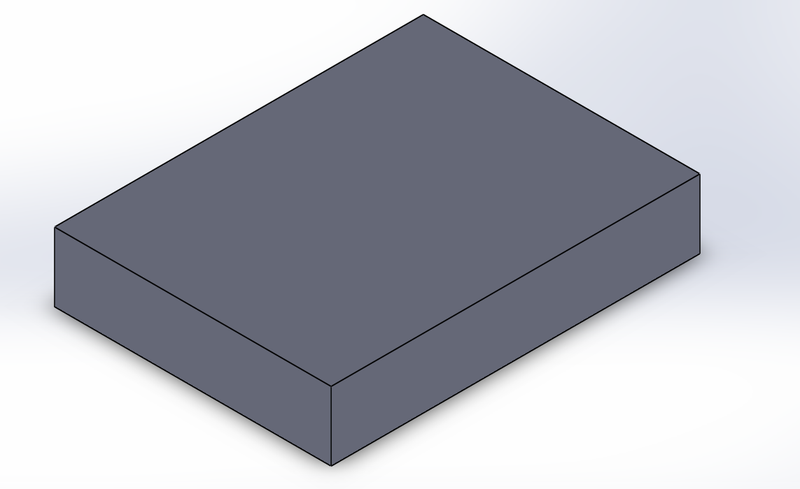
Milling Touch-Off: Our Lab Convention
X
Y
Z
Touch-Off Point (Soft/Part Home)
X=0, Y=0, Z=0
top, front, left corner of the stock

Slide 10
( j )
y
8
Write an NC program to cut the letter P 1” deep and centered in the grid at a feed of 5.5 IPM and a spindle speed of 1800 RPM using a tool that is numbered 04.
Assume the soft home position is as defined in our lab, and that the hard home position is at x = 0, y = 0, z = 10.
7
6
5
4
3
2
Assume that we want it in absolute coordinates.
1
0
x ( i )
0
1
2
3
4
5
6
7
8

Slide 11
( j )
y
8
Write an NC program to cut the letter P 1” deep and centered in the grid at a feed of 5.5 IPM and a spindle speed of 1800 RPM using a tool that is numbered 04.
Assume the soft home position is as defined in our lab, and that the hard home position is at x = 0, y = 0, z = 10.
7
6
5
4
3
2
Assume that we want it in incremental coordinates.
1
0
x ( i )
0
1
2
3
4
5
6
7
8

Slide 12
Questions & Issues
Assignment(s):
Start HW 01 from Schedule Page
Lab (current):
Lathe & Mill Operations:
Homing the machine(s) (Hard Home)
Tool Changes
Touch-Off (Soft Home)
Facing & Grooving Cuts
Rough & Finish Profiling Cuts*
Parting Cuts*
Pocketing Cuts*
NC Lathe Programming – See Schedule Page link

Slide 13
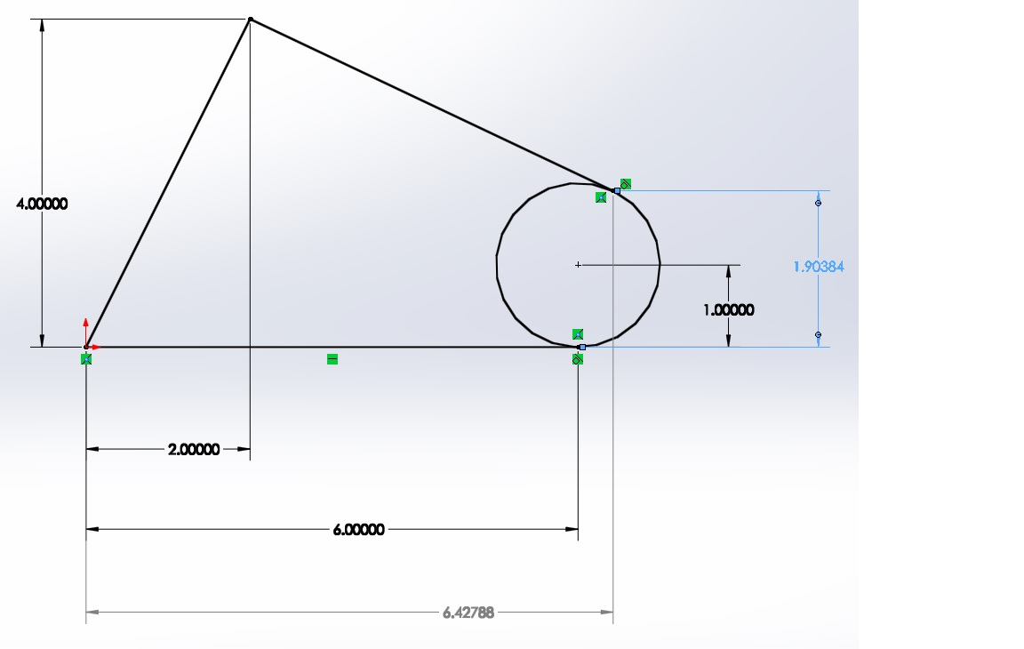
HELP: HW 01 NC Calculations
Coordinates
for point of tangency
(Use with HW 01)

Slide 14
APT
Automatically Programmed Tool
NC language instead of an NC code
Abbreviated English format
Symbolic addresses
Describes motion of the tool edge(s) relative to the surfaces of the part
Drive surface
Part surface
Check surface
Computer computes center point of the tool for the user
This creates a CL (cutter location) data file that is converted to G Code by a post-processor

Slide 15
APT
Four types of APT statements:
Geometry statements
Define the geometric elements that define the part
Motion statements
Describe the path taken by the cutting tool
Post-processor statements
Apply to the specific machine tool, such as feeds, speeds, feature actuation (coolant on, etc)
Auxiliary statements
Miscellaneous statements that identify the part, tool, tolerances, etc.

Slide 16
APT TO, ON, PAST Modifiers
GOFWD/ L3, PAST, L2
GOFWD/ L3, ON, L2
P4
GOFWD/ L3, TO, L2
L2
L3
P3 C1
P1
L1
P2
0
1
2
3
4
5
6
7
8
GOFWD/ L3, PAST, P2
GOFWD/ L3, ON, P2
GOFWD/ L3, TO, P2

Slide 17
APT Example

Slide 18
L8
Write an APT program to cut the letter P centered in the grid at a feed of 5.5 IPM and a spindle speed of 1800 RPM using a tool that is ½” in diameter.
Assume the soft home position is as defined in our lab, and that the hard home position is at P0, and plane PL1 is the correct depth.
L7
C1
L6
L5
L4
P10 (10" above)
L3
L2
L1
C2
L0
L10
L11
L12
L13
L14
L15
L16
L17
L18

Slide 19
P4
P5
8
L8
Write an APT program to cut the outside of the letter P centered in the grid at a feed of 5.5 IPM and a spindle speed of 1800 RPM using a tool that is ½” in diameter.
Assume the soft home position is as defined in our lab, and that the hard home position is at P0, and plane PL1 is the correct depth for the cut (1” below surface).
C1
7
6
P2
5
P1
4
L4
P10 (10" above)
3
P3
2
L12
1
P0 (10" above)
L0
0
0, 0, -1
2, 0, 10
8, 0, -1
0
1
2
3
4
5
6
7
8

Slide 20
Computers & NC
NC
Numerical Control
Electric control based on paper tape, hard wired CPU
DNC
Direct Numerical Control
Single, fast mainframe computer
Central control of each NC machine (time sharing)
Each NC machine cabled to central CPU
CNC
Computer Numerical Control
Each CNC has its own CPU, maybe retrofitted
Production continues if central CPU goes down

Slide 21
Computers & NC
DNC / HNC
Distributed / (Hierarchical) Numerical Control
Library of programs centrally maintained
Distributed production data acquisition and central database
Centralized production control adapting to changing conditions
Limited loss of production if central CPU is down
CAD/CAM
Computer-Aided Design / Computer-Aided Mfg
Stronger design / manufacturing database
Enhanced knowledge (CPU), off-line error-checking
More productive, flexible; less tedious and error-prone

Slide 22
Questions & Issues
Assignment(s):
Start HW 02 from Schedule Page
Lab (current):
Lathe & Mill Operations:
Homing the machine(s) (Hard Home)
Tool Changes
Touch-Off (Soft Home)
Facing & Grooving Cuts
Rough & Finish Profiling Cuts*
Parting Cuts*
Pocketing Cuts*
NC Lathe Programming – See Schedule Page link

