Slide 1
IENG 475 - Lecture 06
Process Planning

Slide 2
Power and Energy Relationships
Power requirements to perform machining can be computed from:
P_{c} = F_{c} v N-m/s (W) ft-lb/min
where: P_{c} = cutting power;
F_{c} = cutting force; and
v = cutting speed
Customary U.S. units for power are Horsepower
(= 33000 ft-lb/min)

Slide 3
Power and Energy Relationships
The Gross machine power (P_{g}) required is:
P_{c} = P_{g}• E
where E = mechanical efficiency of machine tool
Typical E for machine tools = ∼ 80 - 90%
Note: Alternate relationships for the same -

Slide 4
Unit Power in Machining
Useful to convert power into power per unit volume rate of metal cut
Called the unit power, P_{u} or unit horsepower, HP_{u}
or
where MRR = material removal rate

Slide 5
Specific Energy in Machining
Unit power (P_{u}) is also known as the specific energy (U), or the power required to cut a unit volume of material:
where t₀ = un-deformed chip thickness;
w = width of the chip; and
F_{c} = cutting force
Units for specific energy are typically N‑m/mm³ (same as J/mm³) or as in‑lb/in³
Table on Materials page approximates specific energy for several materials based on estimated hardness

Slide 6
Specific Energy in Machining
Unit power (P_{u}) is also known as the specific energy (U), or the power required to cut a unit volume of material:
 |  |  | Specific Energy (U)
 |  |  | - or - Unit Power (Pu) |  | Unit Horsepower (HPu)
Material | Hardness (HB) |  | N-m/mm3 | in-lb/in3 | hp-min/in3
Carbon Steel | 150 | 200 | 1.6 | 240,000 | 0.6
 | 201 | 250 | 2.2 | 320,000 | 0.8
 | 251 | 300 | 2.8 | 400,000 | 1
Alloy Steels | 200 | 250 | 2.2 | 320,000 | 0.8
 | 251 | 300 | 2.8 | 400,000 | 1
 | 301 | 350 | 3.6 | 520,000 | 1.3
 | 351 | 400 | 4.4 | 640,000 | 1.6
Cast Irons | 125 | 175 | 1.1 | 160,000 | 0.4
 | 176 | 250 | 1.6 | 240,000 | 0.6
Stainless Steels | 150 | 250 | 2.8 | 400,000 | 1
Aluminum | 50 | 100 | 0.7 | 100,000 | 0.25
Aluminum Alloys | 100 | 150 | 0.8 | 120,000 | 0.3
Copper |  |  | 1.9 | 280,000 | 0.7
Brass | 100 | 150 | 2.2 | 320,000 | 0.8
Bronze | 100 | 150 | 2.2 | 320,000 | 0.8
Magnesium | 50 | 100 | 0.4 | 60,000 | 0.15

Slide 7
Specific Energy in Machining
Unit power (P_{u}) correction factor for Depth of Cut:
Depth of | Specific Energy
Depth of Cut (in) | Correction Factor
0.0013 | 1.80
0.0025 | 1.57
0.0050 | 1.35
0.0075 | 1.17
0.0100 | 1.04
0.0125 | 0.98
0.0150 | 0.92
0.0175 | 0.87
0.0200 | 0.83
0.0250 | 0.79
0.0300 | 0.76
0.0350 | 0.72
0.0400 | 0.69
0.0450 | 0.68
0.0500 | 0.67

Slide 8
Selection of Cutting Parameters
One of the major tasks in process planning:
For each operation, decisions must be made about machine tool, cutting tool(s), and cutting conditions
These decisions must give due consideration to workpart machinability, part geometry, surface finish, and so forth
Cutting Parameters:
speed
feed
depth of cut
cutting fluid

Slide 9
Selecting Depth of Cut
Depth of cut is often predetermined by workpiece geometry and operation sequence
Roughing - depth is made as large as possible to maximize material removal rate, subject to limitations of horsepower, machine tool and setup rigidity, and strength of cutting tool
Finishing - depth is set to achieve final part dimensions
Machinery’s Handbook is a good empirical resource for approximate depth of cut

Slide 10
Determining Feed
In general: feed first, speed second
Determining feed rate depends on:
Tooling – harder tool materials require lower feeds
Roughing or Finishing ‑ Roughing means high feeds, Finishing means low feeds
Constraints on feed in Roughing ‑ Limits imposed by cutting forces, setup rigidity, and sometimes available power
Surface finish requirements in Finishing – select feed to produce desired finish

Slide 11
Process Planning
Deciding which processes and methods should be used, and in what sequence
Determining tooling requirements
Selecting production equipment and systems
Estimating costs of production for the selected processes, tooling, and equipment
Groover, M. P. (1996), p. 966

Slide 12
Details of Process Planning
Processes & sequences
Equipment selection
Tools, dies, molds, fixtures, and gages
Cutting tools and cutting parameters for machining operations
Methods
Work standards
Estimating production costs
Material handling
Plant layout & facilities design
See Tables 41.1 & 41.3 in Groover (1996) for considerations

Slide 13
Process Planning for Parts
Sequence and Details for a Single Component:
Starting raw material
Basic process
Secondary processes
Property-enhancing processes
Finishing operations
Finished part
End Result is a Route Sheet

Slide 14
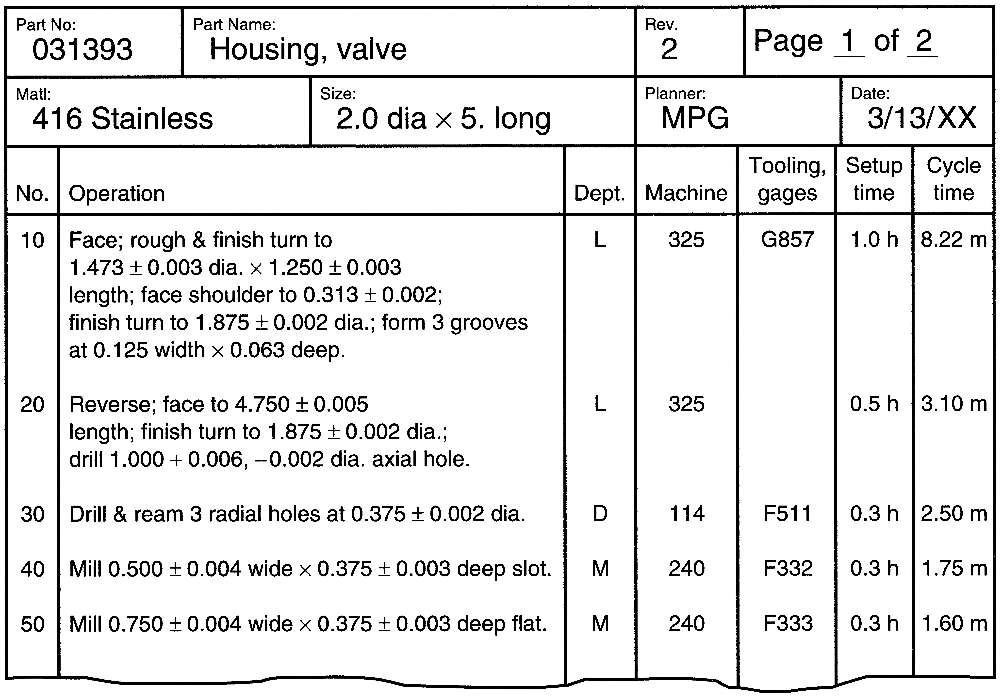
Example Routing Sheet
Figure 41.3 – Typical route sheet for specifying the process plan

Slide 15
Make or Buy Decision
Inevitably, the question arises whether a given part should be purchased from an outside vendor or made internally
It should be noted that virtually all manufacturers purchase their starting materials from suppliers
Very few production operations are vertically integrated all the way from raw materials to finished product

Slide 16
Make or Buy Decision (continued)
Given that a company purchases some of its starting materials, it is reasonable to question whether the company should purchase the parts that would otherwise be made in its own factory
The answer to the question is the make or buy decision
The make or buy question is probably appropriate to ask for every component used by the company

Slide 17
Make or Buy Decision
Vendor will bid a unit cost for an estimated quantity
Decision Process:
Roll up in-house costs for comparison on a per unit basis:
Material Cost
Direct Labor
Labor Overhead
Equipment Fixed Costs
Other considerations:
idle/mothball costs,
schedule impact,
agility,
quality…

Slide 18
Make or Buy Example
The quoted part price from a vendor = $8.00 per unit for 1000 units. The same part made in the home factory would cost $9.00. The cost breakdown on the make alternative is as follows:
Unit material cost = $2.25 per unit
Direct labor = $2.00 per unit
Labor overhead at 150% = $3.00 per unit
Equipment fixed cost = $1.75 per unit
Total = $9.00 per unit
Should the component be bought or made in‑house?

Slide 19
Make or Buy Example - continued
Although the vendor's quote seems to favor the buy decision, consider the possible effect on the factory if the quote is accepted
Equipment fixed cost is an allocated cost based on an investment that has already been made
If the equipment is rendered idle by a decision to buy the part, then the fixed cost of $1.75 continues even if the equipment is not in use
The overhead cost of $3.00 consists of factory floor space, indirect labor, and other costs that will also continue even if the part is bought

Slide 20
Make or Buy Example - continued
By this reasoning, the decision to purchase might cost the company as much as:
$8.00 + $1.75 + $3.00 = $12.75 per unit
if it results in idle time in the factory on the machine that would have been used to make the part
On the other hand, if the equipment can be used to produce other components for which the internal prices are less than the corresponding external quotes, then a buy decision makes good economic sense

Slide 21
Questions & Issues
Assignment(s):
Complete HW 00 from Schedule Page (2 – 3 persons/team)
Scan & e-mail (Subject: IENG 475 HW00; CC: teammates) by 5:00 PM
Start HW 01 from Schedule Page (2 persons/team)
Lab this week
Manual Lathe & Mill Operations:
Homing the machine(s)
Tool Changes
Touch-Off
Facing Cuts
Rough & Finish Profiling Cuts
Parting Cuts*
Pocketing Cuts*

