Slide 1
IENG 475 - Lecture 05
Drilling & Milling Operations

Slide 2
Agenda
Vertical Milling Equipment
Drilling Operations
Milling Operations
Machining Calculations
Questions & Issues

Slide 3
Milling
Machining is an operation in which work is fed past a rotating tool with multiple cutting edges
Axis of tool rotation is perpendicular to feed direction
Usually creates a planar surface; other geometries possible either by cutter path or cutter shape
Other considerations and terms:
Milling is an interrupted cutting operation
Cutting tool called a milling cutter, cutting edges called "teeth"
Machine tool called a milling machine

Slide 4
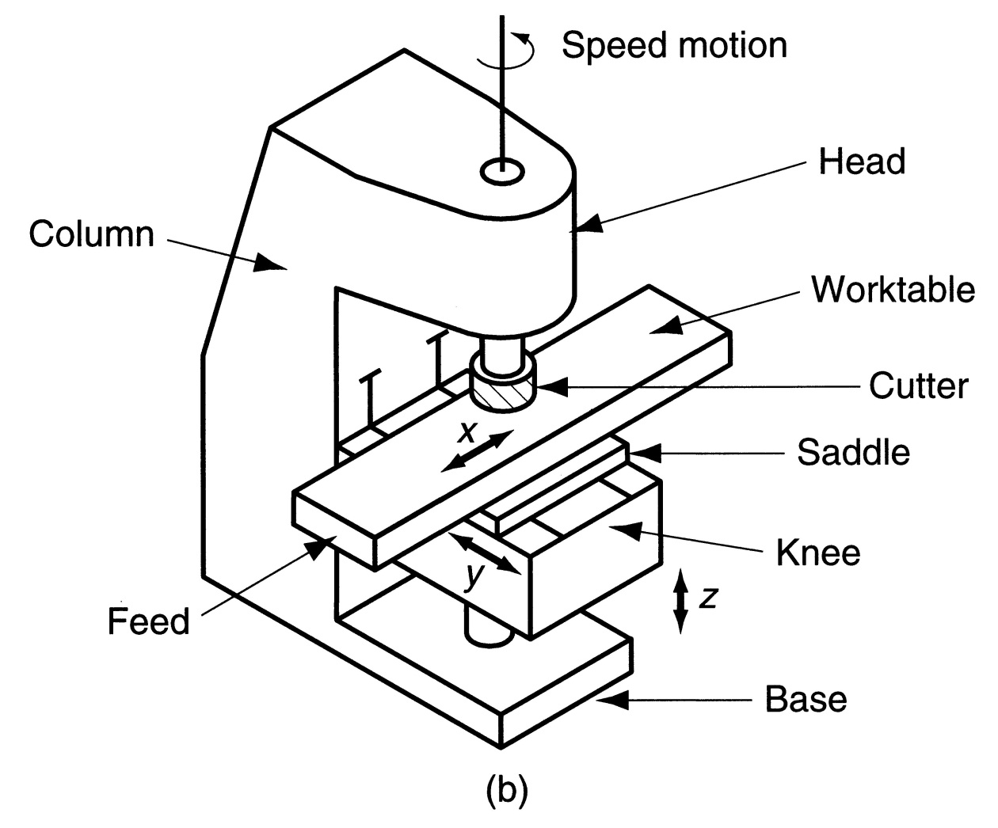
Vertical Mill
Figure 22.23 (b) vertical knee‑and‑column milling machine

Slide 5
CNC Vertical Mill
Head
Column
Saddle
Table
Knee
Spindle Speed

Slide 6
CNC Vertical Mill: Axes & Tools
Spindle
Tool Holder
+ Z-axis
Cutter
Alternate Tools (in quick-change magazine)
+ X-axis
Air Vise
– Y-axis

Slide 7
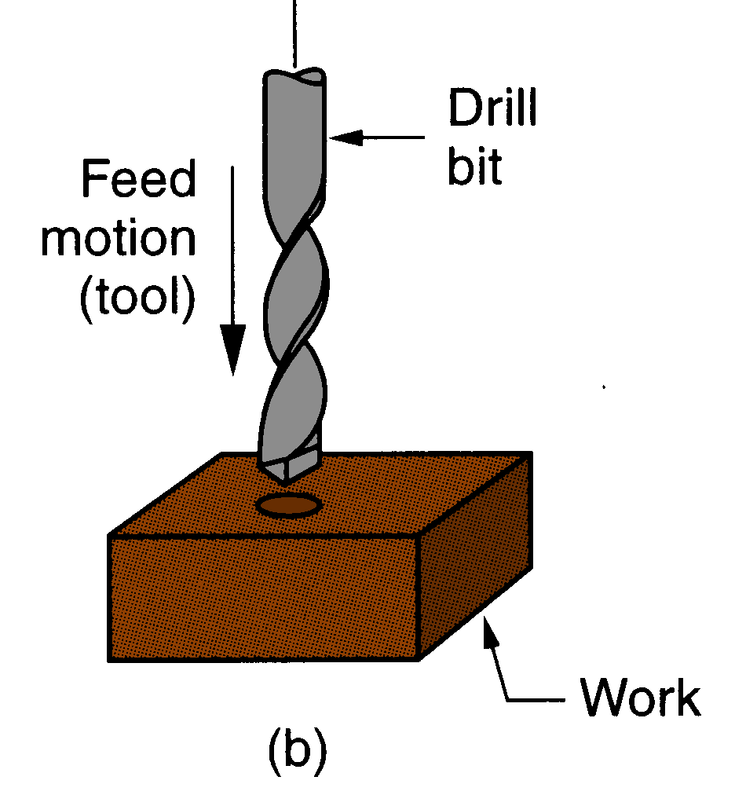
Drilling
Creates a round hole in a workpart
Contrasts with boring which can only enlarge an existing hole
Cutting tool is called a drill or drill bit
Customarily performed on a drill press, but can be done on a vertical mill and on a lathe
Figure 21.3 (b) drilling

Slide 8
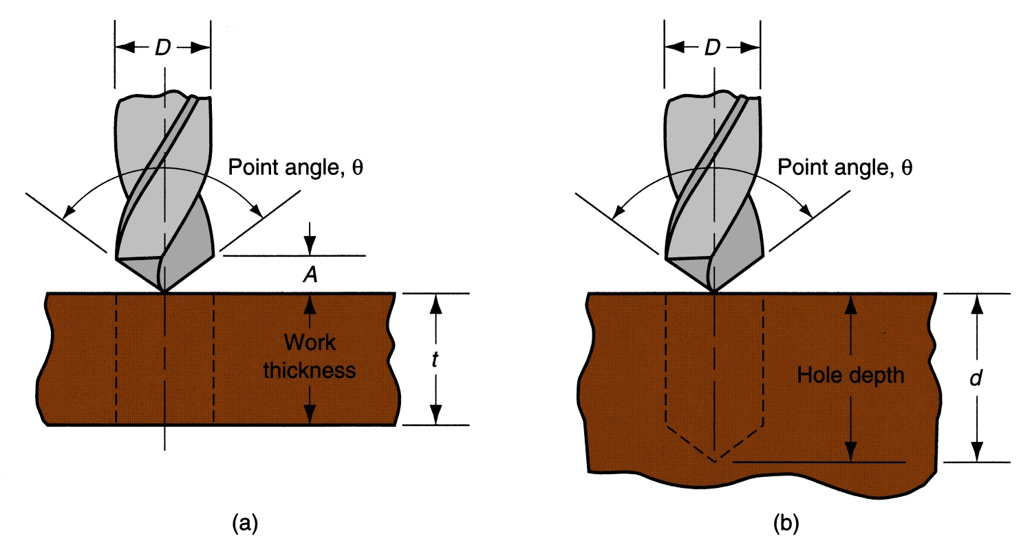
Through Holes vs. Blind Holes
Through‑holes - drill exits the opposite side of work
Blind‑holes – drill does not exit work on opposite side
Figure 22.13 ‑ Two hole types: (a) through‑hole, and (b) blind hole

Slide 9
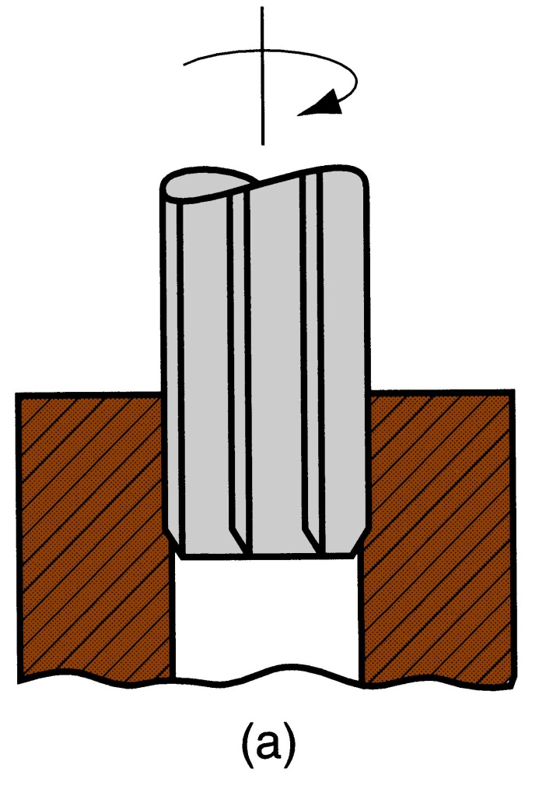
Reaming
Used to slightly enlarge a hole, provide better tolerance on diameter, and improve surface finish
Figure 22.14 ‑ Machining operations related to drilling: (a) reaming

Slide 10
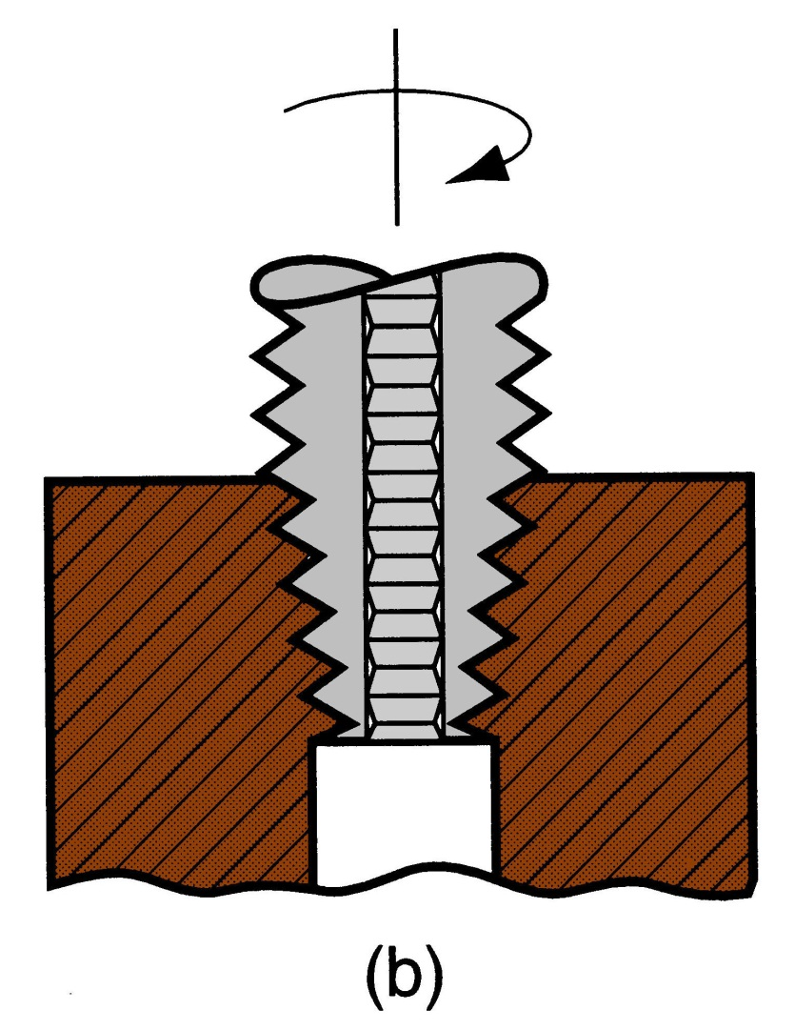
Tapping
Used to provide internal screw threads on an existing hole
The tool is called a tap
Figure 22.14 (b) tapping

Slide 11
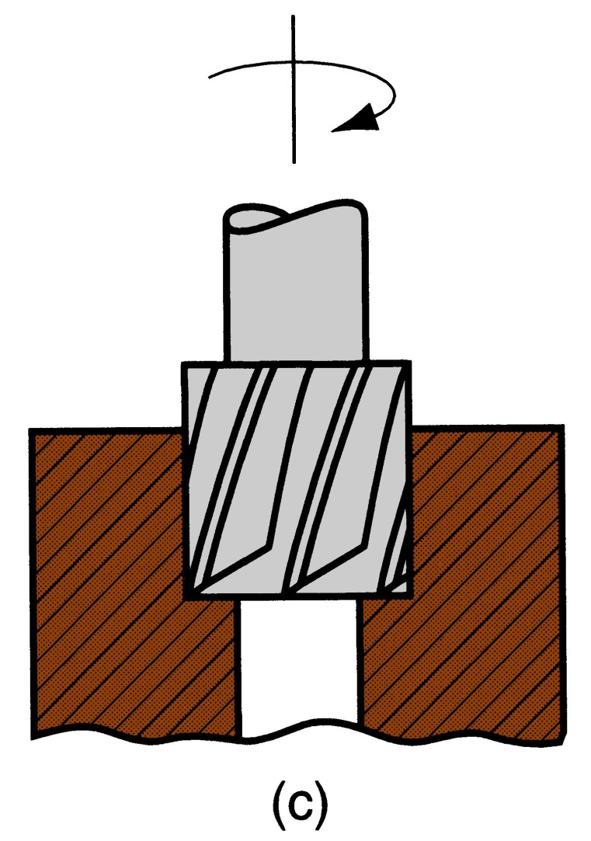
Counterboring
Provides a stepped hole, in which a larger diameter follows a smaller diameter partially into the hole
Figure 22.14 (c) counterboring

Slide 12
Accurate Hole-making
Sequence of Operations:
Pilot (Center) Drill
Drilling
Boring
Reaming

Slide 13
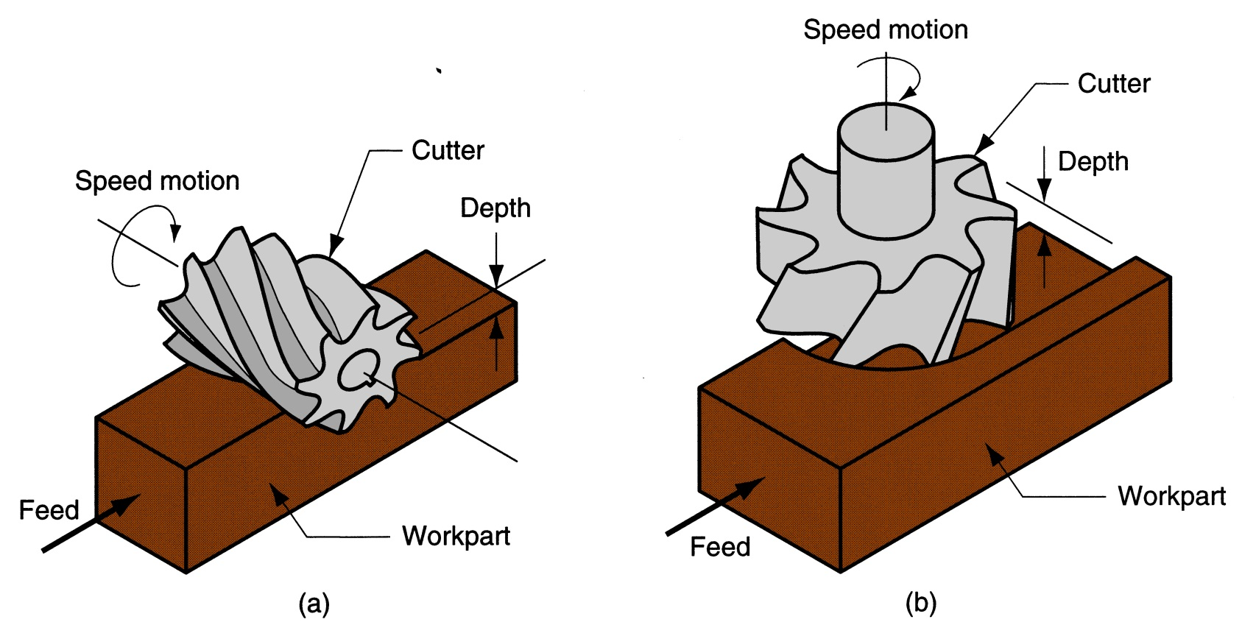
Milling Parameters Illustrated
Figure 21.3 ‑ Two forms of milling: (a) peripheral milling, and (b) face milling

Slide 14
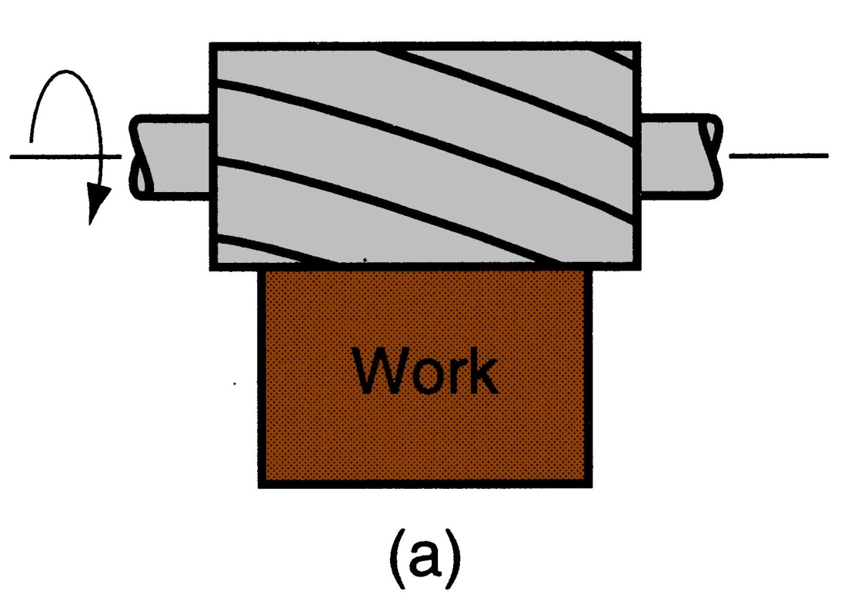
Slab Milling
The basic form of peripheral milling in which the cutter width extends beyond the workpiece on both sides
Figure 22.18 (a) slab milling

Slide 15
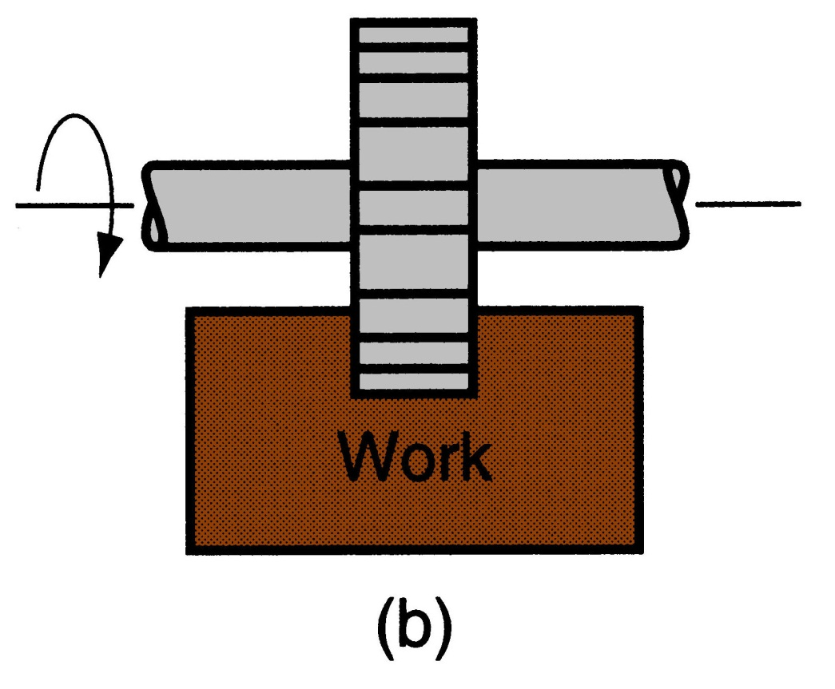
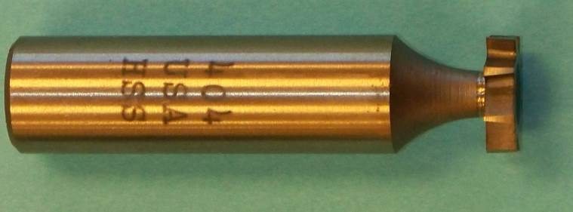
Slotting
Width of cutter is less than workpiece width, creating a slot in the work
Figure 22.18 (b) slotting

Slide 16
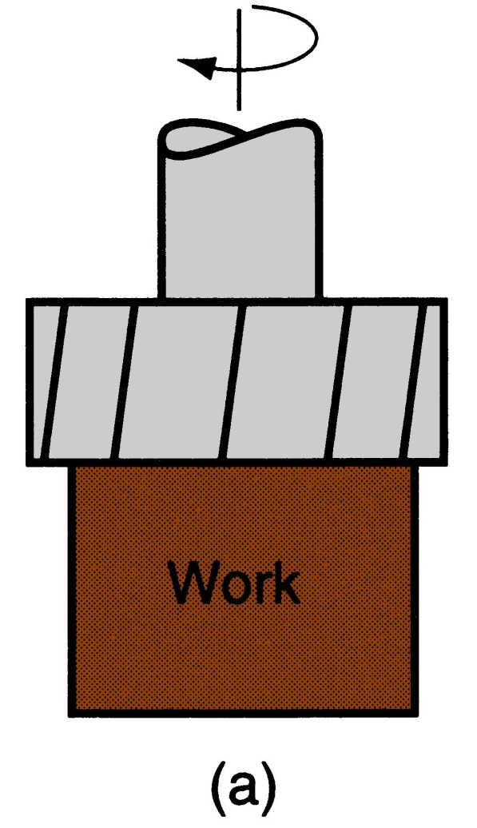
Conventional Face Milling
Cutter overhangs work on both sides
Figure 22.20
(a) conventional face milling

Slide 17
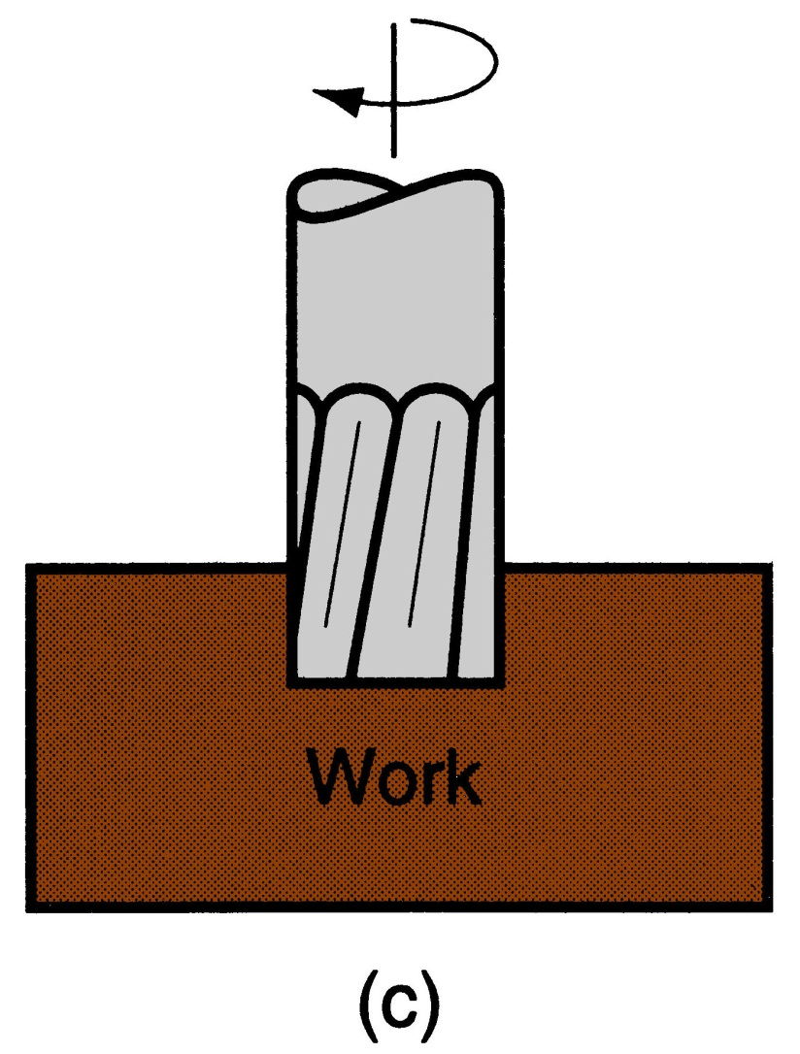
End Milling
Cutter diameter is less than work width, so a slot is cut into part
Figure 22.20 ‑ (c) end milling

Slide 18
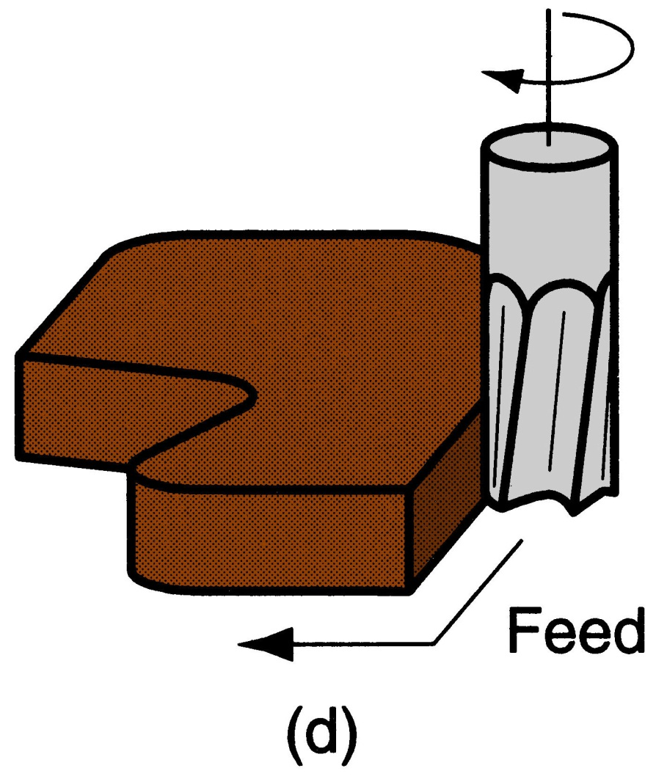
Profile Milling
A form of end milling in which the outside periphery of a flat part is cut
Figure 22.20 (d) profile milling

Slide 19
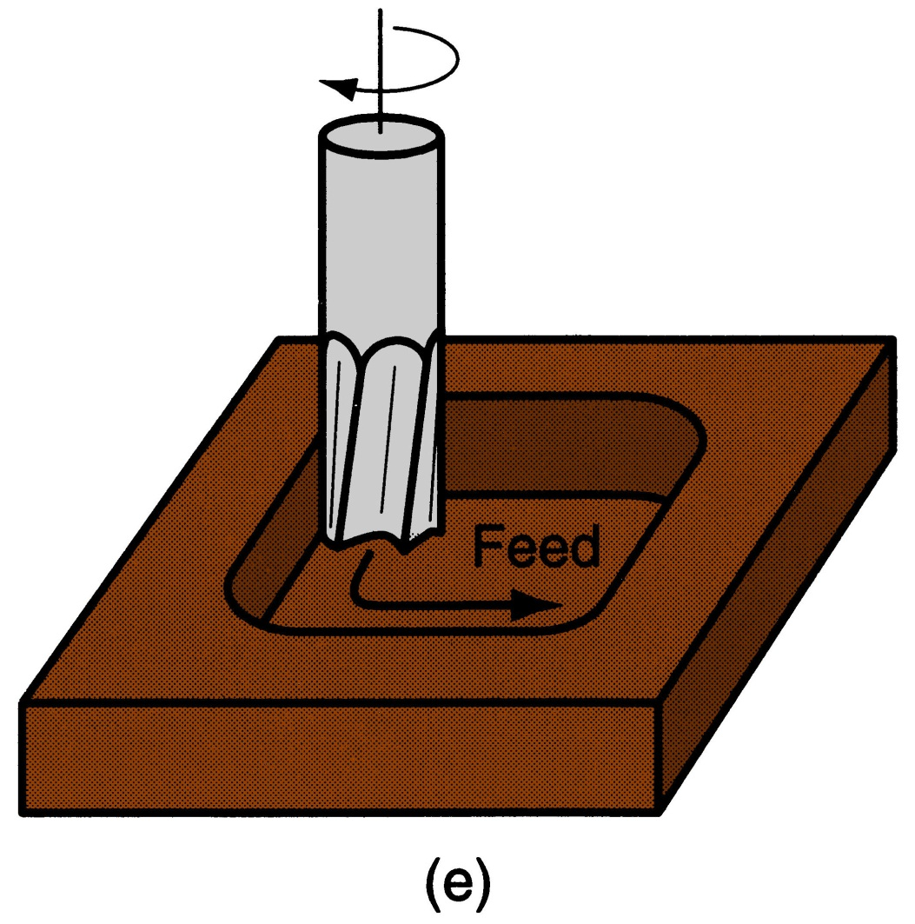
Pocket Milling
Another form of end milling used to mill shallow pockets into flat parts
Figure 22.20 (e) pocket milling

Slide 20
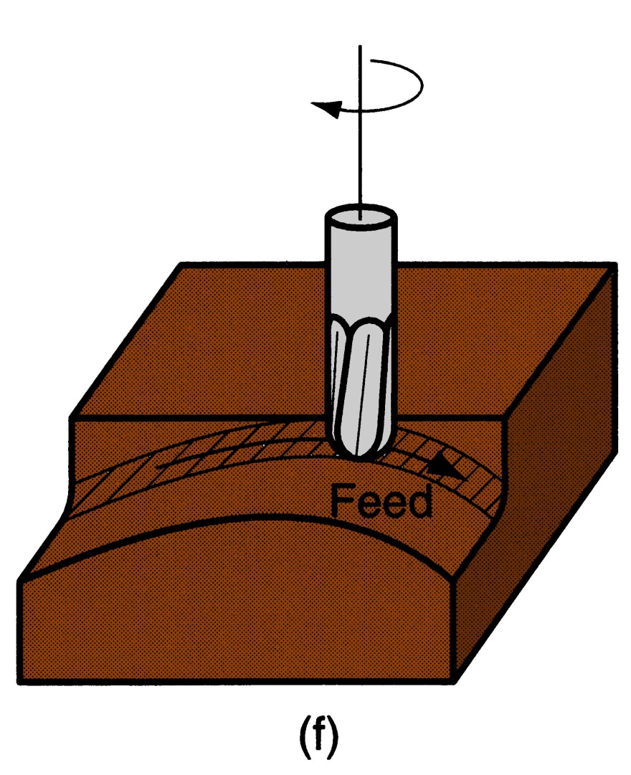
Surface Contouring
Ball‑nose cutter is fed back and forth across the work along a curvilinear path at close intervals to create a three dimensional surface form
Figure 22.20 (f) surface contouring

Slide 21
Machining Calculations: Drilling
Spindle Speed - N (rpm)
v = cutting speed
D = tool diameter
Feed Rate - f_{r} (mm/min -or- in/min)
f = feed per rev
Machining Time - T_{m} (min)
Through Hole :
t = thickness
θ = tip angle
Blind Hole :
d = depth
Mat’l Removal Rate - MRR (mm³/min -or- in³/min)
π D² f_{r} N
4
MRR=

Slide 22
Machining Calculations: Milling
Spindle Speed - N (rpm)
v = cutting speed
D = cutter diameter
Feed Rate - f_{r} (mm/min -or- in/min)
f = feed per tooth
n_{t} = number of teeth
Machining Time - T_{m} (min)
Slab Milling:
L = length of cut
d = depth of cut
Face Milling:
w = width of cut
2nd form is multi-pass
Mat’l Removal Rate - MRR (mm³/min -or- in³/min)
-or-
MRR
=
w d f
r

Slide 23
Questions & Issues
Assignment(s):
Complete HW 00 from Schedule Page
Lab this week & next:
Manual Lathe & Mill Operations:
Homing the machine(s)
Tool Changes
Touch-Off
Facing Cuts
Rough & Finish Profiling Cuts
Parting Cuts*
Pocketing Cuts*

