Slide 1
IENG 475 - Lecture 04
Lathe Operations

Slide 2
Agenda
Introduction to Machining
Processes
Parameters
Turning
Types of Cuts
Lathe Terminology
Process Parameters
Questions & Issues

Slide 3
Fixture Quiz
What is the theoretical minimum number of points of contact necessary for:
A vertically oriented rotational part?
A prismatic part?
What is the vocabulary term for:
A feature that “error-proofs” the use of a fixture?
A component that constrains the primary and secondary planes for horizontally oriented rotational parts?
Explain two relative benefits for:
Modular fixturing (vs. Permanent or General Purpose)

Slide 4
Manufacturing Operations
Four classes of Processing Operations:
Solidification Processes
Particulate Processes
Deformation Processes
Material Removal Processes
Two classes of Assembly Operations:
Mechanical Assembly
Joining

Slide 5
Machining
Variety of work materials can be machined
Most frequently applied to metals
Variety of part shapes and special geometry features possible, such as:
Screw threads
Accurate round holes
Very straight edges and flat surfaces
Good dimensional accuracy and surface finish
Wasteful of material
Chips generated in machining are wasted material, at least in the unit operation
Time consuming
A machining operation generally takes more time to shape a given part than alternative shaping processes, such as casting, powder metallurgy, or forming

Slide 6
Machining Operations
Generally performed after other manufacturing processes (casting, forging, …)
Other processes create the general shape of the workpart
Machining provides the final shape, dimensions, finish, and special geometric details that other processes cannot create
Most important machining operations (by frequency) :
Turning
Drilling
Milling
Other machining operations:
Shaping and planing
Broaching
Sawing

Slide 7
Primary Machining Parameters
Cutting Speed – (v)
Primary motion
Peripheral speed m/s ft/min
Feed – (f)
Secondary motion
Turning: mm/rev in/rev
Milling: mm/tooth in/tooth
Depth of Cut – (d)
Penetration of tool below original work surface
Single parameter mm in
Resulting in Material Removal Rate – (MRR)
MRR* = v f d mm³/s in³/min
where v = cutting speed; f = feed; d = depth of cut
* general model, only!

Slide 8
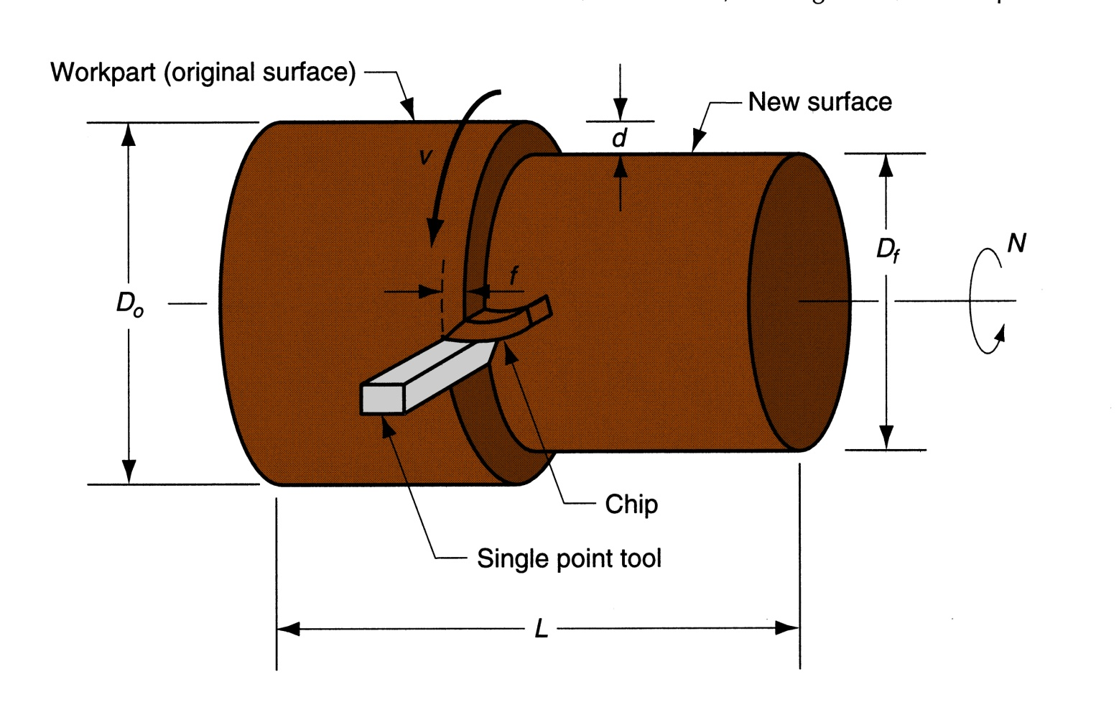
Turning Parameters Illustrated
Figure 22.5 ‑ Turning operation [Groover (2004), p.503]

Slide 9
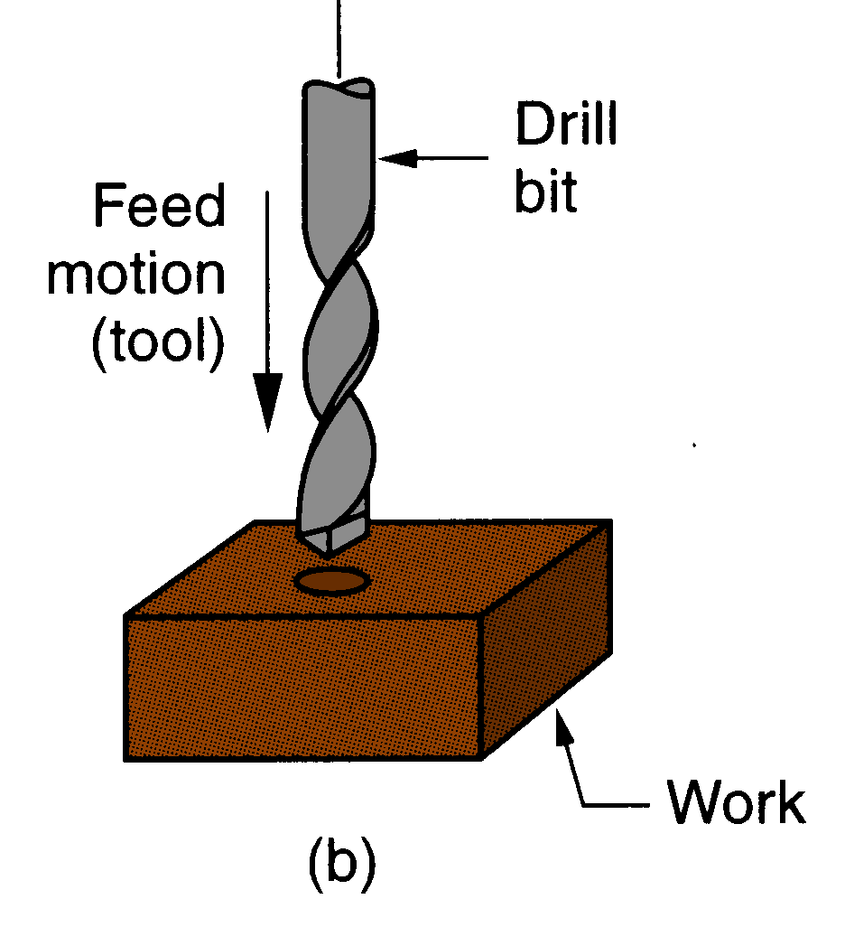
Drilling
Creates a round hole in a workpart
Contrasts with boring which can only enlarge an existing hole
Cutting tool called a drill or drill bit
Customarily performed on a drill press
Figure 21.3 (b) drilling
[Groover (2004), p.501]

Slide 10
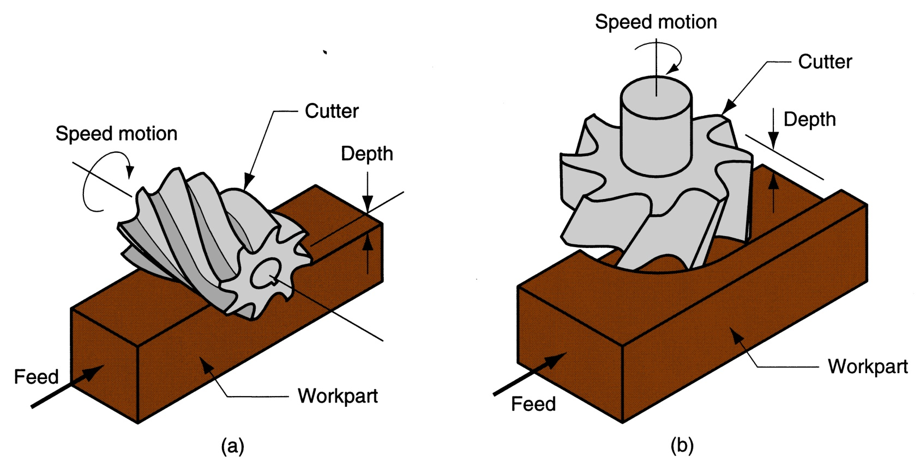
Milling Parameters Illustrated
Figure 21.3 ‑ Two forms of milling:
(a) peripheral milling, and (b) face milling
[Groover (2004), p.516]

Slide 11
Machining Operations & Parameters
Operation Type | Speed | Feed | Depth of Cut
Turning: workpiece rotates single point cutting | Surface speed (periphery) of workpiece | Parallel to the workpiece axis* (*except parting/grooving) | Tool penetration below original work surface
Drilling: tool rotates single pass cutting | Surface speed (periphery) of tool | Parallel to the tool axis | Tool penetration below original work surface (depth of hole)
Milling: tool rotates multi-point cutting | Surface speed (periphery) of tool | Perpendicular to the tool axis | Tool penetration below original work surface

Slide 12
Cut Types: Roughing & Finishing
Cut Type | Number of Passes | Speed | Feed | Depth of Cut
Roughing: removes large amounts to get close to shape | 1 + | Low | High 0.4 - 1.25 mm/ .015 - .050 in/ | High 2.5 - 20 mm .100 - .750 in
Finishing: achieves final dimensions, tolerances, and finish | 1 - 2 | High | Low 0.125 - 0.4 mm/ .005 - .015 in/ | Low 0.75 - 2.0 mm .030 - .075 in

Slide 13
Turning
A single point cutting tool removes material from a rotating workpiece to generate a rotationally symmetric shape
Machine tool is called a lathe
Types of cuts:
Facing
Contour turning
Chamfering
Parting (Cut-off) / Grooving
Threading

Slide 14
Turning Parameters Illustrated
Figure 22.5 ‑ Turning operation [Groover (2004), p.503]

Slide 15
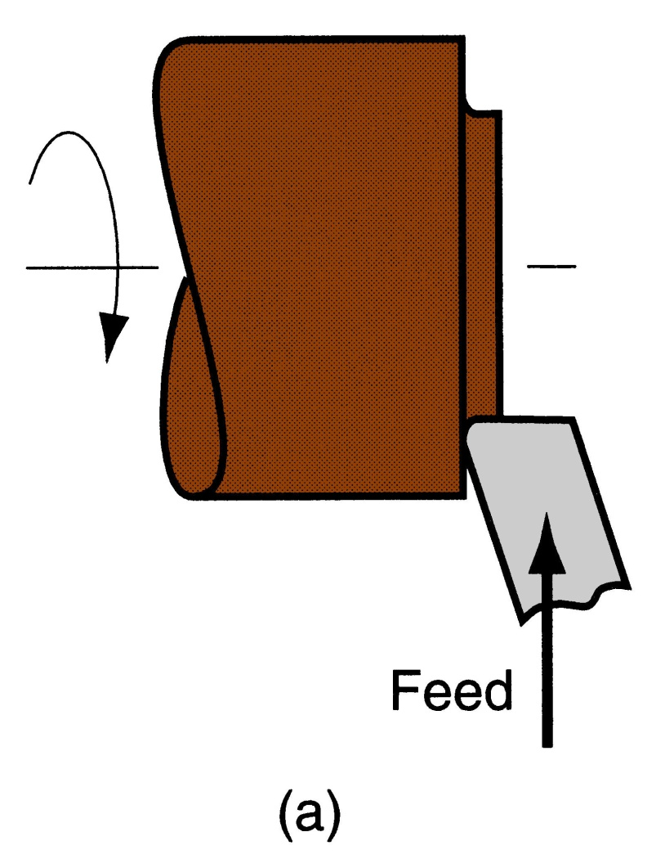
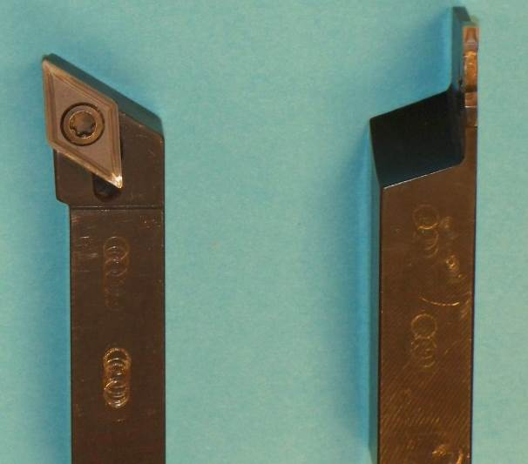
Facing
Tool is fed
radially inward
Figure 22.6 (a) facing

Slide 16
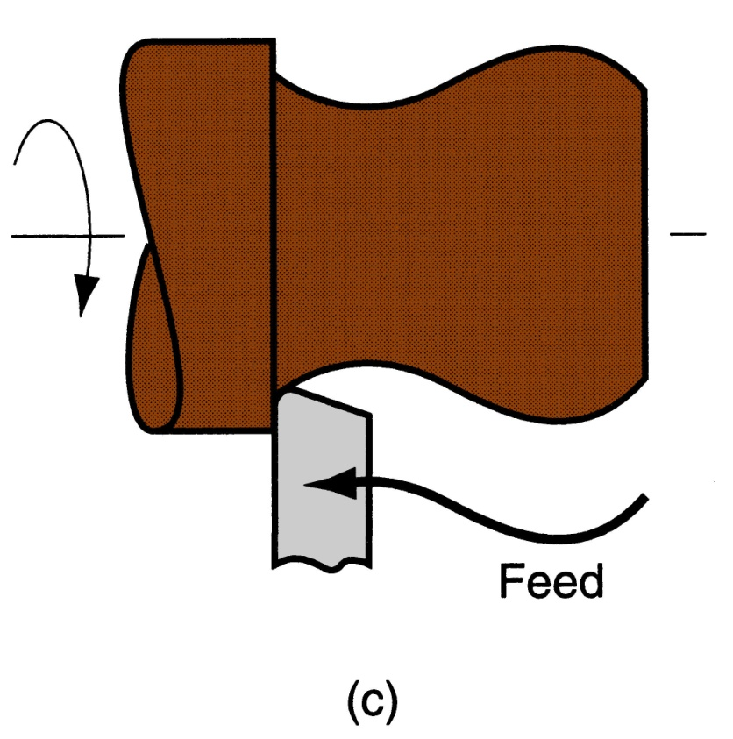
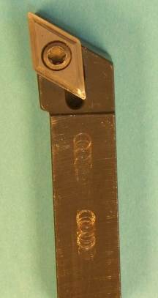
Contour Turning
Instead of feeding the tool parallel to the axis of rotation, tool follows a contour that is not necessarily straight (thus creating a contoured form).
Figure 22.6 (c) contour turning

Slide 17
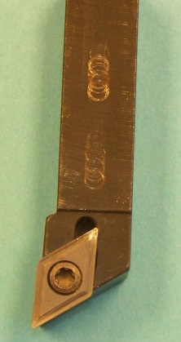
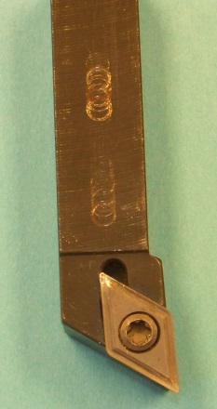
Right & Left Hand Tools
Right Hand Tool:
Cuts from right to left
Left Hand Tool:
Cuts from left to right

Slide 18
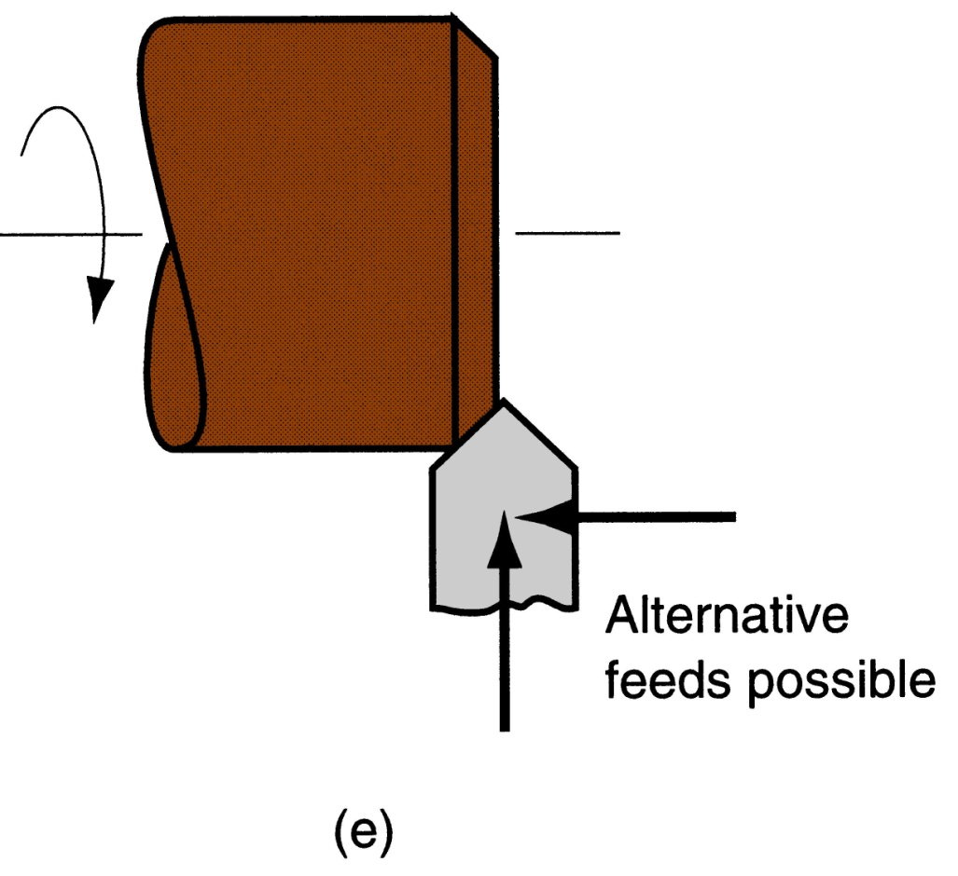
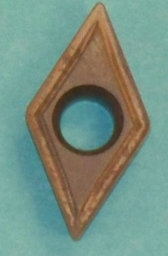
Chamfering
Cutting edge cuts an angle on the corner of the cylinder, forming a "chamfer"
Figure 22.6 (e) chamfering

Slide 19
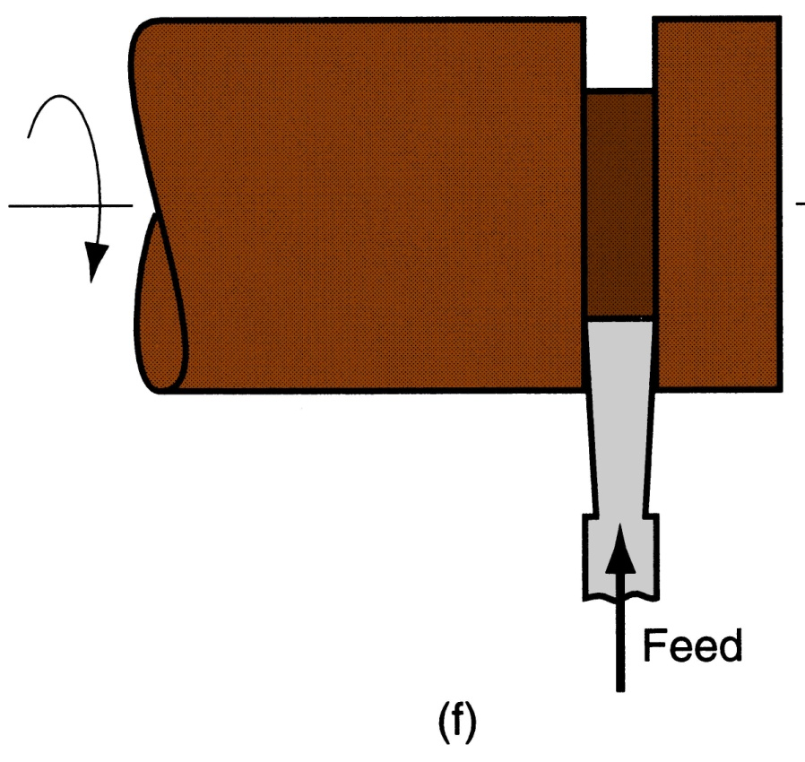
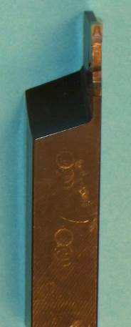
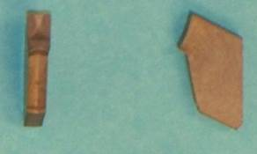
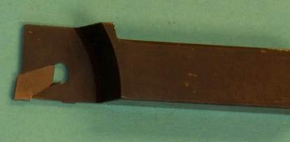
Parting (Cutoff) / Grooving
Tool is fed radially into rotating work at some location to cut off end of part, or provide a groove
Figure 22.6 (f) cutoff

Slide 20
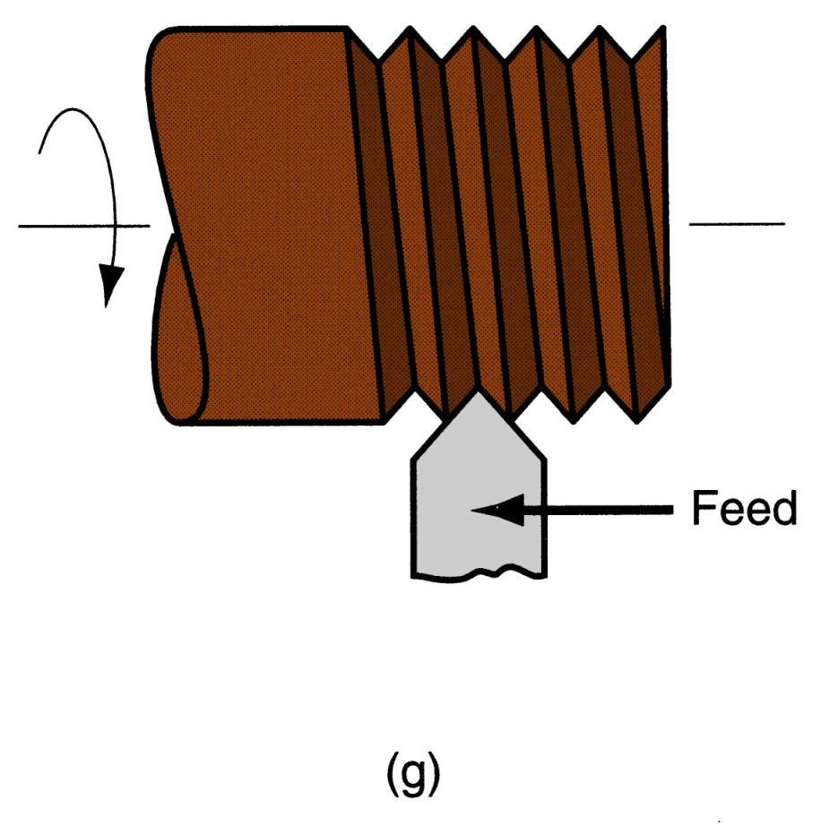
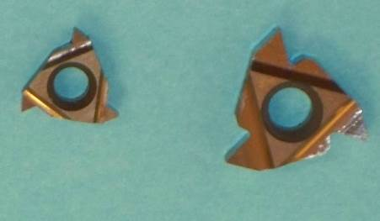
Threading
Pointed form tool is fed linearly across surface of rotating workpart parallel to axis of rotation at a large feed rate, thus creating threads
Figure 22.6 (g) threading

Slide 21
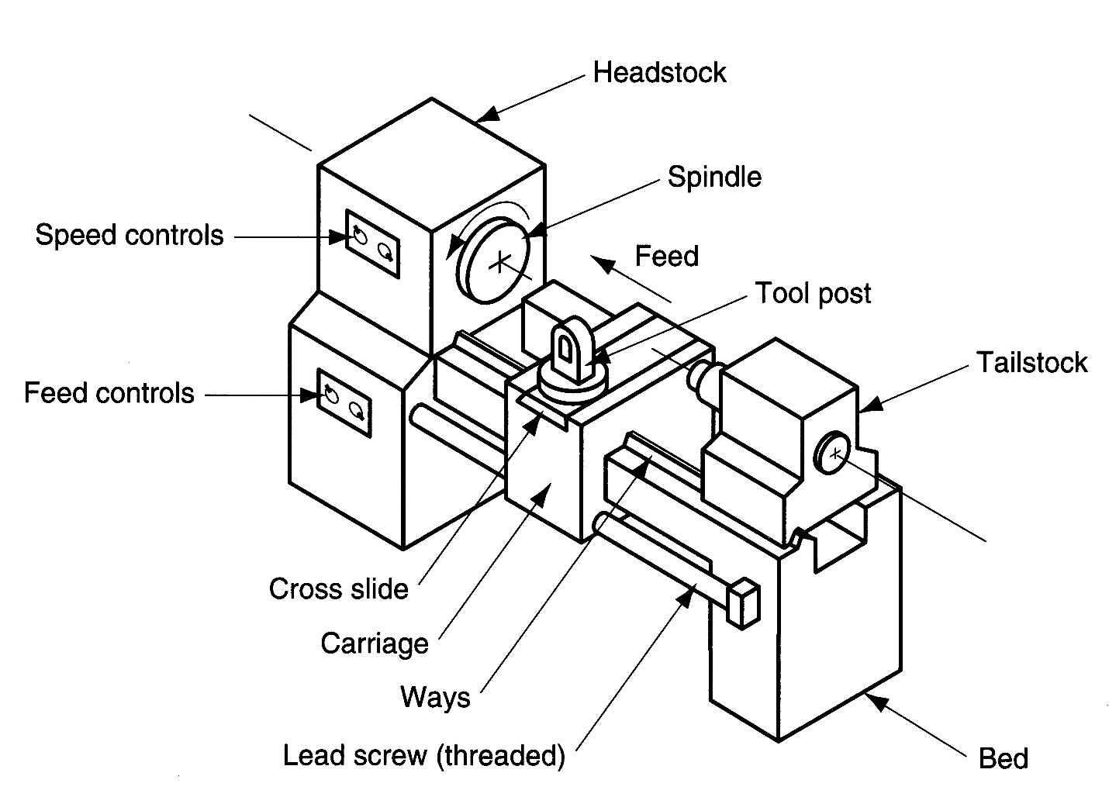
Engine Lathe
Figure 22.7
Diagram of an engine lathe, showing its principal components

Slide 22
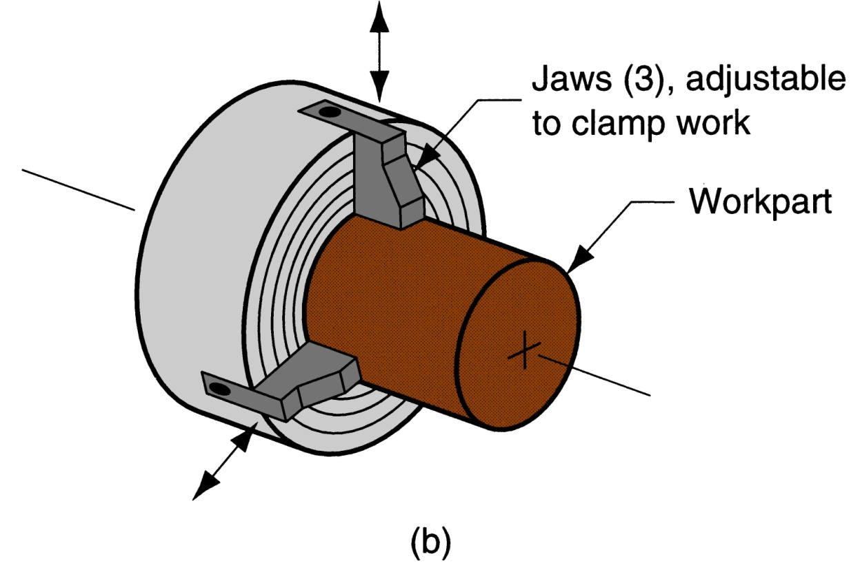
Chuck
Figure 22.8 (b) three‑jaw chuck

Slide 23
Turret Lathe
Manual operation is replaced by a “turret” that holds multiple tools
Tools are rapidly brought into action by indexing the turret
Tool post is replaced by multi‑sided turret to index multiple tools
Applications: high production work that requires a sequence of cuts on the part

Slide 24
CNC Turret Lathe
Spindle Speed
Tool Turret
+ X-axis
Ways
+ Z-axis
Spindle
Cross Slide

Slide 25
CNC Lathe: Air-Operated Chuck
Right Hand Profile Tool
Chuck

Slide 26
CNC Lathe: Tool Turret
Left Hand Profile Tool
Tool Turret
Grooving / Parting Tool
Tool Holder
Right Hand Profile Tool

Slide 27
Machining Calculations: Turning
Spindle Speed - N (rpm)
v = cutting speed
D_{o} = outer diameter
Feed Rate - f_{r} (mm/min -or- in/min)
f = feed per rev
Depth of Cut - d (mm/rev -or- in/rev)
D_{o} = outer diameter
D_{f} = final diameter
Machining Time - T_{m} (min)
L = length of cut
Mat’l Removal Rate - MRR (mm³/min -or- in³/min)
π(D_{o}² – D_{f} ²)f N
4
MRR =

Slide 28
Questions & Issues
Finish Fixturing & Start Machining This Week:
Next Week: finish Machining (mill & drill), start Process Planning
This means the Due Date for HW 00 must change to 06 FEB
This also means that you must start HW 00 sometime soon …
Following Week: NC / CNC Programming
Lab this week:
Fixturing (manual tools & drill press)
Lab next week:
Manual Lathe & Mill Operations:
Rough & Finish Profiling Cuts
Facing Cuts
Parting Cuts
Tool Changes
Touch-Off

