Slide 1
IENG 475 - Lecture 03
Tooling & Fixturing

Slide 2
Agenda
Manufacturing Cost Breakdown
Value-Added Concept
Value-Added Time in Manufacturing
Principles of Workholding
Questions & Issues

Slide 3
Manufacturing Cost Breakdown
40%
15%
5%
25%
15%
Selling Price
Manufacturing Cost
Eng’g
Admin, Sales, Mktg, etc.
Profit
R & D
Plant / Mach. Depreciation, Energy
Direct Labor
Indirect Labor
Parts & Mat’ls
Mfg Cost
12%
26%
12%
50%
Fig. 2.5 Breakdown of costs for a manufactured product [Black, J T. (1991)]

Slide 4
Economic Justification of Tooling
Tooling can be justified / rejected based on economic principles
  savings/piece must be better than the increased cost/piece
total cost/pc w/o tooling
total cost/pc if tooling existed
≥
tooling cost/pc
labor cost/pc w/o tooling
machine cost/pc w/o tooling
labor cost/pc with tooling
machine cost/pc with tooling
cost
of tooling
per pc
interest on tooling cost/pc

Slide 5
Economic Justification of Tooling
R = labor rate/hr, without tooling
R_{t} = labor rate/hr, with tooling
t = hours/pc, without tooling
t_{t} = hours/pc, with tooling
R_{m} = machine rate/hr, including overhead
C_{t} = cost of tooling
n = number of interest periods tooling will be used
i = interest rate per period (cost of capital)
N = number of pieces to be produced with tooling
(A/P,i,n) factor from Engineering Econ!
(R + R_{m})t _ (R_{t} + R_{m})t_{t} ≥ C_{t} i(1 + i)^{n}
N (i + 1)^{n _} 1

Slide 6
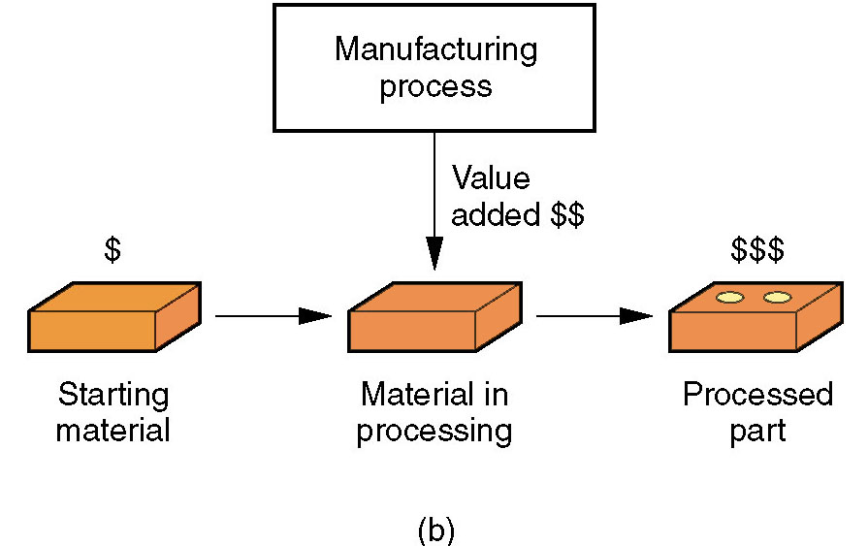
Value-Added Concept
Value-Added with respect to manufacturing is the transformation of materials into items of greater value by means of processing and / or assembly operations
  Manufacturing adds value
  to the material by changing
  the shape or properties, or
  by combining it with other
  materials that have been
  similarly altered
Figure 1.1 (b) Manufacturing as an economic process.
[Groover, M. (2004) Fundamentals of Modern Mfg. p. 5]

Slide 7
Value-Added Time in Manufacturing
Time on machine
Moving & Waiting
Time in factory
5%
95%
30%
70%
Time on machine
Cutting
Loading, Positioning, Gaging, etc.
Fig. 2.3 How time is spent by a typical part in a batch production machine shop

Slide 8
Workholding Introduction
(3) Workholding device purposes:
  Location - positioning the workpiece with respect to the tool (without being under the forces of the tool)
  Clamping - maintaining the position of the workpiece during machining (opposing the forces from the tool)
  Support - minimizing the deflection of the workpiece during machining (opposing the forces from the tool)
Fixtures
  Position workpieces
Jigs
  Guide tools** & position workpieces
  ** control the manufacturing of “features of location” (datums)

Slide 9
Fixturing
Five Principles:
  Locating and clamping should reduce the idle time of a machine to a minimum
  Locating and clamping should not interfere with the motions of the tool (sweep volume)
  Adequate clearance and configuration should allow for easy removal of chips and access of coolant
  Design should be robust enough to withstand all coupled cutting forces and vibrations
  Design should encourage correct workpiece orientation, and eliminate incorrect orientation

Slide 10
Positioning (Location)
Prismatic Workpieces: 6 pts
  3 points for primary datum plane
    Eliminates translation along Z axis and rotation about X and Y axes
  2 points for secondary datum plane
    Eliminates translation along Y axis and rotation about Z
  1 point for tertiary datum plane
    Eliminates translation along X axis

Slide 11
Positioning
Vertically Rotational Workpieces: 5 pts
  3 points for primary datum plane
    Eliminates translation along Z axis and rotation about X and Y axes
  1 point for secondary datum plane
    Eliminates translation along Y axis
  1 point for tertiary datum plane
    Eliminates translation along X axis
  Symmetry means we don’t care about axis of rotation

Slide 12
Positioning
Horizontally Rotational Workpieces: 5 pts
  2 points for primary datum plane*
    Eliminates translation along Z axis and rotation about the Y axis
  2 points for secondary datum plane*
    Eliminates translation along Y axis and rotation about Z
  1 point for tertiary datum plane
    Eliminates translation along X axis
  Symmetry means we don’t care about axis of rotation
* In practice, the primary and secondary plane pegs are replaced by V-shaped blocks

Slide 13
Locating and Supporting Principles
Position locating pins as far apart as possible for stability
Keep the center of mass low, and close to the centroid of the locator pins
Position locating pins to contact datum surfaces and help enforce geometric tolerance constraints
Locating pin surfaces should be as small as possible and wear well
Locating pin surfaces should have fixed positions – movable surfaces should be used for clamping
Buttons and pins should be preferred to planar surfaces for locational control – easier to remove chips / debris and easier to replace when worn
Error-proof locating schemes are the preferred positioning systems (poka yoke)

Slide 14
Clamping and Supporting
Design clamping force directions to act against locators
Primary cutting forces should be directed toward the fixture body and not oppose clamping forces
Cutting forces should be absorbed by fixed locators/supports and not by clamping friction
Avoid clamping on surfaces with finish quality constraints

Slide 15
Setup (Orientation)
Additional setups (reorientation and clamping of the workpiece) are required whenever an operation needs to access a currently inaccessible workpiece surface
Setups should be minimized, because:
  Re-orientation time does not add value to the product and lowers throughput
  Additional fixtures increase the fixed costs of the product
  Re-orientation offers an additional opportunity for unacceptable variation in dimensional and geometric tolerances

Slide 16
Fixturing Reduction
Multipurpose fixtures are preferred to special or single purpose fixtures
  Cost reduction opportunity
Modular fixtures have reposition-able elements that may be reconfigured for reuse on a variety of parts
  Opportunity to recover fixturing costs over a larger number of products
Fixtures should be as self-contained as possible
  Fewer actuation (clamping) actions required of the operator and machine can result in greater product throughput

Slide 17
Fixturing Images
General purpose fixtures spread the tooling cost across many, many part varieties; but increase the setup and operator time required per unit.
Permanent fixtures minimize setup and operator time per unit, but the tooling cost is recovered over fewer part varieties.
Modular fixtures cover the middle ground efficiently.
(Image from Carr-Lane)

Slide 18
Fixturing Images
Modular fixturing components
(Image from Carr-Lane)

Slide 19
Fixturing Images
Modular fixturing example.
(Image from Carr-Lane)

Slide 20
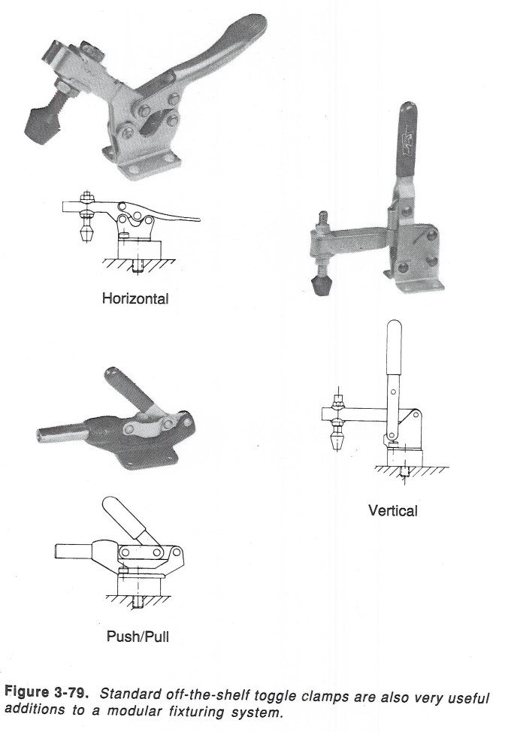
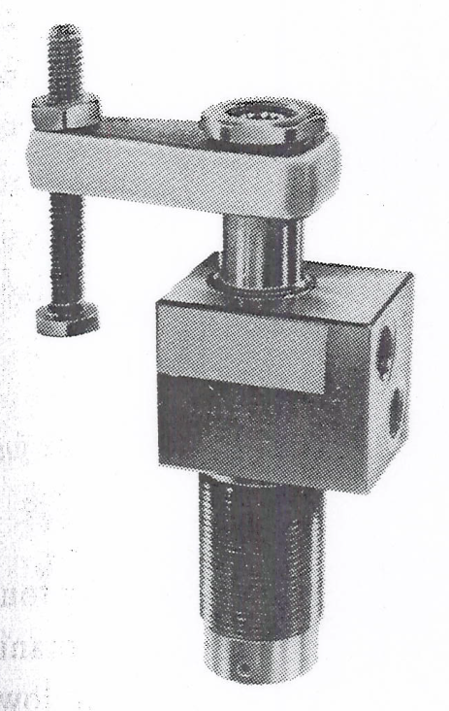
Fixturing Images
Examples of manual devices for providing clamping forces (left).
Example of pneumatic (automated/manual) device for providing a clamping force (right).
(Images from Carr-Lane)

Slide 21
Questions & Issues
Start preparing your engineering notebooks
  Lectures slides have formulas for:
    Lathe Operations
    Milling Operations
    Drilling Operations
Lab this week
  Turn in ONE report per team:
    Cover Sheet
    Summary of Lab Safety Fishbone
      Lab Check Sheet
    Safe Operation Check Sheet for each machine
    Copy or original machine Fishbone from each member
  Prepare to construct a Fixture

Slide 22
MEA – Model Eliciting Activity
Modify the Fixture Cost Model
  Lecture 03, Slide 05 formula for:
    A difference in Machine Rate per Hour
      R_{m} – machine rate per hour, without tooling
      R_{mt} – machine rate per hour, with tooling
    An effective interest rate (i = i_{e}) that has compounding and payments more frequently than once per year:
      r – annual interest rate
      m – no. of compounding periods per year
      m_{e} – no. of compounding periods per payment period
    Solve this model for a.) Cost of Tooling; b.) Total Parts

