Slide 1
SENIOR DESIGN
IENG 464 / 465
FALL / SPRING
2015 – 2016
TOPICS:
Draft Team Formation
Safety Minor & Six Sigma Requirements
Project Management Process
Project Proposal Preparation
PROJECT SELECTION

Slide 2
DRAFT TEAM FORMATION
Get into desired project teams:
One team per table group
Ideally four people per team
Select a spokesperson:
Prepare to provide:
Project Title
Project Sponsor
Team Member Listing
Brief Problem Description and Skills Required
Undecided persons should stay in the middle

Slide 3
SAFETY MINOR REQUIREMENTS
Significant Safety Content
If anyone on your team is working on the Safety Minor, the project must have significant safety content
The team member(s) working on the Safety Minor must work on that safety content
What to do:
See Dr. Kerk or Dr. Piper ASAP
Fill out the paperwork and turn in to Dr. Piper
Do this in conjunction with your Proposal
Do the design work
Invite Dr. Piper or Dr. Kerk to the Conceptual Design Presentation
Get Mid-Project Approval signature and feedback (adjust project accordingly)
Do the implementation work
Invite Dr. Piper or Dr. Kerk to the Final Results Presentation
Get Final Project Approval signature, so you can …
Graduate with a Safety Minor

Slide 4
SIX SIGMA CERTIFICATE REQUIREMENTS
Six Sigma Project (IENG 463) requirements:
DMAIC process is used DURING the project
Stand alone project report is submitted for a LETTER GRADE
Six Sigma Project Report:
Report Structure:
Cover Page
Introduction & Problem Statement
Headings for DMAIC Sections
Recommendations, Conclusions and Acknowledgements
References
Appendices
Report is due at NOON on Last day of Finals Week

Slide 5
PROJECT MANAGEMENT PROCESS
IEEM Senior Design Projects address REAL problems:
IEEM developed expertise is demonstrated DURING the project
IEEM Project Rubric considers: Context, Analysis, Recommendations, and Communication
ALL projects require management of the “triple constraint”: Time, Budget, and Function
Result of each term is an earned LETTER GRADE
Senior Design Project Process:
Draft Team Formation
Individual Resumes
Client-Team Meetings
Engineering Project Proposal & Documentation
Conceptual Design Development
Progress Reporting
Conceptual Design Presentation
Design Development & Testing
Progress Reporting
Results Presentation
Final Project Documentation
Final Documentation is due at NOON on Last day of Finals Week

Slide 6
IEEM PROJECT & PRESENTATION RUBRIC
 | 3 | 2 | 1 | 0
Context
Account for Environmental Variables | Can identify both engineering and other environmental variables apropos to issue | Can identify engineering related environmental variables apropos to the issue | Can identify environmental variables, but unsure which are related to the issue | Fails to identify environmental variables or see the need for these variables
Define Problem | Root cause(s) of problem determined | Root cause(s) looked for, but process ended too soon | Multiple symptoms aggregated as problem | First symptom seen “defined” as the problem
Gather Evidence | Wide range of appropriate evidence sources used | Some appropriate evidence sources used | Evidence sources used, but not entirely appropriate to issue | No or inappropriate evidence sources used
Analysis
Choose Appropriate Tools | Both quantitative and qualitative tools used as appropriate | Uses quantitative tools as appropriate | Uses tools, but tools are not appropriate to issue | No tools or frameworks used
Develop a Chain of Evidence | Clear links – uses data in its context and connects data using appropriate tools | Links – uses data and connects using appropriate tools | Almost links – based on inadequate data or tools | No links – no chain of evidence
Recommendations
Make Choices | Recommendation links to chain of evidence and shows consideration of additional alternatives | Recommendation links to chain of evidence but comes from the “canned” set of alternatives | Recommendation does not link to chain of evidence | No recommendation made
Reasonable Solutions | Solution(s) considers implementation concerns, level of actual improvement, economic impact, social impact, and ethics | Solution(s) considers implementation concerns and economic impact | Solution(s) is technically feasible, but no additional concerns are considered | Solution(s) is not feasible
Communication
Clarity of Argument | Presentation of argument demonstrates problem definition, chain of evidence, analysis, and recommendation in easy to follow manner | Presentation of argument demonstrates problem definition, chain of evidence, analysis, and recommendation but not easy to follow | Presentation of argument demonstrates only parts of: problem definition, chain of evidence, analysis, and recommendation | Presentation of argument cannot be followed by reasonable audience member
Professional Presentation | Well organized, uses professional language and grammar, appropriate use of tables, figures, etc, aimed at audience | Somewhat organized, mostly uses professional language and grammar, appropriate use of tables, figures, etc, mostly aimed at audience | Somewhat organized, poor grammar, uses texting language, needed figures, tables, etc present and appropriate, not aimed at audience | No organization, poor grammar, uses texting language, needed figures, tables, etc not present, not aimed at audience

Slide 7
PROJECT PROPOSAL PREPARATION
Engineering Project Proposal Sections:
Cover Page
Executive Summary
Introduction
Problem Statement
Constraints
Scope of Work
Deliverables
Tasks
Timing
Budget
Team Qualifications
Team Members and Roles
Summary of Team Qualifications
Conclusions and Recommendations
References
Appendices
Hard copy of the Project Proposal is due at 5:00 PM, 21 SEP, at RM308

Slide 8
Team Composition
Team Size Limitations
Teams can fire non-performers
Must consult with Dr. Jensen to fire
Means your team is a person smaller
Means a fired person is going to have to work REAL hard to pass
Ideal Team Size:
Single discipline team: 4 persons
Multi-discipline team: 4 – 6 persons
Minimum team size: 3 persons
There is no team of size 1 (or 2, at least at the start of Sr. Design, anymore)
Be wary of “waterfall” design models for “everything”
Waterfall models have their place – some things cost $$$
Very few designs really can’t be prototyped inexpensively
Avoid large projects that have leaders without strong project management skills
especially if the waterfalls can’t be done concurrently!
Avoid any project that doesn’t require every one to be responsible for progress reporting

Slide 9
Potential Design Projects
Starting Point for Forming Teams

Slide 10
Project Options
Multi-Disciplinary
Must meet all requirements of IE and other depts
Multi-Year, Project Continuations
Initial team leader will be the continuing student
Multi-Role, Single Discipline
Client Proposed Projects
Projects of your own proposal

Slide 11
Multi-Disciplinary Project Options
Linked on Materials Page
Rapid Response Casting System
ME project listing
CAMP projects
Some EE/CPE projects may not be not on list
Most CS projects are closed again this year
Big Question: Does SDSMT want to do multidisciplinary design?
Requires students and departments to collaborate
Meet everybody’s requirements
Demonstrate measureable project success

Slide 12
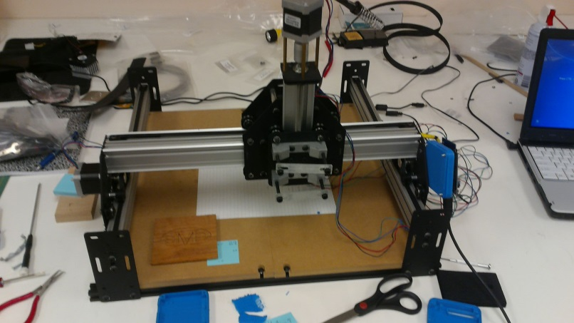
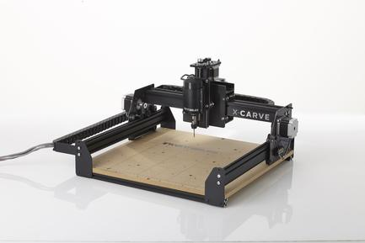
LOW COST CNC ROUTER & GLOBAL SUPPLY CHAIN PROJECT
Lack of equipment for exploring CNC programming, process planning and general manufacturing engineering activities hinders STEM education in some cultures/lands
The goal of this project will be to identify, define, construct and demonstrate a small, expandable CNC Router and develop an inexpensive and effective supply chain for meeting the global technical education needs.
Considerations:
Low cost system (approximately $1 000 USD or less)
Open-source software and hardware
Excellent construction documentation in multiple languages
Development of small, low-cost products demonstrating basic operations
Development of a global supply chain for sourcing the original equipment and replacement/expansion parts

Slide 13
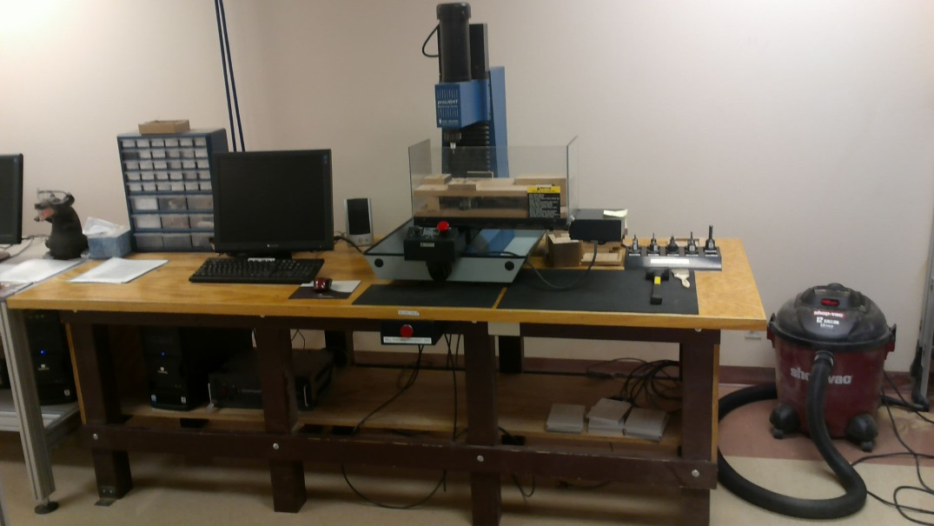
CNC VERTICAL MILL WORKSTATION PROJECT
In order to fit the planned equipment for the Manufacturing/ Innovation Laboratory into the new, Library basement space, it will be necessary to redesign the CNC Vertical Mill workstation for a smaller footprint.
The current workstation has an approximate 8’ x 3’ footprint (without operator), is not ADA compliant, and has a horizontal layout.
The redesigned workstation should:
Fit an approximate 4’ x 3’ footprint (without operator), using a more vertical layout
Accommodate wheelchair access
Demonstrate improved physical and cognitive ergonomics, both for operation and for assembly/relocation
Considering improved guarding and safety of operation
Be easily relocatable with respect to the laboratory location
Be repeat ably relocatable with respect to the laboratory conveyor and robotic tending equipment.

Slide 14
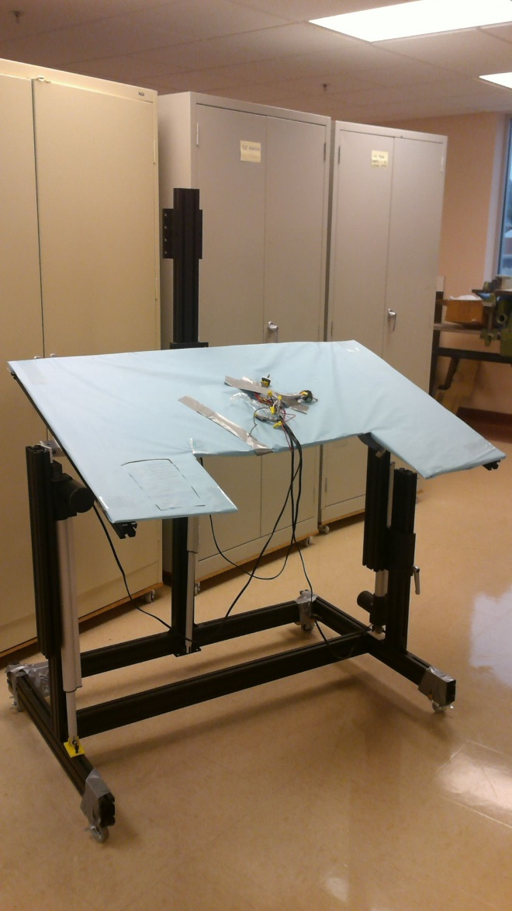
BHW ERGONOMIC ADJUSTABLE EASEL KIT DESIGN COMPLETION PROJECT
Black Hills Works supports a number of clients with differing physical needs. There is a pressing need for a means to complete the existing redesign of an electrically adjustable easel to different heights and tilt angles.
The current design is functional, is powered by rechargeable drill battery, has an approximate 4’ x 3’ footprint (without operator), and is ADA compliant. However it needs optimization and process planning for BHW staff to reproduce and operate.
The redesigned easel will require:
Optimal, final redesign/development for ergonomic operations, including ADA/wheelchair accessibility and safety.
Completion of controls for configuration, based on solid physiological and ergonomic criteria, and appropriate to the identified client population.
At least two iterations of purchase, construction, operational and usability testing of the retrofit kit(s) to meet customer constraints and needs prior to the Spring Design Fair.
Proposal of a cost-effective system for kit production.
Possible submission of the final design for NISH Competition.

Slide 15
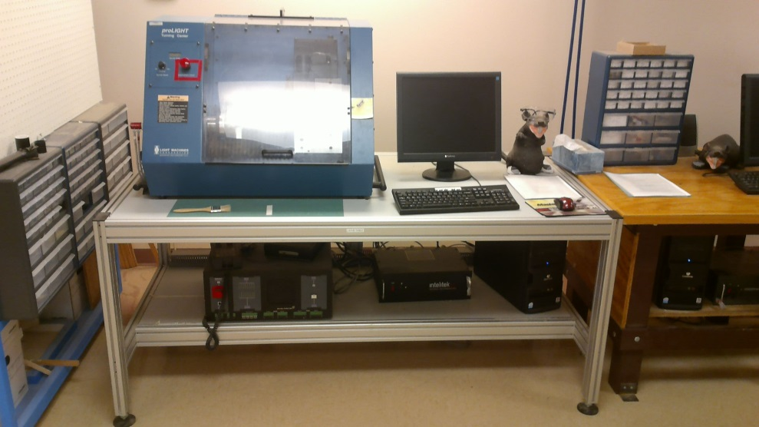
CNC LATHE (TURNING CENTER) WORKSTATION PROJECT
In order to fit the planned equipment for the Manufacturing/ Innovation Laboratory into the new, Library basement space, it will be necessary to redesign the CNC Lathe workstation (called a TURNING CENTER) for a smaller footprint.
The current workstation has an approximate 6’ x 3’ footprint (without operator), is not ADA compliant, and has a horizontal layout.
The redesigned workstation should:
Fit an approximate 4’ x 3’ footprint (without operator), using a more vertical layout
Accommodate wheelchair access
Demonstrate improved physical and cognitive ergonomics, both for operation and for assembly/relocation
Considering improved guarding and safety of operation
Be easily relocatable with respect to the laboratory location
Be repeat ably relocatable with respect to the laboratory conveyor and robotic tending equipment.

Slide 16
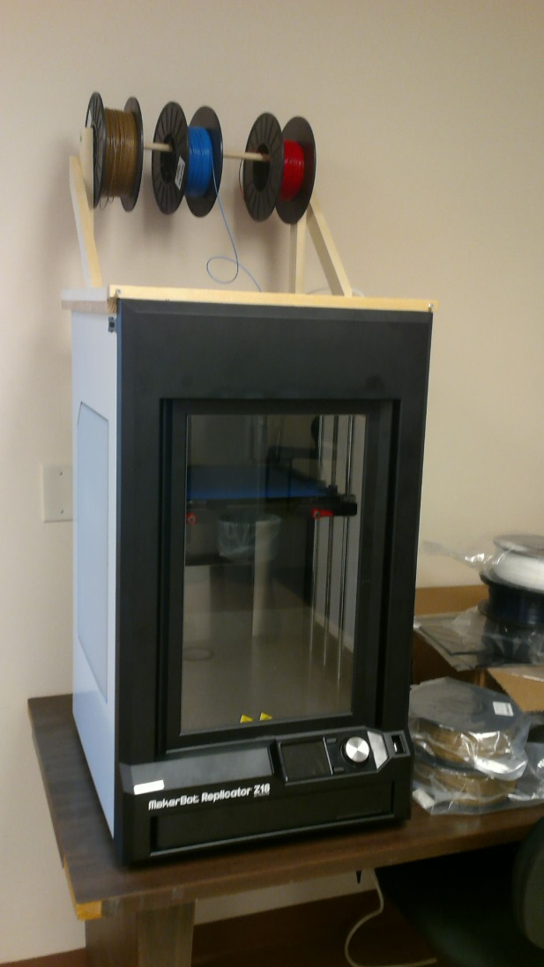
3-D PRINTING WORKSTATION PROJECT
At the end of the Spring Term in 2016, the Industrial Engineering Department will be moving into the basement floor of the SDSM&T Library. In order to fit the planned equipment for the Manufacturing/ Innovation Laboratory into the allocated space, it will be necessary to redesign the 3-D Printing workstation for a smaller footprint.
The current equipment has five printers spread over a nearly 11’ x 2’ footprint (without operator), and has a horizontal layout. The equipment that must be accommodated includes the following:
Five MakerBot 3-D Printers of various sizes
At least one Fujitsu T 901 tablet computer and mouse
Set of small drawers holding maintenance tools and materials
Necessary hand tools for workstation operation and adjustment.
The redesigned workstation should accommodate all the items and:
Fit an approximate 6’ x 30” footprint (without operator), using a more vertical layout
Accommodate wheelchair access
Demonstrate improved physical and cognitive ergonomics, both for operation and for assembly/relocation
Incorporate better filament storage and feeding operations
Contain the appropriate electrical power systems
Be easily relocatable with respect to the laboratory location
Be expandable to incorporate existing 3-D laser digitizer.

Slide 17
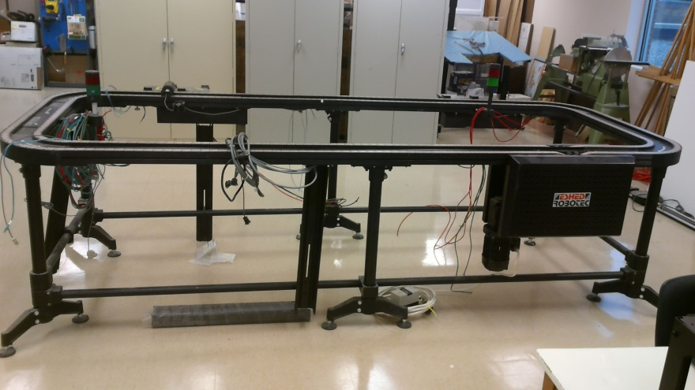
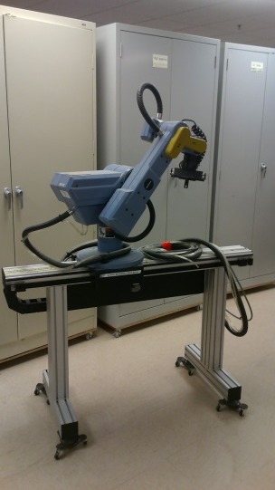
CNC ROUTER/CONVEYOR WORKSTATIONS PROJECT
In order to fit the planned equipment for the Manufacturing/ Innovation Laboratory into the new, Library space, it will be necessary to redesign the lab’s conveyor and add two or more CNC router workstations within the existing footprint.
The current workstation has an approximate 12’ x 8’ footprint (without operator or attaching workstations.) This project will:
Add two or more CNC Routers, each with an approximate 21” x 22” footprint (without operator), these should be constructed and re/dis-mountable for demonstrations
Add a Scorbot ER V+ robot on a 56” x 10” linear slide for CNC Router tending operations
Add a robotic controller for the ER V+ robot
Add storage below the CNC Routers/Robot for standard book boxes of raw stock materials
Demonstrate improved physical and cognitive ergonomics, both for operation and for assembly/relocation
Be repeat-ably relocatable with respect to the laboratory CNC Vertical Mill/Lathe, AS/RS, and robotic tending equipment.

Slide 18
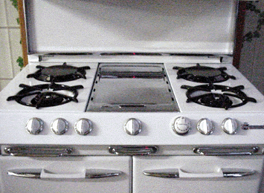
Stovetop Access
There are a lot of products on the market geared toward preventing children from accessing stovetops, but these products become impractical for adults over 3 feet tall!
Many of the people we support require close supervision when the stove is in operation.
Problems results when the person independently accesses the stove or when the support staff has to step away to respond to an emergency.
This project is the completion of a design created last year. An interested team will need to view the existing design and
Arrange for construction and testing of a full scale prototype
Create detailed production plans for BHW staff to reproduce, including cost estimation
Fully document the production and operation methods for the design.
This project is available, but is not linked on the course Materials page. See instructor for existing documentation.

Slide 19
RC Central Concessions Overhaul
This project is necessary to create a sustainable model in which the concession stand is a benefit to the student athletes, the athletic department, and Central High School. The concession stand had failed to make a profit and, worse, in most years had ended in a deficit. This is a problem for the many student clubs, and organizations at Central High School whose primary fundraiser is working the concession stand.
In order to create a fully sustainable model, the project will involve planning, implementation, and assessment of both facility design and operations. Key considerations include:
Assuring the new, sustainable model fits into the strategic plan of the athletics department and Central High School;
Optimizing the layout of the concession stand area for safe operations by rotating crews of volunteers with little or no prior experience;
Designing inventory, ordering, and budgeting systems that interact seamlessly with one another and require limited staff time to operate; and
Developing both staff training and just-in-time training for concession stand volunteers that promotes a safe, effective workplace and considers the anticipated level of entering experience of the workers.

