Slide 1
IENG 366
Exam II Review
Reading: pp. 326 – 395.

Slide 2
Exam Format
Exam:
Time: one hour & 15 minutes exam design (OK for more time and taking breaks…)
Covers just the material since the last exam
Format: short answer & work through questions
Exam available by 5:00 PM on 23 APR (will be e-mailed)
Exam DUE by 5:00 PM (MDT) on 30 APR the next week
Return file via e-mail, use Subject: IENG 366 Midterm II Exam
Materials:
Engineering Notebook
Table of Cumulative Normal Probabilities will be provided on Exam
Calculator
Course Website Content, including liked solutions, slides, videos
NO:
Contact, discussion with any one other than instructor while working the exam
Materials outside of those listed above
Extra time (verify and start on exam by 8:00 AM on 28 APR)
Process:
Check that exam received in good shape, if not, contact Instructor by 8:30 AM 28 APR
Do not wait excessively to return exam … expect internet issues … no grace period

Slide 3
Midterm Exam II
Topical Coverage and Expectations

Slide 4
Controlling Topics
Financials: Statements (absolute measures) & Associated Ratios (relative measures):
Balance Sheet: (purpose)
Current Ratio (use – what it measures)
Acid Test (use – what it measures)
Leverage Ratio (use – what it measures)
Income (Profit & Loss) Statement: (purpose)
Inventory Turnover (use – what it measures)
Asset Turnover (use – what it measures)
Accounts Receivable Turnover (use – what it measures)
Profitability (use – what it measures)
Cash Flow: (purpose)
Terms
Assets, Liabilities, Equity (definition)
Ratio Types: (what they measure)
Liquidity
Leverage
Activity
Profitability

Slide 5
Managing Research & Developments Topics
Research (definition)
Basic Research
purpose & who does it
Applied Research
purpose & who does it
Development (definition)
Product Strategies: (qualitative description – goals and characteristics)
First-to-Market
Follow-the-Leader
Me-Too
Application Engineering
Screening Projects: (qualitative description – characteristics, not calculations)
Simple Payback Time
Net Present Worth
Annual Worth
Time to Payback

Slide 6
Intellectual Property Topics
IP: Ideas and Inventions (products of the mind)
“first to invent” vs “first to file”
Types of IP Protection: (what is protected & protection duration)
Patents
Design Patents
Utility Patents
Plant Patents
Trademarks
Copyrights
Trade Secrets
Legal Aspects of Inventorship (practical aspects)
Disclosure
Laboratory Notebooks
Documentation (practice)
Patent Infringement

Slide 7
Product Development Topics
Stages of Product Development
Conceptual
Technical Feasibility or Concept Definition
Development
Commercial Validation
Production
Product Support
Disposal Stage
Concurrent Design Concerns
Product Liability & Safety
Availability, Reliability, Maintainability
Metrics: MTTF, MTTR, MTBF, Availability (calculation similar to HW 03)
Bathtub Curve (see next topic …)
Ergonomics & Producibility

Slide 8
Production Planning Topics
Graphical Relationships
(understanding relationships & interpretation – no calculations)
Bathtub Curve (qualitative description)
Economic Order Quantity (quantified reading – EOC location)
Break Even Chart
Simple Break-even (quantified reading – B/E location)
Break-even w/ Automation Effects (quantified reading – profits / costs)
Learning Curve (qualitative description)
Common Facility Layouts
Process Layout (Job Shop) (qualitative description - why)
Product Layout (Mass Production) (qualitative description - why)
Group Technology (GT Cell) Layout (qualitative description - why)
Interpreting a triangularized GT Matrix (reading - algorithm not required)

Slide 9
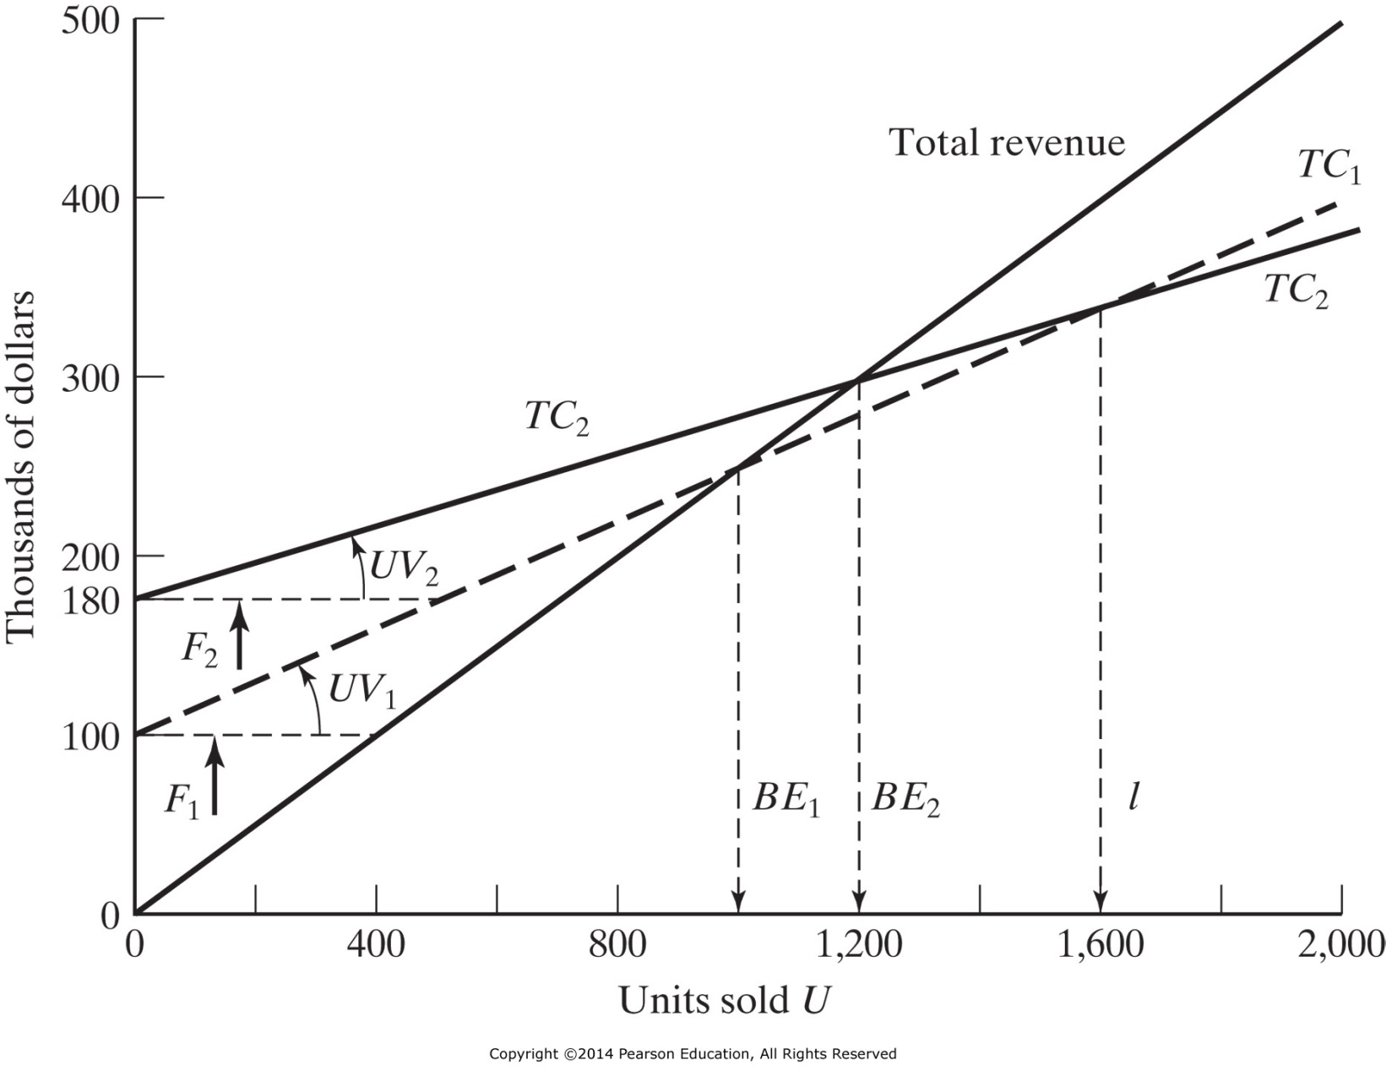
Figure 11-5 Break-even chart showing the effect of automation.
Increased Automation Profits
Δ BE
Lowered Automation Variable Costs
Incremental Automation Fixed Costs

Slide 10
Production Operations Topics: Quality Engineering
Use of a rational, verifiable, improvement process - steps:
Define
Measure
Analyze
Improve
Control
Cost of Quality
Cost per Good Part (calculate as per slide 14, Lecture 13)
7 Tools of Ishikawa (matching tool with description / illustration)
Histogram
Pareto Chart
Fishbone Chart (Cause & Effect Diagram)
Check Sheet
Defect Concentration Diagram
Scatter (Plot) Diagram
Statistical Process Control Charts (interpretation only, no calculations)
Variables Charts (distribution location vs spread)
Attributes Charts (difference in variables, defects, defectives)

Slide 11
Project Management Topics
Triple Constraint of all True Projects
Project management life cycle (identify portions of curve)
Work Breakdown Structure
Gantt Chart (work through problem)
Networks
Activity on Node (ES, LS, EF, LF calculations)
PERT / CPM (work through problem)
Critical Time, Critical Path, Slack/Float Time
Expected Time, Variance, z-statistic, Cumulative Probability
Crashing a project (work through problem)
Normal Time, Normal Cost, Crash Time, Crash Cost, Max Crash, Slope

Slide 12
Project Organization Topics
Three Organizational Forms for Project Management
Functional Organizations
Projectized Organizations
Matrix Organizations
Project Leadership
Effective PMs
Success Characteristics
Failure Characteristics
Project Control & Communications

Slide 13
Professionalism and Ethics Topics
Steps in Personal & Professional Ethical Solutions
Professions and Ethics
Attributes of a Profession (employment ≠ profession)
Licensee’s Obligations (identify conflict points)
To Society
To Employers & Clients
To Other Licensees
Ethics Tool: Line Drawing (work through problem)
Negative Paradigm
Positive Paradigm
Hypothetical Examples (anchors)
Current Example placement

Slide 14
IENG 366 Engineering Management
Questions & Issues?
Do not forget to attempt Ethics Bonuses
Bonuses pdf is Due at 5:00 PM (MDT) on 24 APR
E-mail to instructor, use Subject: IENG 366 Ethics Bonus
Check Discussion & Notices Pages before Exam II
It may be updated through this week, Friday
Check scores for HW, Bonuses on Saturday 25 APR
Let instructor know of corrections by Noon, 08 MAY
Do Course Evaluation after 5:00 PM on 30 APR
Possible that Midterm II scores will be ready by 02 MAY
Check on Grades: Midterm II Summary Page
Optional Comprehensive Exam:
Pre-recorded review for Opt. Comp. Exam posts 30 APR – D2L
Opt. Comp. Exam will be ready by 8:00 AM on 02 MAY
Opt. Comp. Exam will be DUE by 12:00 PM (noon) on 08 MAY

