Slide 1
IENG 366
Engineering Ethics
Reading: pp. 374 – 395.

Slide 2
Professionals & ethics
One of the hallmarks of modern professions are codes of ethics promulgated by various professional societies.
These codes serve to guide practitioners of the profession in making decisions about how to conduct themselves and how to resolve ethical issues that might confront them.
Fleddermann, C.B. (1999)

Slide 3
Professional Ethics and Conduct
Values drive our behavior
Ethical standards govern our behavior within the engineering professional community
Attributes of a Profession:*
The work requires sophisticated skills, the use of judgement, and the exercise of discretion. Also, the work is not routine and is not capable of being mechanized.
Membership in the profession requires extensive formal education, not simply practical training or apprenticeship.
The public allows special societies or organizations that are controlled by members of the profession to set standards for admission to the profession, to set standards of conduct for members, and to enforce these standards; and
Significant public good results from the practice of the profession.
* Martin & Schinzinger (1989)

Slide 4
Engineering Ethics: Core Concepts
Public Interest
Qualities of Truth, Honesty, and Fairness
Professional Performance

Slide 5
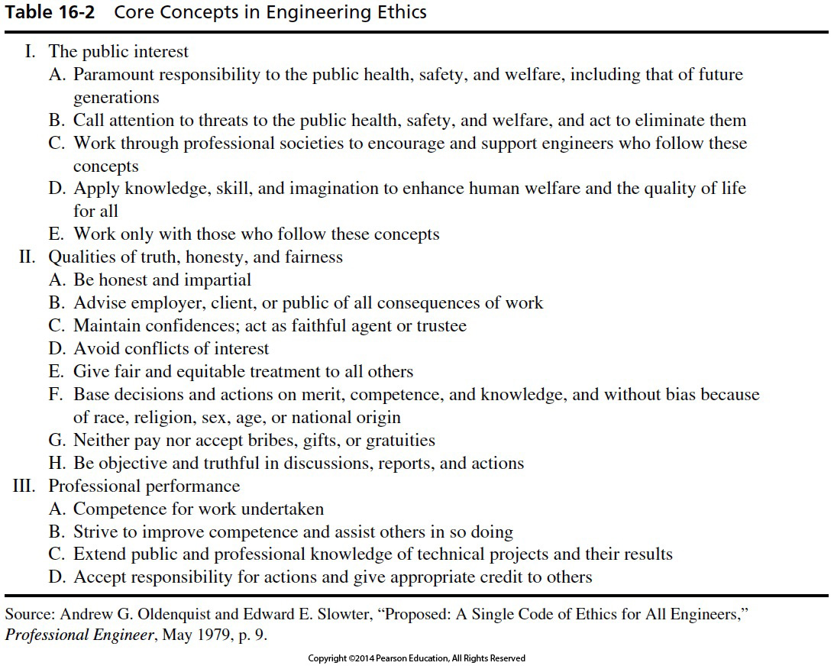

Slide 6
Ethical Problems: Consulting and Construction
Political contributions
Distribution of public services
Construction safety

Slide 7
Ethical Dilemma Guidelines in Professional Practice – NIEE
Steps in Professional Ethical Solutions:
Determine the facts in the situation
Define the Stakeholders
Assess the motivations of the Stakeholders
Formulate alternative solutions
Evaluate proposed alternatives
Seek additional assistance, as appropriate
Select the best course of action
Implement the selected solution
Monitor and assess the outcome

Slide 8
Licensee’s Obligation to Society
Licensees, in the performance of their services for clients, employers, and customers, shall be cognizant that their first and foremost responsibility is to the public welfare.
Licensees shall approve and seal only those design documents and surveys that conform to accepted engineering and surveying standards and safeguard the life, health, property, and welfare of the public.
Licensees shall notify their employer or client and such other authority as may be appropriate when their professional judgement is overruled under circumstances where the life, health, property, or welfare of the public is endangered.
Licensees shall be objective and truthful in professional reports, statements, or testimony. They shall include all relevant and pertinent information in such reports, statements, or testimony.
NCEES Rules of Professional Conduct: Model Rules, Section 240.15, Rules of Professional Conduct

Slide 9
Licensee’s Obligation to Society
Licensees shall express a professional opinion publicly only when it is founded upon an adequate knowledge of the facts and a competent evaluation of the subject matter.
Licensees shall issue no statements, criticisms, or arguments on technical matters which are inspired or paid for by interested parties, unless they explicitly identify the interested parties on whose behalf they are speaking and reveal any interest they have in the matters.
Licensees shall not permit the use of their name or firm name by, nor associate in the business ventures with, any person or firm which is engaging in fraudulent or dishonest business or professional practices.
Licensees having knowledge of possible violations of any of these Rules of Professional Conduct shall provide the board with the information and assistance necessary to make the final determination of such violation.
NCEES Rules of Professional Conduct: Model Rules, Section 240.15, Rules of Professional Conduct

Slide 10
Licensee’s Obligation to Employer and Clients
Licensees shall undertake assignments only when qualified by educations or experience in the specific technical fields of engineering or surveying involved.
Licensees shall not affix their signatures or seals to any plans or documents dealing with subject matter in which they lack competence, nor to any such plan or document not prepared under their direct control and personal supervision.
Licensees may accept assignments for coordination of an entire project, provided that each design segment is signed and sealed by the licensee responsible for the preparation of that design segment.
Licensees shall not reveal facts, data, or information obtained in a professional capacity without the prior consent of the client or employer except as authorized or required by law. Licensees shall not solicit or accept gratuities, directly or indirectly, from contractors, their agents, or other parties in connection with work for employers or clients.
NCEES Rules of Professional Conduct: Model Rules, Section 240.15, Rules of Professional Conduct

Slide 11
Licensee’s Obligation to Employer and Clients
Licensees shall make full prior disclosures to their employers or clients of potential conflicts of interest or other circumstances which could influence or appear to influence their judgement or the quality of their service.
Licensees shall not accept compensation, financial or otherwise, from more than one party for services pertaining to the same project, unless the circumstances are fully disclosed and agreed to by all interested parties.
Licensees shall not solicit or accept a professional contract from a governmental body on which a principal or officer of their organization serves as a member. Conversely, licensees serving as members, advisors, or employees of a government body or department, who are principals or employees of a private concern, shall not participated in decisions with respect to professional services offered or provided by said concern to the governmental body which they serve.
NCEES Rules of Professional Conduct: Model Rules, Section 240.15, Rules of Professional Conduct

Slide 12
Licensee’s Obligation to Other Licensees
Licensees shall not falsify or permit misrepresentation of their, or their associates’, academic or professional qualifications. They shall not misrepresent or exaggerate their degree of responsibility in prior assignments nor the complexity of said assignments. Presentations incident to the solicitation of employment or business shall not misrepresent pertinent facts concerning employers, employees, associates, joint ventures, or past accomplishments.
Licensees shall not offer, give, solicit, or receive, either directly or indirectly, any commission, or gift, or other valuable consideration in order to secure work, and shall not make any political contribution with the intent to influence the award of a contract by public authority.
Licensees shall not attempt to injure, maliciously or falsely, directly or indirectly, the professional reputation, prospects, practice, or employment of other licensees, nor indiscriminately criticize other licensees’ work.
NCEES Rules of Professional Conduct: Model Rules, Section 240.15, Rules of Professional Conduct

Slide 13
Ethical Problems: Industrial Practice
Environmental
Conflict of interest
Gifts
Moonlighting
Inside Information
Post-employment limitations
Whistle-blowing

Slide 14
Line Drawing: Engineering Ethics Tool
Negative Paradigm – example that is unambiguously NOT morally acceptable.
Positive Paradigm – example that is unambiguously morally acceptable.
Place hypothetical, but similar, examples along the spectrum.
Place the current, proposed example along the spectrum using 1 – 3 as scaling.
Use the tool to identify more appropriate solutions that may modify the proposed solution.
CAUTION: Can be used to “prove” something right when it is actually wrong!
Must be used objectively and honestly
Must avoid incorrect paradigms and dishonest placements
Negative Paradigm
Positive Paradigm

Slide 15
IENG 366 Engineering Management
Questions & Issues?

