Slide 1
IENG 366
Project Organization, Leadership, & Control
Reading: pp. 351 – 339.

Slide 2
Project organization
A project is a one-time job that has definite starting and ending points, clearly defined objectives, scope, and (usually) a budget.
Increased emphasis on Project Management follows with increased emphasis on Customer / Client service and on lean organizations … leading to

Slide 3
Elements of the Project Organization
Project Officer: “Unifying Agent” bearing primary responsibility
Project Manager
Project Engineer
Project Administrator

Slide 4
Elements of Project Organization
Key Functional Support
Systems Analysis
Product Design and Analysis
QA and Reliability
Product Planning
Product Installation and Test
Training, Logistics Planning, and Field Support

Slide 5
Elements of Project Organization
Three Organizational Forms for PM:
Functional Organizations
Projects take place within a firm organized by function
Projectized Organizations
Projects are the primary form of organization within a firm
Matrix Organizations
Project personnel report to both a project manager and a functional manager

Slide 6
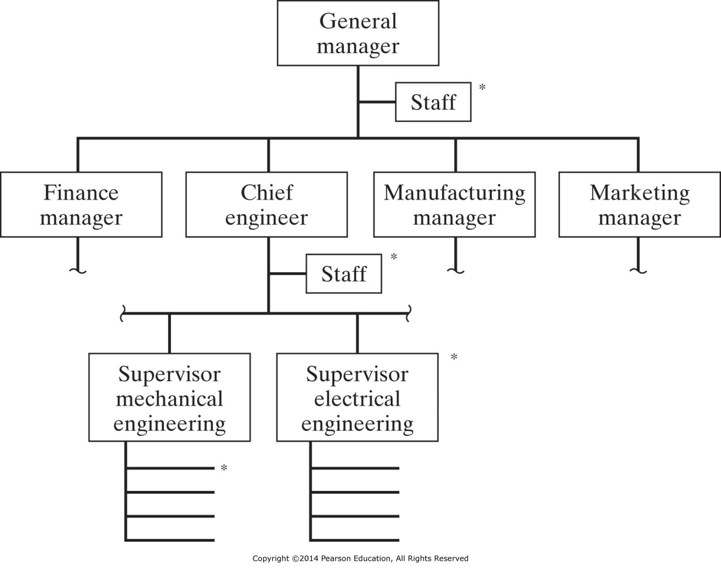
Figure 15-1 Typical functional organization (showing locations (*) from which a project manager or coordinator might lead a project).

Slide 7
Conducting Projects in a Functional Organization
A Project Manager is appointed to coordinate activities
The PM has no line authority over most project personnel
PM must lead by persuasion and influence

Slide 8
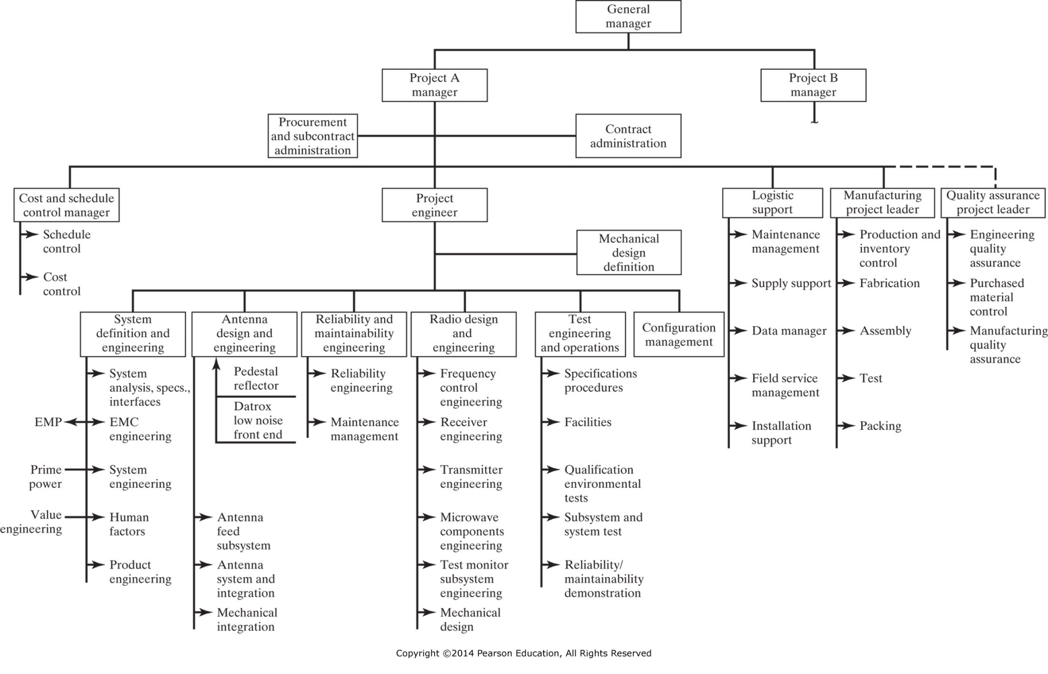
Figure 15-2 Fully projectized organization. (Adapted from Russell D. Archibald, Managing High-Technology Programs and Projects, © John Wiley & Sons, Inc., New York, 1976, pp. 104–105. Reprinted by permission of John Wiley & Sons, Inc.)

Slide 9
Conducting Projects in a Projectized Organization
A Project Manager has direct control over all elements needed to execute the projects
The PM is like the head of a full division within the company – with the exception of certain staff functions common to all projects
The PM can lead by line authority

Slide 10
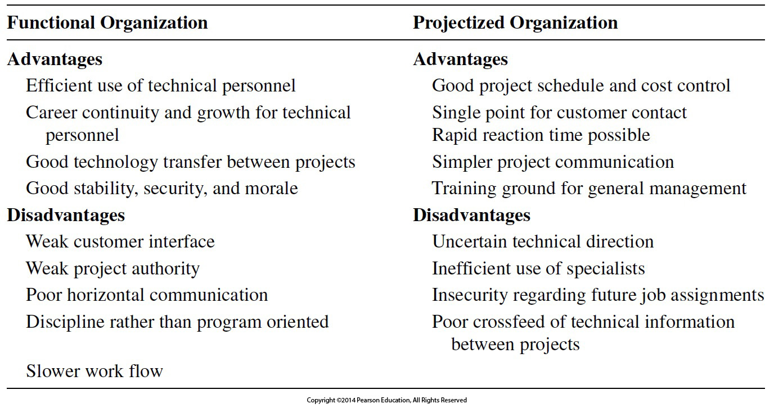
Advantages & Disadvantages of Functional and Projectized Organization Structures for Project Management

Slide 11
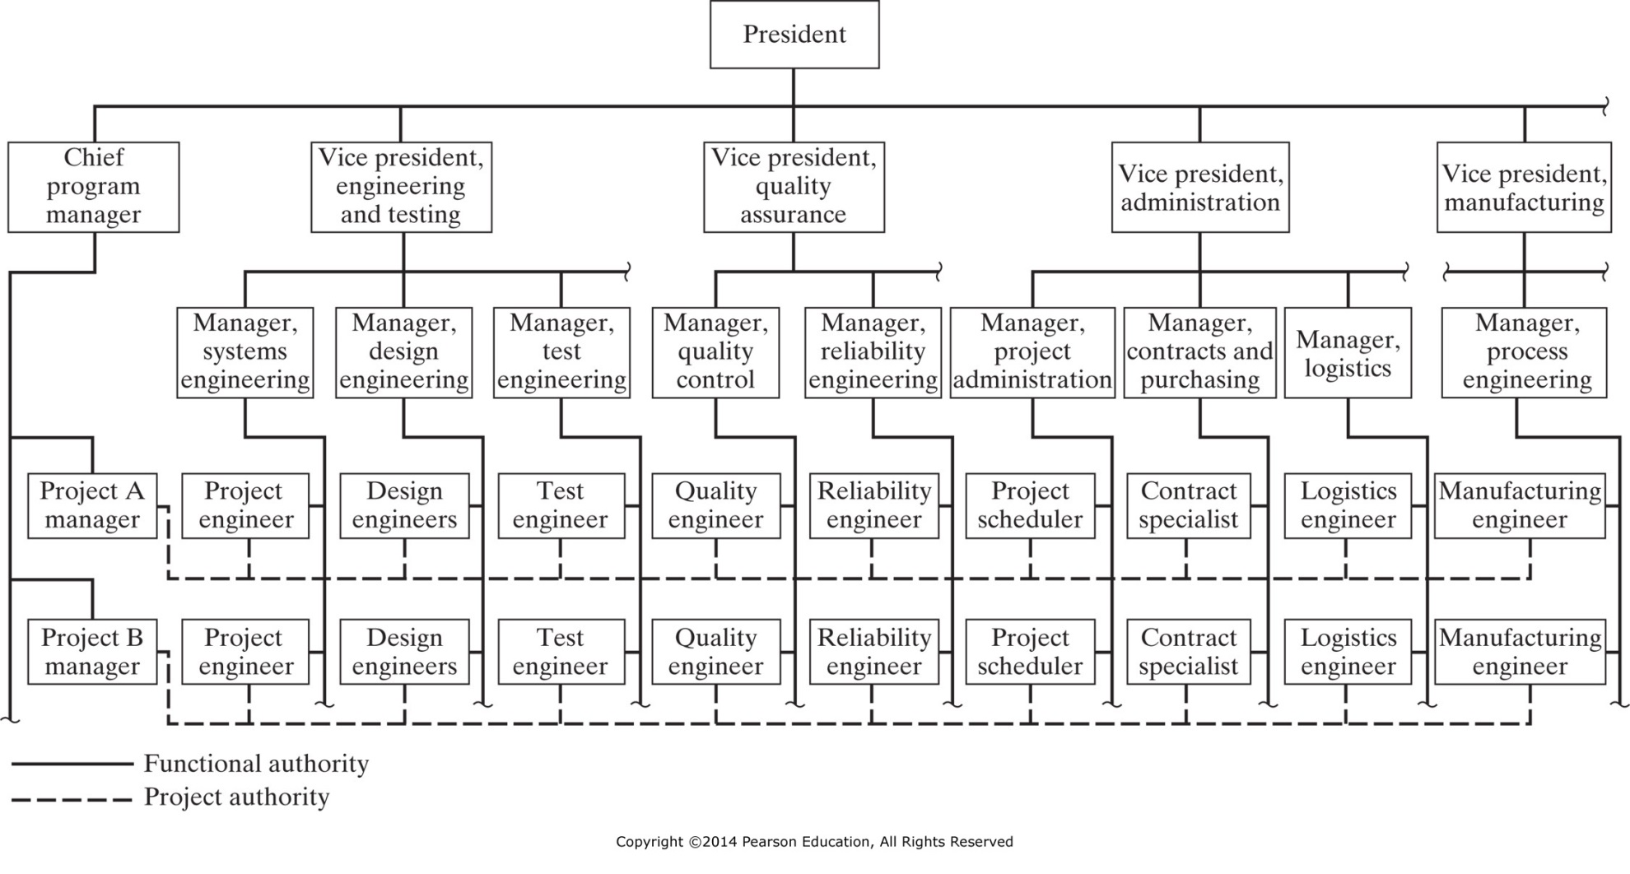
Figure 15-3 Typical matrix organization.

Slide 12
Conducting Projects in a Matrix Organization
Project personnel report to both functional and project managers
The Project Manager controls:
Project Tasks
Project Resources
Project Schedule
AND is the focal point for customer contact, project changes, and project communication

Slide 13
Conducting Projects in a Matrix Organization
Project personnel report to both functional and project managers
The Functional Manager is responsible for:
Assignment of functional specialists
Quality of work done within the functional specialty
Selecting, evaluating, and rewarding work within the specialty

Slide 14
Project Leadership
A project is a one-time job that has definite starting and ending points, clearly defined objectives, scope, and (usually) a budget.
The skills of the Project Manager often differ from those typical of the Functional Manager

Slide 15
Effective Program Managers
Need a blend of skills:
Technical
Administrative
Interpersonal
Scope of the PM:
Sets project priorities relative to other activities
Primary point of contact for customer
Defines the work to be performed by supporting departments in terms of cost, schedule, and performance
Controls the project budget
Responsibilities of the PM:
Responsible for design reviews
Responsible for configuration and design control
Responsible for source selection decisions
Responsible for project status reports
Performs merit review of assigned project personnel

Slide 16
Characteristics Associated with Success
Commitment of parent organization, project manager, and client to
Schedules
Budget
Technical Performance
Frequent Feedback
Adequate Control
Public Support
Reduced Bureaucratic Complexity (i.e. Red Tape)
A More “Projectized” Than “Functional” Organizational Form
Judicious use of Planning and Control Tools
Participative Decision Making Within the Team
Project Management Skills
Bottom Line:
Commitment to a Satisfied Customer

Slide 17
Characteristics Associated with Failure
Inadequate project manager skills
Poor customer coordination and rapport
Poor rapport and coordination within own organization
Lack of project team participation
Poor project control
Lack of familiarity with project requirements
Lack of resources
Poor public relations

Slide 18
Project control
A project is a one-time job that has definite starting and ending points, clearly defined objectives, scope, and (usually) a budget.
One key to success of the Project Manager is how communications are handled – they need to support

Slide 19
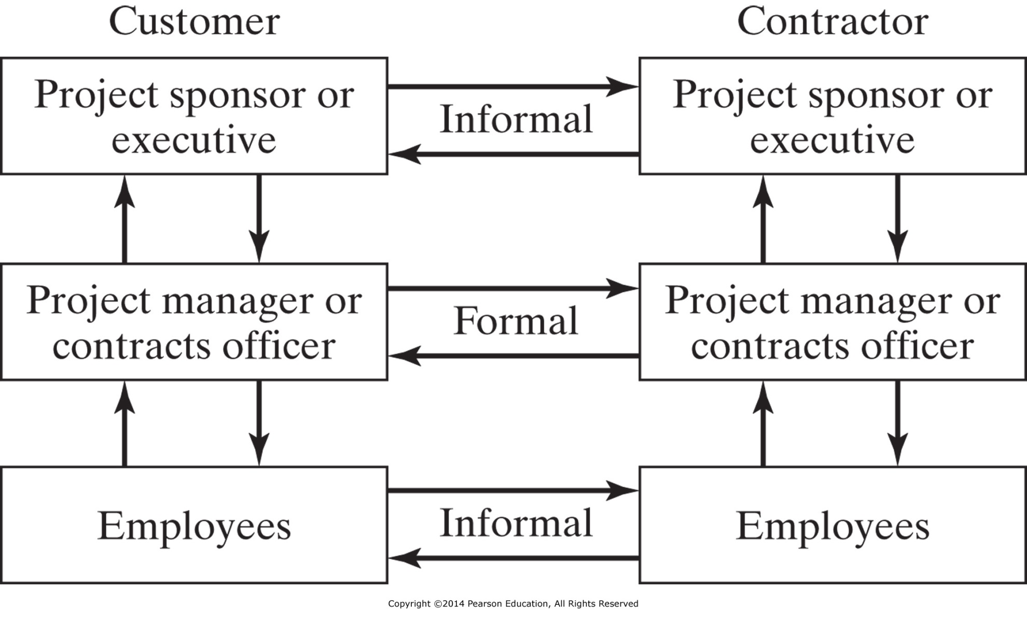
Figure 15-6 Customer (client) communications. (From David I. Cleland and Harold Kerzner, Engineering Team Management, Van Nostrand Reinhold Company, Inc., New York, 1986, pp. 63–64.)

Slide 20
IENG 366 Engineering Management
Questions & Issues?

