Slide 1
IENG 366
Project Planning & Acquisition
Reading: pp. 326 – 346.

Slide 2
Project management
A project is a one-time job that has definite starting and ending points, clearly defined objectives, scope, and (usually) a budget.

Slide 3
Triple Constraint of a Project
Three constraints common to all true projects:
Time
Cost
Performance (functionality)
Expectations of clients are an inherent part of the project specifications
Kerzner, H. (2003)

Slide 4
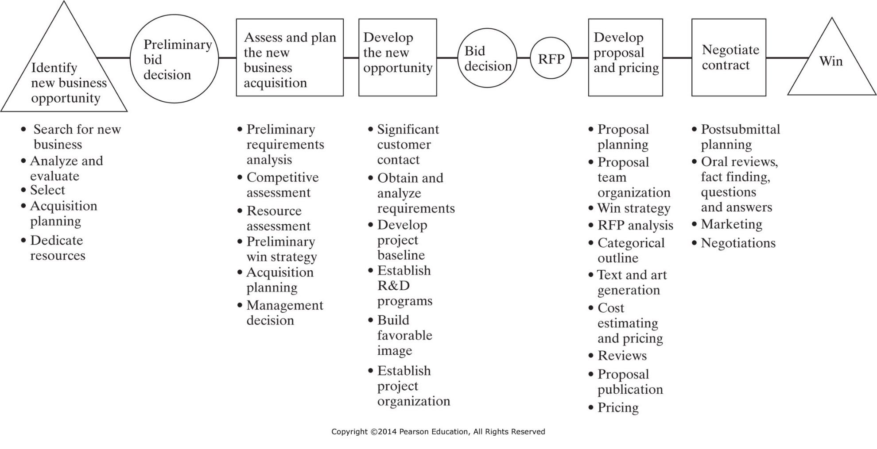
Figure 14-2 Phases in winning new contracts in a project-oriented business. (From Hans J. Thamhain, Engineering Project Management, © John Wiley & Sons, Inc., New York, 1984, p. 55. Reprinted by permission of John Wiley & Sons, Inc.)

Slide 5
Project Proposal Process
Description of what is to be accomplished
Scope
Proposal or estimate of time Schedule
Proposal or estimate of cost Budget

Slide 6
Project Proposal Process
Pro-active businesses prepare in advance
Technical capabilities/skills/skill mix
Assessment of future technologies
Assessment of future markets
Proposals are expensive to complete

Slide 7
Proposal Preparation
Based on RFP
Statement of Work (SOW)
Statement of Objectives (SOO)
Schedule
Specifications
Standard Clauses

Slide 8
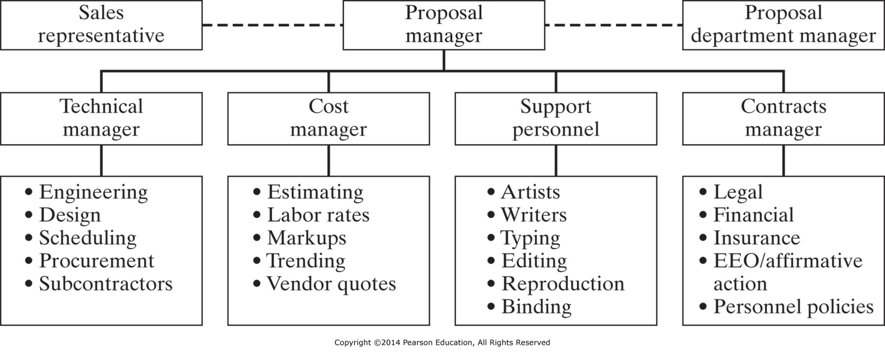
Figure 14-3 Typical organization chart for a major proposal. (Adapted from Harold Kerzner, Project Management: A Systems Approach to Planning, Scheduling, and Controlling, 2nd ed., Van Nostrand Reinhold, Inc., New York, 1984, p. 823.)

Slide 9
Potential Problems When NOT Using PM
Excessive work loads
Cost overruns
Staffing conflicts
Scope of project changes
Work redone or duplicated
Insufficient resources
Missed deadlines

Slide 10
Project Management Life Cycle
Level of effort
Conception
Planning
Implementation
Termination
1. Goals
2. Specifications
3. Scope
4. Responsibilities
5. Teams
1. WBS
2. Budgets
3. Resources
4. Risks
5. Schedule
1. Status reports
2. Change Orders
3. Quality Audits
4. Contingencies
1. Train user 2. Transfer documents 3. Release resources 4. Reassign staff 5. Lessons learned
Meredith, J. R. & Mantel, S. J. (2006)

Slide 11
Scope the Project
What is the Problem/Purpose?
Establish Goal/Objectives
What Client Need is being Satisfied by the Project?
Identify Success Criteria
Identify Risks and Assumptions

Slide 12
Develop Detailed Plan
Project Team
Identify project activities
Estimate durations
Determine resources
Construct network

Slide 13
Project Planning Tools
Milestone Schedule
Key start and end dates
May include entrance and exit criteria for each milestone
Work Breakdown Structure (WBS)
Level-by-level subdivision of work to be performed in the contract
Common framework or outline

Slide 14
Work Breakdown Structure
Structured listing of tasks
Start at top level, and decompose
Divide into three to seven major tasks
Sub-divide major tasks (& sub-sub-divide…)
Define task activity
Input, output, required time, required resources
Assign responsibility

Slide 15
WBS Example
Design Pizza
1.1 Select crust
1.2 Select sauce & cheese(s)
1.3 Select topping(s)
Acquire Materials
2.1 Buy dough & sauce
2.2 Buy meat(s) & cheese(s)
2.3 Buy produce
Construct Pizza
3.1 Prepare crust
3.2 Append sauce & cheese
3.3 Apply toppings
Bake Pizza
4.1 Preheat oven
4.2 Cook pizza
4.3 Remove & serve

Slide 16
Pizza WBS
ACTIVITY | RESP | INPUT | OUTPUT | DUR
1.0 Design Pizza | Tim | Ideas | BOM | 8 min
1.1 Select crust | Ellen
1.2 Select sauce & cheese(s) | Andy
1.3 Select topping(s) | Mindy
2.0 Acquire Materials | Tim | BOM, $$ | Ingredients | 30 min
2.1 Buy dough & sauce | Ellen
2.2 Buy meats & cheeses | Andy
2.3 Buy produce | Mindy
3.0 Construct Pizza | Tim | Ingredients | Unbaked Pie | 20 min
3.1 Prepare crust | Ellen
3.2 Append sauce & cheese | Andy
3.3 Apply toppings | Mindy

Slide 17
Scheduling
A schedule is the conversion of a project action plan into an operating timetable
It serves as the basis for monitoring and controlling project activity
Taken together with the plan and budget, it is probably the major tool for the week-to- week management of projects

Slide 18
Gantt Chart (or bar chart)
Conversion of ‘static’ WBS to ‘dynamic’ Gantt Chart
Shows sequence of activities
Shows timing of activities
Allows tracking of performance
A Gantt Chart is a horizontal bar chart
Empty bars show time allotted for task
Filled bars show progress to date
Symbol (empty shape) shows “Deliverables”

Slide 19
Gantt Chart
Task, duration, and start / end are shown by horizontal bars on a time scale:
Tasks are listed on left
Duration is shown by the length of the ‘empty’ box
Deliverables are shown by ‘empty’ symbol at due date
Bars may be grouped logically:
By sequence
By function
By resource …
Progress is tracked graphically:
Current date is depicted as a thick, vertical line
Task % complete is noted by filling in the bar / symbol

Slide 20
Gantt Progress Tracking
Tasks Dur.
A 5
B 5
C 4
D 7
E 6
F 12
G 12
H 6
I 3
Status:
Tasks A, B, D, and E are complete
Task C is 10 days behind (requires 1 more day of effort)
Task F is 1 day ahead (and that person is available to work on Task C)
Task G is on-time
Task H could have already started (but hasn’t, and does not have to, yet)
Task I is neither ready to start, nor scheduled to start, yet
0 5 10 15 20 25 30 35
Bold line for current date

Slide 21
Schedule Management Issues
How frequently should the PM track progress?
A: At least twice as frequently as it is reported.
What happens if something goes wrong?
A: You (the PM) will be held accountable
… but how accountable depends
The project manager is often dependent on team members to call attention to problems, and members are biased
The project manager must make sure that the bearer-of-bad-news is not punished; nor should the admitter-to-error be executed, however …
The hider-of-mistakes may be shot with impunity – and then sent to project Siberia
Meredith, J. R. & Mantel, S. J. (2006)

Slide 22
Gantt Charts - Summary
There are several advantages to the use of Gantt charts:
They are easy to construct
Even though they may contain a great deal of information, they are easily understood
While they may require frequent updating, they are easy to maintain
Gantt charts provide a clear picture of the current state of a project

Slide 23
Gantt Charts - Summary
The Gantt chart shows planned and actual progress for a number of tasks displayed against a horizontal time scale
It is an effective and easy-to-read method of indicating the actual current status for each set of tasks compared to the planned progress for each item of the set
It can be helpful in expediting, sequencing, and reallocating resources among tasks
Gantt charts usually do not show technical dependencies

Slide 24
Project NETWORK MODELS
PERT and CPM techniques for managing the network of project activities allow engineering managers to focus on the currently critical tasks in light of variation.

Slide 25
Network Techniques: PERT and CPM
With the exception of Gantt charts, the most common approach to scheduling is the use of network techniques such as PERT and CPM
The Program Evaluation and Review Technique (PERT) was developed by the U.S. Navy in 1958
Activity on Arrow (AOA)
The Critical Path Method (CPM) was developed by DuPont during the same time period
Activity on Node (AON)

Slide 26
Network Techniques: PERT and CPM
PERT has been primarily used for research and development projects
CPM was designed for construction projects and has been generally embraced by the construction industry
The two methods are quite similar and are often combined for educational presentation

Slide 27
Scheduling Terminology
Activity - A specific task or set of tasks that are required by the project, use up resources, and take time to complete
Event - The result of completing one or more activities. An identifiable end state occurring at a particular time. Events use no resources.
Network - The combination of all activities and events define the project and the activity precedence relationships

Slide 28
Scheduling Terminology
Path - The series of connected activities (or intermediate events) between any two events in a network
Critical - Activities, events, or paths which, if delayed, will delay the completion of the project. A project’s critical path is understood to mean that sequence of critical activities that connect the project’s start event to its finish event

Slide 29
Scheduling Terminology
An activity can be in any of these conditions:
It may have a successor(s) but no predecessor(s) - starts a network
It may have a predecessor(s) but no successor(s) - ends a network
It may have both predecessor(s) and successor(s) - in the middle of a network

Slide 30
Drawing Networks
Activity-on-Arrow (AOA) networks use arrows to represent activities while nodes stand for events
Activity-on-Node (AON) networks use nodes to represent activities with arrows to show precedence relationships
The choice between AOA and AON representation is largely a matter of personal preference

Slide 31
Hypothetical Network
3
1
2
5
6
4

Slide 32
AOA Network Building Blocks
Activity
Event
Duration
Install software
79
80
1 day
(Dummy Activity) X
Dummy Activities have zero duration, and are used to address informational, approval and timing dependencies

Slide 33
AOA – Activities Defined
B Construction plans
4
1
A Application approval
2
C Traffic study
3
D Service availability check
5

Slide 34
Partial AOA Network – Dependencies
3
X
B
A
C
E
1
2
4
(A)
3
B
X
A
C
E
1
2
4
(B)
4
B
E
C
A
X
3
1
2
(C)

Slide 35
Partial AOA Network
4
B
E
X
A
C
3
1
2
D
F
(D)
5
4
B
E
X
A
C
3
Y
1
2
D
F
5
(E)

Slide 36
Full AOA Network
4
E 15
B
X
Y
15
0
0
1
A 5
2
C 10
3
5
F 10
6
G 170
7
H 35
8
Legend
D 5
Activity Duration

Slide 37
PERT: Activity-on-Node Network Fundamentals
J, K, & L can all begin at the same time, if you wish (they need not occur simultaneously)
J
A
B
C
A is preceded by nothing B is preceded by A C is preceded by B
K
M
but
L
All (J, K, L) must be completed before M can begin
(1)
(3)
Y
Y and Z are preceded by X
X
Z
Z is preceded by X and Y
X
Z
Y and Z can begin at the
same time, if you wish
Y
AA
AA is preceded by X and Y
(2)
(4)

Slide 38
PERT: Activity on Node Notation
Early Start (ES) Early Finish (EF)
Activity Duration (D)
Late Start (LS) Late Finish (LF)

Slide 39
PERT: Calculating ES and EF
Forward Pass Through Network:
Move left to right, covering each simultaneous activity in order
ES = maximum of EF for all immediate predecessor activities (0 for START activity)
EF = ES + Duration
Critical Time = EF of the END activity

Slide 40
PERT: Calculating LS and LF
Backward Pass Through Network:
Move right to left, covering each simultaneous activity in order
LF = minimum of LS for all immediate successor activities (Critical Time for END activity)
LS = LF – Duration
Slack (Float) Time:
LS – ES Note: Slack = 0 for Critical Activities

Slide 41
PERT: Critical Path Example
1
4
4
5
5
6
B 3
F 1
G 1
3
6
6
7
7
8
0
1
1
4
8
9
9
11
A 1
C 3
H 1
Z 2
0
1
1
4
8
9
9
11
1
3
4
8
D 2
E 4
2
4
4
8
Critical Time = 11 days
Slack D = 1 day
Slack B, F, G = 2 days
Critical Path = A, C, E, H, Z

Slide 42
PERT: Critical Path Management
CP are those activities where ES = LS
Any delay in these activities will delay production!
Wrong to say that these activities are the most important, though:
Frequently, activities with slack are put off until too late if not monitored!
Other paths may be near-critical, and will also delay the project if not monitored!

Slide 43
PERT Activity Calculation
t(e) = a + 4m + b a = Most Optimistic (MO)
6 m = Most Likely (ML)
b = Most Pessimistic (MP)
t(e) = Activity Duration
When a single estimate for activity time is not sufficient!

Slide 44
PERT Activity Times & Variances
Assume CP = 1 – 2 – 3 – 4 – 5 – 6 – 7:
Activity | a | m | b | t(e)
1-2 | 17 | 29 | 47
2-3 | 6 | 12 | 24
3-4 | 16 | 19 | 28
4-5 | 13 | 16 | 19
5-6 | 2 | 5 | 14
6-7 | 2 | 5 | 8
30
13
20
16
6
5
$$t\left(e\right)=\frac{a+4m+b}{6}$$
$$=\frac{17+4∙29+47}{6}$$
$$=\frac{180}{6}$$
CT = 90
$=$ 30

Slide 45
PERT Schedule Probability
Z = T(S) – T(E) Z = Probability of
ΣSD[T(E)]² Meeting Schedule
T(S) = Scheduled Duration
T(E) = Critical Path Duration
ΣSD[T(E)]² = sum of the
variance of each
of the CP tasks
(variance = [std dev]²)
Z is found from the standard normal table probabilities

Slide 46
Variance of Activity Estimates
Activity | a | m | b | t(e) | [(b-a)/6]² Var
1-2 | 17 | 29 | 47 | 30
2-3 | 6 | 12 | 24 | 13
2-4 | 16 | 19 | 28 | 20
3-5 | 13 | 16 | 19 | 16
4-5 | 2 | 5 | 14 | 6
5-6 | 2 | 5 | 8 | 5
25
9
4
1
4
1
Var =${\left[\frac{\left(b−a\right)}{6}\right]}^{2}$
=${\left[\frac{\left(47−17\right)}{6}\right]}^{2}$
=${\left[\frac{\left(30\right)}{6}\right]}^{2}$
$=$ 25
VAR(CT) = 44

Slide 47
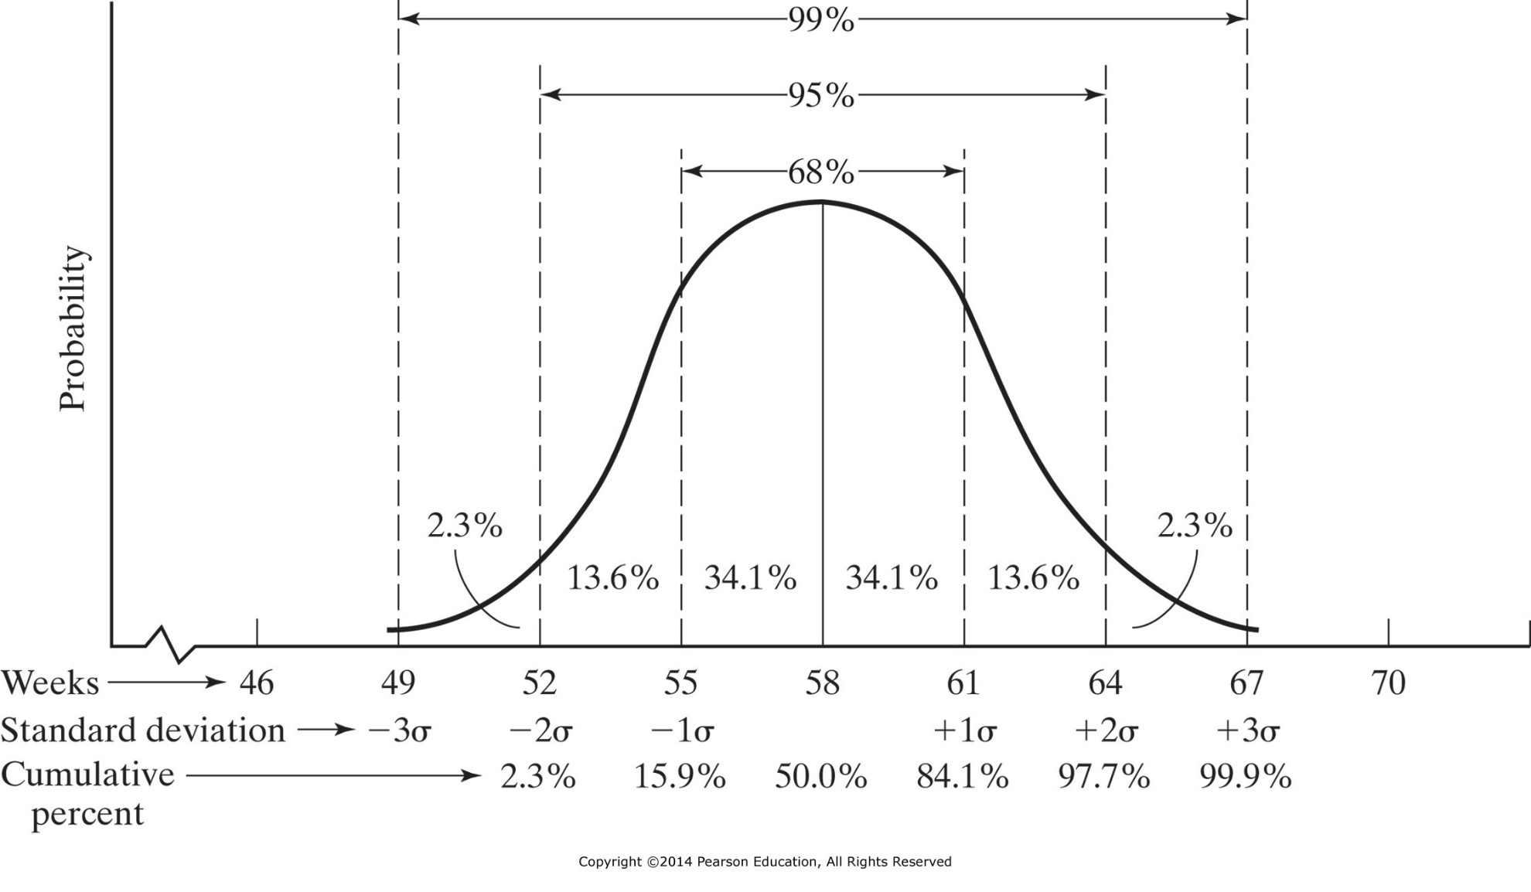
Figure 14-10 Normal probability distribution of project critical path.

Slide 48
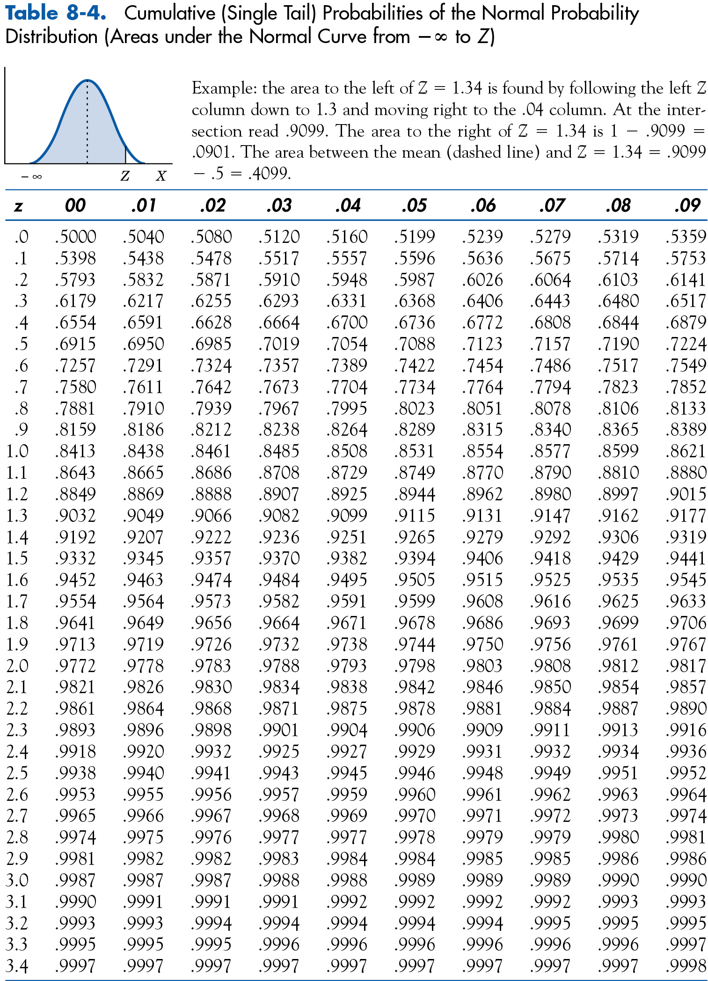
$$=P\left(\frac{100−90}{\sqrt{44}}\right)$$
$$P\left(CT≤100days\right)$$
$$=P\left(1.51\right)$$
$$=93.5\%$$
Z-Table Expanded

Slide 49
Z Table: Note P(-z) = P(1 - z)
Z Value | Probability | Z Value | Probability
-2.0 | 0.02 | +2.0 | 0.98
-1.5 | 0.07 | +1.5 | 0.93
-1.0 | 0.16 | +1.0 | 0.84
-0.7 | 0.24 | +0.7 | 0.76
-0.5 | 0.31 | +0.5 | 0.69
-0.3 | 0.38 | +0.3 | 0.62
-0.1 | 0.36 | +0.1 | 0.54

Slide 50
CRASHING ProjectS
Crashing a project does not wreck it, but since time is money, it can buy time to complete the project ...

Slide 51
Project Management Triple Constraint
On-time
Under-budget (or At-budget)
Meeting performance specifications
Because there are uncertainties, the PM must be able to make good trade-offs:
Assuming that project performance goals are most necessary for the firm (fixed), trade-offs are:
Time
Money (for resources)

Slide 52
Critical Path Method - Crashing a Project
CPM includes a way of relating the project schedule to the level of physical resources allocated to the project
This allows the project manager to trade time for cost, or vice versa
In CPM, two activity times and two costs are specified, if appropriate, for each activity

Slide 53
Critical Path Method - Crashing a Project
The first time/cost combination is called normal, and the second set is referred to as crash
Normal times are “normal” in the same sense as the ‘m’ time estimate of the three times used in PERT
Crash times result from an attempt to expedite the activity by the application of additional resources

Slide 54
Critical Path Method - Crashing a Project
Careful planning is critical when attempting to expedite (crash) a project
Expediting tends to create problems; and the solution to one problem often creates several more problems that require solutions
Some organizations have more than one level of crashing

Slide 55
Crashing – Sample Network
3
8
6
6
6
3
10
7
1
2
4
0
11
5
5
Critical Path = 3 + 6 + 8 + 6 = 23 Time Units

Slide 56
Crashing – An Example
Activity | Normal Time | Normal Cost | Crash Time | Crash Cost | Slope | Max Crash Time
1-2 | 3 | $50 | 2 | $70
2-3 | 6 | $80 | 4 | $160
2-4 | 10 | $60 | 9 | $90
2-5 | 11 | $50 | 7 | $150
3-6 | 8 | $100 | 6 | $160
5-7 | 5 | $40 | 4 | $70
6-7 | 6 | $70 | 6 | $70

Slide 57
Crashing – An Example
Slope:
Assumes that the crash cost and crash time is linear:
If partial crashing is allowed, slope indicates increase in cost per unit crash time used
If partial crashing is not allowed (technological requirement), full crash time must be used and the full increase in cost is incurred
Max Crash Time:
Difference between crash and normal time

Slide 58
Crashing – Sample Network
3
$100
$80
6
$70
$50
$60
7
1
2
4
5
$40
$50
“Normal” Project Total Cost = $50 + $80 + $100 + $70 +
$60 + $50 + $40 = $450

Slide 59
Crashing – An Example
Activity | Normal Time | Normal Cost | Crash Time | Crash Cost | Slope | Max Crash Time
1-2 | 3 | $50 | 2 | $70 | 20 | 1
2-3 | 6 | $80 | 4 | $160 | 40 | 2
2-4 | 10 | $60 | 9 | $90 | 30 | 1
2-5 | 11 | $50 | 7 | $150 | 25 | 4
3-6 | 8 | $100 | 6 | $160 | 30 | 2
5-7 | 5 | $40 | 4 | $70 | 30 | 1
6-7 | 6 | $70 | 6 | $70 | 0 | 0

Slide 60
Crashing – Sample Network
Critical Path = 23 Days
3
$100
$80
8
$70
6
6
6
$50
$60
3
2
10
7
1
4
$50
5
$40
11
5
“Normal” Project Total Cost = $50 + $80 + $100 + $70 +
$60 + $50 + $40 = $450

Slide 61
Crashing – An Example
Activity | Normal Time | Normal Cost | Crash Time | Crash Cost | Slope | Max Crash Time
1-2 | 3 | $50 | 2 | $70 | 20 | 1
2-3 | 6 | $80 | 4 | $160 | 40 | 2
2-4 | 10 | $60 | 9 | $90 | 30 | 1
2-5 | 11 | $50 | 7 | $150 | 25 | 4
3-6 | 8 | $100 | 6 | $160 | 30 | 2
5-7 | 5 | $40 | 4 | $70 | 30 | 1
6-7 | 6 | $70 | 6 | $70 | 0 | 0

Slide 62
Crashing – Sample Network
Critical Path = 23 Days
“Crashed”Path = 20 Days
$160
3
6
$80
6
$70
6
6
$70
$60
2
10
7
1
2
4
$50
5
$40
11
5
“Crashed” Project Total Cost = $70 + $80 + $160 + $70 +
$60 + $50 + $40 = $530

Slide 63
Project RESOURCE MODELS
Project Managers must not only meet the Triple Constraint of time, money and functionality –
they must also balance their use of resources: equipment, facilities and PEOPLE.
(We will not cover this topic this term … but it is worth acknowledging!)

Slide 64
The Resource Allocation Problem
A shortcoming of most scheduling procedures is that they do not address the issues of resource utilization and availability
Scheduling procedures tend to focus on time rather than physical resources
Time itself is always a critical resource in project management, one that is unique because it can neither be inventoried nor renewed

Slide 65
The Resource Allocation Problem
Schedules should be evaluated not merely in terms of meeting project milestones, but also in terms of the timing and use of scarce resources
A fundamental measure of the project manager’s success in project management is the skill with which the trade-offs among performance, time, and cost are managed

Slide 66
The Resource Allocation Problem
The extreme points of the relationship between time use and resource use are these:
Time Limited: The project must be finished by a certain time, using as few resources as possible. But it is time, not resource usage, that is critical
Resource Limited: The project must be finished as soon as possible, but without exceeding some specific level of resource usage or some general resource constraint

Slide 67
The Resource Allocation Problem
If all three variables - time, cost, specifications - are fixed, the system is “over-determined”
In this case, the project manager has lost all flexibility to perform the trade-offs that are so necessary to the successful completion of projects
A system-constrained task requires a fixed amount of time and known quantities of resources

Slide 68
Resource Loading
Resource loading describes the amounts of individual resources an existing schedule requires during specific time periods
The loads (requirements) of each resource type are listed as a function of time period
Resource loading gives a general understanding of the demands a project or set of projects will make on a firm’s resources:
People
Equipment / facilities

Slide 69
Resource Loading
Looking early on at resource loading is an excellent guide for early, rough project planning
Because the project action plan is the source of information on activity precedencies, durations, and resources requirements, it is the primary input for both the project schedule and budget
The action plan links the schedule directly to specific demands for resources

Slide 70
Resource Loading
The PERT/CPM network technique can be modified to generate time-phased resource requirements
The project manager must be aware of the ebbs and flows of usage for each input resource throughout the life of the project
It is the project manager’s responsibility to ensure that the required resources, in the required amounts, are available when and where they are needed

Slide 71
Resource Leveling
Resource leveling aims to minimize the period-by-period variations in resource loading by shifting tasks within their slack allowances
The purpose is to create a smoother distribution of resource usage
Advantages include:
Less hands-on management is required
May be able to use a “just-in-time” inventory policy

Slide 72
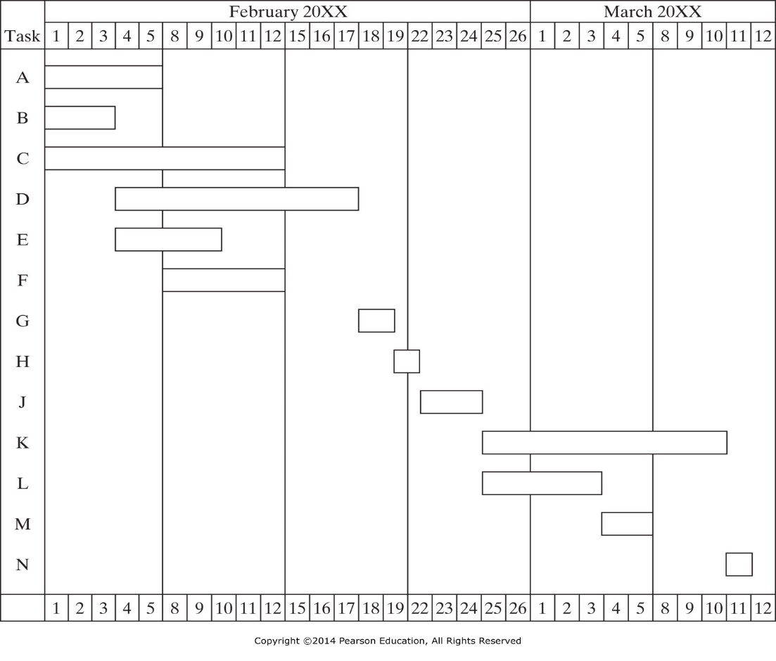
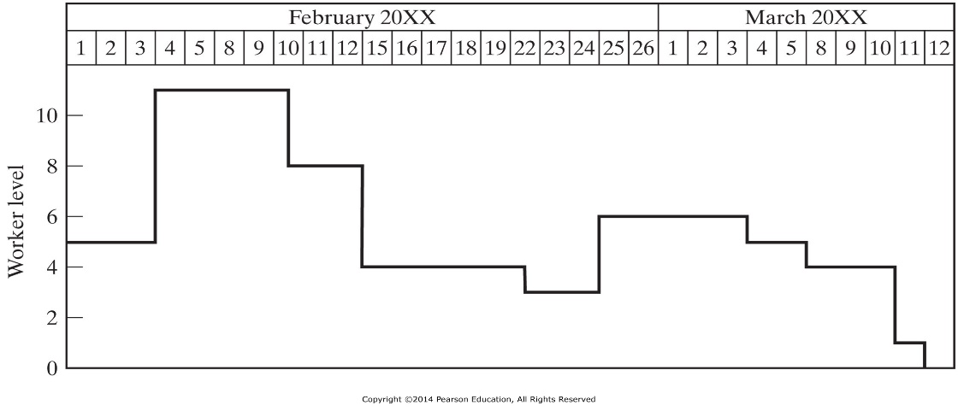

Slide 73
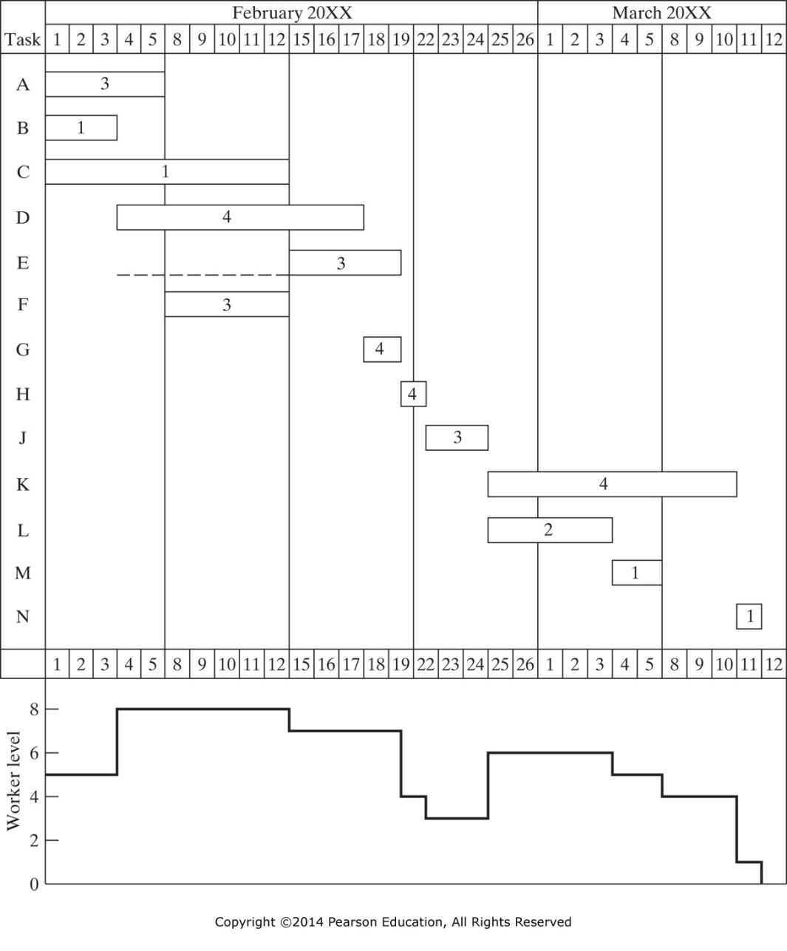
Figure 14-12 Adjusted schedule and worker-level profile for house project.

Slide 74
Resource Leveling
When resources are leveled, the associated period-to-period costs also tend to be leveled
The project manager must be aware of the cash flows associated with the project and of the means of shifting them in ways that are useful to the parent firm
Resource leveling is a procedure that can be used for almost all projects, whether or not resources are constrained

Slide 75
Constrained Resource Scheduling
There are two fundamental approaches to constrained allocation problems:
Heuristic approaches employ rules of thumb that have been found to work reasonably well in similar situations
Optimization approaches seek the best solutions but are far more limited in their ability to handle complex situations and large problems

Slide 76
Heuristic Methods
Heuristic approaches to constrained resource scheduling problems are in wide, general use for at least two reasons:
They are the only feasible methods of attacking the large, nonlinear, complex problems that tend to occur in the real world of project management
While the schedules that heuristics generate may not be optimal, they are usually quite good- certainly good enough for most purposes

Slide 77
Heuristic Methods
Most heuristic solution methods start with the PERT/CPM schedule and analyze resource usage period by period, resource by resource
In a period when the available supply of a resource is exceeded, the heuristic examines the tasks in that period and allocates the scarce resource to them sequentially, according to some priority rule
Technological necessities always take precedence

Slide 78
Heuristic Methods
Common priority rules:
As soon as possible
As late as possible
Shortest task first
Most resources first
Minimum slack first
Most critical followers
Most successors
Arbitrary

Slide 79
Optimizing Methods
The methods to find an optimal solution to the constrained resource scheduling problem fall into two categories:
Mathematical programming
Enumeration
Mathematical programming can be thought of as linear programming (LP) for the most part

Slide 80
Optimizing Methods
Linear programming is usually not feasible for reasonably large projects where there may be a dozen resources and thousands of activities
In the late 1960s and early 1970s, limited enumeration techniques were applied to the constrained resource problem
Tree search, and branch and bound methods were devised to handle up to five resources and 200 activities

Slide 81
Optimizing Methods
Mathematical Programming formulations require:
An objective function
A series of constraints (linear / integer)
A lot of time for a problem of medium size
Another, more recent method is Evolutionary Programming:
Still require an objective function
Still need constraints
But give good solutions in a reasonable time

Slide 82
IENG 366 Engineering Management
Questions & Issues?

