Slide 1
IENG 366
Managing Production Operations
Reading: pp. 279 – 299.

Slide 2
Production Operations
Major focus of production operations is on efficiency and effectiveness of processes
Production operations often include substantial measurement and analysis of internal processes

Slide 3
Production Planning and Control Systems
Material Requirements Planning (MRP)
Manufacturing Resource Planning (MRP II)
Enterprise Resource Planning (ERP)
Synchronized Manufacturing (OPT)
Lean Manufacturing (TPS)

Slide 4
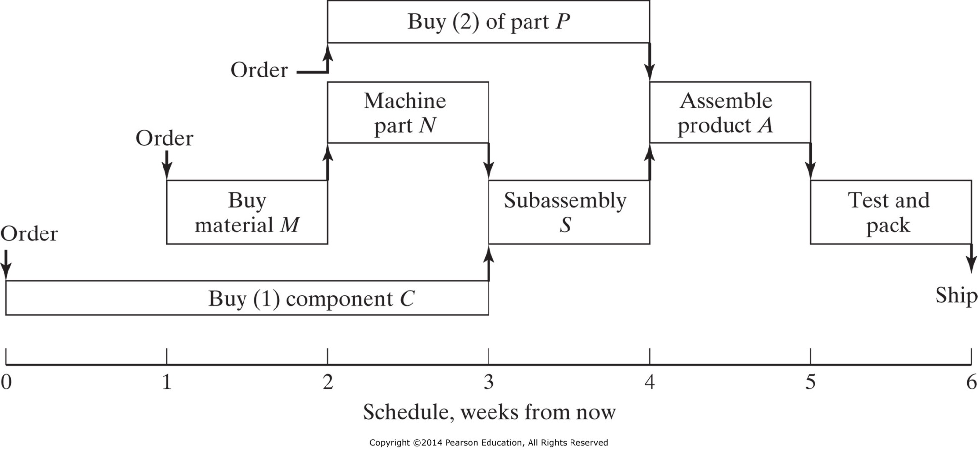
Figure 11-8 Schedule of production lead times for product A.

Slide 5
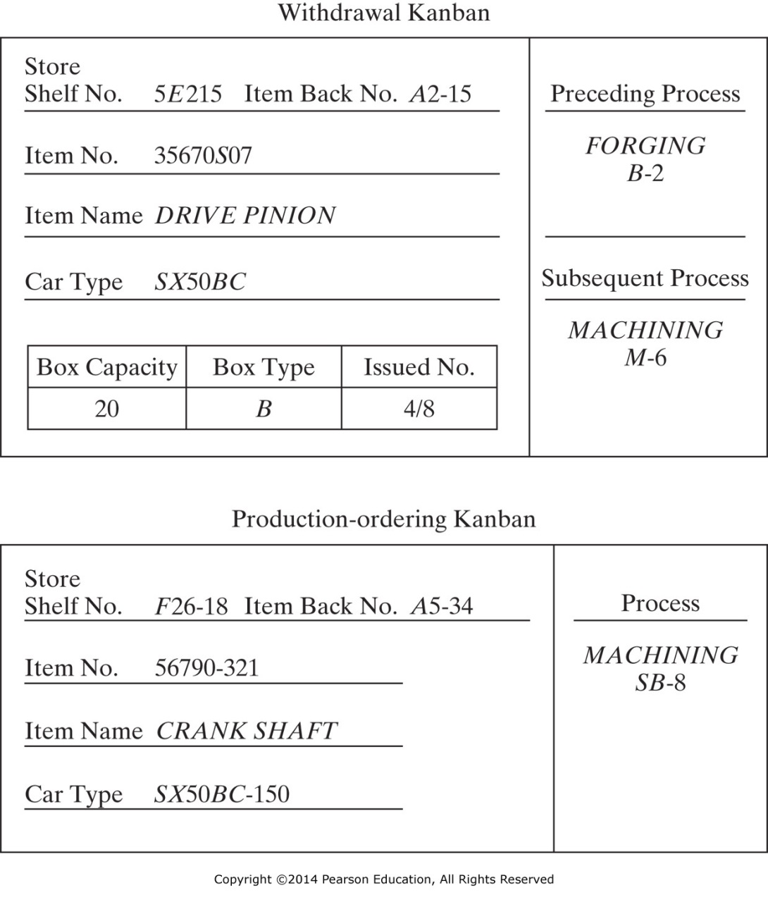
Figure 11-9 Examples of kanban cards. (From Hussein M. Reda, “A Review of ‘Kanban’—the Japanese ‘Just-in-Time’ Production System,” Engineering Management International, 4, 1987, p. 146).

Slide 6
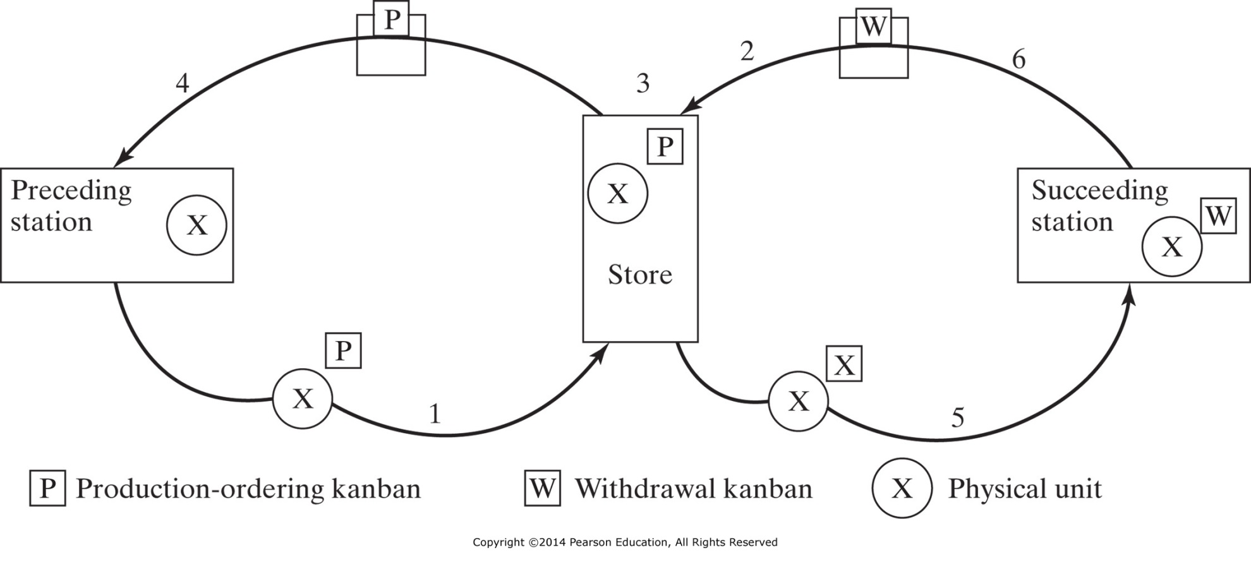
Figure 11-10 Mechanics of a simple kanban cycle. (1) Part produced at preceding station and P-kanban attached to it is sent to the store. (2) When the part is needed at a succeeding station, a W-kanban is sent to the store to withdraw the part. (3) At the store, the P-kanban is removed from the part and the W-kanban attached to it. The P-kanban is then collected in a “production-ordering” box. (4) At short time intervals, the P-kanban is then sent to the preceding station, constituting a production order. (5) The part with the W-kanban goes to the succeeding station to meet the demand. (6) The W-kanban is detached from the part and collected in a “withdrawal” box. (From Hussein M. Reda, “A Review of ‘Kanban’—the Japanese ‘Just-in-Time’ Production System,” Engineering Management International, 4, 1987, p. 146).

Slide 7
Quality Engineering

Slide 8
Malcolm Baldrige Quality Award Criteria
Leadership
Strategic Planning
Customer and market focus
Measurement, analysis, and knowledge management
Human resource focus
Process management
Business results

Slide 9
International Organization for Standardization
ISO: developing highly specific standards since 1947
Generic Management Business Standards
ISO 9000 – 1987
  Requires an organization to create processes in all functional areas that focus on customer needs and reasonable expectation and that validate requirements of quality
Primarily Environmental Management
ISO 14000 – 1997

Slide 10
Baldrige / ISO Difference
Baldrige criteria focuses on results and continuous improvement
ISO helps determine what is needed to maintain an efficient quality conformance system

Slide 11
Basic Requirements of Quality Improvement
Management commitment
Focus on customer
  Internal or external
  Any person receiving the output
Continuous improvement of processes
Utilization of entire work force
Performance measures for the processes
Use of a rational, verifiable, improvement process:
  Define
  Measure
  Analyze
  Improve
  Control

Slide 12
Quality: Understanding Process Variation
Three Aspects:
  Location
  Spread
  Shape
Variability is inherent in all processes.
SPC helps to:
  Quantify
  Communicate
  Make Decisions

Slide 13
Quality Myth:
Higher Quality ⇔ Higher Cost
Total Cost
Failure
Cost
$
Quality Cost
Defect Rate

Slide 14

Very Often:
Higher Quality ⇔ Lower Cost
Textbook ex: Manufacture of Copier Part
100 parts
Manufacturing Process
$20 / part
75% Conform
(75 good parts)
(10 scrap parts)
25% Non-conforming:
(25 parts)
Re-work Process
$4 / part
(15 good parts)

Slide 15
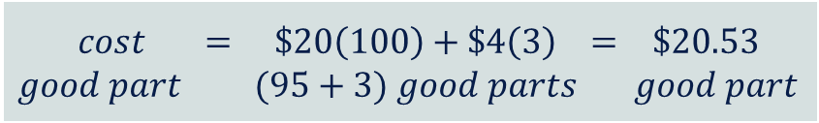
Study finds excessive process variability responsible for high nonconformity rate
New SQC procedure implemented
  NOW: manufacturing non-conformities = 5%
  SAVINGS: $22.89 – $20.53 = $2.36 / good part
  PRODUCTIVITY: 9% improvement

Slide 16
Quality Control Tools and Techniques
7 Tools of Ishikawa
  Histogram
  Pareto Chart
  Fishbone Chart (Cause & Effect Diagram)
  Check Sheet
  Defect Concentration Diagram
  Scatter (Plot) Diagram
  Statistical Process Control Charts
    Variables Charts
    Attributes Charts
    Individuals Charts
    Short Run SPC
Process Capability Measures
MIL STD 105D & Other Sampling Plans
Designed Experiments

Slide 17
Ishikawa’s Tools: Histogram

Slide 18
Ishikawa’s Tools: Pareto Chart
80% of any problem is the result of 20% of the potential causes
  Histogram categories are sorted by the magnitude of the bar
  A line graph is overlaid, and depicts the cumulative proportion of defects
  Quickly identifies where to focus efforts

Slide 19
Ishikawa’s Tools: Cause & Effect Diagram
Man
Method
Skill Level
Low RPM
Attention Level
Travel Limits
Dusty
Environment
Bad Paint
Temperature
Humidity
Poor Conductor
Poor Mixing
Orifice Clogs
Worn Parts
Poor Vendor
Machine
Material
The purpose of the cause and effect diagram is to obtain as many potential influencers of a process, so that the problem solving can take a more directed approach.

Slide 20
Ishikawa’s Tools: Defect Diagram
A defect concentration diagram graphically records the frequency of a defect with respect to product location.
  Obtain a digital photo or multi-view part print showing all product faces.
  Operator tallies the number and location of defects as they occur on the diagram.

Slide 21
Ishikawa’s Tools: Check Sheet
Title
Check sheets are used to collect data (values or pieces of information) in a consistent manner.
  List each of the known / possible problems
  Record each occurrence including time-orientation.
Header Info: Date, Time, Location, Operator, etc.
Times of Problem Occurrence (periodic)
List
of Prob
Types
Raw Data recorded here
Statistics
For Prob Types
Time of Occurrence Statistics
Overall Statistics
Instructions, settings, comments, etc.

Slide 22
Ishikawa’s Tools: Scatter Plot
A scatter plot shows the relationship between any two variables of interest:
  Plot one variable along the X-axis and the other along the Y-axis
  The presence of a relationship can be inferred or ruled out, but it cannot determine if a cause and effect relationship exists
Y
Y
Y
X
X
X

Slide 23
Ishikawa’s Tools: SPC Charts
α
2
UCL
α
2
α
2
μ₀
C_{L}
α
2
LCL
μ₀
Sample Number
2-Sided Hypothesis Test
Sideways Hypothesis Test
Shewhart Control Chart
A control chart is like a sideways hypothesis test
  Detects a shift in the process
  Heads-off costly errors by detecting trends

Slide 24
Why Monitor Both Process Mean and Process Variability?
Process Over Time
Control Charts
X-bar
R
X-bar
R
X-bar
R
Ishikawa’s Tools: SPC Charts

Slide 25
Use of Ishikawa’s Tools
Removing special causes of variation
Preparation for:
  hypothesis tests
  control charts
  process improvement
Statistical Quality Control and Improvement
Improving Process Capability and Performance
Continually Improve the System
Characterize Stable Process Capability
Head Off Shifts in Location, Spread
Time
Identify Special Causes - Bad (Remove)
Identify Special Causes - Good (Incorporate)
Reduce Variability
Center the Process
LSL μ₀ USL

Slide 26
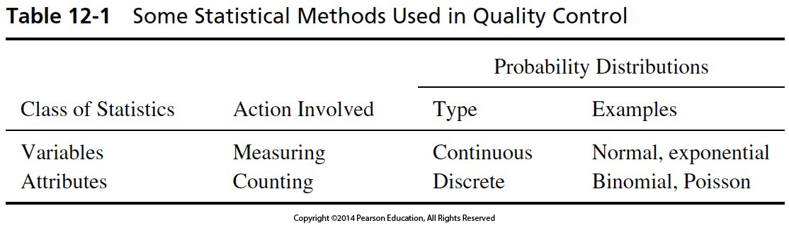

Slide 27
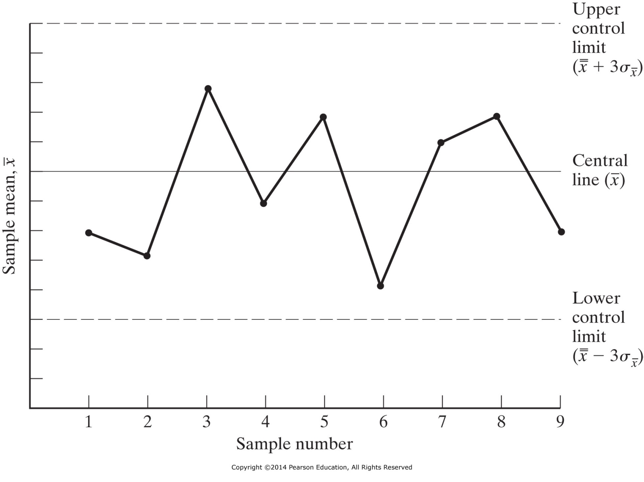
Figure 12-2 X-bar control chart.

Slide 28
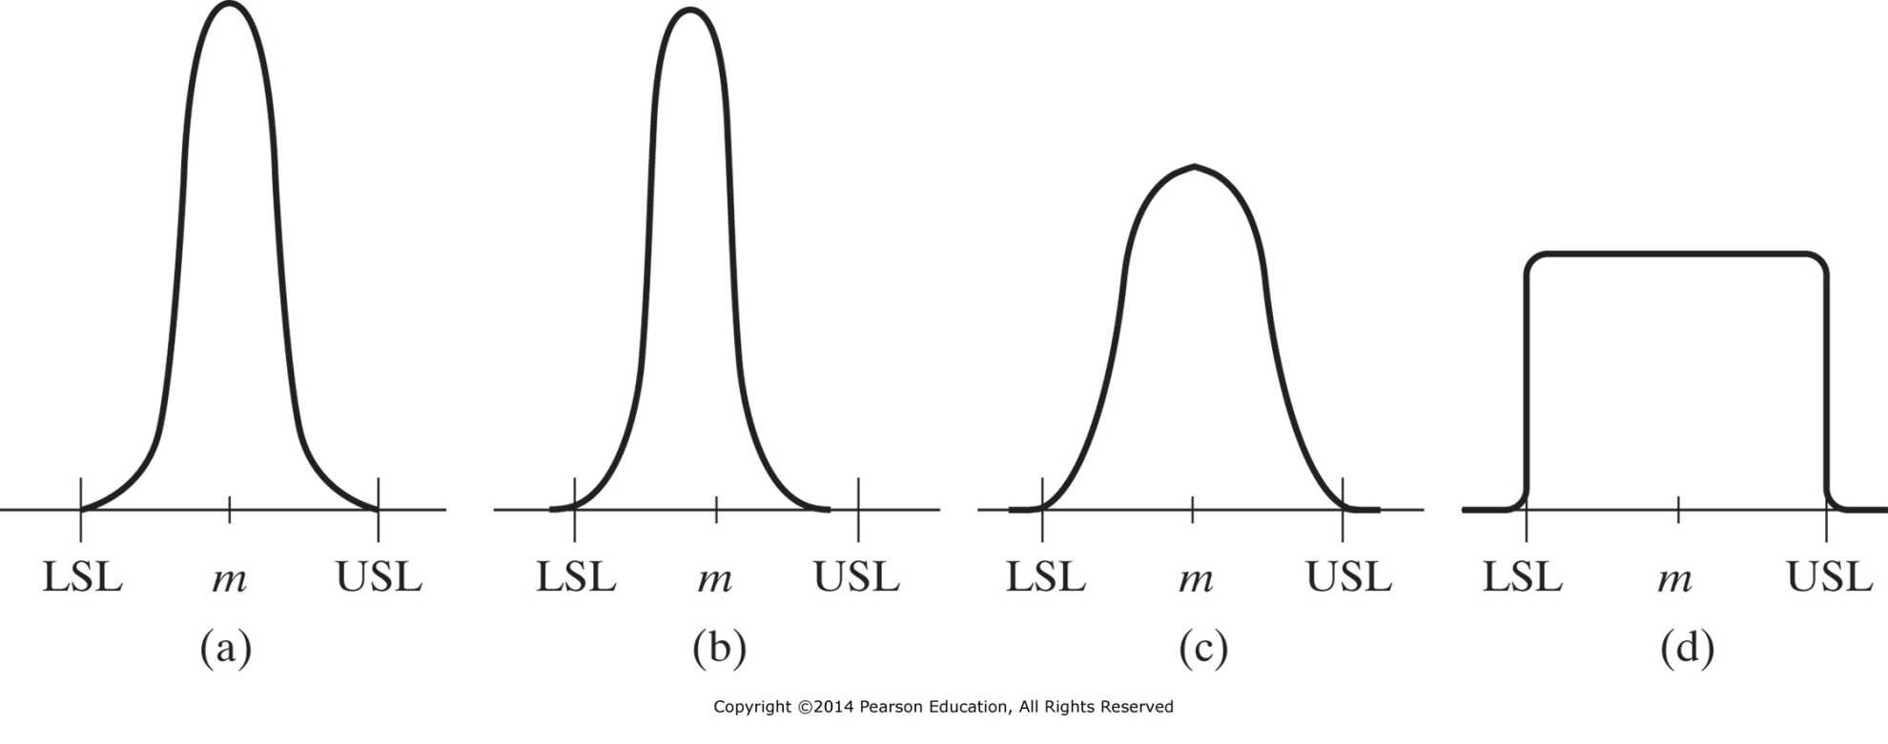
Figure 12-3 Four distributions of a quality characteristic in terms of the upper and lower specification limits (USL and LSL) and specification midpoint m.

Slide 29
Control Charts (HW 03)
Variables
  Continuous measures
    L, W, H, Dia.
    Viscosity
    Temperature
Attributes
  Discrete measures
    Defectives
      (no value)
    Defects
      (diminished value)
Variables Charts
  X-bar charts
    Location of dist. Center
  R- (or s-charts)
    Range (spread) of dist.
Attributes Charts
  Variable / Fixed sample size
    Defectives
      p-, np-charts
    Defects
      u-, c-charts

Slide 30
IENG 366
Engineering Management
Questions & Issues?

