Slide 1
IENG 366
Managing Product & Production Planning
Reading: pp. 250 – 275.

Slide 2
Product Planning

Slide 3
New Product Development Stages
Conceptual
Technical Feasibility or Concept Definition
Development
Commercial Validation
Production
Product Support
Disposal Stage

Slide 4
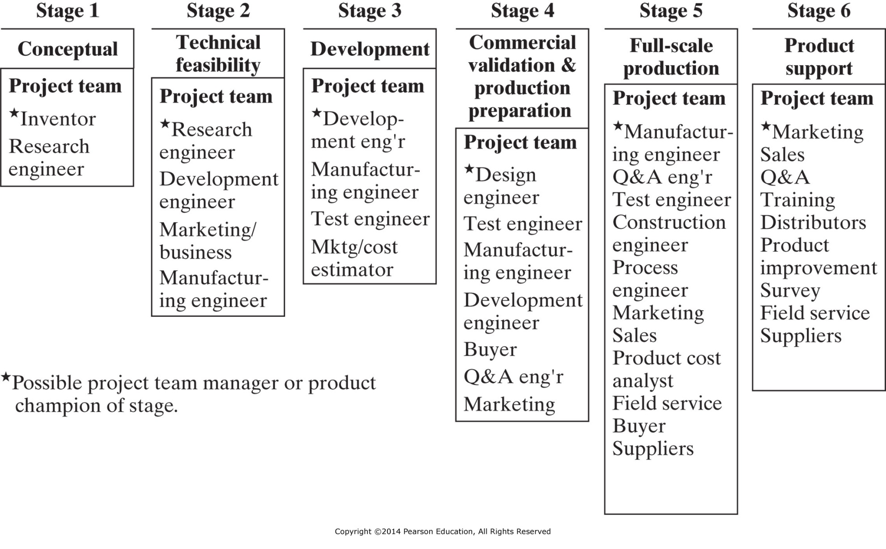
Figure 10-2 Formulation of a multispeciality project team designed to accomplish concurrent engineering in the stages of new product development. (From National Society of Professional Engineers, Engineering Stages of New Product Development, NSPE Publication #3018, Figure 22, p. 10.)

Slide 5
Concurrent Engineering
A set of methods, techniques, and practices, that:
Increases consideration within design phase of factors from later in cycle
Creates a design of processes
Facilitates a reduction of the time required to translate design into products
Enhances the ability to meet user’s needs

Slide 6
Special Considerations in Concurrent Design
Product Liability
Safety
Reliability
Maintainability
Availability
Ergonomics
Producibility

Slide 7
Product Liability
Designer foresees unlikely conditions
Risks are reduced to the greatest extent possible
Product contains adequate warnings
Meets user’s reasonable expectations of safety

Slide 8
Safety
Safeguards to Reduce or Eliminate Accidents Influenced By:
Design
Proven materials and components
Proven manufacturing methods
Clear instructions

Slide 9
Reliability
The probability that the product:
Will perform a specified function
Under specified conditions
For a stated period of time

Slide 10
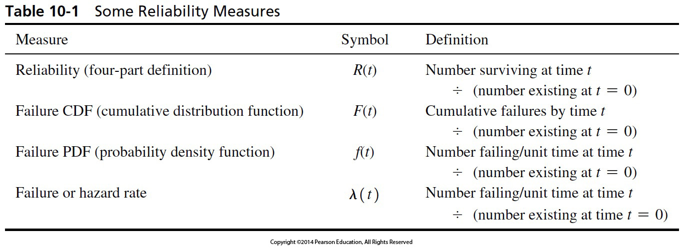
Reliability

Slide 11
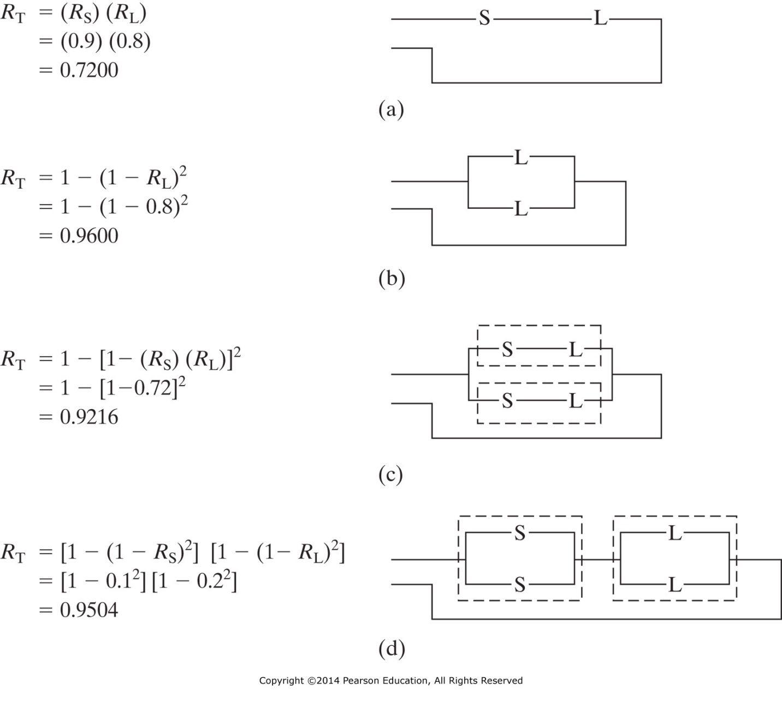
Figure 10-4 Simple reliability models: (a) series; (b) simple parallel; (c) series in parallel; (d) parallel in series. S, switch; L, lamp; R_{T}, total system reliability; dashed “boxes” indicate subsystems analyzed within [] in calculation.

Slide 12
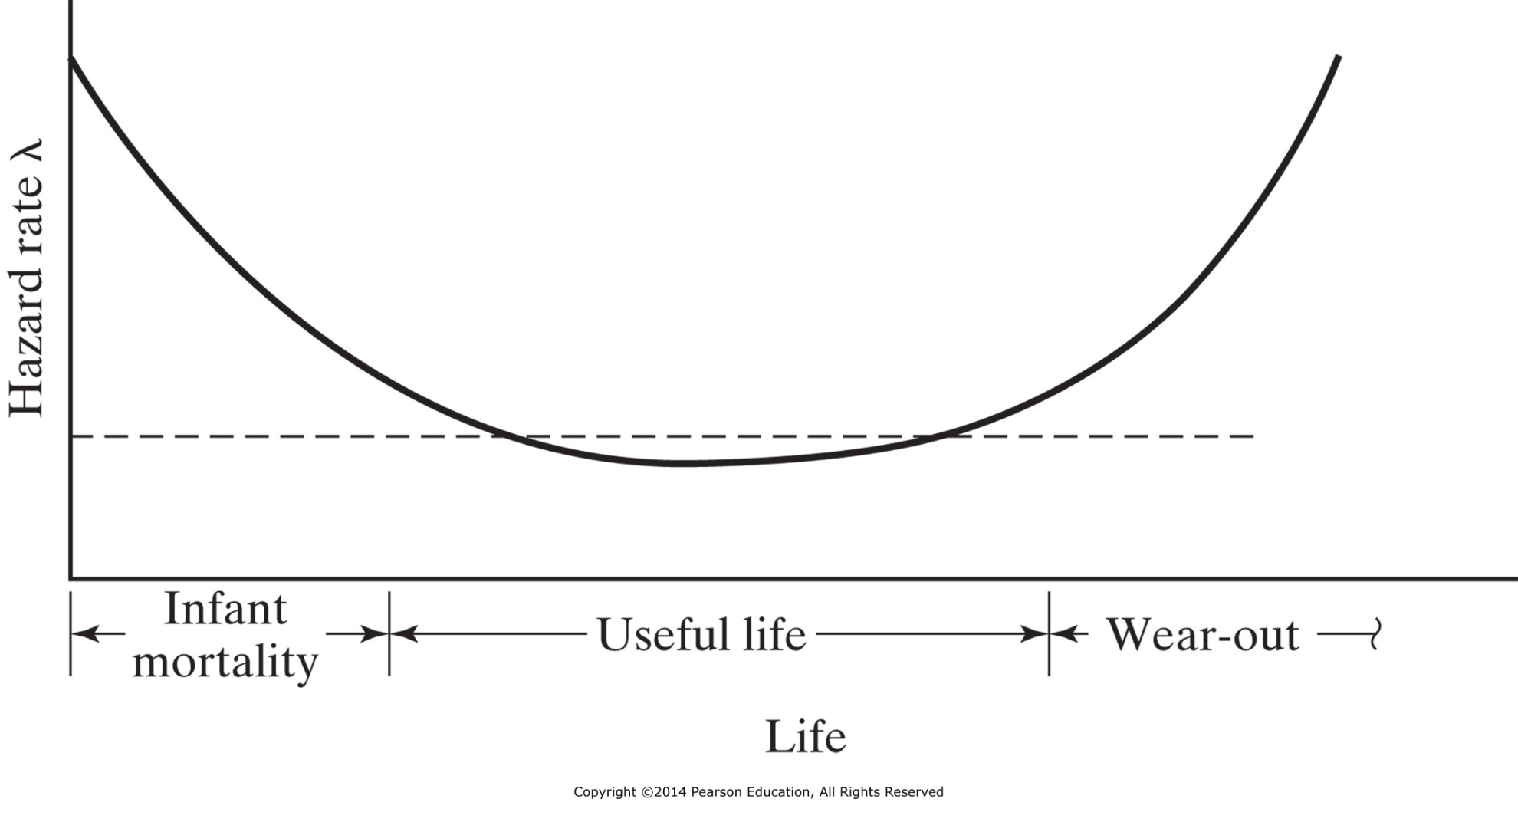
Figure 10-5 The bathtub curve.

Slide 13
Reliability
Reliability is a measure of how often a system fails:
How long (on average) you can run it until it stops working right
How do you know that it’s not working right?
MTTF (Mean Time To Failure) or
MTBF (Mean Time Between Failures)

Slide 14
Maintainability
Maintainability is a measure of how long it takes to return a system to proper operation:
Sum of the times required to:
diagnose the problem
obtain repair parts / tools
repair the failed components
return the unit to operating conditions
MTTR (Mean Time To Repair)

Slide 15
Availability
Availability is a function of Reliability and Maintainability:
It is the percentage of time that you can count on using it for production
% Availability = MTTF
MTTF + MTTR

Slide 16
Ergonomics
Human Factors Engineering
Science of designing machines, products, and systems to maximize the safety, comfort, and efficiency of the people who use them
One of primary goals is prevention of workplace injuries, illnesses, fatigue and accidents
May use simulations – replicas of workstations, aircraft, cars, trucks – and advanced sensors to collect data:
Physiological Effort
Cognitive Effort

Slide 17
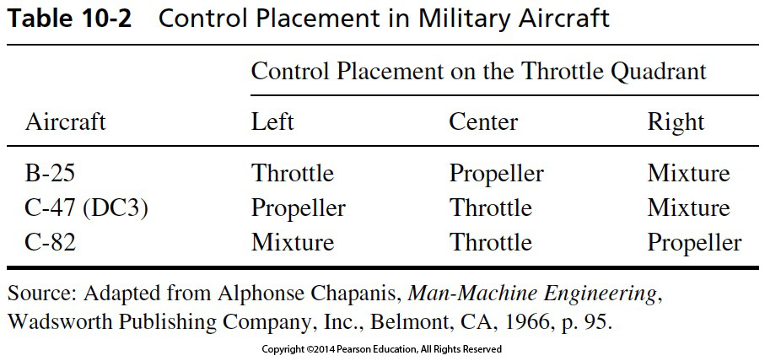
Table 10-2 Control Placement in Military Aircraft

Slide 18
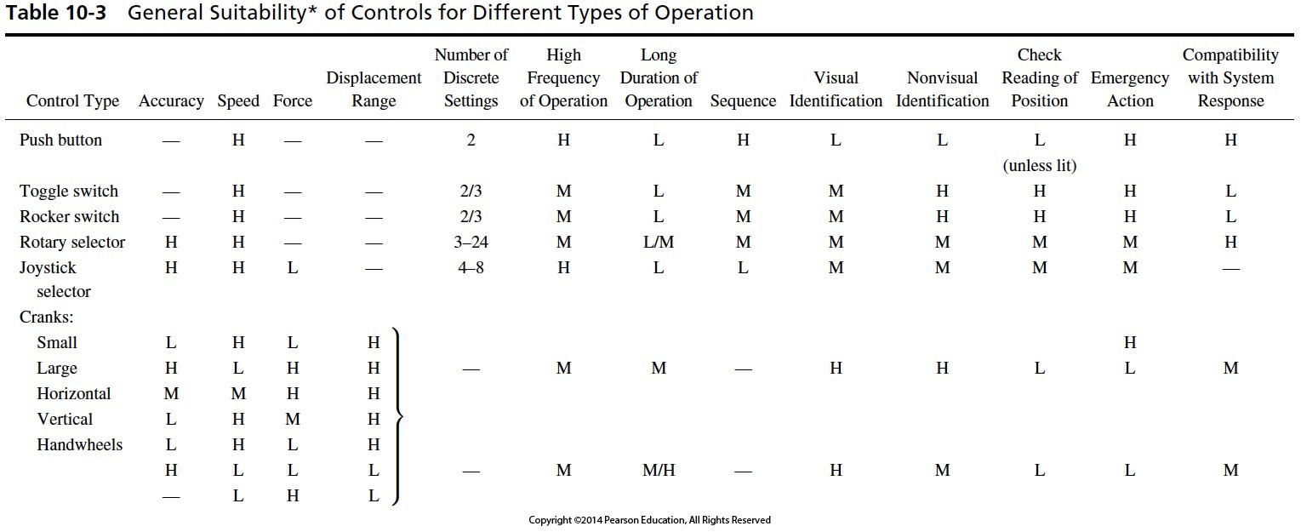
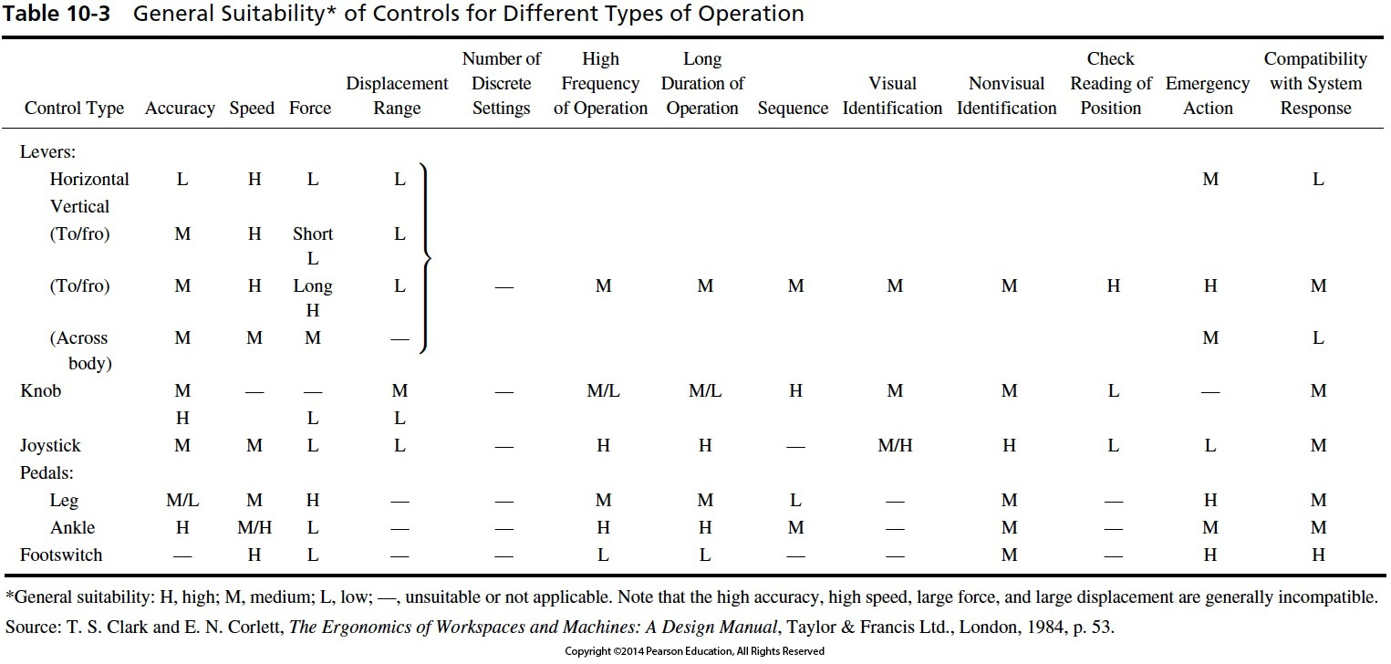

Slide 19
Production Planning
Activities involved in estimating and predicting how the product and the production system will be designed to meet the anticipated production quantities, quality, and profitability.

Slide 20
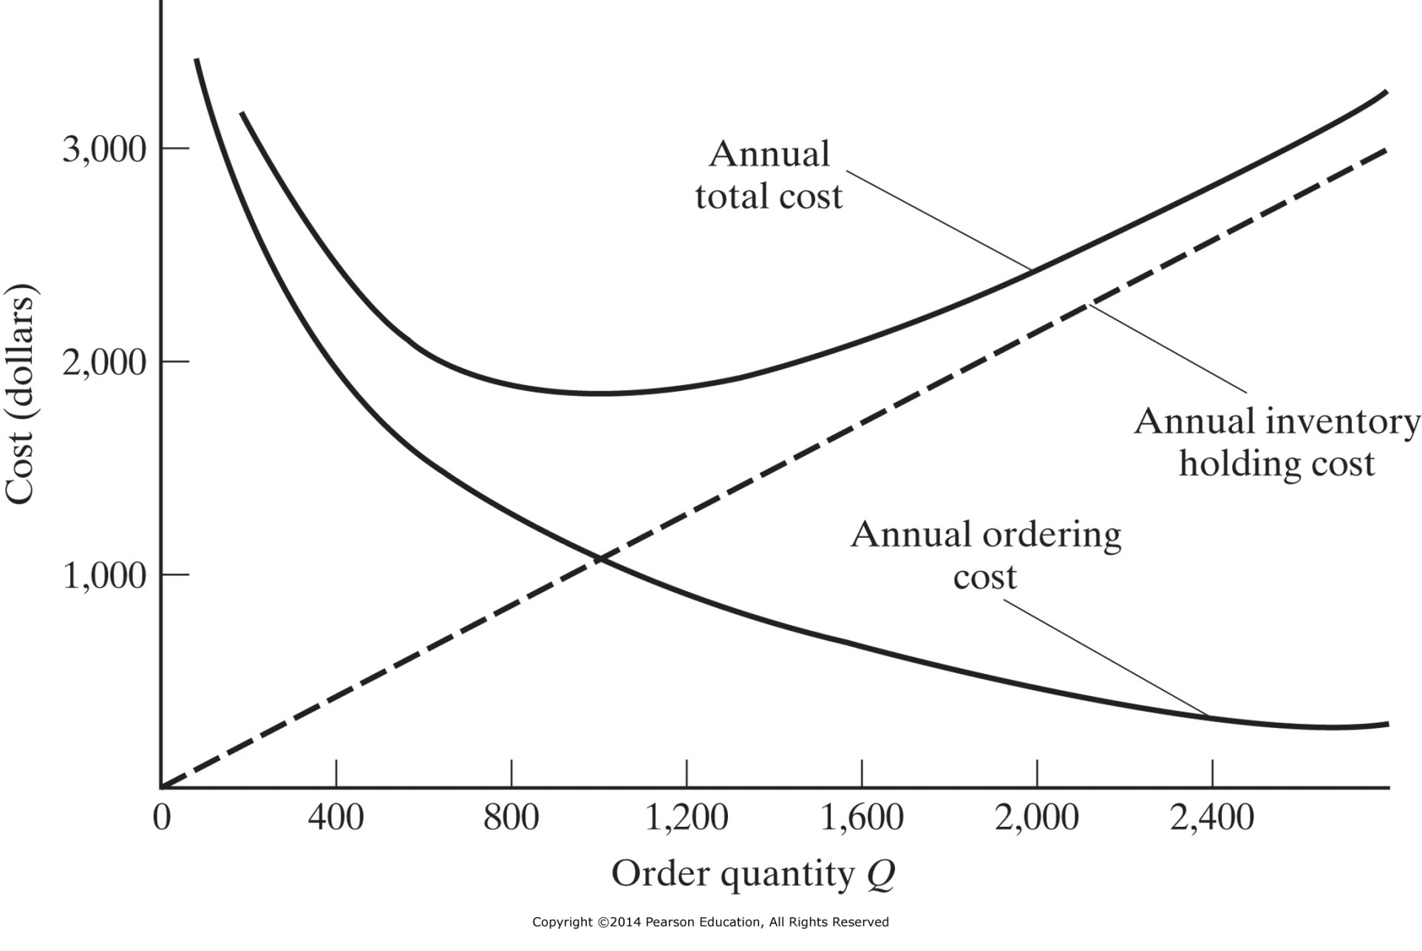
Figure 11-3 Economic order quantity.

Slide 21
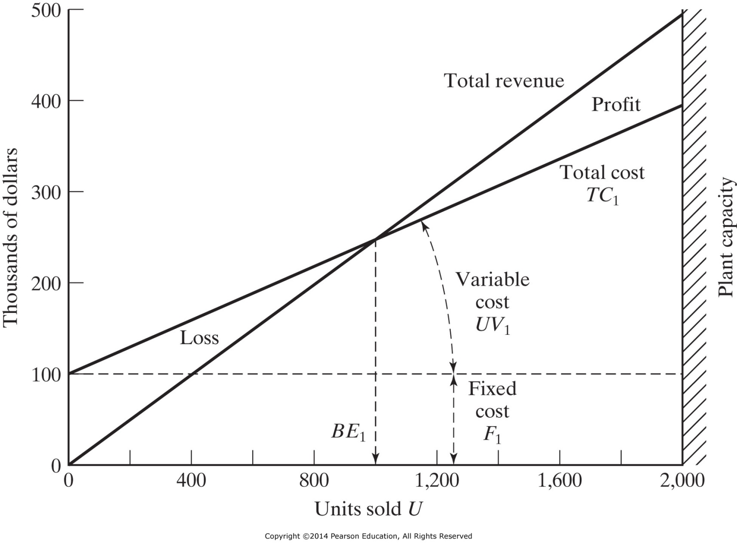
Figure 11-4 Break-even chart.

Slide 22
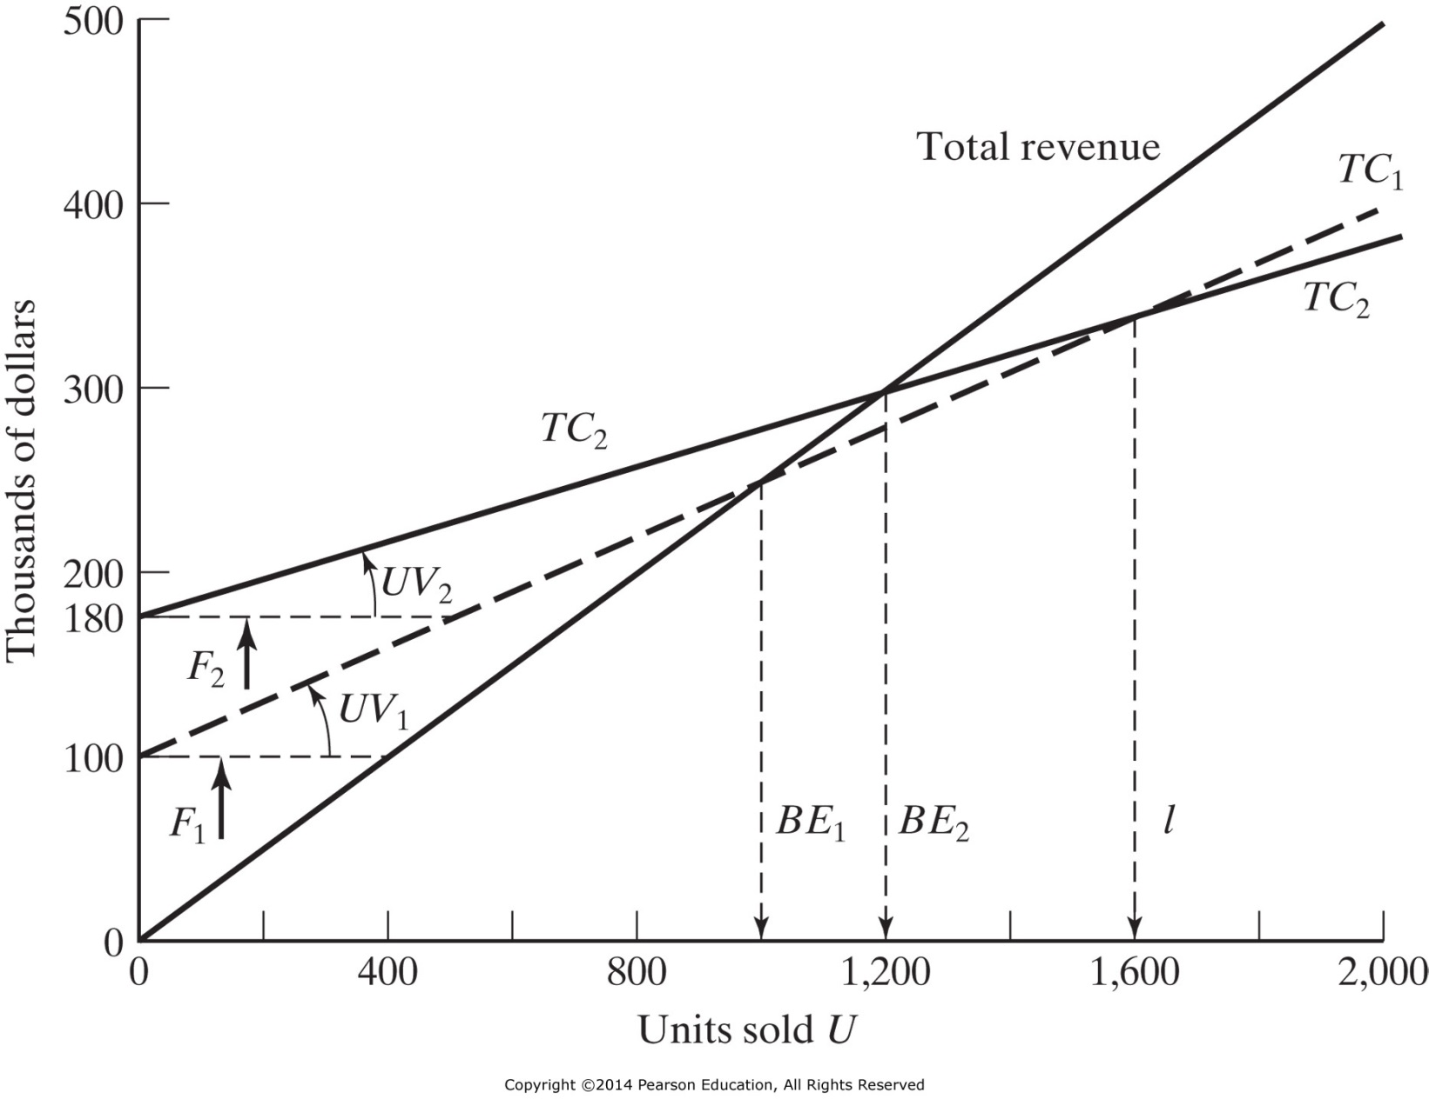
Figure 11-5 Break-even chart showing the effect of automation.
Increased Automation Profits
Δ BE
Lowered Automation Variable Costs
Incremental Automation Fixed Costs

Slide 23
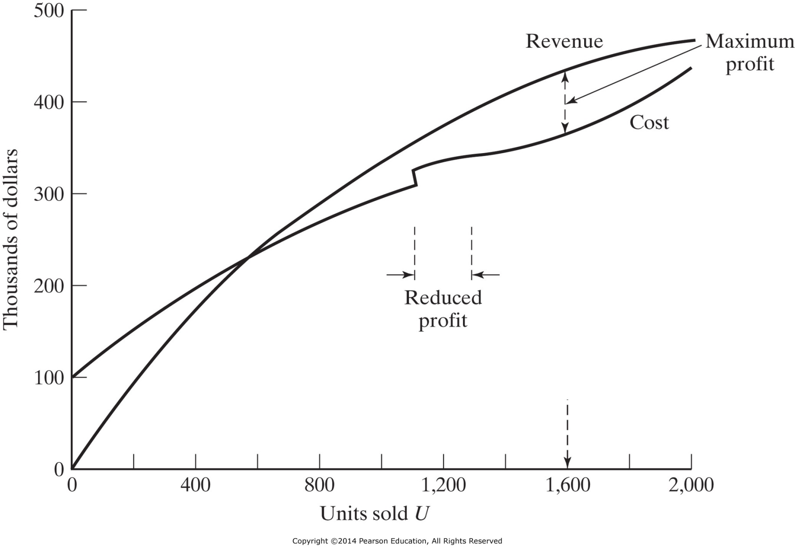
Figure 11-6 A more realistic break-even chart.

Slide 24
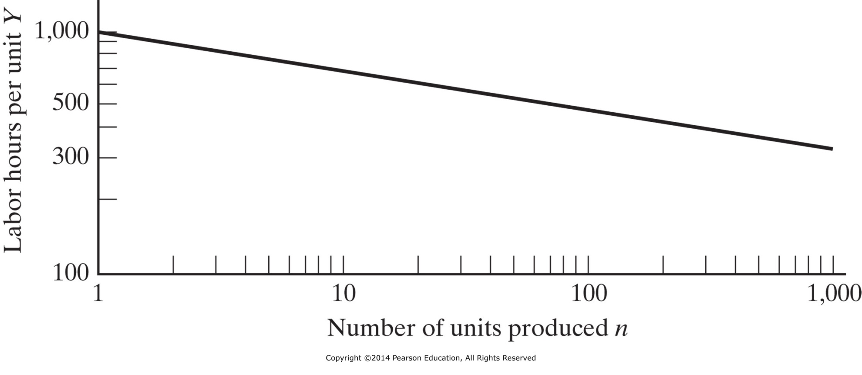
Figure 11-7 A 90 percent learning curve.
$Y_{n}$=$Y_{1}n^{−b}$
$ln Y_{n}$= $ln Y_{1}−b ln n$
Solving for $b, set k=0.90 and n=2:$
$$\frac{Y_{2}}{Y_{1}}=k= 2^{−b}$$
$ln (0.90)$= $ln \left(1\right)−b ln \left(2\right);$
$$b= \frac{−ln⁡(0.90)}{ln⁡(2)}=0.152$$
If the first unit takes 1000 minutes to produce, then the second takes 900 minutes, and the fourth takes 810 minutes, … because the operator learns how to make it at a 90% rate of improvement.
Actual learning also has a forgetting effect when production stops (red lines), so the effect is averaged (black line).

Slide 25
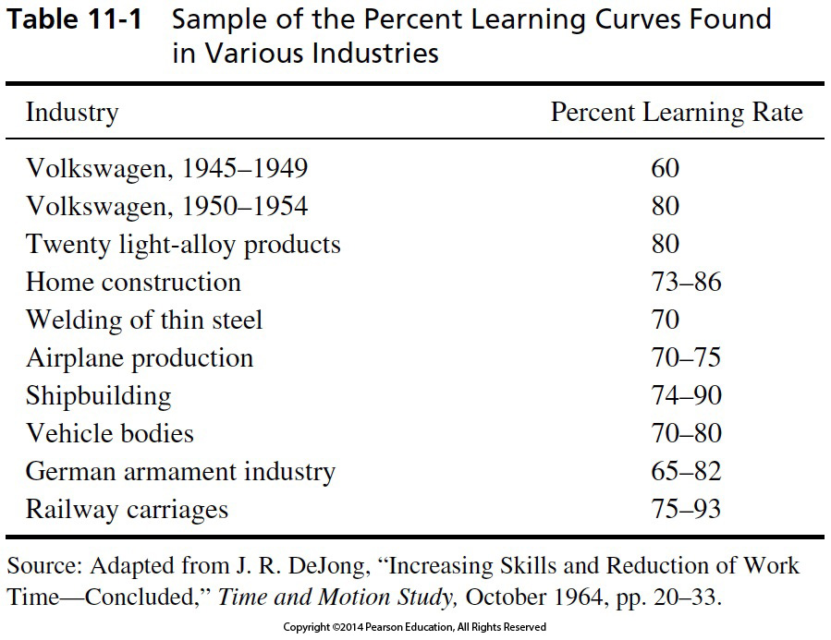

Slide 26
Layout Planning
Comprises all activities involved in selection for and transportation routes among departments, processes, work centers, machines, and service functions.

Slide 27
Planning Manufacturing Facilities
Area Selection
Location of markets
Location of materials
Transportation facilities
Labor supply
Location of other plants and warehouses
Community Selection
Managerial preferences
Community facilities
Community attitudes
Community, government and taxation
Financial inducements
Site Selection
Size of site
Topography
Utilities
Waste Disposal
Transportation facilities
Land costs

Slide 28
Common Errors in Facility Location Analysis
Labor cost miscalculations
Inadequate labor reservoir
Lack of distribution outlets
Underestimated importance of taxes
Purchasing unsuitable building

Slide 29
Objectives of Layout Planning
Minimize materials-handling costs
Reduce congestion of personnel and material
Increase safety of personnel
Increase labor efficiency
Facilitate communication and coordination
Provide operations flexibility
Improve morale
Increase quality of working life

Slide 30
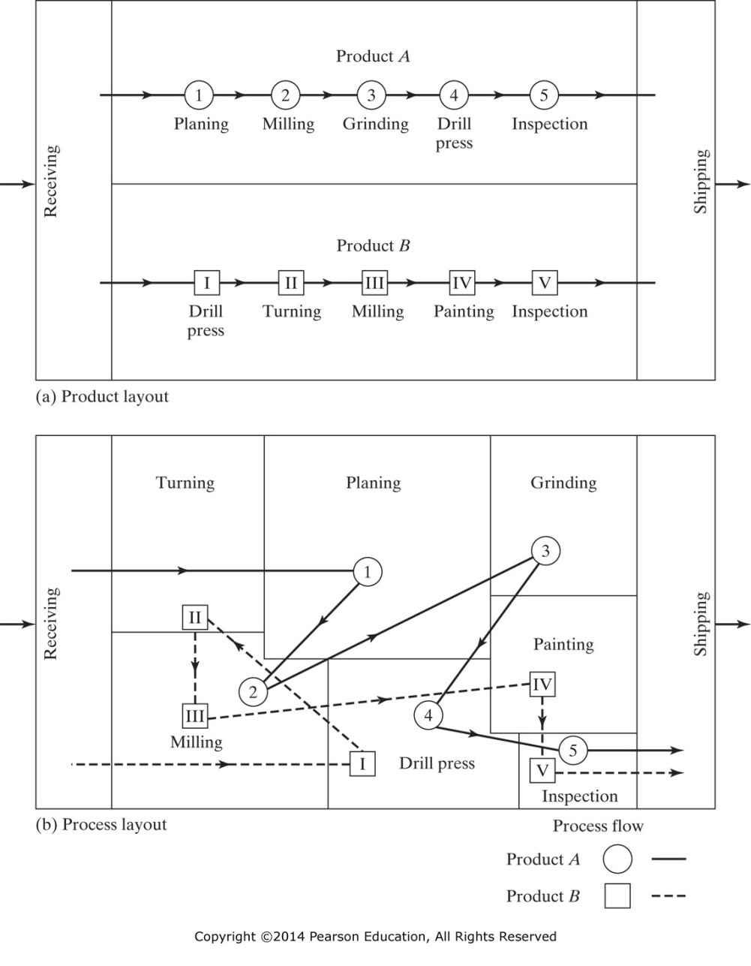
Figure 11-2 Schematic representations of (a) product and (b) process layouts. (From Arthur C. Laufer, Production and Operations Management, 3rd ed., South-Western Publishing Company, Cincinnati, OH, 1984, pp. 232–233).

Slide 31
Facilities Planning: Job Shop Layout
Drill
Grind
H. Mill
H. Mill
Drill
Grind
H. Mill
H. Mill
Drill
V. Mill
V. Mill
Drill
CMM
V. Mill
V. Mill
Receiving
Lathe
Lathe
L. Paint
Oven
Lathe
Lathe
P. Paint
Shipping

Slide 32
Facilities Planning: Mass Production Layout
V. Mill
H. Mill
Drill
Drill
Grind
Lathe
CMM
Receiving
L. Paint
Oven
Shipping

Slide 33
Facilities Planning: Group Technology Layout
V. Mill
Grind
Drill
Drill
Grind
H. Mill
Lathe
Drill
CMM
Receiving
L. Paint
Oven
Shipping

Slide 34
Group Technology: Relationship (Incidence) Matrix
How to Identify Families – Incidence Matrix
Rows and Columns:
Parts requiring operations on different machines
Tools (in a CNC magazine) needed to produce part families
Departments requiring technicians (shared head count)
Departments requiring adjacent location
Integrated Circuits requiring modularization
An entry in the incidence matrix means that there is a strong relationship between the row and column items

Slide 35
Group Technology: Incidence Matrix
Rows represent Operations (index = i)
Columns represent Components (index = j)
Cell Entries are: (M _{i j} )
1 (or mark) - if the component requires the operation
0 (or blank) - if the component does NOT require the operation
 | A-112 | A-115
Saw01 | 1
Lathe01
Lathe02 | 1
Drill01 |  | 1
Mill02 |  | 1
Mill05
Grind05 | 1

Slide 36
Group Technology: Solution Methods
Requirements:
Need for grouping similar items together, and identifying separable items
Incidence Matrix: of related entities
Tooling
Equipment
Parts
Integrated Circuits
Modular Components
Solution Method: Matrix Triangularization
King’s Algorithm* * method implemented for this class
Direct Clustering Algorithm
Kusiak’s Triangularization Method
Ullman’s Design Structure Matrix

Slide 37
Group Technology: Partitioning
Ideally, the cells form mutually exclusive blocks (as below). These blocks define the families:
Family A consists of Components A1, A3, A4, A5, A8, and A9; which can be machined in a cell performing Operations G05, L01, L02, and S01
Family B consists of Components A0, A2, A6, and A7; which can be machined in a cell performing Operations D01, G06, M02, and M05
 | A4 | A3 | A5 | A8 | A9 | A1 | A2 | A6 | A7 | A0
L01 | 1
G05 |  |  |  |  |  | 1
L02 |  | 1 | 1 | 1 | 1 | 1
S01 | 1 | 1 | 1 | 1 | 1 | 1
M02 |  |  |  |  |  |  | 1
G06 |  |  |  |  |  |  |  |  |  | 1
D01 |  |  |  |  |  |  | 1 |  |  | 1
M05 |  |  |  |  |  |  |  | 1 | 1 | 1

Slide 38
IENG 366 Engineering Management
Questions & Issues?

