Slide 1
IENG 366
Managing Research & Development
Reading: pp. 222 – 275.

Slide 2
RESEARCH & Development

Slide 3
R & D: Definitions
Research
Both basic and applied, is systematic, intensive study directed toward fuller scientific knowledge of the subject studied.
Basic Research
Devoted to achieving a fuller knowledge or understanding, rather than practical application, of the subject under study … it may be in fields of present or potential interest to a company.
Typically done by governments and research universities
Applied Research
Directed toward the practical application of knowledge, which of industry means the discovery of new knowledge that has specific commercial objectives with respect to either products of processes.
Typically be done by corporations, industry organizations, and universities
Development
The systematic use of scientific knowledge directed toward the production of useful materials, devices, systems, or methods, including design and development of prototypes and processes.
National Science Foundation

Slide 4
Product Life Cycle
B.S. Blanchard

Slide 5
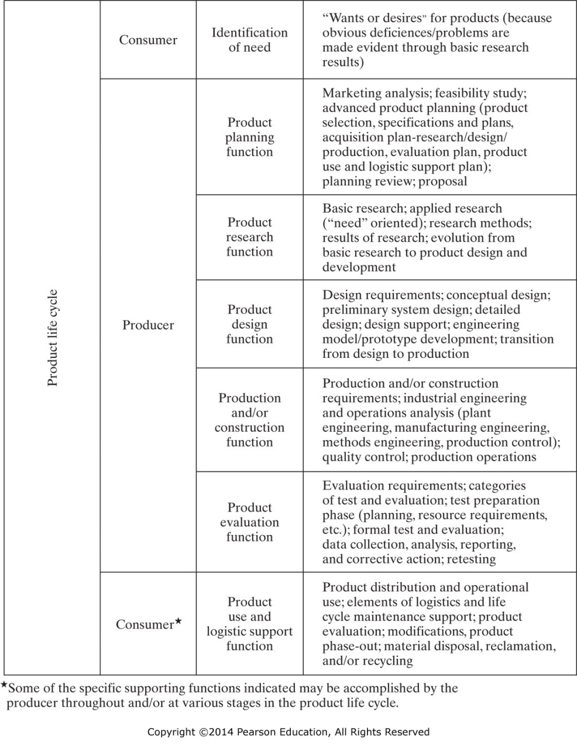
Figure 9-1 Steps or functions and typical activities in the product life cycle. (From Benjamin S. Blanchard, Engineering Organization and Management, © 1976, p. 16..)

Slide 6
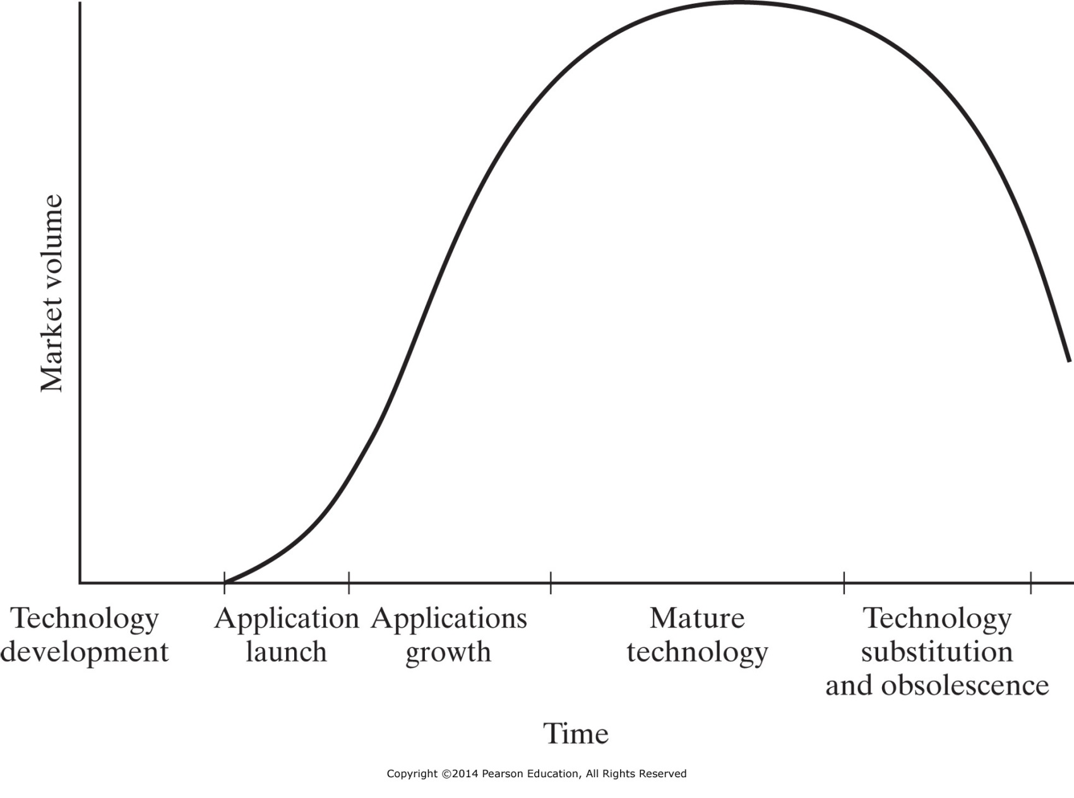
Figure 9-2 Technology life cycle. (From Frederick Betz, Managing Technology: Competing Through New Ventures, Innovation, and Corporate Research, 1987, pp. 72–74.)

Slide 7
R & D: New Product Strategies
First-to-Market
Typically demands major research expenditures
Typically demands heavy development expenditures
May require large marketing expenditures
Has tremendous possibilities for rewards
Follow-the-Leader
Does NOT require major research effort
Does demand high engineering development efforts
Goal is to wait for a competitor to find research success, then firm joins the race and tries to beat the competitor to market
Me-Too
Does NOT have ANY research effort
Does NOT have ANY development effort
Strategy is to copy designs from others, buying or leasing the needed technology
Concentrates on being the absolute minimum-cost producer
Requires maintaining the lowest possible overhead
Application Engineering
Takes an established product and produces it in forms particularly well suited to customer needs
Requires no research and little development effort
Requires a good deal of effort to understand customer needs
Requires flexibility in production capabilities

Slide 8
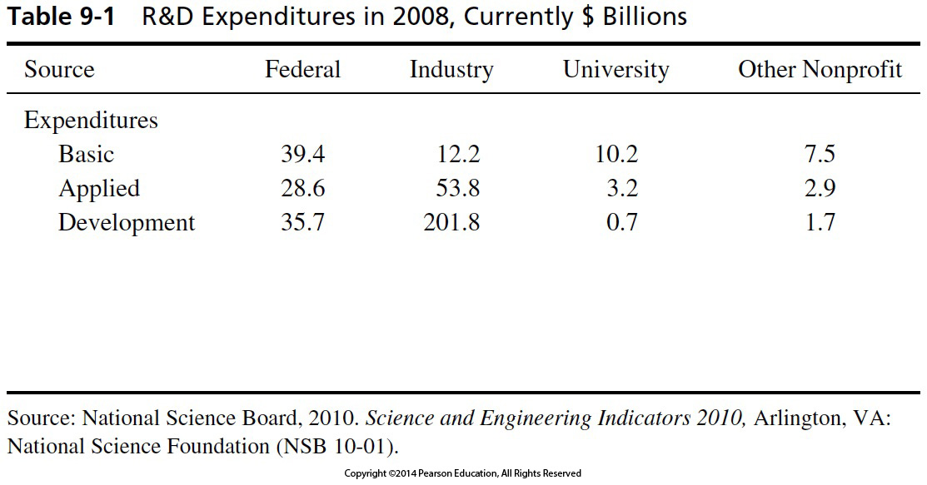
R & D: Relative Expenditure Levels

Slide 9
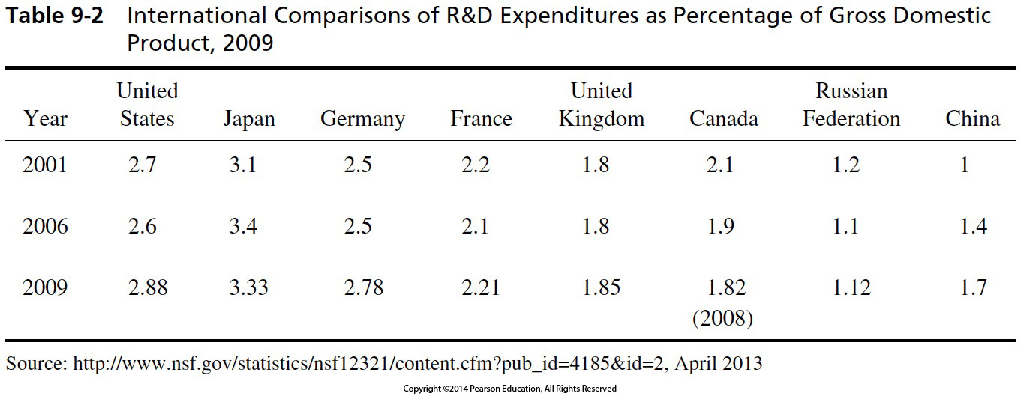
R & D: National Investment Levels

Slide 10
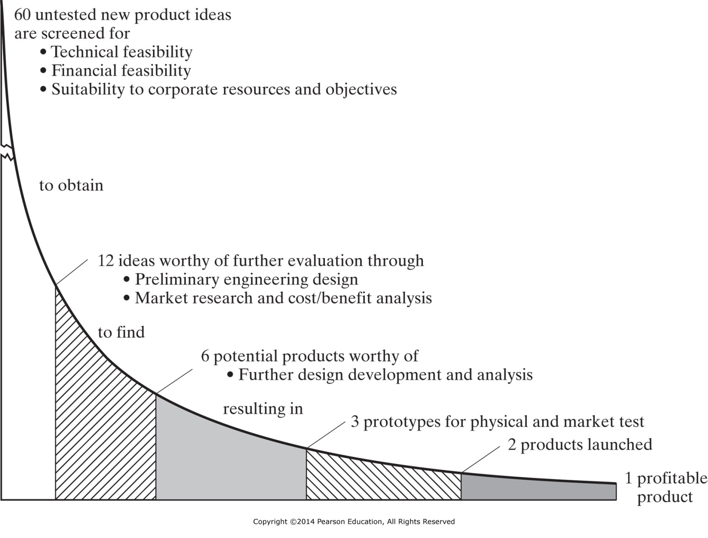
Figure 9-3 Screening of research project ideas.

Slide 11
R & D: Screening Projects
Review of Engineering Economic Analysis:
Simple Payback Time
Does NOT account for the time value of money
Payback must occur within company standards
Net Present Worth
DOES account for the time value of money
Establish a Minimum Attractive Return Rate (MARR = i in calculations)
Take all cash flows back to present
Positive NPW means the project IS feasible
All projects must have same lifetime in order to compare NPWs, though
Annual Worth
DOES account for the time value of money
Establish MARR , compute NPW, and check for feasibility
Convert NPW to Annual Worth for comparison (Projects do NOT have to have the same lifetimes)
Time to Payback
DOES account for the time value of money
Establish MARR , compute NPW, and check for feasibility, Convert NPW to Annual Worth
Payback must occur within company standards
$$T_{PB}= \frac{I}{A}$$
$$T_{PB}= \frac{I}{AW}$$

Slide 12
R & D: Screening Projects
Sum of score from simple judgement scale for each item (below): (-2, -1, 0 , +1, +2)
Technical Factors
Availability of skills, facilities, and probability of technical success
Research Direction & Balance
Compatibility with research goals and desired research balance
Timing
With respect to market development relative to competition
Stability
Of the potential market with respect to economic change and difficulty of substitution
Position Factor
Relative to other products and raw materials
Market Growth Factors
Marketability and Compatibility
With existing goals, distribution methods, and customer make-up
Producability
Using current facilities and employees
Financial Factors
Required investment level and rate of return
Patentability
and need for continuing defensive research
R. E. Seiler

Slide 13
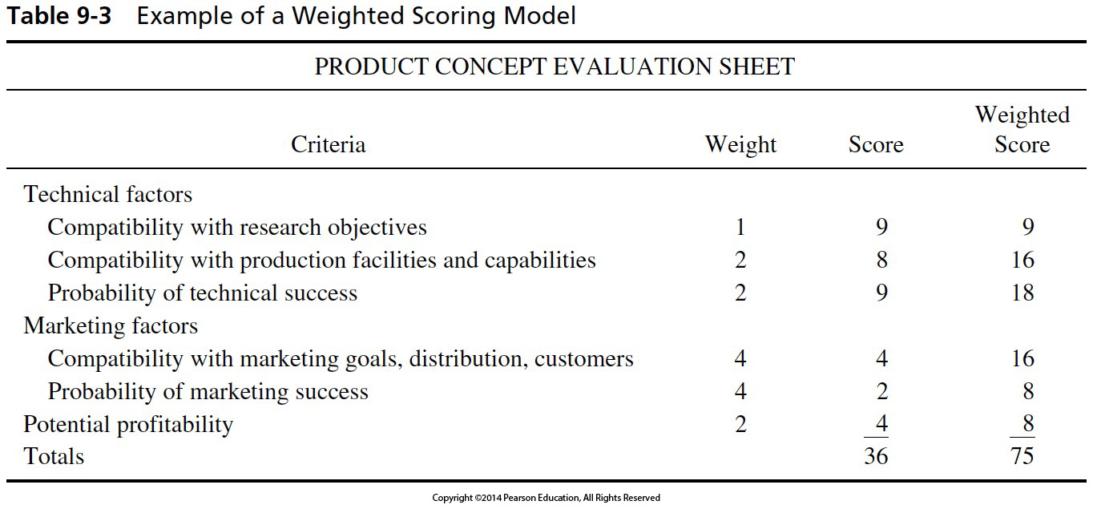
R & D: Screening Projects

Slide 14
INTELLECTUAL PROPERTY

Slide 15
Intellectual Property (IP)
Ideas and Inventions (products of the mind)
Patents, Copyrights and Trademarks are methods of protecting intellectual property.
Lawyers in this field are referred to as:
intellectual property lawyers,
patent lawyers,
patent agents,
patent attorneys, or
patent trolls
U.S. has joined the rest of the world by moving from “first to invent” to “first to file”, so protecting IP is vital!

Slide 16
IP Protection Types
Design Patents
Protection for a fixed design or “look” of an object
Duration: 14 years
Utility Patents
Protection for a composition of matter, a process, a method or an apparatus that is useful
Duration: 20 years
Plant Patents
Protection for new plants reproduced asexually (graft / clone)
Duration: 20 years
Three Primary Criteria for Grant of a Utility Patent:
Novelty
Usefulness
Non-obvious to someone “skilled in the art”

Slide 17
IP Protection Types
Trademarks
A distinguishing symbol, design, mark or word used by a manufacturer to identify his product from his competitors’
A mark, character or symbol by which another entity is recognized or associated
Duration: 10 years, can be renewed for additional 10 year terms
Copyrights
Protection for the right to reproduce, derive, distribute, perform, and display a creative work in tangible form
Duration: Life of author + 70 years
Trade Secrets
Protection for information that is secret, substantial and valuable; must not be generally known in the trade or industry to which it applies
Must be actively protected, often through limited disclosure and non-disclosure / confidentiality agreements
Duration: As long as it is not disclosed
May legally be “reverse engineered”

Slide 18
IP: Examples of Copyrights
Literary works
Musical works
Dramatic works
Choreographic works
Pictorial works
Motion Pictures/Videos
Sound Recordings
Computer Software

Slide 19
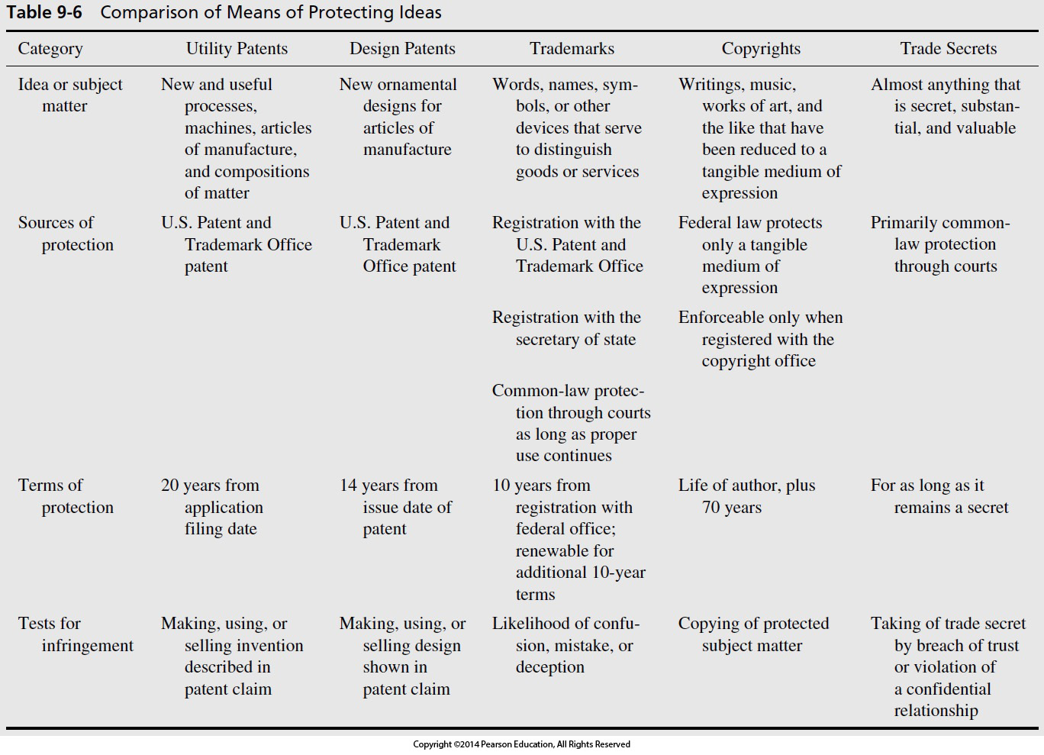

Slide 20
IP: Disclosure
Full, formal disclosure to Technology Transfer Manager
Bound laboratory notebooks with third party corroboration
Completion of Disclosure Checklist
Include drawings and sketches

Slide 21
Inventorship - Legal Aspects
Joint Inventorship is two or more persons who have contributed to the inventive acts of an invention
Group research often results in joint inventorship, however, it is critical to document evidence of joint inventorship in laboratory notebooks
Companies typically have their engineers sign an agreement specifying the ownership of the invention rights as a condition of employment

Slide 22
IP: Laboratory Notebooks - Legal Aspects
The best primary record of invention is a numbered, bound laboratory notebook
Pages skipped or not completely filled in by writing have a line drawn through the unwritten portion(s)
Contemplated or planned experiments are written out as precisely as possible, with results recorded as soon as they are obtained
Each page is initialed and dated by the person who directs the experiments
Each page is initialed and dated by the person who conducts the experiments
This creates a complete and timely record of the experimental work, in a manner which is legally recognized as “highly probative evidence”

Slide 23
IP: Diligence in Documentation
Record progress (or failure) using lab notebooks and project reports
At least once a month, all of the inventors and two technically competent witnesses should sign and date the entries
Always use actual dates... never backdate or predate
Make numbered, dated, comprehensive sketches and a written description of the concept
Sign and date all documents with the inventor and two witnesses who are:
not the inventor
fully understand the idea
expected to be around years later to testify in court, if necessary

Slide 24
IP: Patent Infringement
A patent is infringed when the invention covered by the patent is used without the permission of the inventor during the time that the patent is in force
The patent owner has the right to sue the infringer in the federal courts, collect compensation for past infringement, and can cause the infringer to cease and desist all infringing activity

Slide 25
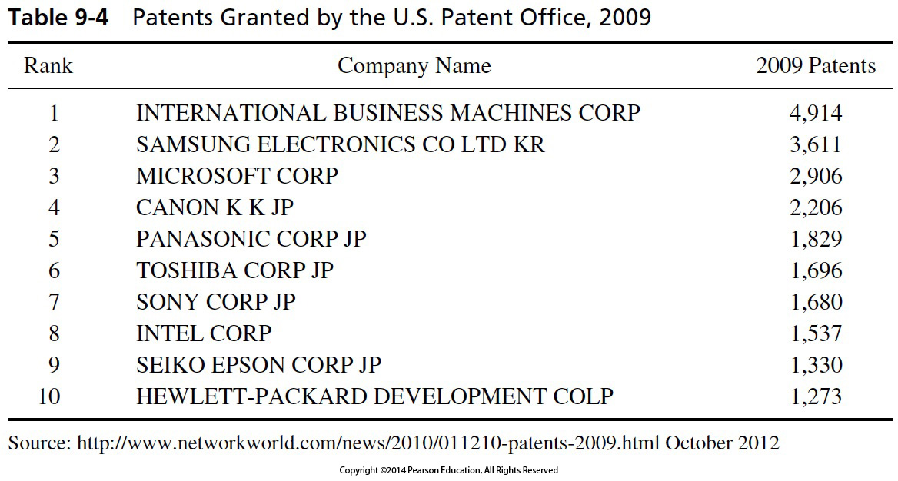
IP: Patent Productivity

Slide 26
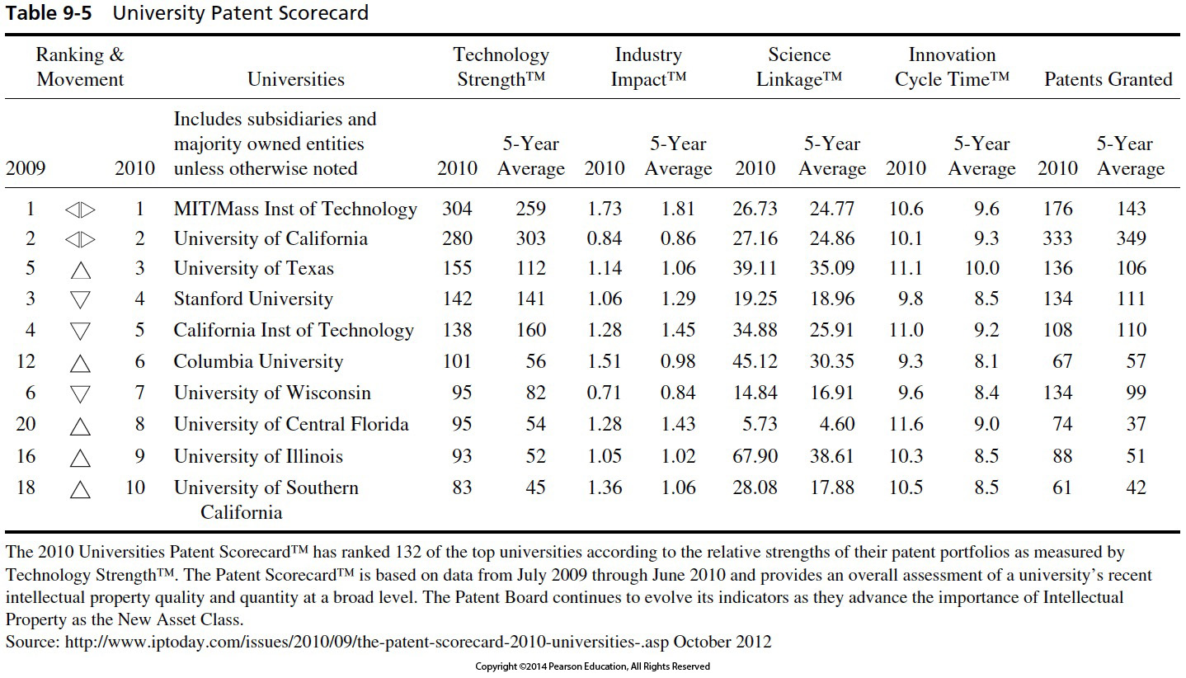
IP: Patent Productivity

Slide 27
IP: Protection Web Addresses
Patent Office - http://www.uspto.gov
Copyright - http://www.copyright.gov

Slide 28
Creativity

Slide 29
Creativity Process
R. E. Shannon’s (1980) steps in the creative process:
Preparation
Frustration
Inspiration or illumination
Verification
Edison (and others) took some exception:
“Genius is 1% inspiration and 99% perspiration”
“Inspiration is for amateurs. Professionals show up and get to work.”

Slide 30
Creativity Techniques
Brainstorming
Nominal Group Technique
Attribute-listing
Mindmapping
… and other methods (see text for some descriptions)

Slide 31
Characteristics of Creative People
Self-confidence and Independence
Curiosity
Different Approach to Problems
Personal: loners, game players, creative writers

Slide 32
Personnel Needed for Technological Innovation
Idea Generators – the creative individual
Entrepreneurs – undertakes effort to transform innovation into product
Gatekeepers – connect ideas, people, information – networkers
Program Managers – provide management without inhibiting
Sponsors or Champions – provides financial and moral support

Slide 33
IENG 366 Engineering Management
Questions & Issues?

