Slide 1
IENG 366
Controlling
Reading: pp. 194 – 218.

Slide 2
Controlling
“Compelling Events to Conform to Plans”.

Slide 3
Control: Closed Loop vs. Open Loop
Closed Loop
Automatic or cybernetic
Monitors or manages process by internal, self-regulating system
Essential feature is strong feedback system
Example: Home thermostat system
Open Loop
Requires external monitoring or agent to activate control
Example: Cruise control on an automobile

Slide 4
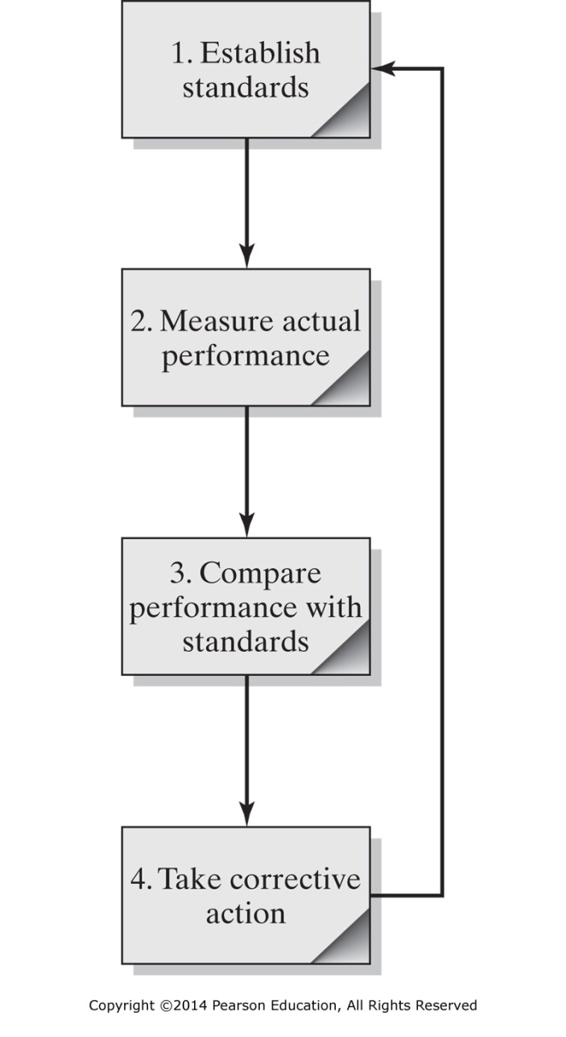
Figure 8-1 The control process.

Slide 5
Characteristics of Effective Control Systems
Effective
Efficient
Timely
Flexible
Understandable
Tailored
Highlight deviations
Lead to corrective actions

Slide 6
Financial
Human Resource
Social
Other
FOUR
Control: Three Types of Controls

Slide 7
Financial Controls

Slide 8
Financial Budgets:
Budgets are the plans for the future allocation and use of resources over a fixed period of time.
Budgets identify sources of cash and intended uses
Cash Budgets
Capital Expenditure Budgets
Balance Sheet Budget
Control: Budgets

Slide 9
Top Management
Estimates of future sales and production
Priorities used to meet new objectives
Middle Management
Prepares proposed revenue and expense budgets designed to attain estimated sales/production levels
Control: Budget Preparation

Slide 10
Financials: Three Major Statements
Balance Sheet
Shows the firm’s financial position at a particular instant in time
Source for assets and liabilities data for liquidity ratios
Income Statement
Shows financial performance of a firm over a period of time
Source for performance ratio data
Cash Flow
Shows where cash comes from and what it is used for
(Not available on our textbook example)
Control: Budgets

Slide 11
Balance Sheets
Allows us to quickly get handle on financial strength of company
Includes assets, liabilities, and stockholders’ equity
Assets – Anything business owns that has monetary value
Liabilities – Claims of creditors against the assets of the business
Equity – How much of the business’ value is owned by the stockholders
Control: Balance Sheets

Slide 12
Income Statement
Also called Profit and Loss Statement
Most used business report
Snapshot of money as it flows through business over specific period of time
Basic formula: revenues – expenses = income (or profit)
Control: Income Statements

Slide 13
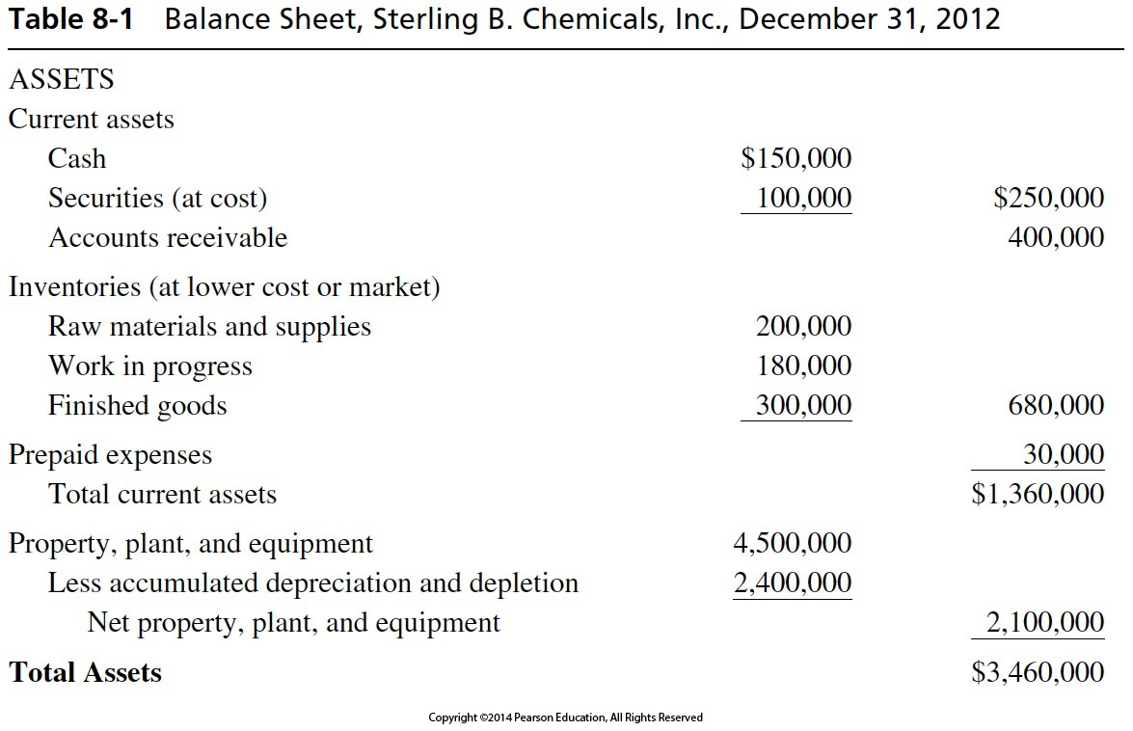
Table 8-1 Balance Sheet, Sterling B. Chemicals, Inc., Dec. 31, 2012

Slide 14
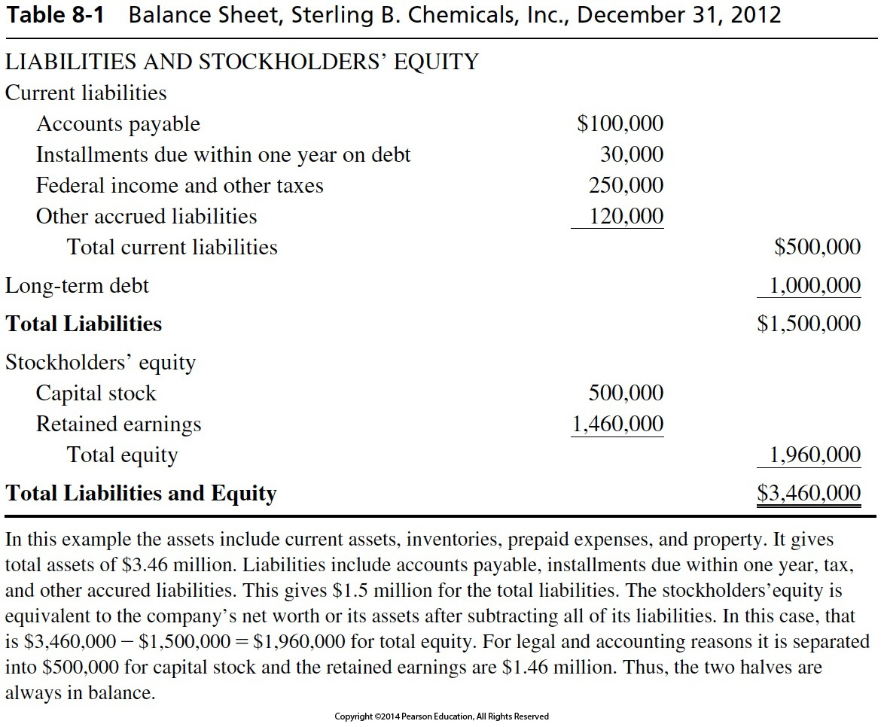

Slide 15
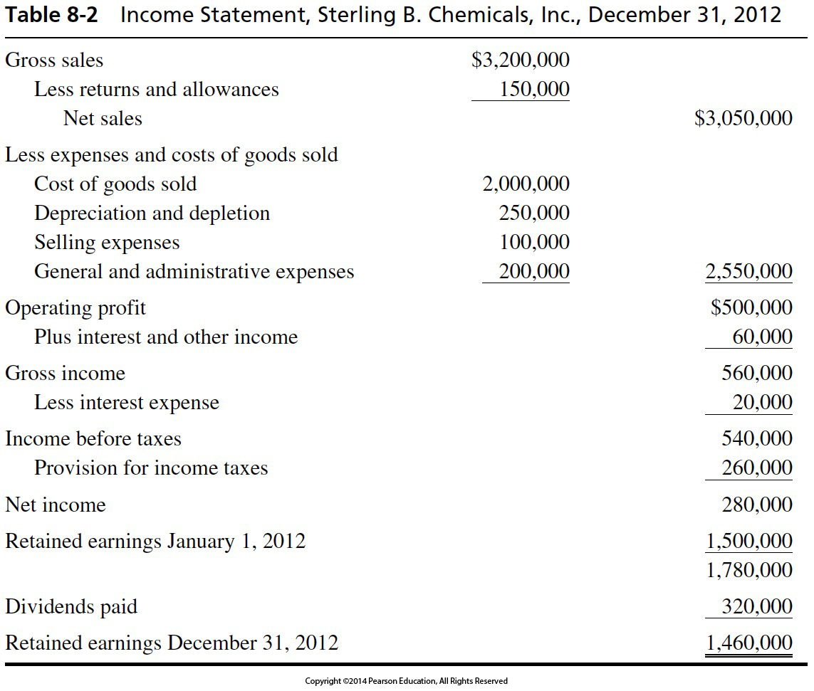

Slide 16
Ratios of two financial numbers, taken from the balance sheet and/or the income statement, and compared to industry averages
Four Types:
Liquidity: Measures ability to meet short term obligations
Leverage: Measures the level of debt in a firm’s financial structure
Activity: Measures how effectively a firm uses its resources
Profitability: Measures profit producing performance of firm
Control: Ratio Analysis

Slide 17
These numbers come from the Balance Sheet
Current Ratio is formulated to show how quick the firm can convert assets to cash within about a year
Acid Test Ratio is how much can be immediately converted to cash
Leverage Ratio is how much influence creditors have in how the company is run
Control: Liquidity & Leverage Ratios

Slide 18
These numbers come from Profit and Loss Statement
How much return we can expect on our investments
Inventory Turnover is how fast we convert sales to profit
Asset Turnover is how well we use assets to produce sales
Accounts Receivable Turnover is a leading indicator of how our firm’s market is doing
Profitability Ratio is a measure of Product Profit Margin
Control: Activity & Profitability Ratios

Slide 20
Cost Centers
Manager’s primary concern is control of costs
Revenue Center
Manager’s primary concern is attaining revenue target
Profit Center
Manager has more freedom to manipulate costs to increase profit
Control: Responsibility Centers

Slide 21
Periodically performed checks on the systems
Verify accuracy of firm’s financial data
May be internal or external
Internal audits also evaluate organizational efficiency
Control: Audits of Financial Data

Slide 22
Human Resources Accounting
Quantifies the value of human resources investment
Costs of recruiting
Costs of training
Costs of process improvement
Management Audits
Evaluate efficiency of management practices
Control: Non-Financial Controls

Slide 23
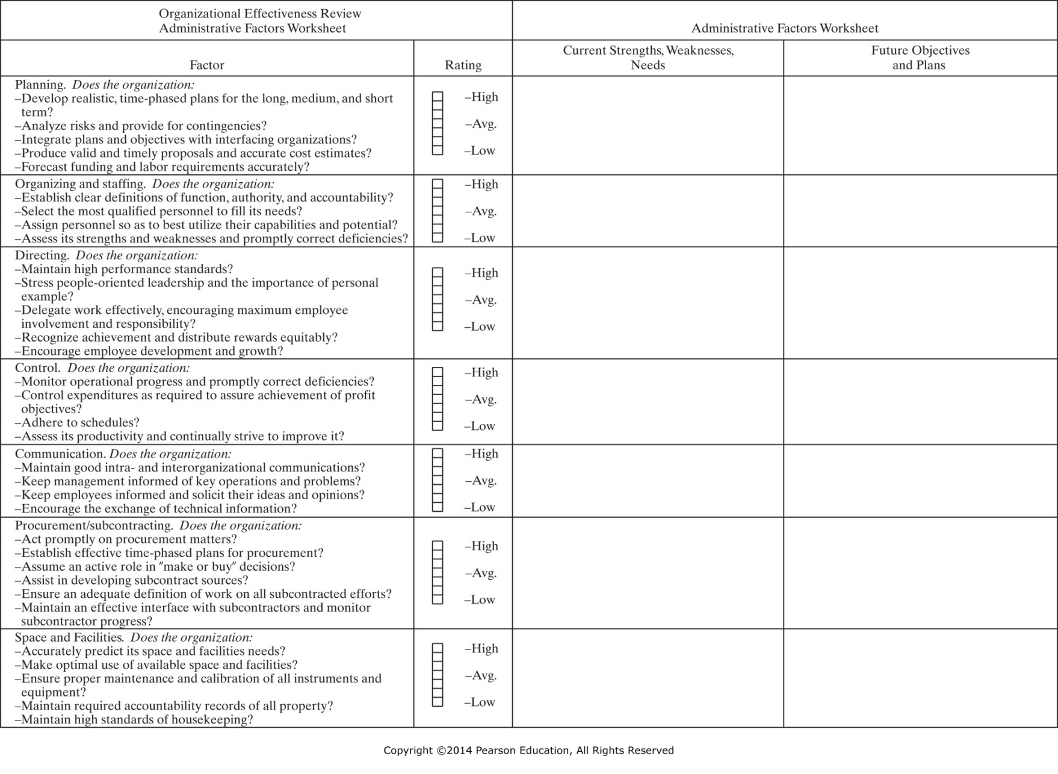
Figure 8-2 Management audit worksheet for administrative activities. (From R&D Productivity: Study Report, 2nd ed., Hughes Aircraft Company, EI Segundo, CA, 1978, pp. 26–27.)

Slide 24
Figure 8-2 Management audit worksheet for administrative activities. (From R&D Productivity: Study Report, 2nd ed., Hughes Aircraft Company, EI Segundo, CA, 1978, pp. 26–27.)

Slide 25
Social Controls
Need to give attention to culture and values
Define standards
Compare with outcomes
Take corrective action - promptly
Other Controls
(addressed later in the text)
Effectiveness of research activities
Systems for release of drawings
Inventory control
Quality control
Control: Non-Financial Controls

Slide 26
IENG 366 Engineering Management
Questions & Issues?

