Slide 1
IENG 366
Human Aspects of Organizing
Reading: pp. 173 – 183.

Slide 2
STAFFing
… is finding, attracting and keeping personnel of the quality and in the quantity needed to meet the organization’s goals.

Slide 3
Staffing Technical Organizations
Managerial Process of Staffing
Identify the Skill Base
Estimate the Number of Personnel
Justify and Requisition the Personnel
Plan Recruiting Strategies & Policies
Select the Best Applicants
Orient and Train Applicants
Evaluate Performance
Provide Compensation

Slide 4
Staffing: New Hires
Adding Staff:
Establish the need for new hires
Starting point is assessing what you already have
Mid-point is foreseeing what you will need
End-point is justifying & requisitioning what you will get
Determine sources (and proportions) for new hires
New college graduates
Experienced professionals
Technician support
Other sources
Increase = (Need) – (Personnel on Hand) + (Attrition)

Slide 5
Table 7-1 Example of Job Description/Requisition

Slide 6
Typically several steps in a filtering process:
Selecting appropriate posting sites
Review of applications and resumes
Initial interviews
Reference checks
Initial screening of candidates
On-site / formal interviews
Selection & position / salary offer
Staffing: H.R. Process of Recruitment

Slide 7
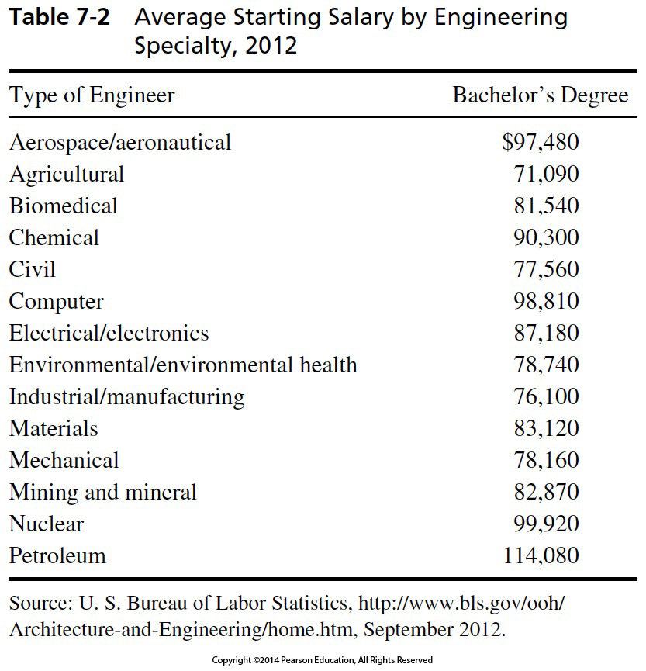
Table 7-2 Average Starting Salary by Engineering Specialty, 2012
Median
2015
$ 107 830
$ 75 090
$ 86 220
$ 97 630
$ 82 220
$ 111 730
$ 95 230
$ 84 560
$ 83 470
$ 91 310
$ 83 590
$ 94 040
$ 102 950
$ 129 990
2018
$ 115 220
$ 77 110
$ 88 550
$ 104 910
$ 86 640
$ 114 600
$ 99 070
$ 87 620
$ 87 040
$ 92 390
$ 87 370
$ 92 250
$ 107 600
$ 137 170
U.S. Mean
$ 38 640

Slide 8
Staffing: Employee Viewpoint
Job Application Process

Slide 9
Career Fair
Resume
Application
References
Correspondence
Career Fair
Initial Interview
Second Interview
Job Offer
Do the job …
Staffing: Employee Viewpoint

Slide 10
References
Separate page that complements resume – do not include with resume initially
Lists professional contacts who have direct knowledge of your skills and qualifications
References may include faculty, former employers, and internship supervisors
Obtain permission from references in advance and provide them with current resume
Staffing: Employee Viewpoint

Slide 11
Correspondence
Keep a copy of everything that you send out
Make sure there is an original signature on all the documents that you mail out
Close with a direct request for some type of action (Ex: interview, phone call, etc.)
Use high-quality stationery for hard copies
Staffing: Employee Viewpoint

Slide 12
Types of Correspondence
Cover letter types
Application
Prospecting/Letter of inquiry
Networking
Thank you letters
Letters of acceptance, withdrawal and rejection
Employment applications
E-mail correspondence
Staffing: Employee Viewpoint

Slide 13
Campus Interview
Graduating engineer typically makes contact with potential employers on campus
Successful campus interviews
Applicant learns about employment opportunities and other advantages with firm
Interviewer learns enough about the applicant
Staffing: Employee Viewpoint

Slide 14
Site (Plant) Visit
Means company has a substantial interest
Normally means three or four staff interviews
Usually includes a tour of the area in which the candidate will work
Normally includes a briefing on company benefit programs and general company policies
Staffing: Employee Viewpoint

Slide 15
The Job Offer
A formal letter offering specific position and identifies:
Salary
Reporting date
Position description and title
The supervisor the candidate reports to
Provisions regarding moving expenses (if applicable)
Staffing: Employee Viewpoint

Slide 16
Staffing: Employer Viewpoint
Job Application Process

Slide 17
Orientation and Training
Helps newcomer become aware of organization and values
Some companies:
Hold orientation classes
Rotate newcomers through short assignments in various key departments
Includes total socialization of newcomer to the environment and culture of the organization
Staffing: Employer Viewpoint

Slide 18
Appraising Performance
Provides feedback to the employee
Guidance on how to improve performance
Performance basis for rewards/promotions
Objective documentation for actions against non-performers
Staffing: Employer Viewpoint

Slide 19
Staffing: Employer Viewpoint

Slide 20
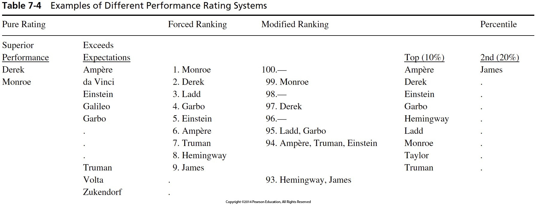
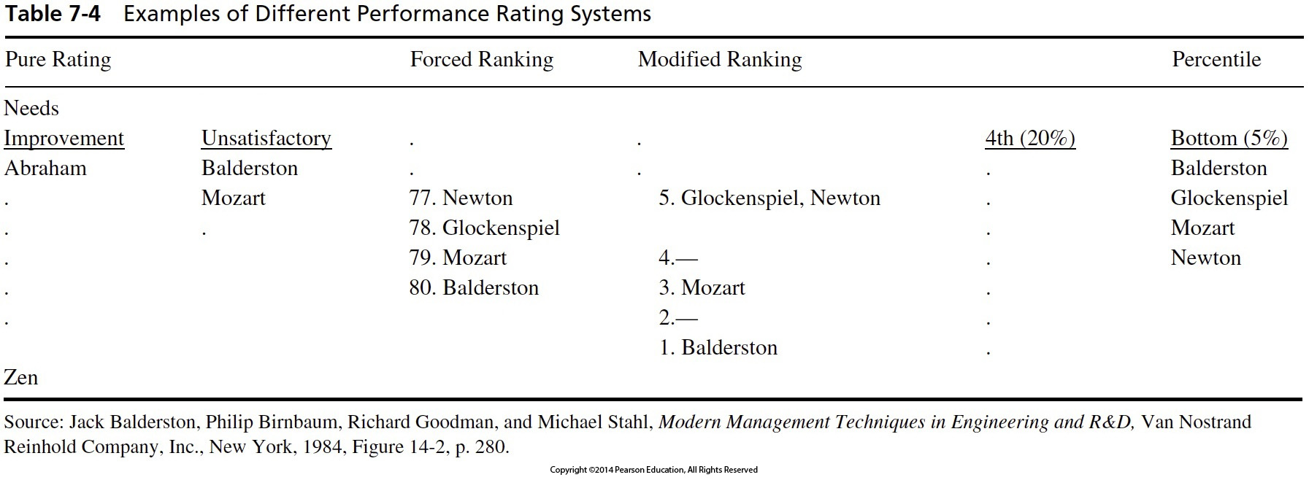
Staffing: Employer Viewpoint

Slide 21
Figure 7-2 Assignment, delegation, and accountability.
Delegating
Staffing: Employer Viewpoint

Slide 22
Levels of Delegation
Duties & Authority flow from the superior to the subordinate.
Accountability flows from the subordinate to the superior.
Levels of Delegation (higher is better) :
Act on own
Act, but advise at once
Recommend, then take resulting action
Ask what to do
Wait until told
Staffing: Employer Viewpoint

Slide 23
Authority and Power
Authority is a right – the legitimacy of which is based … on the position within the organization.
Power is the individual’s capacity to influence decisions.
Sources of power:
Legitimate or formal authority
Reward
Coercive
Expert
Referent
Staffing: Employer Viewpoint

Slide 24
Committees
Committees represent pooled power
Reasons for using committees:
Policy making / administration
Representation
Shared knowledge
Securing cooperation
Pooling of authority
Training of participants
Staffing: Employer Viewpoint

Slide 25
Effective Committees
Give considerable thought to:
Committee purpose and selection of the chair
Committee Size
Smaller is better – usually
Best results appear to come from 5 – 12 members
Preparation – agenda
Conduct of meeting
Meeting follow-up
Staffing: Employer Viewpoint

Slide 26
IENG 366 Engineering Management
Questions & Issues?

