Slide 1
IENG 366
Organizing
Reading: pp. 152 – 170.

Slide 2
ORGANIZing
… is (1) the identification and classification of required activities; (2) the grouping of activities necessary to attain objectives; (3) the assignment of each grouping to a manager with the authority necessary to supervise it; and (4) the provision for coordination horizontally … and vertically ... in the organization structure.

Slide 3
Organizing: Legal Forms
Sole Proprietorship
Partnership
Limited Partnership
Limited Liability Company
Corporation
Cooperative

Slide 4
Organizing: Legal Forms
Sole Proprietorship
Owner makes all decisions
Owner has unlimited liability for all business debts
Few legal restrictions
Profits are taxed only once
Taxation is on the individual tax schedule in U.S.

Slide 5
Organizing: Legal Forms
Partnership
Two or more partners
Partners have unlimited liability for partnership debts
Easy to organize
Profits are taxed only once per partner
Taxation is on the individual tax schedule in U.S.

Slide 6
Organizing: Legal Forms
Limited Partnership
At least one General Partner
General partner has unlimited liability for partnership debts
One or more Limited Partners
Limited partners have limited liability for partnership debts – up to the extent of their investment in the company
Profits are taxed only once per partner
Firm files a tax return, but does NOT pay taxes
Taxation for each partner is on the individual tax schedule in the U.S.

Slide 7
Organizing: Legal Forms
Limited Liability Company
One or more Members (Owners)
Owners have limited personal liability for the debts and actions of the firm – up to the extent of their investment in the company
Business is treated as a separate entity from its members
Flexibility to elect to file member taxes on corporate schedule, if the firm chooses to file as a C corporation
Flexibility to file member taxes on the personal schedule, if the firm chooses to file as an S corporation
Profits are taxed only once per member
Firm files a tax return, but does NOT pay taxes
Taxation for each member is on the individual tax schedule in the U.S.

Slide 8
Organizing: Legal Forms
Corporation
A legal entity that:
Has a perpetual life
Files an annual report and tax returns
Is subject to special state and federal controls
Share Holders have no liability for the debts of the company – beyond the value of their stock
Profits are taxed twice*
Taxation is on the corporate tax schedule for the entity’s profits
Taxation of the share holder’s after-tax dividend distributions is on the individual tax schedule in U.S.
Harder and more expensive to establish, but …
Easier to raise money
Easier to transfer ownership (selling stock)
Easier to change management
*Subchapter S Corporations pass through the profits to their individual shareholder’s tax returns – they are taxed once.

Slide 9
Organizing: Legal Forms
Cooperatives
Ownership is by users & customers (Members)
Each member buys an initial share in the firm
Earnings of the firm are distributed in proportion to patronage
Share holders may cast one vote to elect a Board Member
Board Members run and manage the organization
Distributed earnings are usually tax free
Liabilities of the cooperative are limited to the value of it’s assets

Slide 10
Organizing: Design by Key Activities
Design the load-bearing parts of the structure
Establish the Key Activities:
In what area is excellence required to obtain the company’s objectives?
In what areas would lack of performance endanger the results/survival of the enterprise?
What are the values that are truly important to us in this company?
Analyze the Decisions and Relations:
What decisions are needed to attain effectiveness in key activities?
What crucial relationship(s) must be easy, accessible and central to the unit to assure the success and effectiveness of it’s contribution?

Slide 11
Organizing: Patterns of Departmentation
Basic
Functional
Product
Geographic
Mixed
Matrix (discussed later in the text)

Slide 12
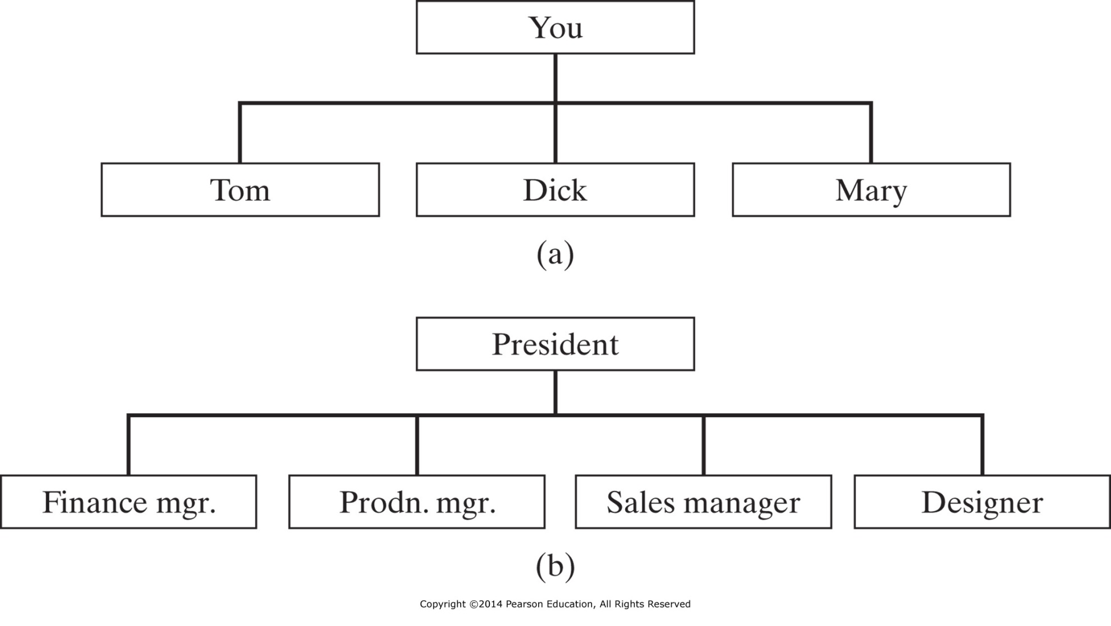
Organizing Patterns: Basic & Functional
Figure 6-1 Methods of departmentation: (a) Basic organization. (b) Functional departmentation.

Slide 13
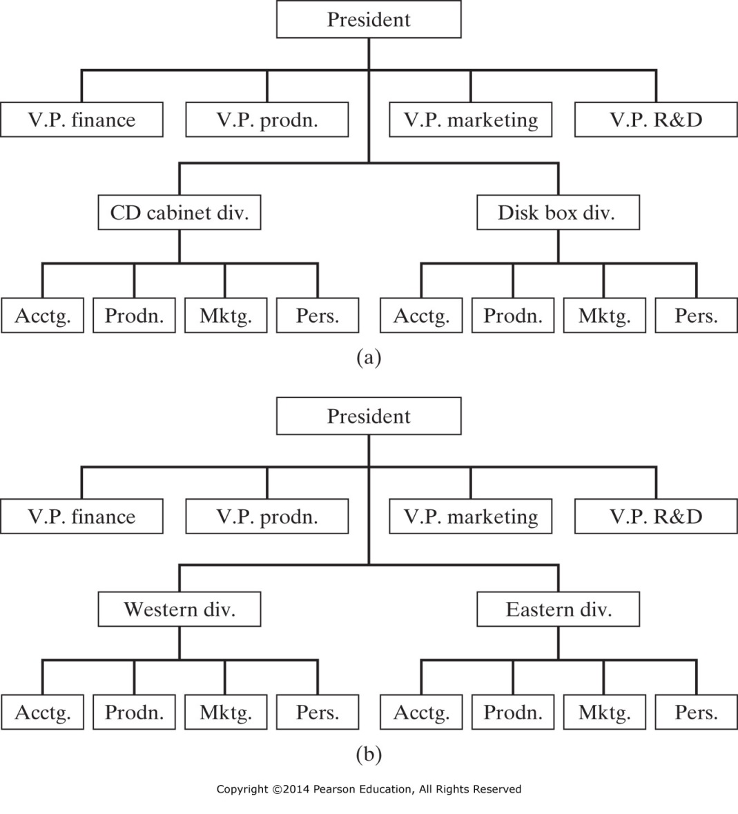
Organizing Patterns: Product & Geographic
Figure 6-2 Methods of departmentation: (a) Product departmentation. (b) Geographic departmentation.

Slide 14
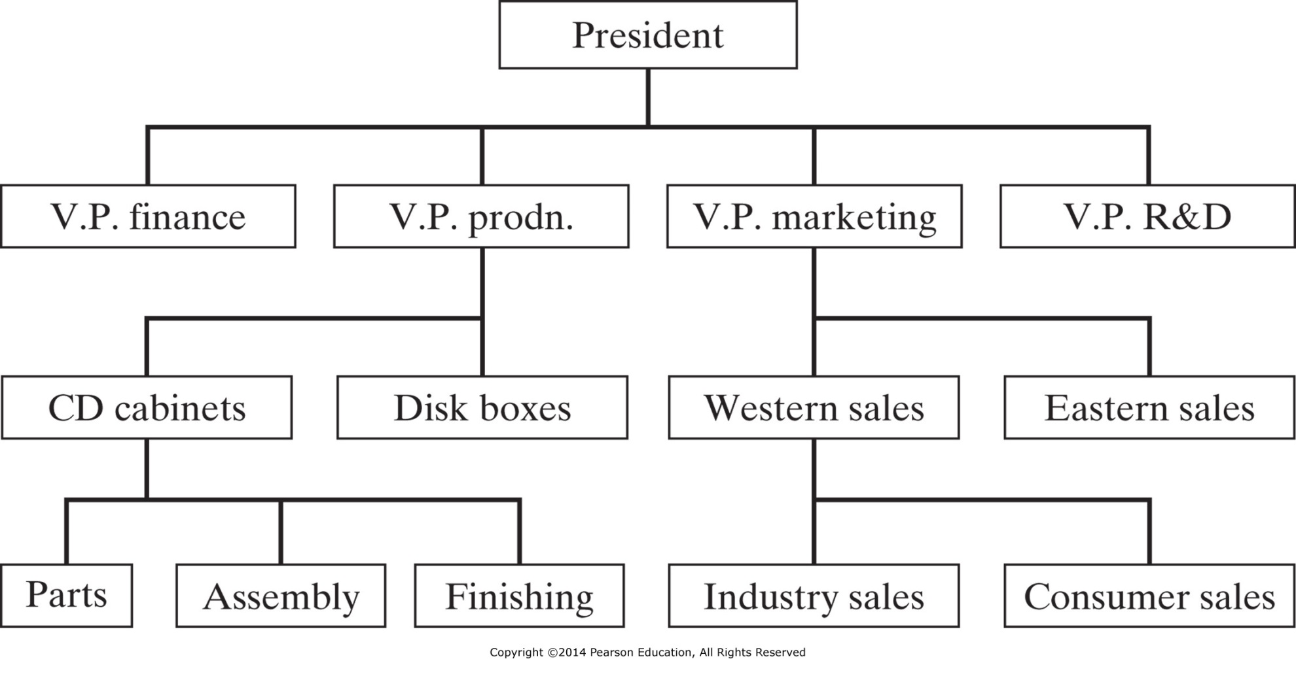
Organizing Patterns: Mixed Departmentation
Figure 6-3 Example of mixed departmentation.

Slide 15
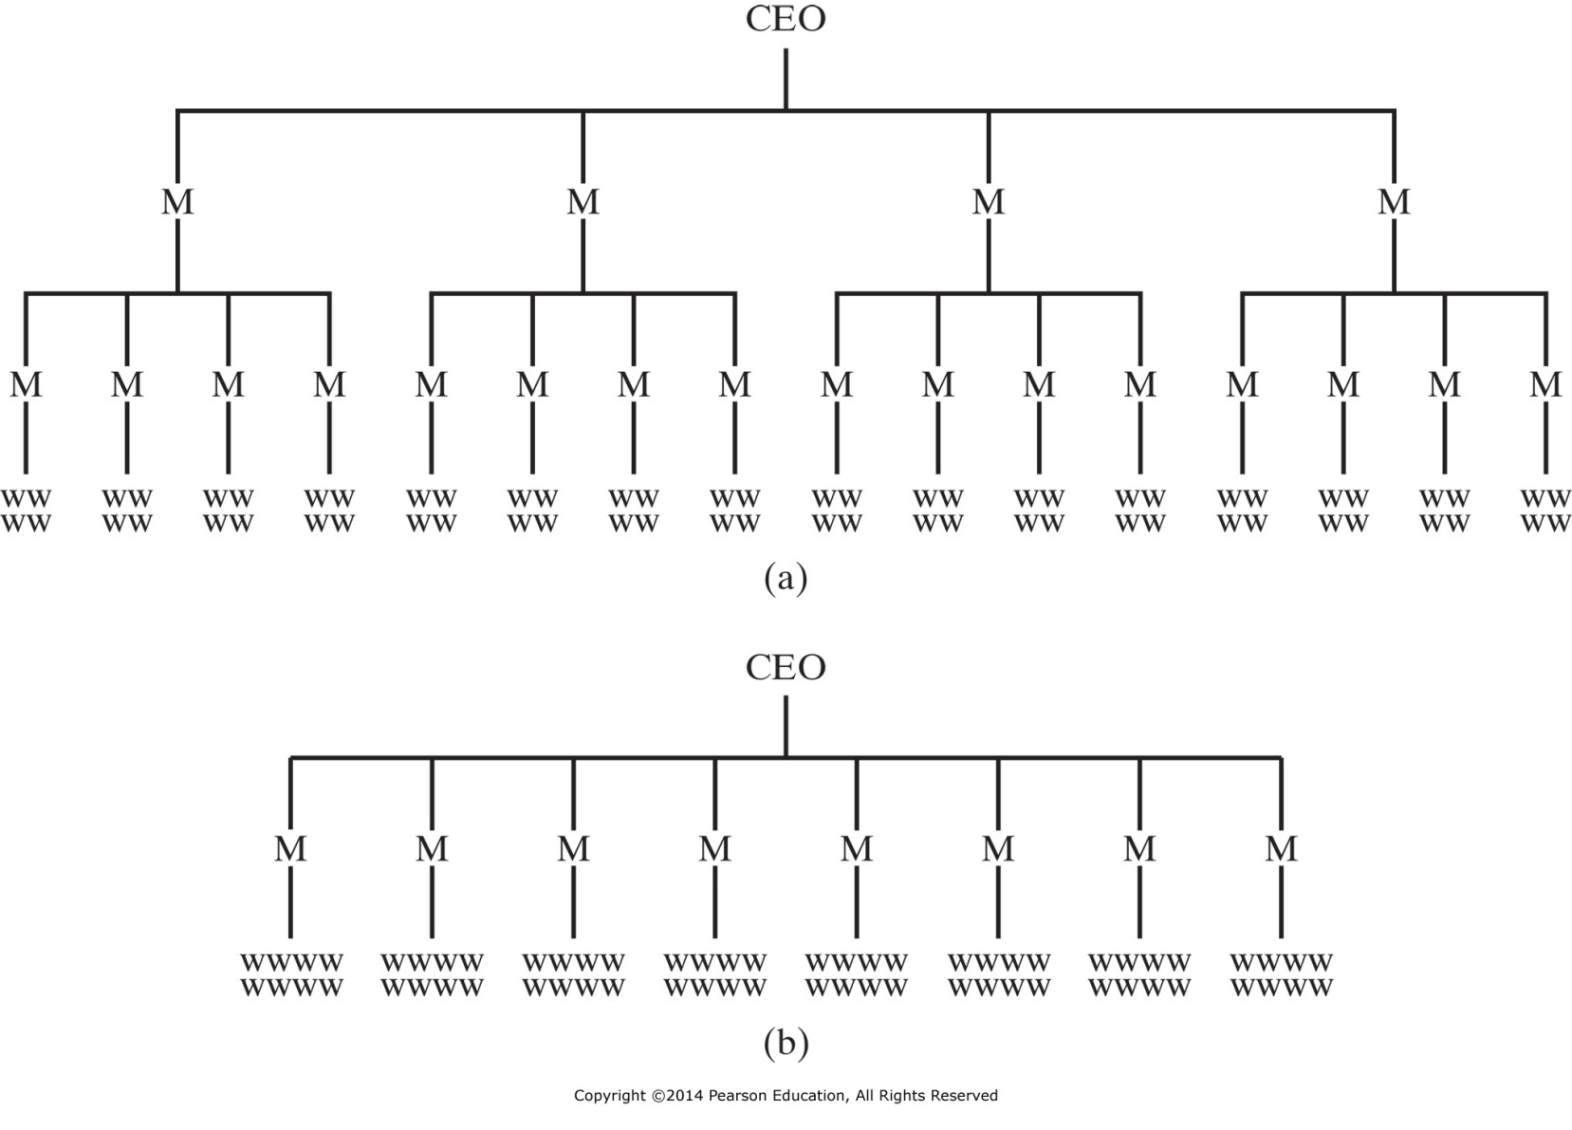
Organizing: Span of Control
Figure 6-4 Control spans of (a) four and (b) eight compared. M, manager; w, worker.

Slide 16
Organizing: Span of Control
Necessary Limits to Span of Control
Subordinate training
Nature of jobs
Rate of change of activities and personnel
Clarity of delegation
Staff assistance

Slide 17
Organizing: Line and Staff Relationships
Line
Superior/Subordinate relationships.
Typically represented vertically in organizational charts
Staff
Advisory in nature, degree of influence may vary.
Typically represented horizontally in organization charts
Provide advice on request
Recommendations when appropriate
Must be consulted by line but have no direct authority
Concurring authority – veto authority over line
Functional
Specialized Authority
As binding as line authority
Usually procedural
Budget formats
Computer system operations

Slide 18
Organizing: Line and Staff Relationships
Staff
(Advisory)
HR Director
(Functional)
Divisional HR
Divisional HR
Line
(Chain of Command)

Slide 19
Organizing: Line and Staff Relationships
Staff (subtypes)
Service
Centralized support functions for entire organization
Custodial
Security
Medical
Personal
Personal support functions - NO formal authority
Authority is derived from acting in the name of the manager
Provide assistance to address managerial overload conditions
Periodic overloads
Ad hoc situations

Slide 20
Organizing Patterns: Matrix Organizations
Functional Groups
Project
Management
Design
Management
Mfg
Management
Personnel
Management
Purchasing
Management
Accounting
Management
Manager
Project A
Design Eng
Mfg Eng
Personnel
Purchasing
Accounting
Project Teams
Manager
Project B
Design Eng
Mfg Eng
Personnel
Purchasing
Accounting
Manager
Project C
Design Eng
Mfg Eng
Personnel
Purchasing
Accounting

Slide 21
Organizing: Teams
Small group of people
Serve interests of its members
Exchange ideas freely and clearly
Have common goals
Committed to achieving goals
Each team member treated equally

Slide 22
Organizing: Teams
Common approaches to building team performance
Establish urgency and direction. Team must have a clear objective.
Select members based on skill and skill potential, not personalities.
Pay particular attention to first meetings and actions.
Set some clear rules of behavior.
Set and seize upon a few, immediate, performance-oriented tasks and goals.
Challenge the group regularly with fresh facts and information.
Spend time together.
Use positive feedback, recognition, and reward.

Slide 23
Information Technology: Work Force Impact
Organizational workers will require higher level skills
Visualization
Conceptual thinking
Process knowledge
Statistical inference
Oral and visual communication
Attentiveness
Individual responsibility

Slide 24
IENG 366 Engineering Management
Questions & Issues?

