Slide 1
IENG 366
Decision Making
Reading: pp. 134 – 139.

Slide 2
DECISION MAKing
Managerial decision making is the process of making a conscious choice between two or more rational alternatives

Slide 3
Management Science Characteristics
Systems View
Include all of the significant, interrelated variables of the problem
Team Approach
Personnel with heterogeneous backgrounds / training work together
Emphasis is on the use of:
formal mathematical models
statistical methods
quantitative techniques

Slide 4
Management Science Process
Real World Model World
Formulate the Problem
Apply the Model’s Solution to the Real System
Construct a Mathematical Model
Test the Model
Derive a Solution from the Model

Slide 5
Planning Process: Scientific Method
Define the problem
Collect data
Develop hypotheses
Test hypotheses
Analyze results
Draw conclusion

Slide 6
Engineering Problem Solving Approach
Define the problem
Collect and analyze the data
Search for alternatives
Evaluate alternatives
Select solution and evaluate the impact

Slide 7
Categories of Decision Making Tools
Certainty
Risk
Uncertainty

Slide 8
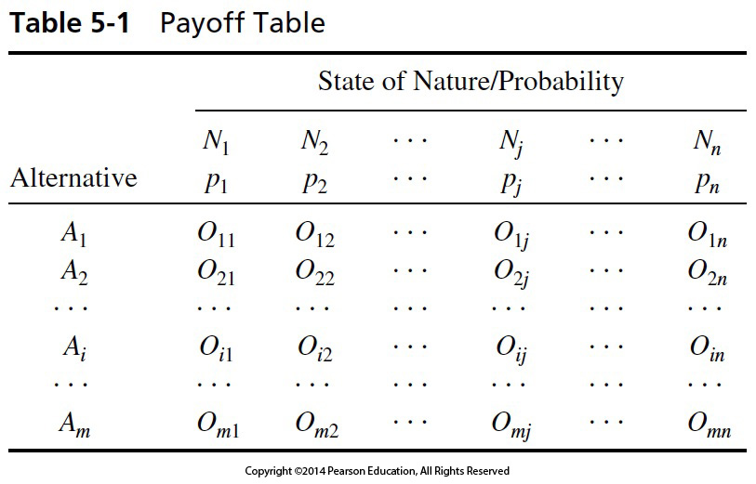
Table 5-1 Payoff Table
If the probability of any one outcome state is 1.0 (certainty), then just pick the alternative with the best payoff.
Decision Making Under Certainty

Slide 9
Decision Making Under Certainty
Linear Programming
One of best known tools of Management Science
Used to determine optimal allocation of an organization’s limited resources

Slide 10
Linear Programming
Preliminaries
State the Problem
Identify the Decision Variables
Formulate the Objective Function
Formulate the Constraints

Slide 11
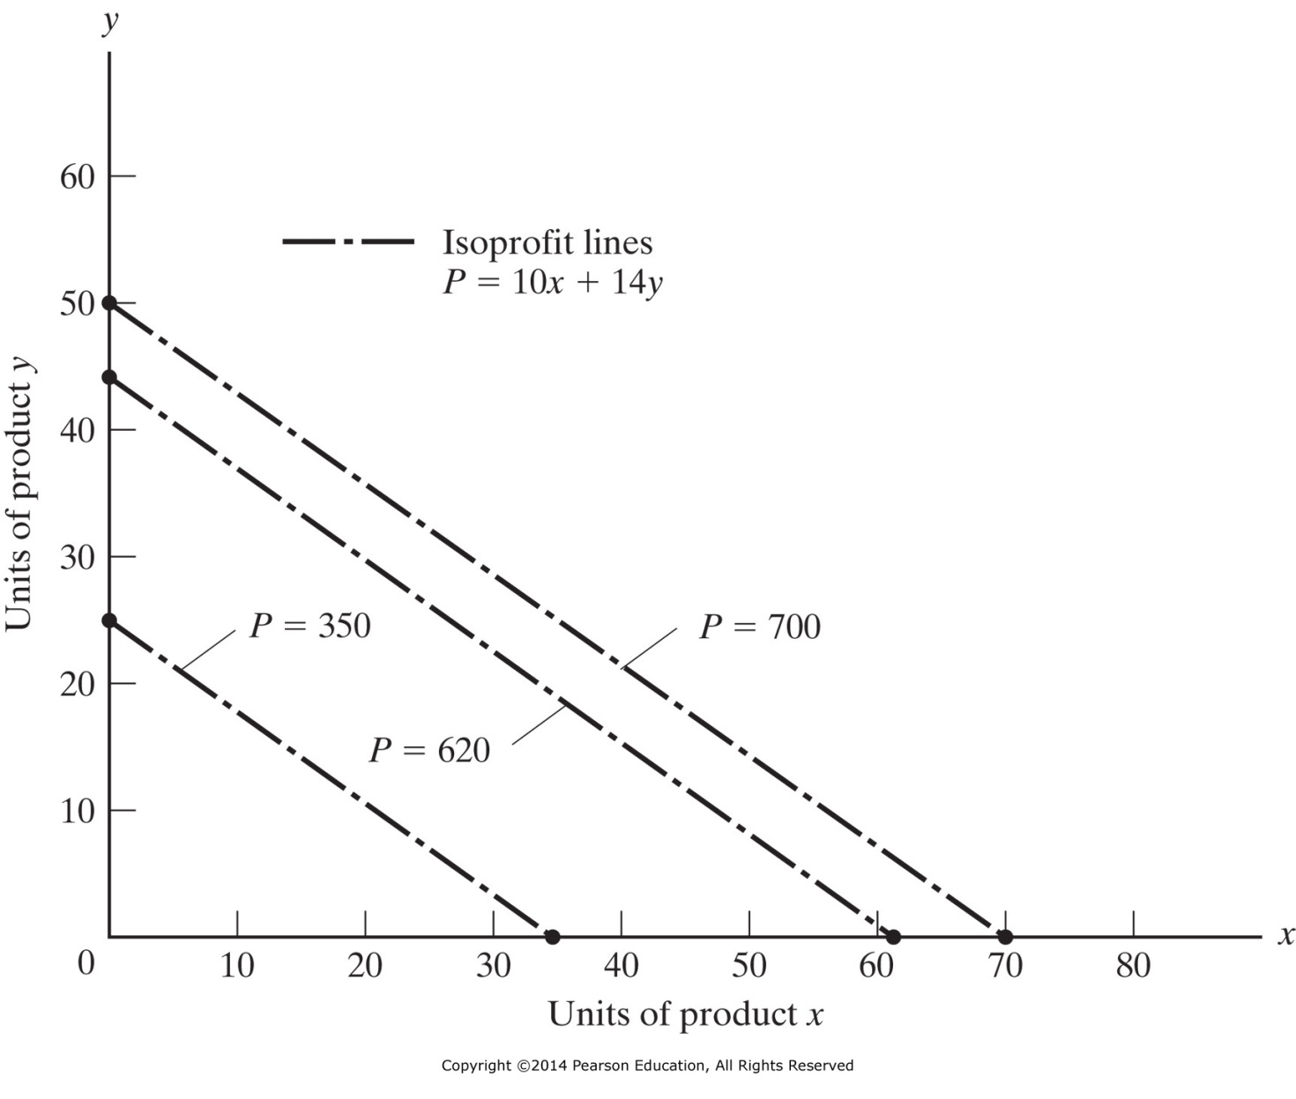
Figure 5-1 Linear program example: Iso-Profit Lines.

Slide 12
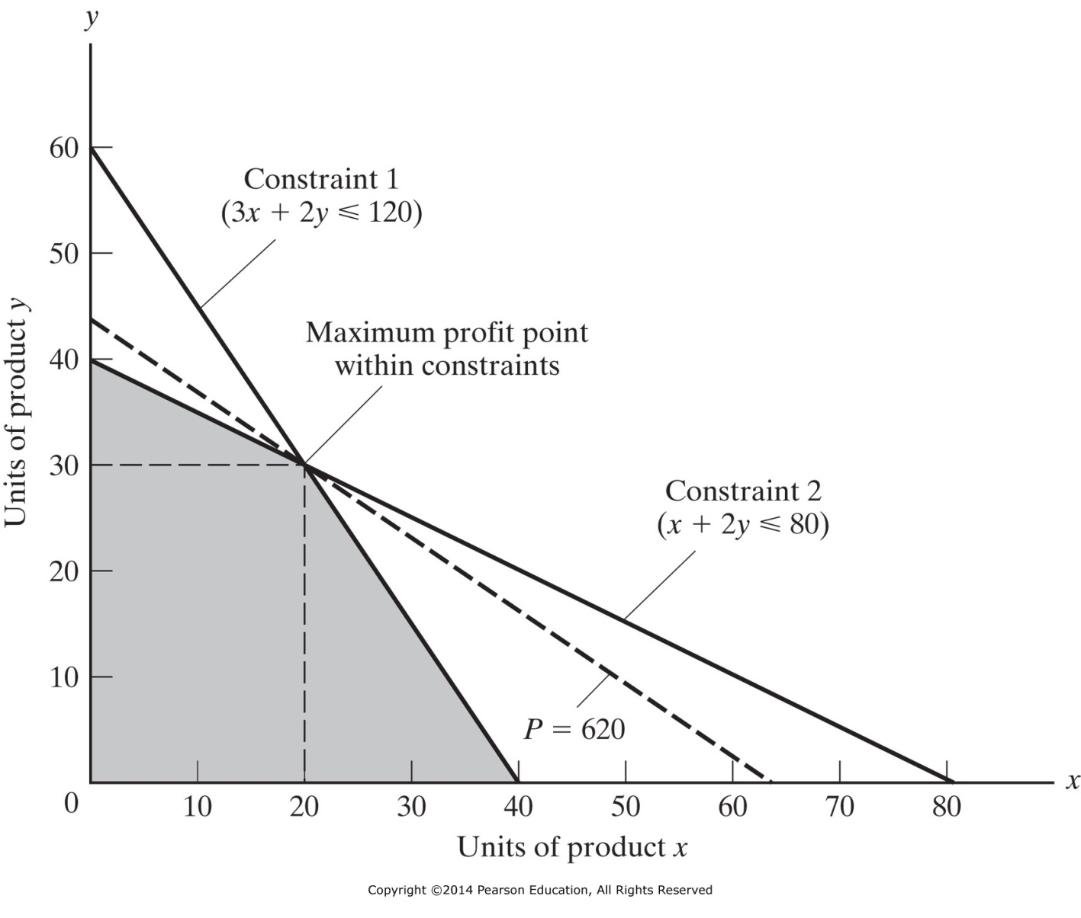
Figure 5-2 Linear program example: Constraints and Solution.
P = $10x + $14y
(Machining Time)
P = $560
P = $620
(Assembly Time)
P = $0
P = $400

Slide 13
Decision Making Under Risk
Expected Value
Decision Trees
Queuing
Simulation

Slide 14
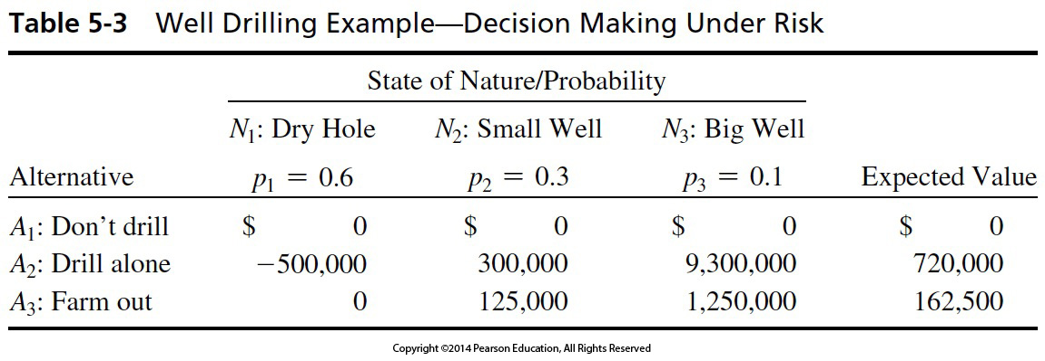
Table 5-3 Well Drilling Example—Decision Making Under Risk
Decision Making Under Risk

Slide 15
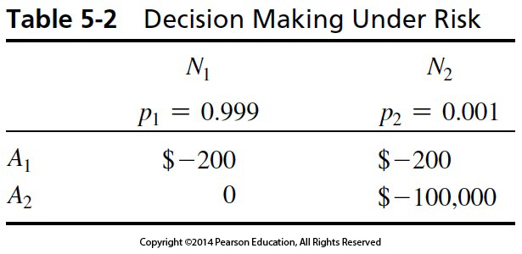
Table 5-2 Decision Making Under Risk
Buying Fire Insurance: Payoff Table

Slide 16
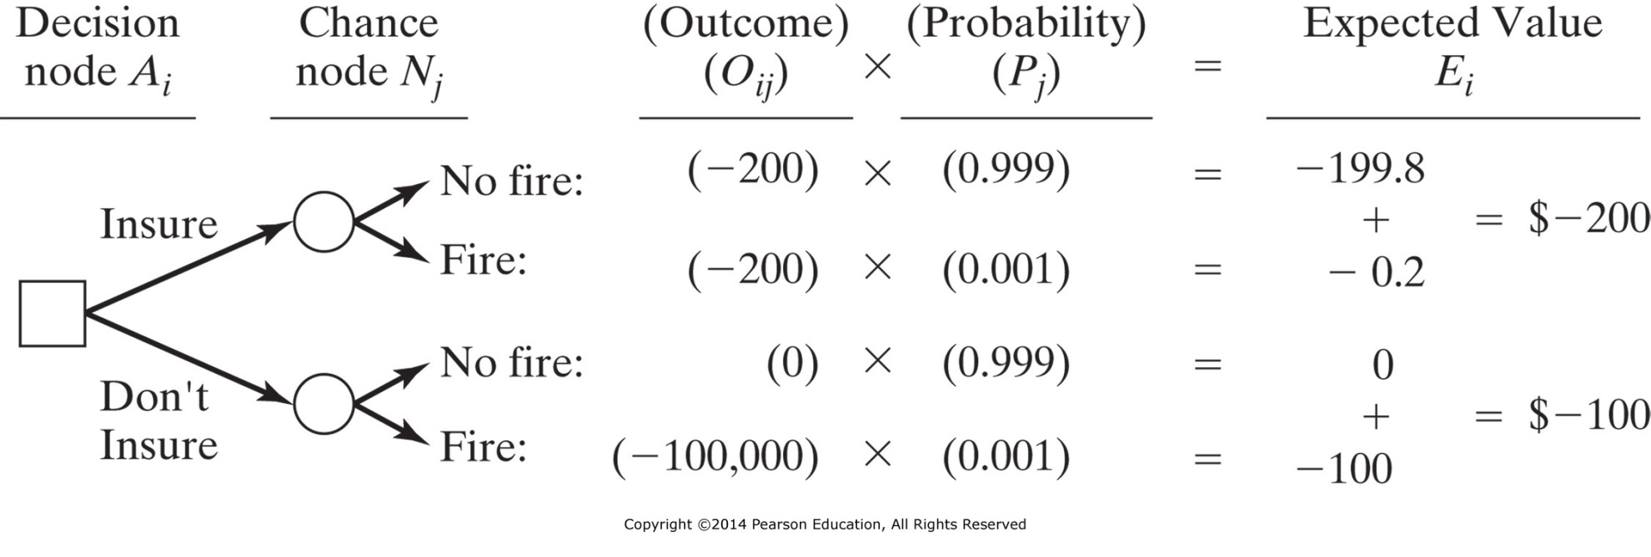
Figure 5-3 Example of a decision tree.
Buying Fire Insurance:
Decision Tree and Expected Value

Slide 17
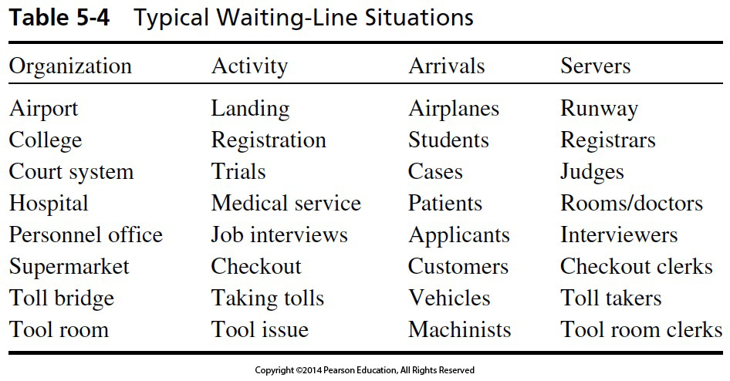
Table 5-4 Typical Waiting-Line Situations
Queueing Theory Applications

Slide 18
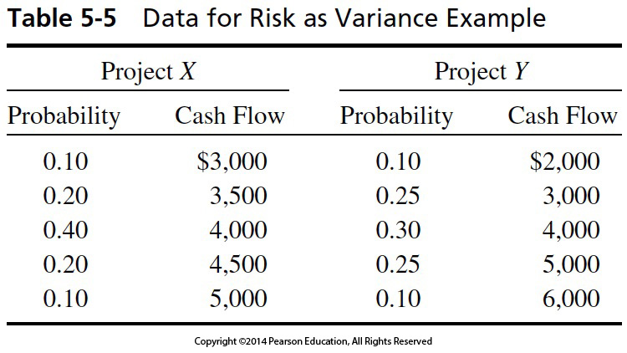
Table 5-5 Data for Risk as Variance Example
Continuous Risk Model: Risk as a Variance

Slide 19
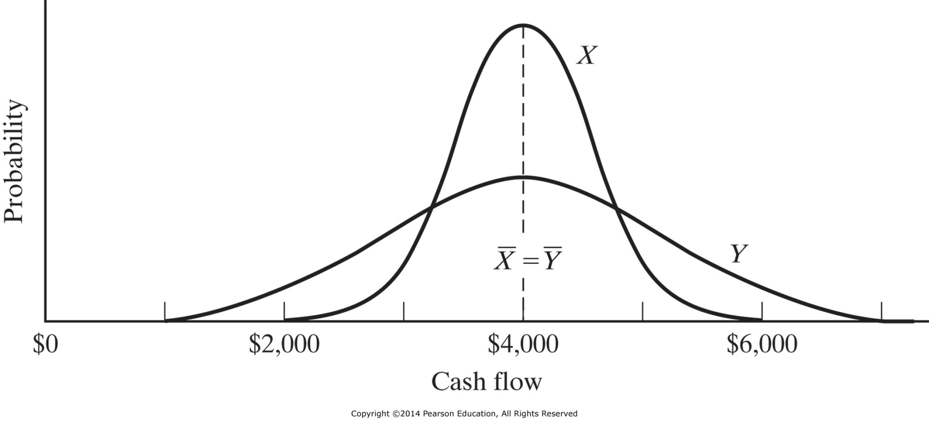
Figure 5-4 Projects with the same expected value but different variances.

Slide 20
Decision Making Under Uncertainty
Maxi-Max
Maximize the maximum outcome (best case)
Maxi-Min
Maximize the minimum outcome (least bad)
Hurwicz
Choose a position in-between optimism and pessimism
α = % optimistic outcome happens, 1 - α = % pessimistic outcome happens
Equally Likely
α = 50% for two outcomes (etc. )
Mini-Max Regret
Minimize the maximum regret (regret = payoff left unclaimed)

Slide 21
Table 5-6 Decision Making Under Uncertainty Example

Slide 22
Table 5-7 Well Drilling Example— Decision Making Under Uncertainty— Regret Analysis

Slide 23
Other Techniques
Six Thinking Hats
Rock, Paper, Scissors (Lizard, Spock)
Coin flipping, drawing straws, throwing dice

Slide 24
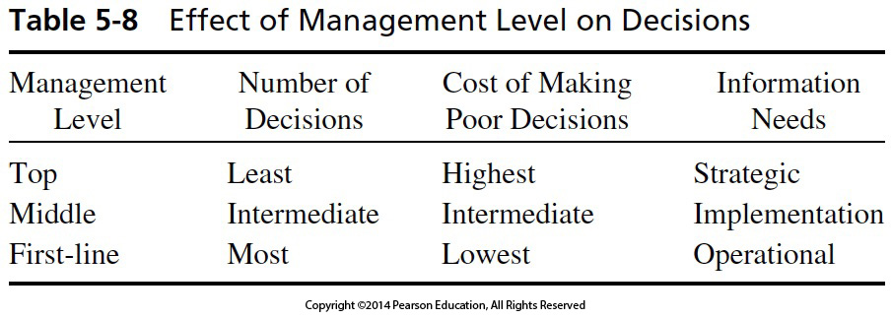
Table 5-8 Effect of Management Level on Decisions

Slide 25
The applicable payoff table of profits (+ ) and losses (- ) is:
Investing in a New Facility Decision
How Would YOU Decide?

Slide 26
If your alternatives and their outcomes (in thousands of dollars) are as shown in the following table, what should be your decision?
Investing in New Tooling Decision
How Would YOU Decide?

Slide 27
IENG 366 Engineering Management
Questions & Issues?

