Slide 1
IENG 366
Forecasting
Reading: pp. 110 – 130.

Slide 2
Forecasting
An essential preliminary effort to effective planning
Engineering managers must be concerned with both future markets and future technology

Slide 3
Why Forecasting? Examples
New Facility Planning
3 – 5 years or more
Production Planning
6 months – 2 years
Work Force Scheduling
Daily – 1 year

Slide 4
Long Range Forecast Examples
Designing New Products
Determining Capacity for New Product
Long Range Supply of Materials

Slide 5
Short Range Forecast Examples
Inventory Amounts for Next Month
Amount of Product to Produce Next Week
Raw Material Quantities for Delivery Next Week
Production Workers to Schedule for Next Week

Slide 6
Forecasting: Qualitative Methods
Judgment Methods
Jury of Expert Opinion
Delphi Method
Historical Methods
Sales Force Composite
User’s Expectations
Market Testing
Market Survey

Slide 7
Jury of Expert Opinion
Process:
Assemble a panel of experts
All the company’s vice-presidents, for example
Each expert provides an estimate of the future condition
Frequently termed an “educated guess”
Decision-Maker yields a considered average of the estimates
Not necessarily quantitative – more likely descriptive of degree
Advantages:
Quick
Inexpensive
Possibility of synergy in forecast
Disadvantages:
Experts are frequently chosen from convenience set
GroupThink and minority domination are distinct possibilities

Slide 8
Delphi Method
Process:
Develop the objective of forecast
Determine number of participants
Some evidence that 5 to 7 panelists is ideal
Select and contact participants
Do NOT co-locate the participants – limit interaction
Develop first questionnaire and submit to panel
Responses are individual and done in isolation
Coordinator analyzes responses
Develop second questionnaire based on results of first
Analyze responses and repeat until:
Consensus is reached or
Experts’ opinions cease to change

Slide 9
Delphi Method
Advantages:
Eliminates effects of interactions between members
Experts do not need to know who other experts are
Can be done at great distance
Disadvantages:
Extremely time-consuming
No opportunity for synergy

Slide 10
Sales Force Composite
Process:
Members of sales force estimate sales
Each develops an estimate for their OWN territory
Regional sales managers adjust the individual estimates
Adjustments reflect the optimism or pessimism of the individual salespersons
General sales manager adjusts for new products and factors
Frequently, the individual salespersons are not aware of these factors
Advantages:
Reasonably quick
Inexpensive
Individual salespersons are in close contact with customers
Disadvantage:
Salespeople will “game” their estimates if they suspect that these estimates might become minimum sales goals

Slide 11
User’s Expectations
Useful if the firm depends on a relatively few, major customers
Process:
Customers of the firm estimate their own needs for the period
Frequently this is conducted under other names:
Market Surveys – if the customer is estimating need for existing products
Market Testing – if the customer is estimating need for new / innovative products
Advantages:
Customer success depends on reliable supplies, so
Communication is in the best interest of both parties
Disadvantages:
Information is expensive to obtain
Customers often do not know their own future needs with much certainty

Slide 12
Forecasting: Quantitative Methods
Time Series Methods
Moving Average
Weighted Moving Average
Exponential Smoothing
Association or Causal Methods
Simple Regression Models
Multiple Regression Models

Slide 13
Moving Average
Process:
Pick a window size (n)
The window size limits the prior history that will be considered
The forecast for the next period (F_{n+1}) is the unweighted average of the (n) window values:
A_{i} is the actual value for period i
n is the window size (number of periods)
Advantages:
Ease of calculation
Ease of data set collection
Disadvantages:
Older observations are just as important as recent trends
Observations outside the window (too old) are completely ignored
$$F_{n+1}=\frac{1}{n}\sum_{i=1}^{n}{A_{i}}$$

Slide 14
Weighted Moving Average
Process:
Pick a window size (n)
The window size limits the prior history that will be considered
Pick a set of weights for each prior period’s actual value
The sum of all the weights must equal 1.0
The forecast for the next period (F_{n+1}) is the weighted average of the (n) window values:
A_{i} is the actual value for period i
w_{i} is the weight for period i
n is the window size (number of periods)
Advantages:
The impact of older observations are mitigated through the weights
Ease of calculation
Ease of data set collection
Disadvantages:
Choice of weights is non-obvious
Observations outside the window (too old) are still completely ignored
$$F_{n+1}=\sum_{i=1}^{n}{w_{i}A_{i}}$$

Slide 15
Exponential Smoothing
Process:
Pick a weight (α) for the current period actual value
The weight for the prior period forecast will become 1 - α (so the sum will equal 1.0)
The forecast for the next period (F_{n+1}) is the weighted function of the current period (actual) value and (all of) the previous period forecast(s):
A_{n} is the actual value for period n
α is the weight for the current period n
good rule of thumb is to pick 0.4 ≥ α ≥ 0.15
F_{n} is the forecast value for all the previous periods
set F_{n} equal to actual value for the previous year to start the series
Advantages:
Adjusts the effects of older observations, but still keeps all old data in model
Ease of data set collection
Disadvantages:
Picking the weight (α) is non-obvious
$$F_{n+1}={αA}_{n}+(1−α)F_{n}$$

Slide 16
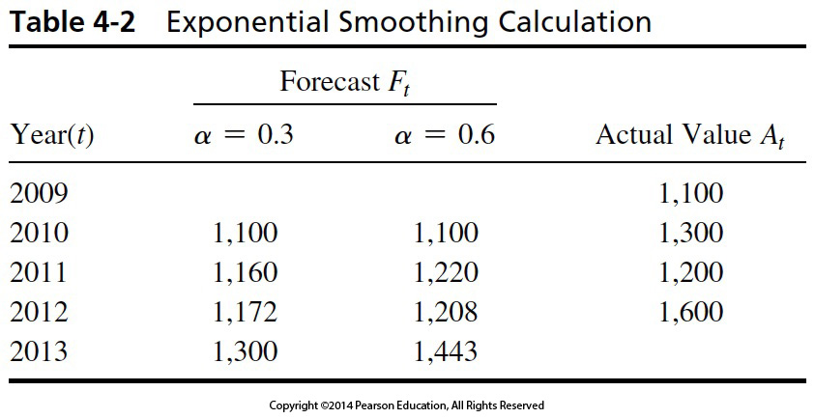
Table 4-2 Exponential Smoothing Calculation

Slide 17
Regression Models
Process:
Compute a linear equation relating the independent variable(s) (presumed causes) to the dependent variable (actual outcome value)
The weight for the prior period forecast will become 1 - α (so the sum will equal 1.0)
The forecast for the future period (F_{n}) is the extrapolation of the linear function for the presumed independent variable(s) for the future period:
*single variable form, only
I_{n} is the independent variable value for period of interest (n)
a is the intercept for the linear function at ($I_{0}$)
b is the slope for the line of best fit
Advantages:
Can identify variables that correlate (and correlation strength) to the forecast variable
Can develop non-linear models via transformations of variables
Disadvantages:
Almost always done with computer software
Does not actually prove cause and effect
$F_{n}=a+b$ ($I_{n}$)

Slide 18
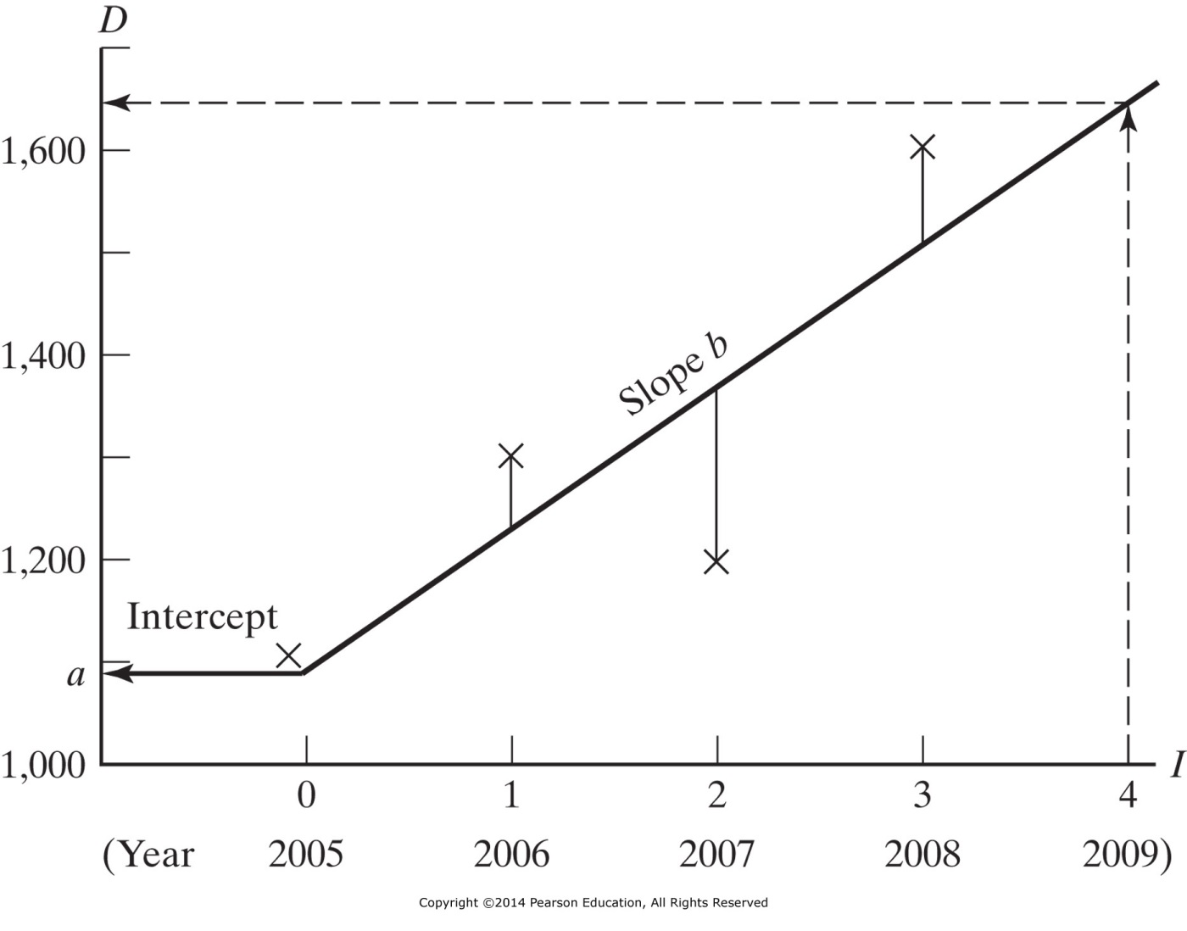
Figure 4-3 Simple regression model.

Slide 19
Forecasting: Hybrid Methods
Environmental Scanning
Goal is to anticipate and interpret changes in the business environment:
Social, political, economic, and technological trends
Traditional: Research Firm does a lot of reading:
Mainstream publications
Fringe Literature
Directed Periodicals
Problems: labor intensive, weighting of sources
Recent: Big Data - computer-based, content analysis
AI-based analysis of web - published content
Problems: weighting of sources, fake news

Slide 20
Examples of Forecasting Models (after S. Robbins (1988) Management, 2nd ed. Englewood Cliffs NJ: Prentice-Hall, Inc.)
Technique | Description | Application
Time-Series Analysis | Fits a trend line to a mathematical equation and projects in the future by means of the equation | Predict next quarter's sales based on four years of previous sales data
Regression Models | Predicts one variable on the basis of known or assumed sets of variables | Seek factors that will predict a certain level of sales from price and advertising expenditures
Econometric Models | Uses a set of regression equations to simulate segments of the economy | Predict change in car sales as a result of changes in tax laws
Economic Indicators | Uses one or more ecnomic indicators to predict a future state of the economy | Use change in GNP to predict discretionary income
Subsitution Effect | Uses a mathematical formulation to predict how, when, and under shat circumstances a new product or technology will replace an existing one | Predict the effect of microwave ovens on the sale of conventional ovens
Panel of Experts | Combining and averaging the opinions of experts | Polling all the company's personnel managers to predict next year's college recruitment needs

Slide 21
Which Method?
Select a few methods
Make a few forecasts
Form considered average
There is NO one best answer

Slide 22
Forecasting New Products
First use judgmental methods
Expert opinions
Consumer intentions

Slide 23
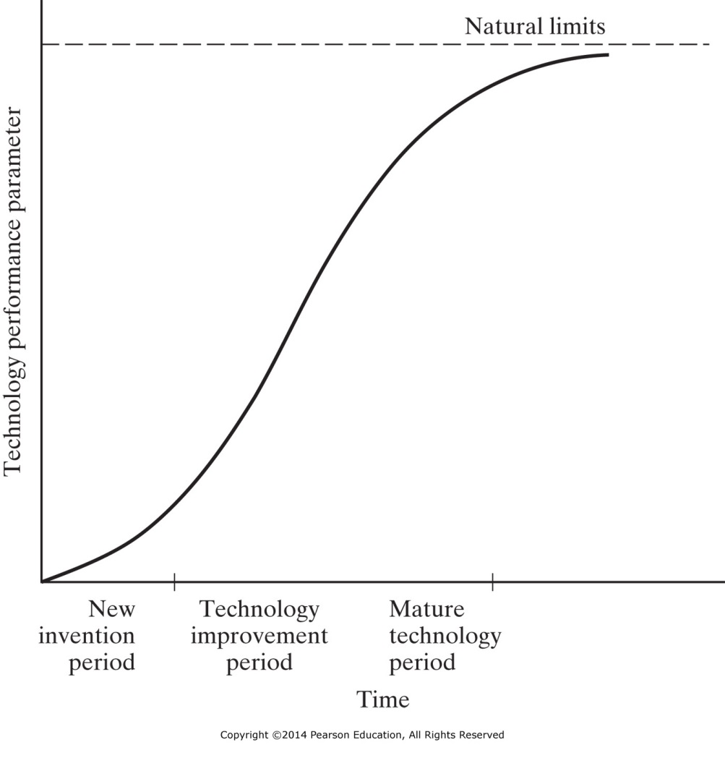
Figure 4-4 Technology S-curve. (From Frederick Betz, Managing Technology: Competing Through New Ventures, Innovation, and Corporate Research, Prentice-Hall, Inc., Englewood Cliffs, NJ, 1987, p. 62; reprinted by permission of Prentice-Hall, Inc., copyright 1987).

Slide 24
Technological Change
Best to use both Qualitative and Quantitative models
Use of Internet
Use of Social Media

Slide 25
Internet Usage

Slide 26
IENG 366 Engineering Management
Questions & Issues?

