Slide 1
IENG 366
Planning and Forecasting
Reading: pp. 86 – 106.

Slide 2
IMPORTANCE OF PLANNING
“The general who wins a battle makes many calculations in his temple ere the battle is fought. The general that loses a battle makes few calculations before hand. It is by attention to this point that I can see who is likely to win or lose.”
Sun Tsu

Slide 3
Functions of Managers: Kootz (Fayol)
Planning
Organizing
Staffing
Leading
Controlling

Slide 4
Planning
Provides a method for identifying objectives
Designs a sequence of programs and activities to achieve objectives

Slide 5
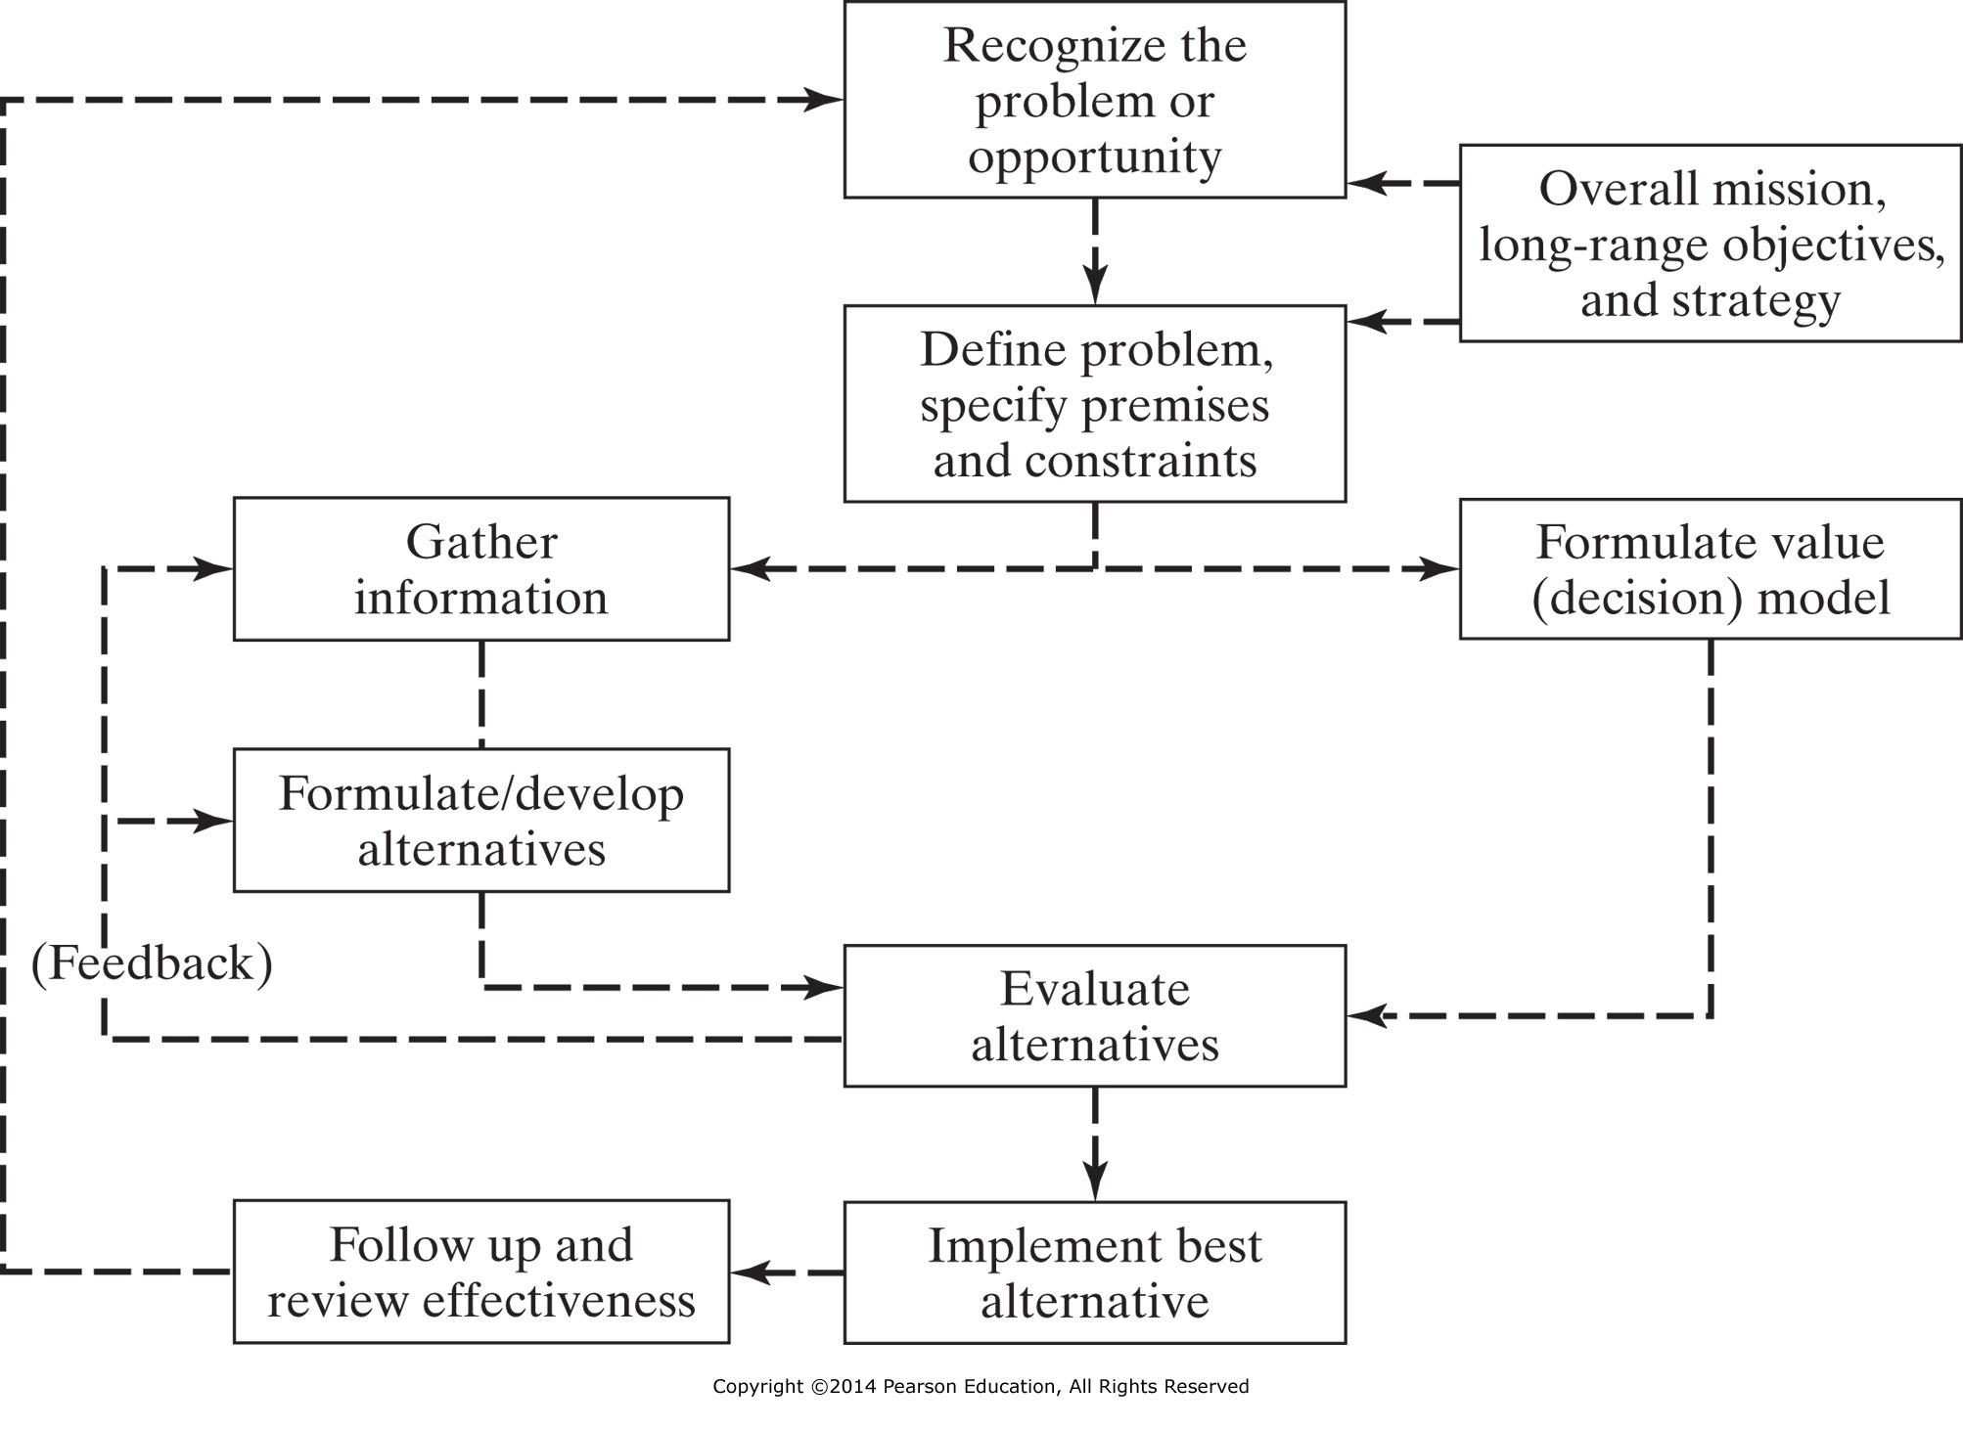
Planning / Decision-Making Process

Slide 6
Effective Planning
Plan to Plan
People implementing plan should be involved in preparing plan

Slide 7
Planning: Foundation
All Planning is Customer Driven
Mission:
Goal(s):
Objectives:
Strategies:

Slide 8
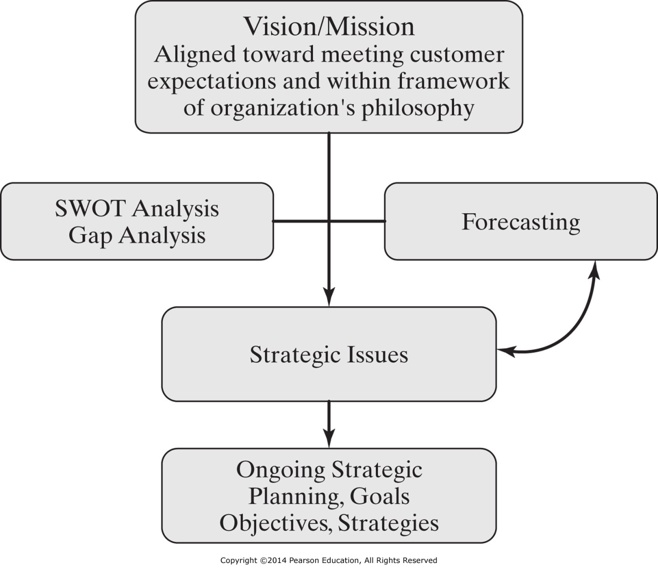
Figure 4-2 Strategic planning.

Slide 9
Strategic Planning
Vision/Mission
SWOT Analysis
Gap Analysis
Goals
Objectives
Strategies

Slide 10
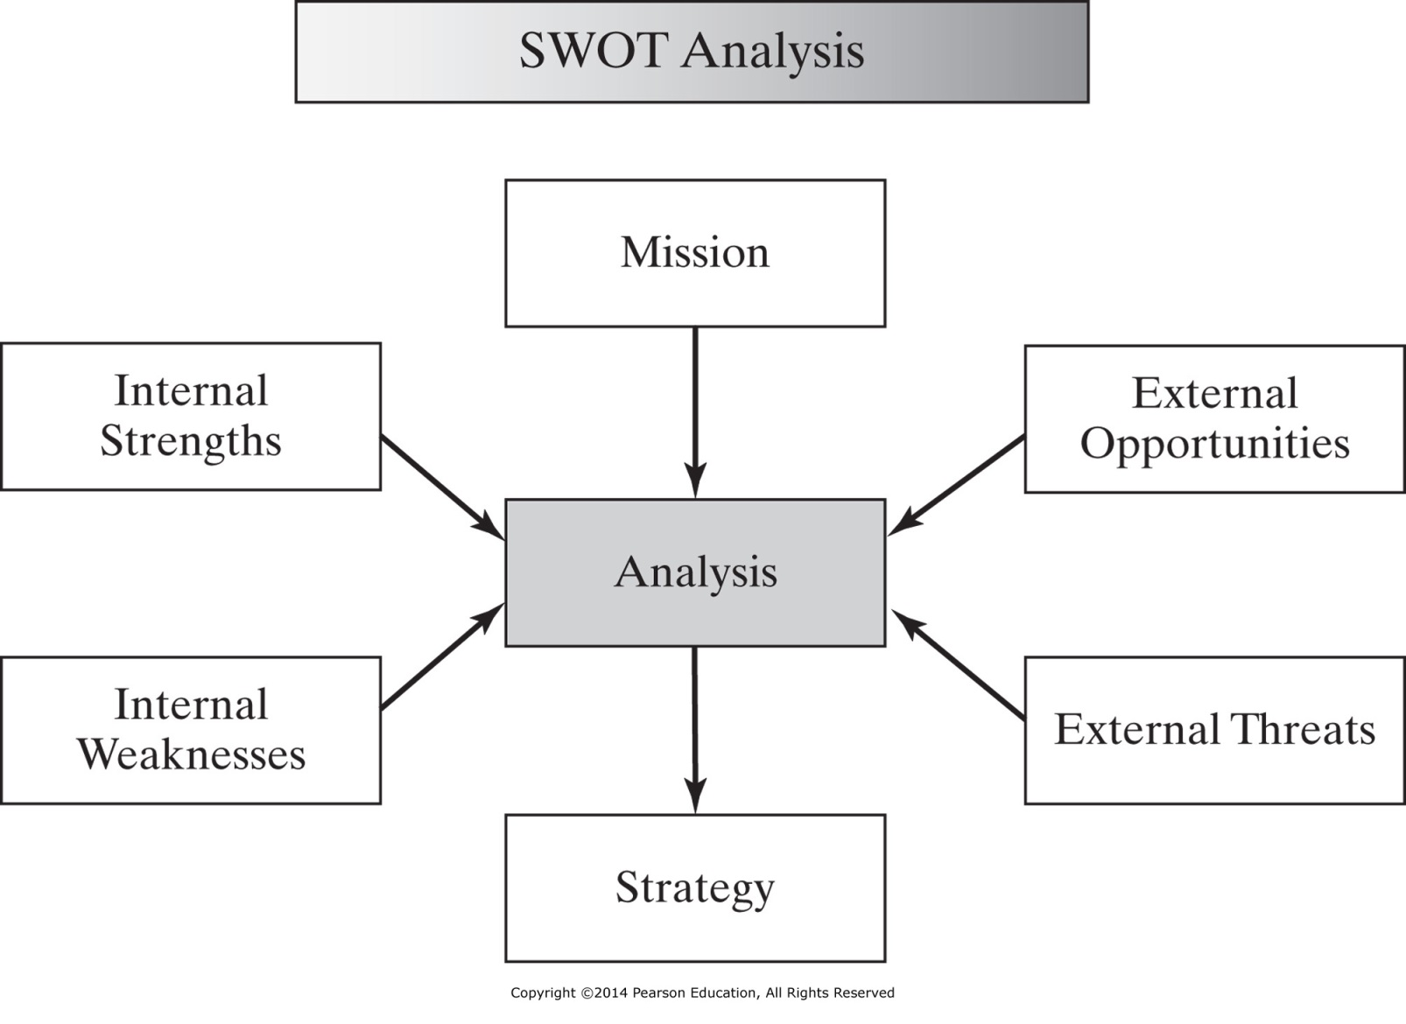
A gap analysis is a technique used to analyze/assess where you currently are with respect to where you would like to be in the future

Slide 11
Planning: SWOT Analysis
Internal Elements
Strengths:
Build on these
Weaknesses:
Resolve these
External Elements
Opportunities:
Exploit these
Threats:
Avoid these
Management
Marketing
Technology
Research
Finances
Systems
Customers
Competition
New Technologies
Government Policies

Slide 12
Strategic Planning
Mission
Goal 1
Goal 2
Goal 3
Objective 1
Objective 2
Strategy 1
Strategy 2

Slide 13
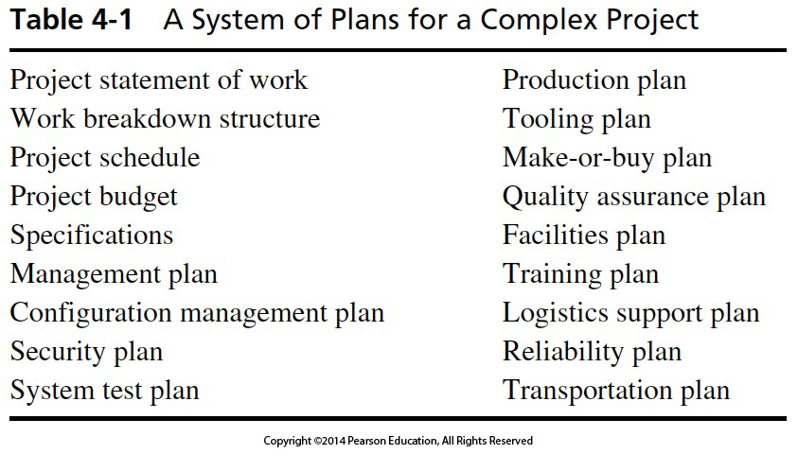
Table 4-1 A System of Plans for a Complex Project

Slide 14
Planning
Strategic Aspects:
What is the Problem/Purpose?
Establish Goal/Objectives
What Client Need is Being Satisfied by the Project?
Identify Success Criteria
Operational (Tactical) Aspects:
What must be done?
Who will do it?
How will it be done?
When must it be done?
How much will it cost?
What do we need to do it?

Slide 15
Vision Statement
A vision statement describes in graphic terms where the goal-setters want to position themselves in the future.

Slide 16
Vision Statement: Microsoft (1980s)
“A personal computer on every desk, and every computer running Microsoft software.”

Slide 17
Strategic Plan
Suggests ways (strategies) to identify and to move toward desired future states
Consists of the process of developing and implementing plans to reach goals and objectives

Slide 18
Strategic Plan: Mission Statement
First step in planning process
Not a business plan
Not an operational plan
What do we want to do
Resembles a vision statement
Has a more immediate business focus with a time horizon

Slide 19
Strategic Plan: Goal Statement
Gives purpose and direction
Used as continual point of reference for questions regarding scope or purpose
Addresses Questions such as:
What do we do?
Why?
For whom do we do it?

Slide 20
Strategic Plan: Objectives
More detailed goal statement
Clarifies a goal
How do we go about it?
To (action verb)
Rest of statement is directional, not detail
Objectives must be consistent with the organization

Slide 21
Goals and Objectives
Objectives for Organizational Survival:*
Market Share
Innovation
Productivity
Physical and Financial Resources
Manager Performance and Development
Worker Performance and Attitude
Profitability
Social Responsibility
*Peter Drucker

Slide 22
Planning: Developing Objectives
SMART Goals
Specific
Measurable
Attainable
Relevant (Realistic)
Trackable (Time-limited)

Slide 23
Planning: Managing Objectives
Management by Objectives
Commonly Referred to as MBO
Employed at every level
Negotiated with Subordinate
Periodic
Typically six months to one year
Review
Focus is constructive (not blame)
End result is to establish next period objectives
May create new objectives
May extend some earlier objectives
May de-emphasize other objectives
*Peter Drucker

Slide 24
Planning: Managing Objectives
Management by Objectives
Advantages:
Greater commitment and satisfaction by Subordinates
Enforced planning and prioritization by both Supervisors & Subordinates
More rational performance evaluation, because it is based on contribution to organizational objectives
Disadvantages:
Time and documentation required
Misuse (assigning rather negotiating tasks)
Gamesmanship
Tendancy to focus on a relatively few objectives that are easily verified, rather than the many complex objectives a professional must balance
*Peter Drucker

Slide 25
IENG 366 Engineering Management
Questions & Issues?

