Slide 1
IENG 366
Motivating People
Reading: pp. 64 – 81

Slide 2
Motivation
“… an inner state that energizes, activates, or moves (hence motivation), and that directs or channels behavior toward goals.”
Berelson & Steiner

Slide 3
Motivation: Theories
Types:
Content Theories
Based on human needs and people’s (sometimes unconscious) efforts to satisfy them
Maslow’s Hierarchy of Needs
McGregor’s Theory X and Theory Y
Herzberg’s Two Factor Theory
McClelland’s Trio of Needs* (* discussed with Project Management, later)
Process Theories:
Rational behavior choices based on expected outcomes
J. Stacy Abrams – Equity Theory
Victor Vroom – Expectancy Theory
Porter – Lawler Extension
B.F. Skinner – Reinforcement Theory (Operant Conditioning)

Slide 4
Motivation: Content Theories
Hierarchy of Needs
Self-Actualization:
Growth, achieving your potential, self-fulfillment
Esteem:
Internal factors – self-respect, autonomy, achievement
External factors – status, recognition, attention
Affiliation:
Acceptance, belonging, friends, affection
Security / Safety:
Protection from physical and emotional harm – job security, predictable work environment
Physiological:
Bodily needs – food, water, shelter, etc…
Abraham Maslow

Slide 5
Maslow’s Hierarchy of Needs
In Theory: A higher level need won’t motivate if a lower level need is lacking (regression happens)!
Self-Actualization:
Growth, achieving your potential, self-fulfillment
Esteem:
Internal factors – self-respect, autonomy, achievement
External factors – status, recognition, attention
Higher Order Needs
In Theory: Once a lower need is substantially satisfied, the next level becomes dominant.
Affiliation:
Acceptance, belonging, friends, affection
(internally satisfied)
Security / Safety:
Protection from physical and emotional harm – job security, predictable work environment
Lower Order Needs
Physiological:
Physical needs – food, water, shelter, etc…
(externally satisfied)
CAUTION: No validating research has ever been presented!

Slide 6
Motivation: Content Theories
Theory X:
Assuming:
the typical worker is naturally indolent and works as little as possible …
is typically unambitious, dislikes responsibility and prefers to be led …
is inherently self-centered and indifferent to the needs of the organization …
is by nature resistant to change, gullible, not very bright & the ready dupe of the demagogue
and since
management is responsible for organizing the elements of productive enterprise – money, materials, equipment and people – in the interest of economic ends…
with respect to people, this is a process of directing their efforts, motivating them, controlling their actions, modifying their behavior to fit the needs of the organization …
without active intervention by management, people would be passive – even resistant – to organization needs…
they must therefore be persuaded, rewarded, punished, controlled – their activities must be directed. This is management’s task!
(External) Motivation by the Carrot and Stick Approach is necessary!
Douglas McGregor

Slide 7
Motivation: Content Theories
Theory Y:
Assuming:
management is responsible for organizing the elements of productive enterprise – money, materials, equipment and people – in the interest of economic ends…
and people are NOT by nature passive or resistant to organizational needs. …
that they have become so as a result of experience in organizations …
the motivation, the potential for development, the capacity for assuming responsibility, the readiness to direct behavior toward organization goals are present in all people and management does not have to put them there …
then
it is the responsibility of management to make it possible for people to recognize and develop these human characteristics for themselves …
the essential task of management is to arrange organizational conditions and methods of operation to that people can achieve their own goals BEST by directing THEIR own efforts towards organizational objectives!
(Internal motivation by) Self-Control and Self-Direction is what drives knowledge workers (… and even manual workers in a modern economy!)
Douglas McGregor

Slide 8
Motivation: Content Theories
Two Factor Theory (Motivation–Hygiene Theory):
Factors in ~ 3600 events that led to extreme dissatisfaction or extreme satisfaction on the job
Job Dissatisfaction is NOT the opposite of Job Satisfaction
Instead there appear to be two scales (factors) that together explain employee motivation …
Hygiene Factors
…are factors that run along a scale from “Dissatisfaction” to “No Dissatisfaction”
They are termed hygiene factors, because if they are lacking to a large degree, people will be negatively inclined, and people expect them to be generally present to a higher degree in order to be OK with the situation (it feels “normal”).
Motivators
…are factors that run along a scale from “No Satisfaction” to “Satisfaction”
They are termed motivators because if they are minimally present, people are OK with that (the “normal” situation), and the more that they are present, the more people tend to be positively inclined.
Therefore, meet Hygiene expectations, increase Motivators to induce performance
Engineers & scientists tend to be Motivation seekers; female laborers are Hygiene seekers
Frederick Herzberg

Slide 9
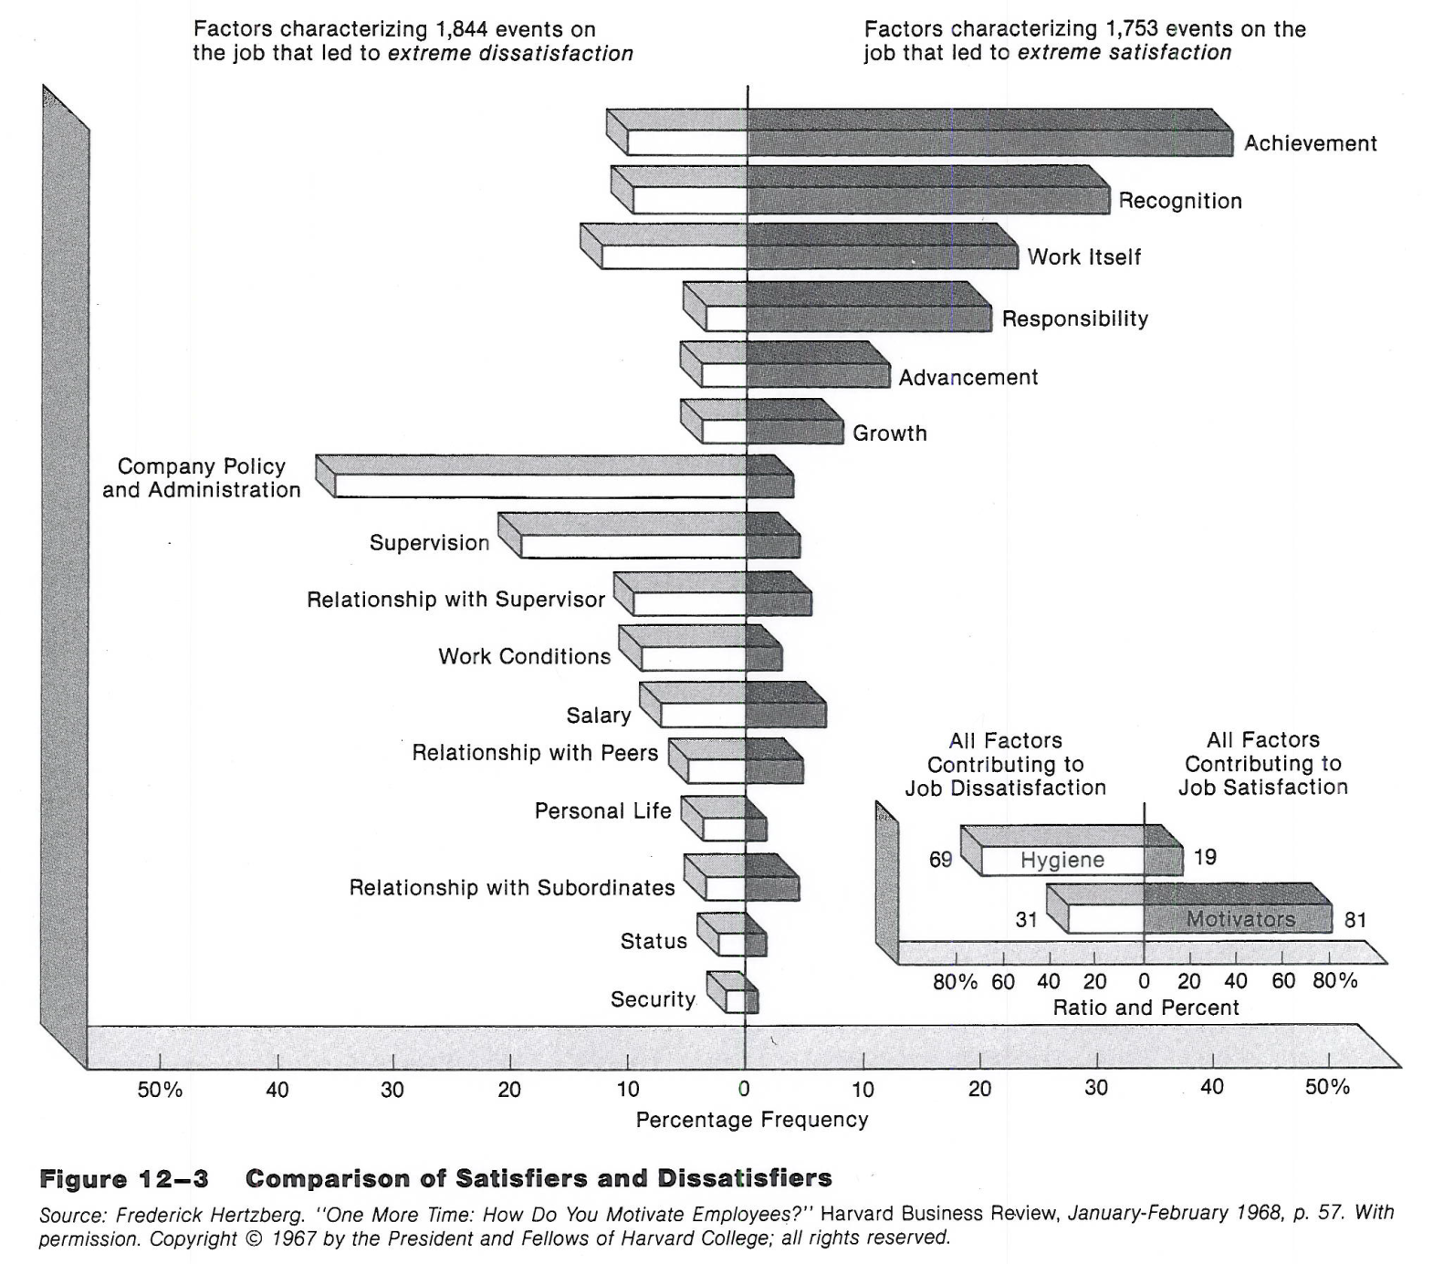
Motivators
Hygiene

Slide 10
Motivators
Hygiene
Proportional

Slide 11
Motivation
“There is only one way under high heaven to get anybody to do anything. And that is by making the other person want to do it.”
Dale Carnegie

Slide 12
Motivation: Process Theories
Equity Theory:
People want to be treated fairly in relation to others (the referent group)
This is a comparison of two ratios of Outputs and Inputs
A person will compare their ratio (personal) with the ratio of relevant others (referent) …
Inputs
Personal contributions to the organization: education, experience, ability, effort, & loyalty
Outputs
Rewards to the person: pay, promotion, recognition, & social relationships
Comparison Outcomes:
Under Rewarded: $\frac{O_{p}}{I_{p}} <\frac{O_{r}}{I_{r}}$
Equity: $\frac{O_{p}}{I_{p}} ≅\frac{O_{r}}{I_{r}}$
Over Rewarded: $\frac{O_{p}}{I_{p}} >\frac{O_{r}}{I_{r}}$
Inequity results in cognitive dissonance (mental tension)
If a person perceives inequity, they will adjust their behavior accordingly …
J. Stacey Adams

Slide 13
Motivation: Process Theories
Equity Theory, continued:
If Under Rewarded in comparison to the Referent:
They may put forth less effort in the future
They may press for greater rewards (higher salary, bigger office, better title)
They may rationalize (mentally distort their own or others perceived inputs)
They may leave the situation (quit or transfer to another group)
If Over Rewarded in comparison to the Referent
They tend to contribute more to the organization (larger quantity / higher quality)
Equity Theory has been shown to work, with one major problem …
… establishing who the referent group is … three categories:
System – the comparison is within the organization in terms of pay policies and procedures and administration of the system
Self – the comparison is with their own self in terms of past jobs or family commitments
Other – the comparison is with other individuals with similar jobs in similar organizations
Scientists tend to compare with their peers within their system
Engineers tend to compare with their peers in industry (other) as well as within their system
J. Stacey Adams

Slide 14
Motivation: Process Theories
Expectancy Theory:
The strength of a tendency to act in a certain way depends on the degree of expectation that the act will be followed by a given outcome and on the attractiveness of that outcome to the individual.
Basic Model:
Effort will lead to Performance which will lead to Outcomes
… of course, Performance is mitigated by the operational environment and one’s ability
The Expectancy strength is the mathematical product of three values:
Effort to Performance Expectancy: the likelihood that one’s effort will result in the desired performance – a value from 0.0 (no chance) to 1.0 (certainty)
Performance to Outcome Expectancy: the likelihood that the performance will result in the desired outcomes – a value from 0.0 (no chance) to 1.0 (certainty)
Valence of the Outcomes: the desirability of the outcome to the performing individual – a value from 0.0 (no chance) to 1.0 (certainty)
A higher Expectancy strength represents better motivation to attempt a task
Expectancy values can be thought of as the probability of getting someone to act
Victor Vroom

Slide 15
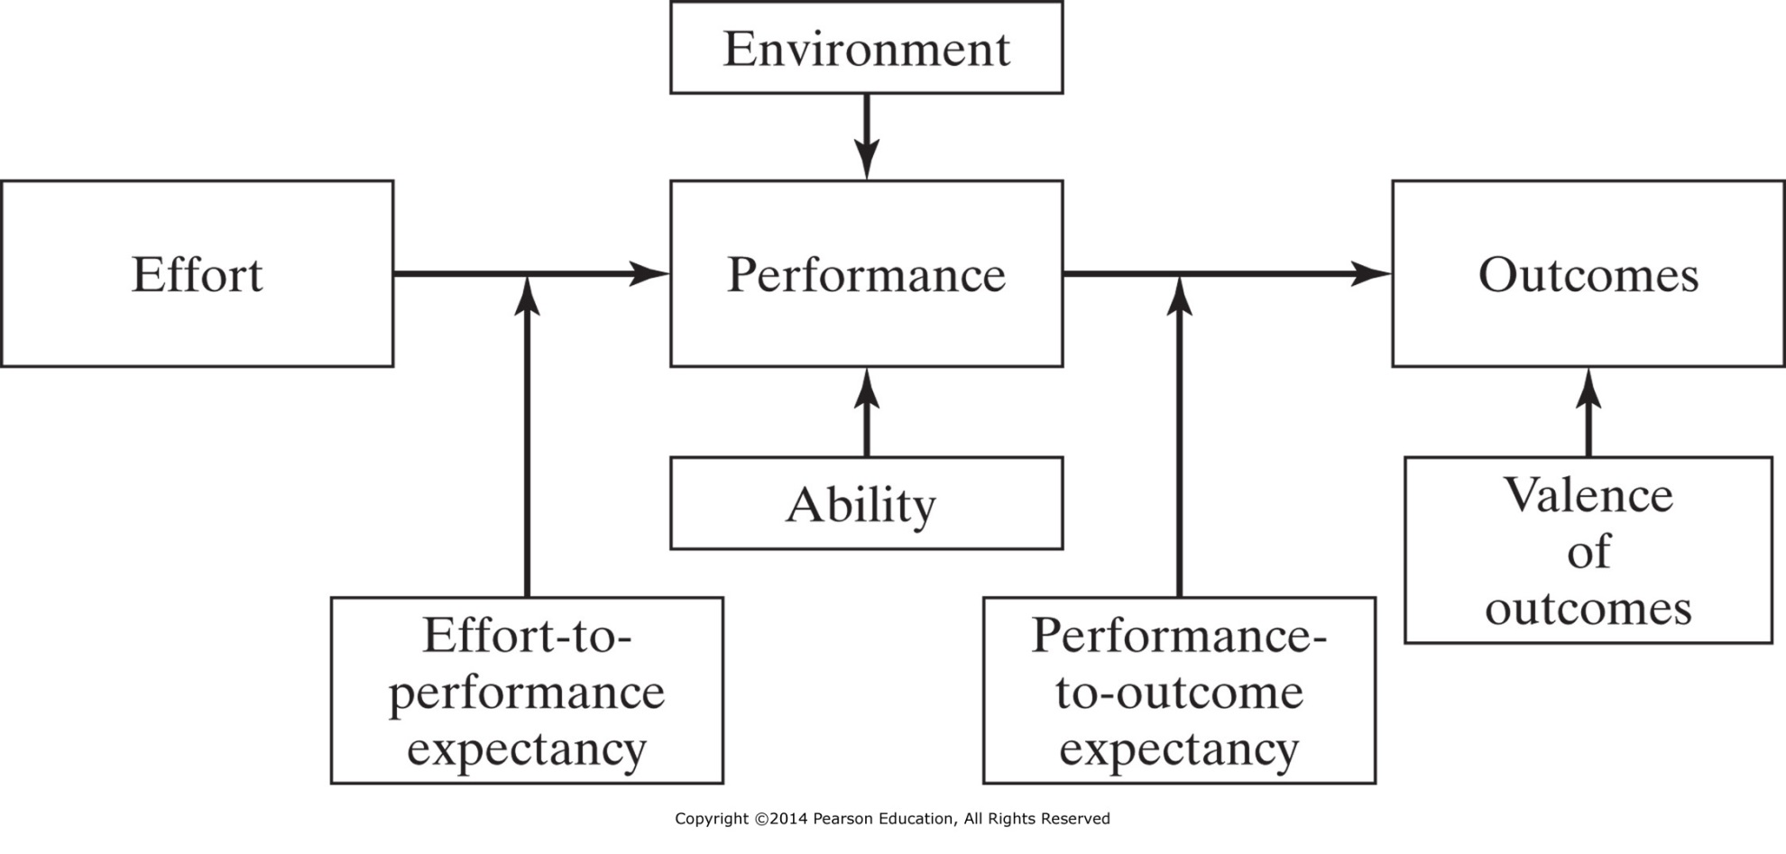
Figure 3-3 Expectancy theory of motivations.
$$Expectancy=(EP)×(PO)×(V)$$

Slide 16
Motivation: Process Theories
personal Belief that task needs to be done adjusts
equity of previous outcome affects Satisfaction which adjusts
$$Expectancy=(EP)×(B)×(PO)×(V∙S)$$
Porter – Lawler Extension

Slide 17
Motivation: Process Theories
Reinforcement Theory:
Behavior is followed by an immediate event (reinforcement) that affects the probability that the behavior is repeated.
Four Types of Reinforcement:
Positive Reinforcement increases the probability that the behavior will be repeated by providing a reward
- getting bonus points if you are in class on the day we do the “Name Quiz”
Negative Reinforcement (avoidance) increases the probability that the behavior will be repeated by letting the person escape an undesired consequence
- getting to skip the pre-test if your homework is turned in by the start of class
Punishment decreases the probability that the behavior will be repeated by imposing an undesired consequence
- getting an “F” grade when you get caught cheating
Extinction decreases the probability that a behavior will be repeated by withholding both reinforcements and/or punishment (ignoring)
- never laughing or even groaning at the professor’s corny Iowa jokes
B.F. Skinner

Slide 18
Motivation: Process Theories
Reinforcement Theory:
Notes on implementation:
Reinforcement and Extinction tend to be most often used …
Punishment works more quickly than Extinction, but the effect is often only temporary and it is more likely to lead to undesirable side-effects (absenteeism, turnover)
Scheduling Reinforcement is important:
Continuous Reinforcement Schedules: provide the reinforcement after every instance of the behavior
Intermittent Reinforcement Schedules: provides a reinforcement after a varying number of instances of the behavior.
Evidence indicates that Intermittent Reinforcement promotes steadier and stronger behaviors
Los Vegas knows this – think about how casino slot machines work!
B.F. Skinner

Slide 19
IENG 366 Engineering Management
Questions & Issues?

