Slide 1
IENG 366
Leading Technical People
Reading: pp. 50 – 64.

Slide 2
Nature of Leadership
“Leadership is the ability to get people to do what they don’t want to do and like it”
Harry S. Truman

Slide 3
Managers & Leaders are Different
Some of the leader and manager characteristics according to Warren Bennis described in the following chart:
Managers | Leaders
Administer | Innovate
Ask how and when | Ask what and why
Focus on systems | Focus on people
Do things right | Do the right things
Maintain | Develop
Short term perspective | Longer term perspective
Imitate | Originate
Are a copy | Are original

Slide 4
Functions of Managers: Kootz (Fayol)
Planning
Organizing
Staffing
Leading
Controlling

Slide 5
Leadership
Are Leaders Born or Are Leaders Made?
How does one become Queen or King today?
How did one become a Monarch in Medieval Times?
How did the earliest Kings (or Queens) get selected?
Are there parallels in non-Western cultures?

Slide 6
Leadership: Traits
Born Leaders?
Physical Qualities:
Health, Vitality, Endurance
Personal Attributes:
Personal Magnetism, Cooperativeness, Enthusiasm,
Ability to Inspire, Persuasiveness, Forcefulness, Tact
Character Attributes:
Integrity, Humanism, Self-Discipline, Stability, Industry (hard work)
Intellectual Qualities:
Mental Capacity, Ability to Teach, Scientific Approach to Problems
Peterson & Plowman

Slide 7
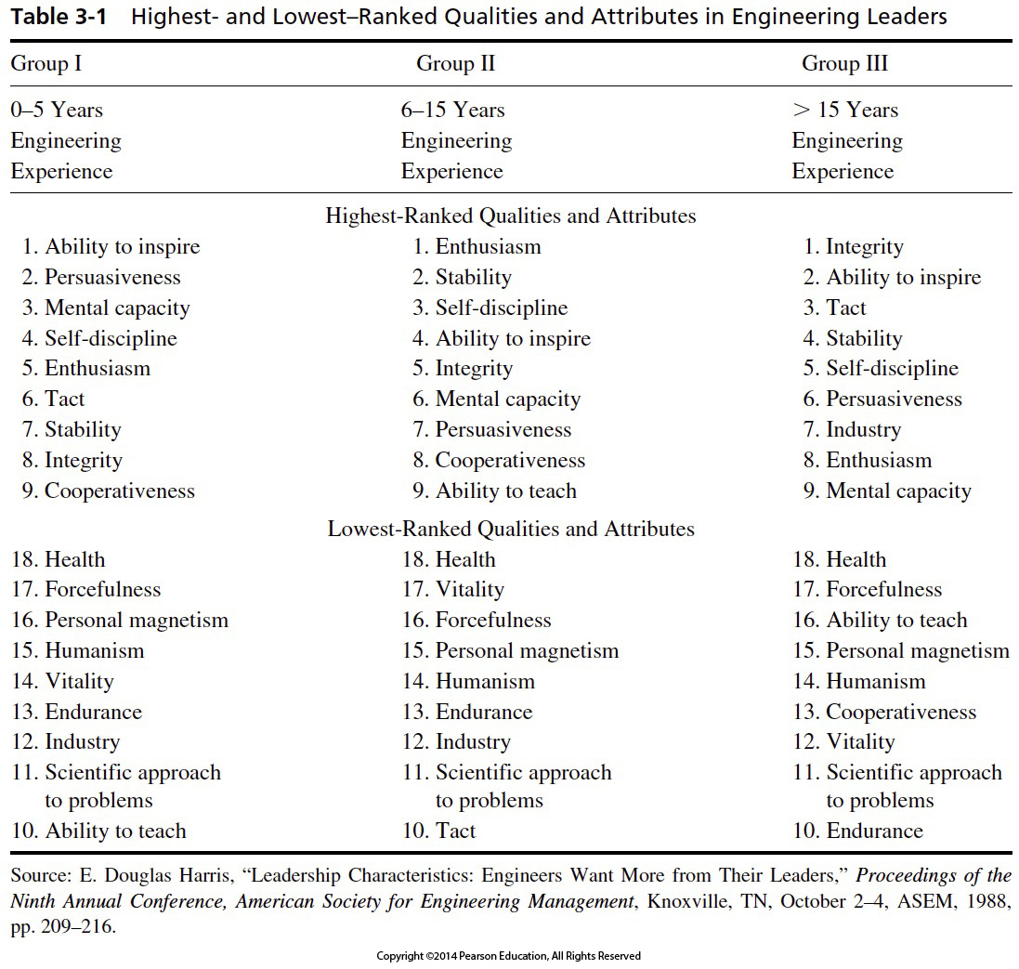

Slide 8
Leadership: Traits
Myers-Briggs Type Indicator (MBTI):
Extroversion vs Introversion:
Extroverts focus on the outer world of people and things
Introverts focus on the inner world of ideas and impressions
Intuition vs Sensing:
INtuition focuses on the future, with a view toward patterns and possibilities
Sensing focuses on the present and on concrete information gained from the senses
Thinking vs Feeling:
Thinking bases decisions on logic and on objective analysis of cause and effect
Feeling bases decisions on values and on subjective evaluation of personal-centered concerns
Judging vs Perceiving:
Judging prefers to have things settled – a planned & organized approach to life
Perceiving prefers to keep options open – a flexible & spontaneous approach to life
Successful Engineering Managers often evaluate as ENTJ
Leaders in Research Organizations often evaluate as INTJ
Only about 2% of the population falls into either of those two categories!

Slide 9
Nature of Leadership
“If your actions inspire others to dream more, learn more, do more and become more, you are a leader. ”
John Quincy Adams

Slide 10
Leadership: Behavioral
Can one Learn to be a Leader?
The Ohio State Studies:
Looked at over a thousand dimensions of leaders, boiled them down to two:
Initiating Structure (IS):
A leader high in initiating structure will assign group members to tasks, and expect them to maintain performance standards and meet deadlines. A leader might also be low in initiating structure.
Consideration (C):
A leader high in consideration is friendly, approachable to subordinates, helps them with personal problems, and treats them as equals. A leader might also be low in consideration.
A leader high in both IS and C (high-high) generally got both better subordinate performance and satisfaction ratings.
But, when subordinates were performing routine tasks, the high-high leaders tended to have more turnover, more grievances, more absenteeism and had lower job satisfaction among their workers. And High C leaders tended to get lower performance ratings by their supervisors.

Slide 11
Leadership: Behavioral
Can one Learn to be a Leader?
The University of Michigan Studies:
(1940s) looked at behaviors related to effective performance – found two grid dimensions:
Employee Oriented:
A leader who was employee oriented tended to emphasize interpersonal relationships, took interest in the needs of their subordinates, and accepted differences.
Production Oriented:
A leader who was production oriented usually emphasized the technical/task nature of the job and were mainly concerned with accomplishing the groups tasks. They rewarded their workers as a means to achieve those goals.
Conclusions showed that employee oriented leaders were strongly favored to obtain higher group productivity and higher group satisfaction. Production oriented leaders were associated with low group productivity and lower group satisfaction.
The OSU and U. Mich. studies had enough exceptions to show that situational factors also play a significant part.

Slide 12
Leadership: Behavioral
Can one Learn to be a Leader?
The Leadership Grid:
Put the U. Mich. and OSU studies into a two dimensional grid. Dimensions were:
Concern for People (Employee Oriented / Consideration):
Scale ran form 1 to 9, with higher values emphasizing interpersonal relationships subordinates, needs of their subordinates, and tendency to accept subordinates as equals.
Concern for Production (Production Oriented / Initiating Structure):
Scale also ran from 1 to 9, with higher numbers emphasizing the tasks to be done, the performance to be attained, and accomplishing the group’s tasks on-time.
Result was a 9 x 9 grid showing where the dominant factors in the leader’s thinking were when trying to obtain the desired performance. Five of those regions became named and described. (see next slide)
Conclusion was that a 9,9 style was best for managers, but there was little evidence that using 9,9 worked best in ALL situations – or that a 9,9 style was even possible in most circumstances.
Blake & Mouton

Slide 13
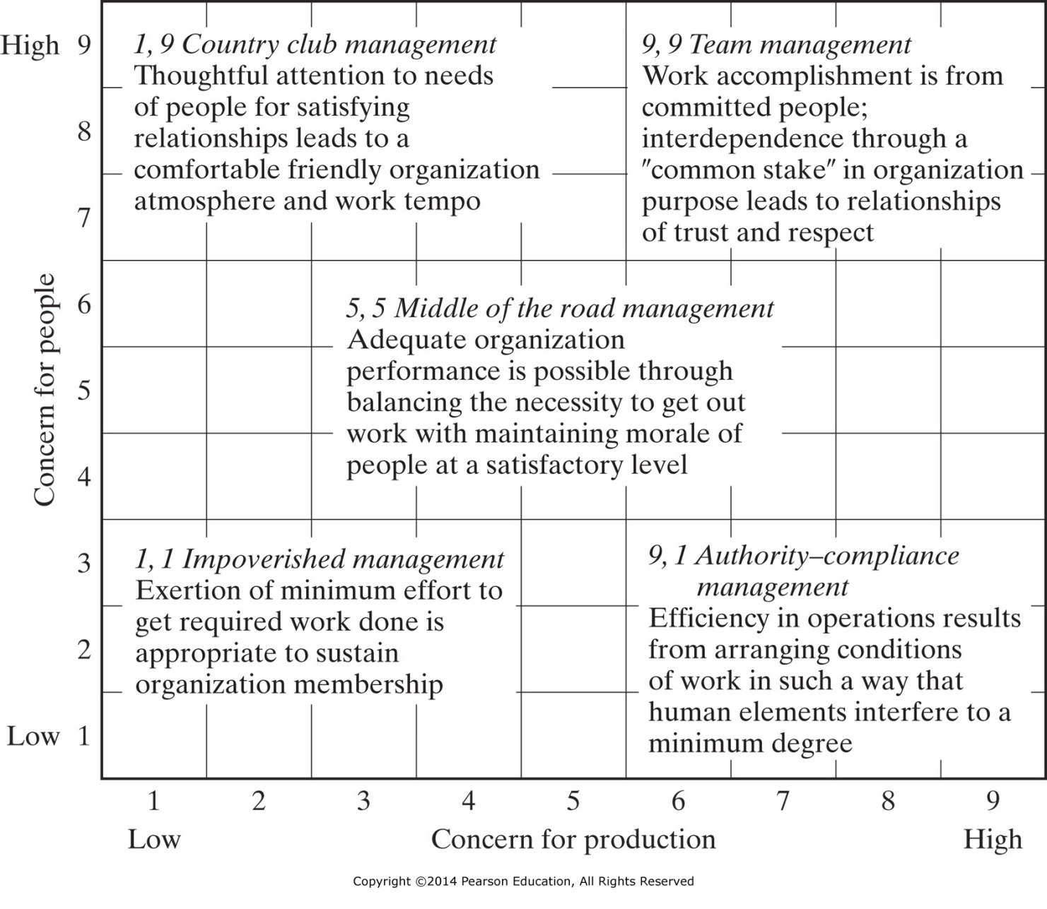
Figure 3-1 The Leadership grid figure. From Leadership Dilemmas—Grid Solutions, by Robert R. Blake and Anne Adams McCanse. Gulf Publishing Company, Houston, TX, copyright 1991 by Scientific Methods Inc., p. 29; reproduced by permission of the owners.

Slide 14
Leadership: Contingency
Leadership is Situational
Life Cycle (Maturity) Theory:
Put the OSU dimensions into a 2 x 2 matrix. Again, the dimensions were:
Initiating Structure (IS):
A leader high in initiating structure will assign group members to tasks, and expect them to maintain performance standards and meet deadlines. A leader might also be low in initiating structure.
Consideration (C):
A leader high in consideration is friendly, approachable to subordinates, helps them with personal problems, and treats them as equals. A leader might also be low in consideration.
The most effective leadership style progresses with time through all four “quadrants” of the OSU model during the life cycle of the task (as annotated on the next slide).
Hersey & Blanchard

Slide 15
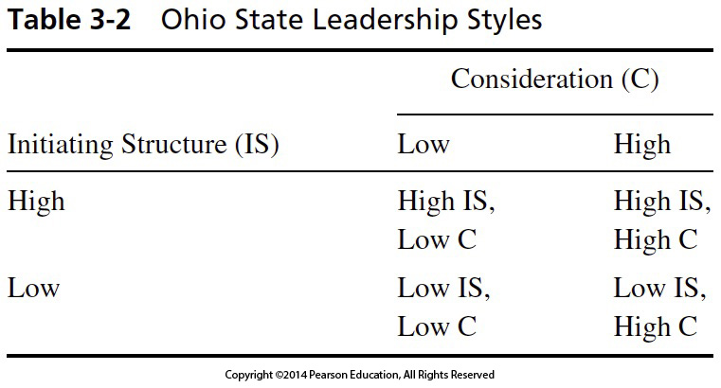
Table 3-2 Ohio State Leadership Styles
Life Cycle (Maturity) Theory
Leadership: Contingency
Hersey & Blanchard

Slide 16
Leadership: Contingency
Leadership is Situational
ContinuumTheory:
Review the OSU dimensions, treating the degree of emphasis as a spectrum between:
Autocratic Leadership:
where the leader makes the decision, tells subordinates, and expects them to carry out that decision.
Democratic Leadership:
where the leader fully shares the decision-making power with subordinates, with each group member having an equal voice/vote.
Continuum is Zero Sum:
The leadership emphasis starts at 100%/0% at one end, progresses through 75%/25%, and 50%/50%, past 25%/75%, and ends at 0%/100% at the far end of the scale.
Where the leader chooses to be on the continuum depends on the situation …
Tannenbaum & Schmidt

Slide 17
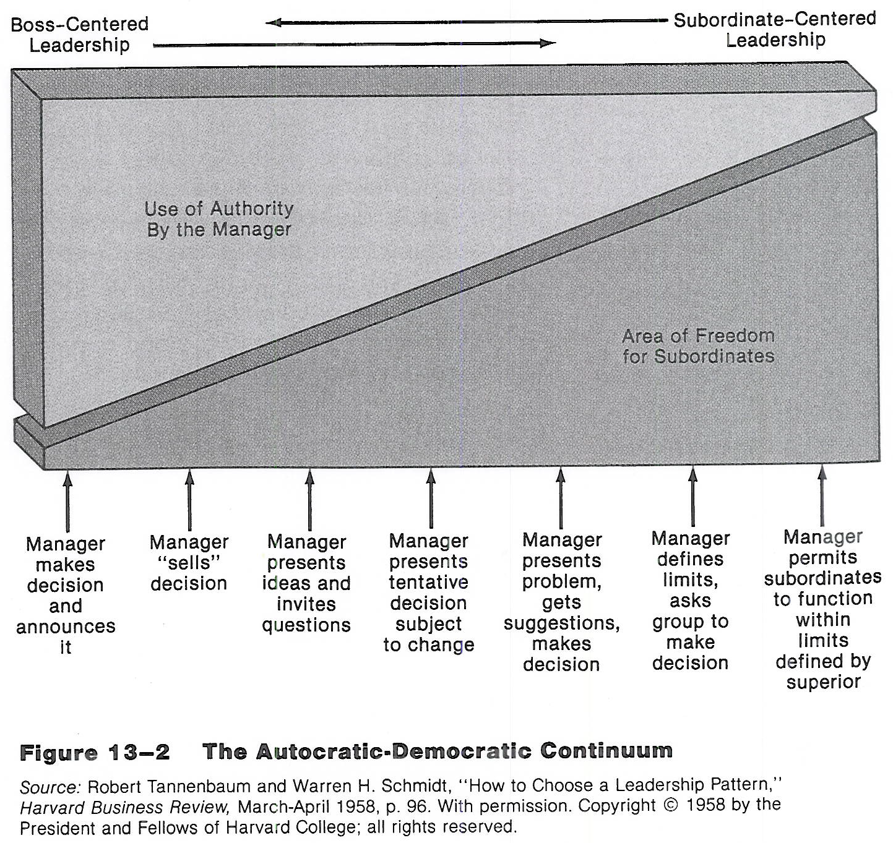
Use of Autocracy by Leader
Use of Democracy by Leader

Slide 18
Leadership: Contingency
Leadership is Evolutionary
Servant Leadership:
Practical philosophy of leadership gaining more acceptance over time:
(Future Leader) Serves First …
Similar to an apprenticeship or an engineering intern or a six-sigma green belt – usually rotating through a variety of situations – as a way to gain knowledge through experience.
… then Becomes a Leader–in–Service:
where the leader expands her / his service to the individuals and the organization – similar to becoming a professional engineer or six-sigma black belt – by taking charge of a group of future leaders and passing on her / his knowledge.
Servant Leadership Emphasizes:
collaboration, trust, empathy, and the ethical use of power – rather than top–down power.
Greenleaf (and others)

Slide 19
Leadership: Contingency
One more viewpoint
14 Types of Executive (Leader) Behaviors:
Eight Leadership Styles for those who were Merely Successful:
“ … and could have been more effective were it not for some serious weaknesses”.
Six Leadership Approaches that are Effective:
“ … in the right situation”.
Situational Leadership means that the leader must understand the motivations of (or how to motivate) subordinates.
… we will talk about motivational theories and models, next time!
Cribben

Slide 20
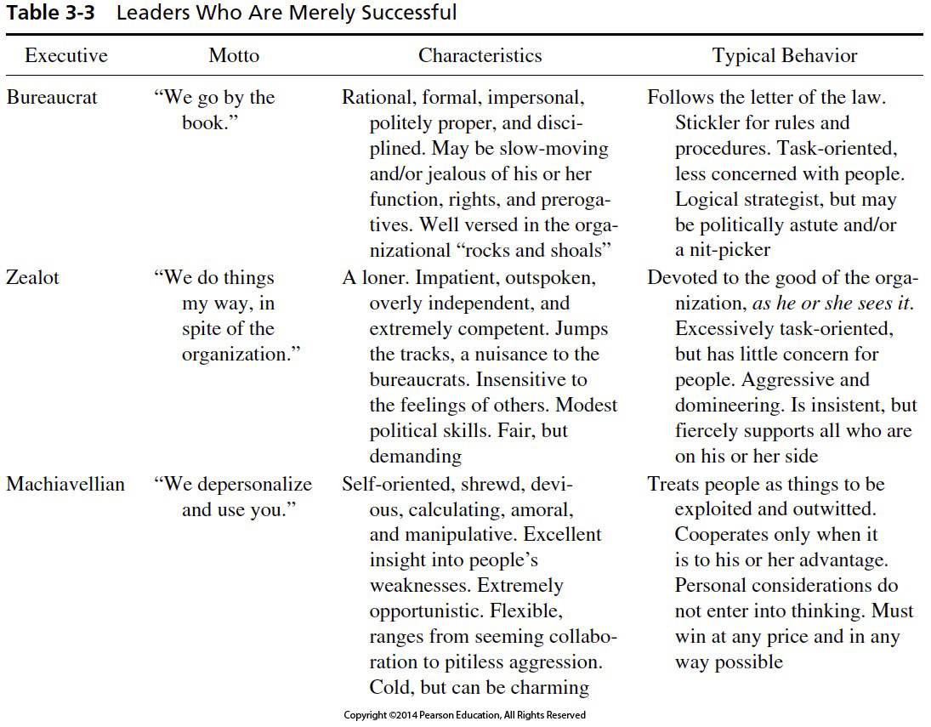

Slide 21
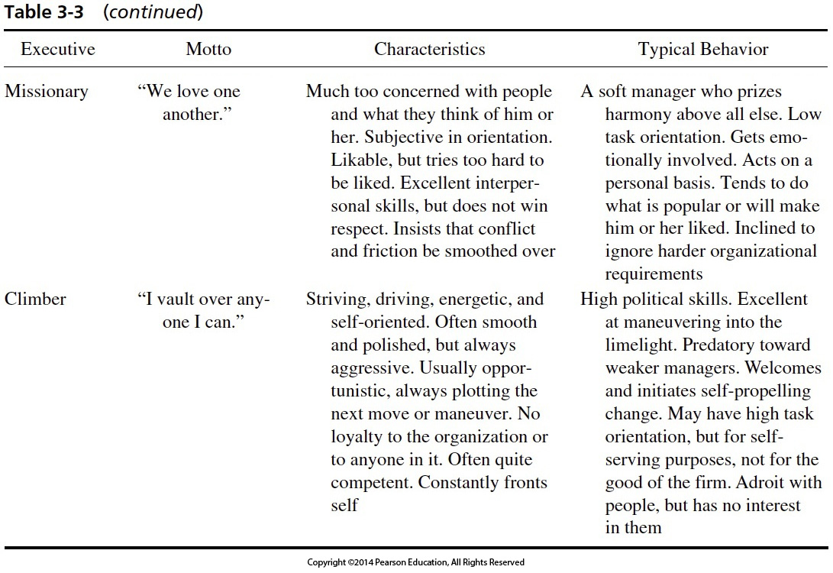

Slide 22
Exploiter
“When I bark, they jump.”
Arrogant, insistent, abusive.
Demeaning, coercive, vindictive, and domineering.
Often quite competent. Rigid, prejudiced, given to snap judgements. Exploits others’ weaknesses.
Exerts constrictive and personal controls. Flogs anyone who is vulnerable. Uses pressure and fear to get things done. Demands subservience. High task orientation. Sees people as minions.
Temporizer
“We bend to the strongest pressure.”
Procrastinating, compromising, and vacillating. Earns contempt. Feels a helpless sense of being put upon. Survival instincts may be superior. May be politically aware.
Low task orientation, low people concern. Reacts to the strongest immediate pressure. Reactive, not active. Behavior varies with pressures.
Glad-Hander
“We sell the sizzle, not the steak.”
Ebullient, superficial, effusive, deceptively friendly, and extroverted. Excellent interpersonal skills. Lacks depth, minimally competent. May be an excellent politician. Survival instincts superior. Talkative, humorous, lacks substance.
Sells himself or herself very well. Low or modest task orientation. Unconcerned with people, but excellent in dealing with them. Gets by on “personality.” Always seeks to impress and to improve his or her position. May use people, but rarely threatens them.

Slide 23
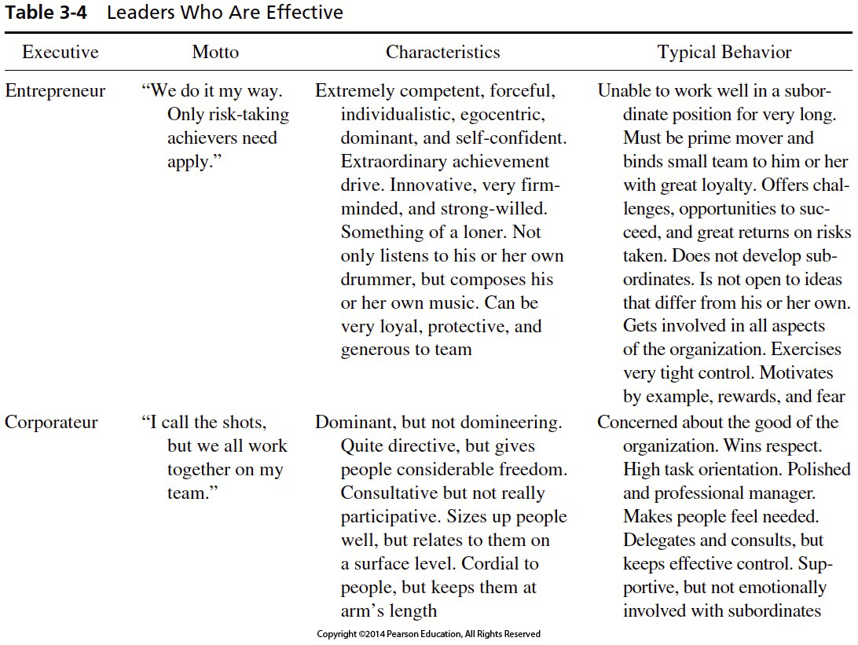
Table 3-4 Leaders Who Are Effective

Slide 24
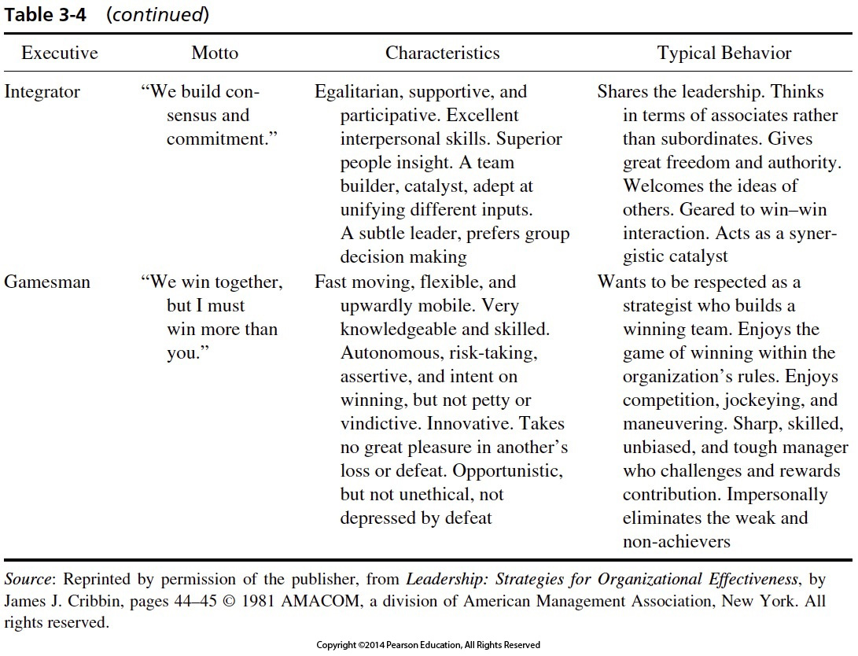

Slide 25
IENG 366 Engineering Management
Questions & Issues?

