Slide 1
IENG 366
Development of Engineering Management

Slide 2
What Do Engineers Do?
Readings: pp. 4 – 19, pp. 23 – 44

Slide 3
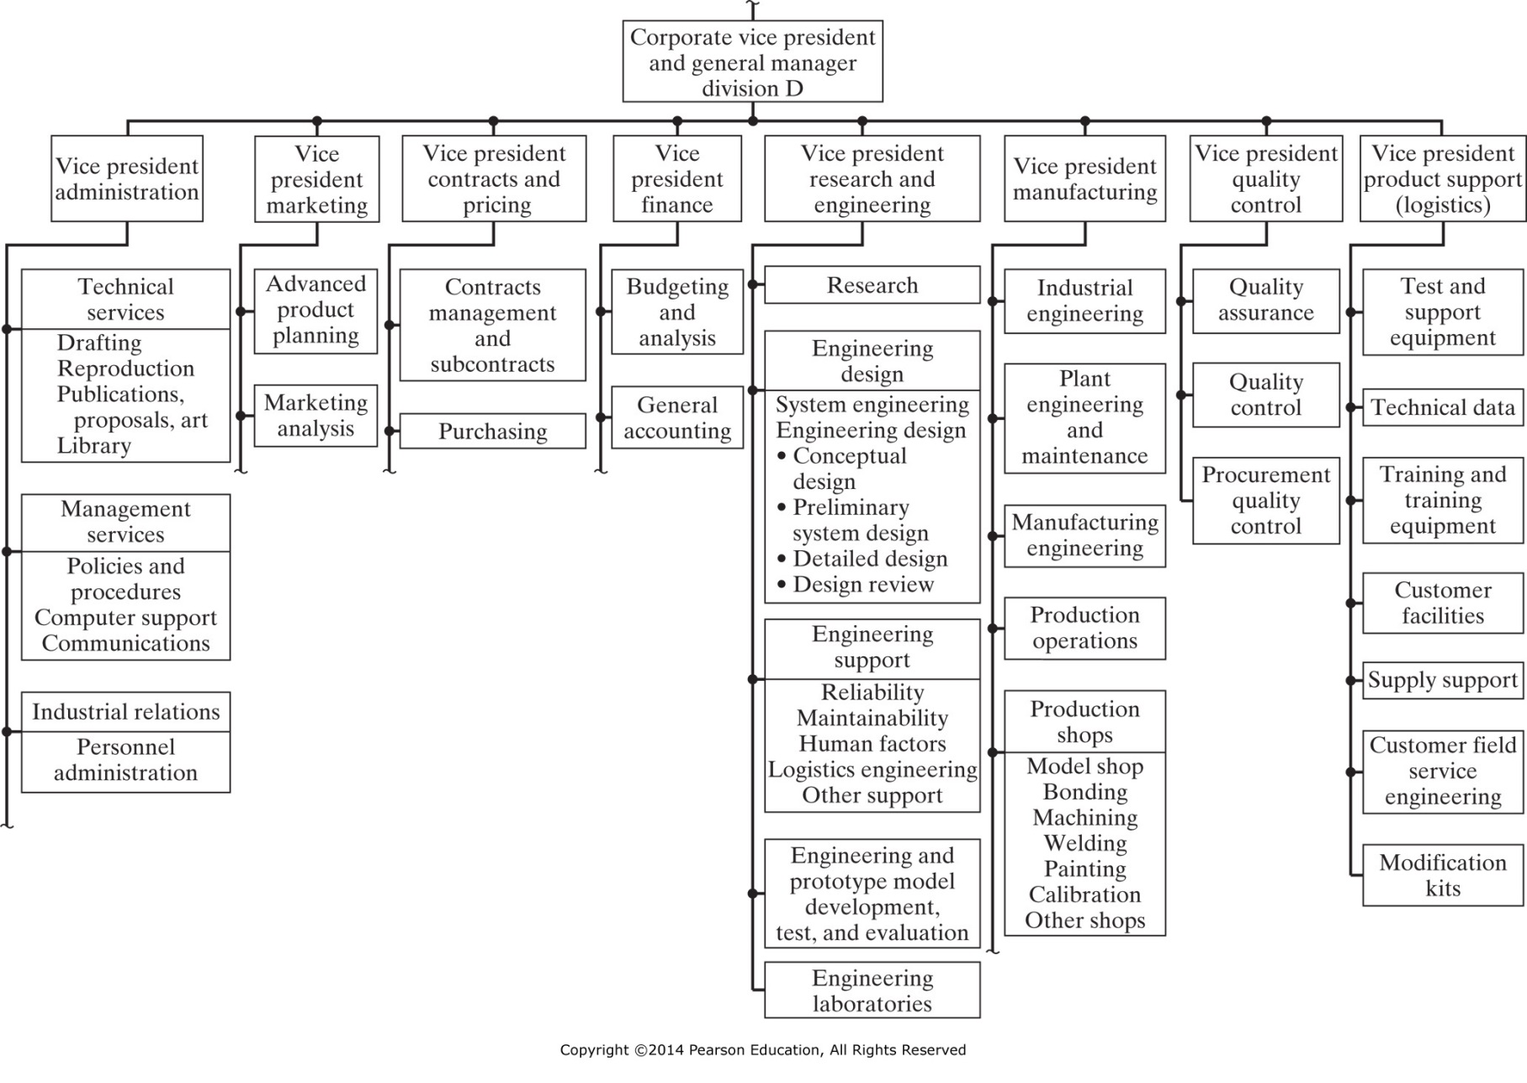
Figure 1-1 Engineering activities within a division of a large corporation. (From Benjamin S. Blanchard, Engineering Organization and Management, © 1976, Figure 10-3, p. 280. Reprinted by permission of Prentice-Hall, Inc., Englewood Cliffs, NJ).

Slide 4
Management Definitions
Organizational or administrative process
Group running an organization
Occupational career

Slide 5
Management Levels
First Line mangers
Middle managers
Top managers

Slide 6
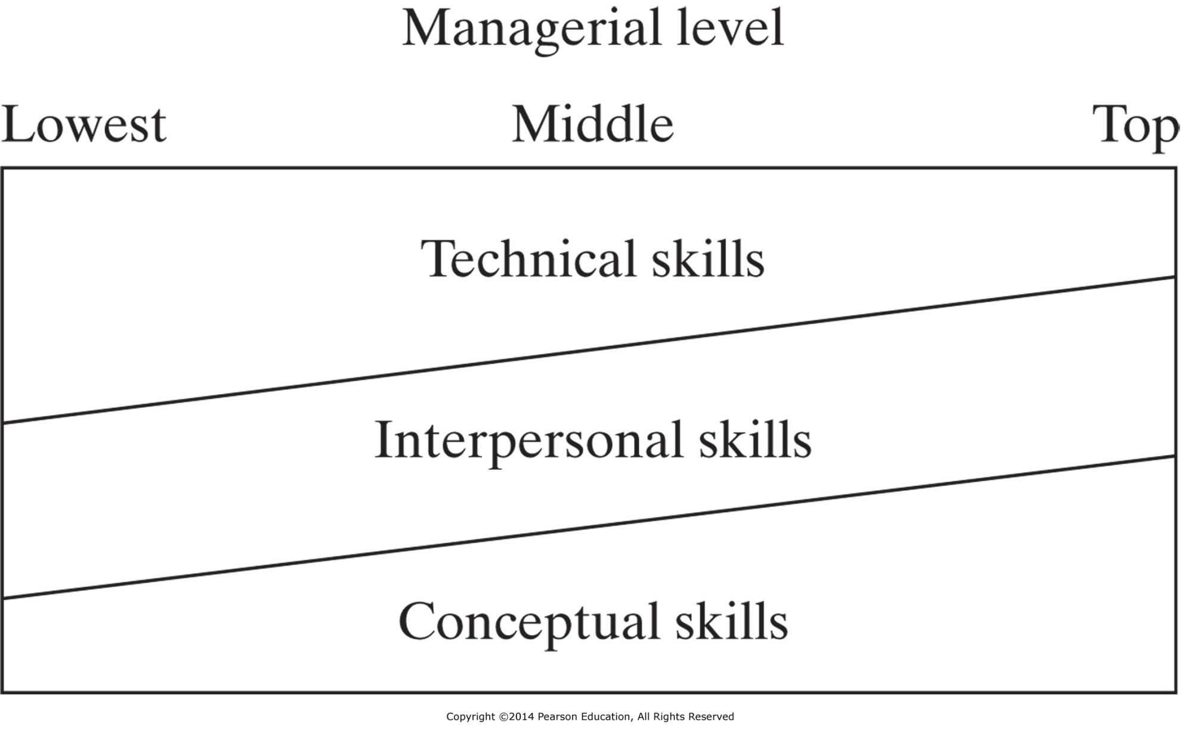
Figure 1-2 Skills required versus management.

Slide 7
Managerial Roles: Mintzberg
Decisional
Entrepreneurial
Disturbance Handler
Resource Allocator
Negotiator
Interpersonal
Figurehead
Leader
Liaison
Informational
Monitor
Disseminator
Spokesperson

Slide 8
Functions of Managers: Fayol
Planning
Organizing
Command
Coordination
Control

Slide 9
Functions of Managers: Kootz
Planning
Organizing
Staffing
Leading
Controlling

Slide 10
Engineering Management
Direct supervision of engineers or of engineering functions
Or, application of quantifiable methods and techniques to practice of management

Slide 11
Babcock
Engineering Managers are distinguished from other managers because they possess both the ability to apply engineering principles and skill in organizing and directing people and projects.
Prentice Hall, 2006

Slide 12
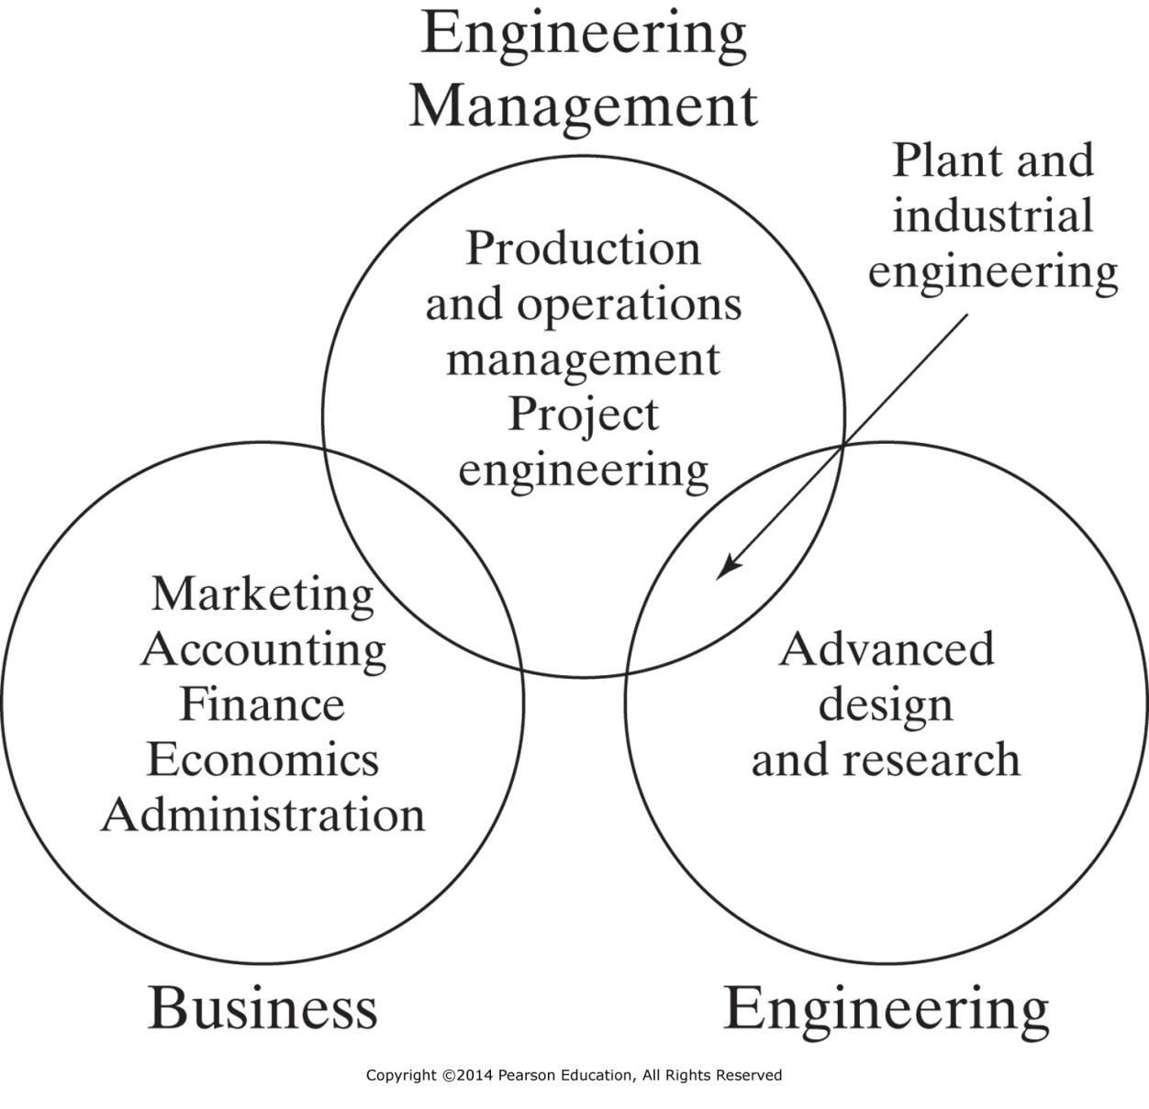
Figure 1-3 The engineering management education program. (From Daniel L. Babcock, “B.S. and M.S. Programs in Engineering Management,” Engineering Education, November 1973, p.102).

Slide 13
Ancient – Egyptians
4000 – 1600 B.C.
Built pyramids
Used managerial principles
Used job descriptions

Slide 14
Ancient – Military
Cyrus the Great (540 B.C.) Use of staff Recognized use of order and division of work
Alexander the Great (300 B.C.) Distinction between line and staff Used discipline and delegation

Slide 15
Ancient – Romans
284 B.C.
Known for building roads, bridges, and water management
Estate and farm management
Emphasis on personnel selection and placement

Slide 16
Medieval Period
Four centuries of Dark Ages
No books on management written

Slide 17
Origins – Arsenal of Venice
Early 1400s
Manufacturing
Numbering of inventory parts
Standardization of parts
Assembly line

Slide 18
Industrial Revolution 1750 – 1800
Agricultural Mgmnt
Spinning Jenny
Water Frame
Mill
Power Loom
Industrial Mgmnt
Chlorine Bleach
Steam Engine
Screw-cutting Lathe

Slide 19
Industrial Revolution Problems of the Factory System
Recruiting/Training Workers
Explosive Growth in Mill Towns
Supervisors: No Background
Upper Management: Sons or Relatives

Slide 20
Management Philosophies
Scientific
Administrative
Behavioral

Slide 21
Scientific Management
Frederic W. Taylor: (1856–1915) Engineer
Father of Scientific Management
Time and Motion Studies
Believed in selecting, training, teaching, and developing workers

Slide 22
Scientific Management
Frank B. Gilbreth: (1868–1924) Contractor
Devised a system for classifying hand motions into 17 basic divisions (called Therbligs)
Lillian Moller Gilbreth: (1878–1972) Psychologist First Lady of Management – expanded their work
Pioneered the field of Human Factors

Slide 23
Scientific Management
Replaced old “rule of thumbs”
Believed in selecting, training, teaching and developing workers
Time Study
Standards Planning
Ergonomics and Human Factors

Slide 24
Administrative Management
Henri Fayol: (1841–1925) Engineer
Developed 14 “General Principles of Administration”
Divided management activities into five divisions
Planning
Organizing (including staffing)
Command (Leading)
Coordination (Leading)
Controlling

Slide 25
Modern Administrative Functions of Managers
Planning
Organizing
Staffing (included in organizing)
Leading
Controlling

Slide 26
Comparison: Fayol and Taylor
Both referenced functional specialization
Fayol – principles of management
Taylor – secure efficiencies
Both emphasized “one best way”

Slide 27
Administrative Management
Max Weber: (1864–1920) Industrialist Major influence in a classical organizational theory
Division of labor
Hierarchy of authority
Employment based on expertise
Inflexible
Rigid
Impersonal
Bureaucracy

Slide 28
Behavioral Management
Hawthorne Studies
Abilene Paradox
Maslow

Slide 29
Behavioral Management: Hawthorne Studies – 1930s
Original intent was to find the level of illumination that made the work of female coil winders, relay assemblers, and small parts inspectors more efficient.
Conclusion – persons singled out for special attention perform as expected
Not everything is explained by Scientific Management – there are interactions with other, human elements

Slide 30
Behavioral Management: Abilene Paradox
Coleman TX – Abilene TX
Someone suggests that the group do something
No one in the group actually thinks it a good idea, but …
No one wants to appear disagreeable,
so no one speaks up
End result is that the action taken has a bad outcome
Failing to manage agreement effectively

Slide 31
Behavioral Management: Maslow – 1960s
Hierarchical theory of human needs Biological / Physiological Needs (lowest level) Security / Safety Needs Social Needs Ego Needs Self-actualization Fulfillment (highest level)
Can’t progress to higher motivation as long as a lower level need is un-met

Slide 32
Contemporary Management Issues: Challenges
Quality and Productivity
Customer Focus
Information Technology
Project Management
Globalization
Management Theory and Leadership

Slide 33
Contemporary Management: Applied Perspectives
Peter Drucker
Peter Senge
Steven Covey
Tom Peters
Scott Adams
Michael Porter
Jim Collins
Thomas Friedman

