Slide 1
The Project
IENG 248 Lab

Slide 2
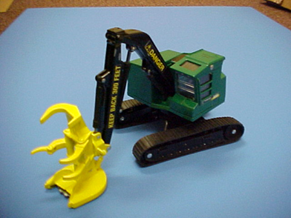
The assignment
Groups of 4 people.
Divide work up evenly among group members.
Each member will do at least one assembly, and the parts of each assembly are to be divided up evenly.
You will be recreating this toy in Solidworks and printing it out turning in each part drawings, A BOM (build of materials), Assembly drawings and the finished product.

Slide 3
What you will complete.
Each individual person will be responsible for:
One Sub-Assembly Drawing
¼ of the parts in EACH Sub Assembly
The Part Drawings for the parts they create
The data on those parts needed for the BOM
Printing out a ¼ of the Total parts in the Full Assembly
As a Team:
Organize the workload amongst yourselves
Complete the Cover Sheet (The Full Assembly Drawing)
The BOM (Build of Materials)
Editing individual parts to to make assemblies work

Slide 4
What you will turn in: The Feller Buncher.
- The Housing Assembly
o The Cab Roof
o The Cab
o The Seat
o The Engine Housing
- The Drive Train Assembly
o The Gear
o The Chassis
o The Wheels
o The Tread
- The Arm Assembly
o The Lower Arm
o The Upper Arm
o The Outer Piston
o The Inner Piston
o The End Factor Connector
- The Tool Claw Assembly
o The Housing
o The Crown Claw
o The Double Claw
o The Claw Joint
o The Single Claw
o The Little Outer Piston
o The Little Inner Piston
o The Saw Blade
All printed out and assembled so that the assembly functions to the same extent of movement that the model we are basing it off of does.

Slide 5
Organizing for a large project
By the end of this project you will have many parts, many .STL’s, a few assemblies, and a large drawing book. Keeping these organized will be a key part of success for you and your group.
-Assigning serial numbers to individual parts could be an effective way of going about this.
Ex: DT_Tr_1 (Drive Train Assembly_Tread_Version One)
This can be effective because you can keep all the parts organized and dated so you know which is the correct one.
-Do what works best for you and your group so you print out the right parts you need and have everything ready to turn in at the end.

Slide 6
Print Requirements
To be allowed to 3D print you need to:
Have the completed part file converted into an .stl file.
The .stl file sliced into G-Code.
The Part file put into an assembly with any part it connects to.
Show me:
The print ready G-Code. (The Preview).
How the part connects to the other parts in the assembly with correct tolerancing.

Slide 7
What you Will turn in: The Design book.
If someone can perfectly recreate your product from all the drawings without question then you have succeeded. You will also need to turn in all the part files.
Organize your project like a book:
Cover sheet
BOM (Build Of materials)
Sub assembly 1, Followed by Each part of the assembly in order.
Sub assembly 2, Followed by Each part of the assembly in order.
Sub assembly 3, Followed by Each part of the assembly in order.
Sub assembly 4, Followed by Each part of the assembly in order.

Slide 8
The Cover Sheet
The full assembly drawing
Showing off the all the parts put together in a “Natural state”
Showing the 3 basic Dimensions. Think about “How big does the box need to be to hold it”
Include a edited title block for your “Company” (team).

Slide 9
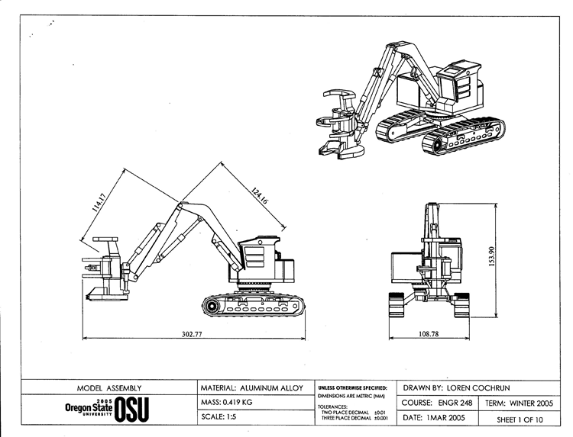

Slide 10
The BOM (Build Of Materials)
The “Table of Contents” for your design book.
Create a table with your parts in order.
Include the name of each part, The assembly it belongs to, The mass of each part in PLA (or whichever filament you're printing with, The cost of of the material used, and the quantity of the part.
For the assemblies add up the values of each part.
Do this for the 3d printed version and a version as if it's made out of anything else.
EX: Chocolate, Aluminum, Rubber, Wood, Multiple.

Slide 11
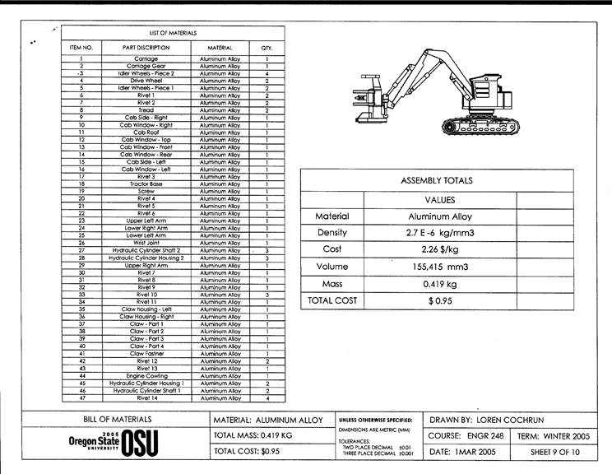

Slide 12
The Sub Assembly Drawings
The “Chapters” of your book
Create a blown out view of your assembly.
Number and label each part to make clear where they go in the assembly and to number the order of the part drawings appear in your book.

Slide 13
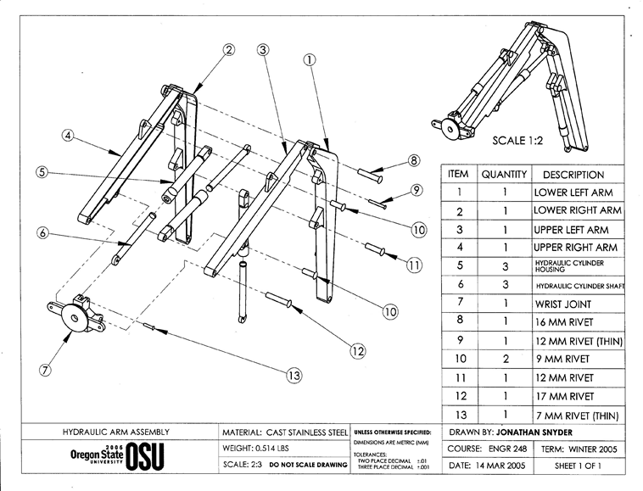

Slide 14
The Part Drawings
Each part that makes up the full assembly
Present with all the views necessary for the specific part
Present all the measurements and information needed to completely recreate your part without question.
Have the title block edited to fit your personal document.
Title blocks Include:
Drawn By Name
Company Name
Material
Scale
Mass
Revision Date
Tolerancing
Unit
Sheet Number
Course and Term

Slide 15
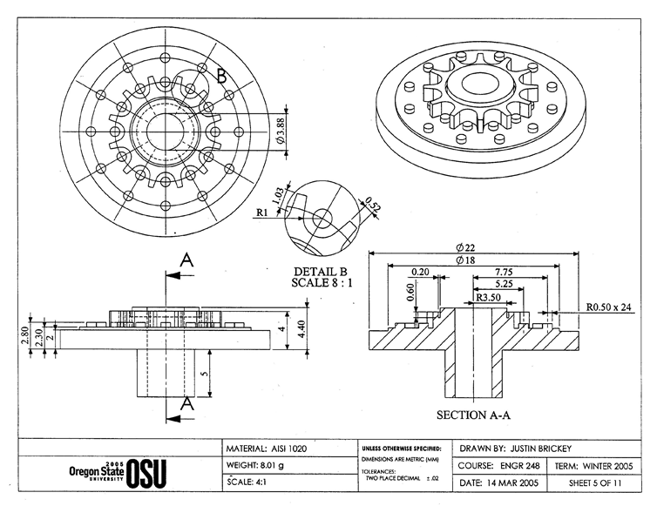

Slide 16
Extra Credit Opportunities
An Alternate End Factor
Create an assembly to replace the Tool Claw that will easily swap with the Tool Claw.
You only need to design it. (Printing is optional)
Solidworks simulation
Complete a stress analysis on the arm assembly using a non-PLA material.
Create an animation of your assembly working or blowing out the assembly parts
*Each Person can only do one. Each team can only do one of each.

Slide 17
Turning in your final project.
-Open the F: drive from your computer
-Go to the folder labeled tmpfiles
-Go to the folder labeled IENG 248 Term Projects
-Create/find the folder with your team name, and open it
-Copy all of the following files into the folder:
-Each individual part file
-Each individual drawing file
-Any assembly file(s)
-Any other files that your team wishes to submit for grading
-Send an E-mail to the instructor with the following subject:
IENG Final Project – and add your team name at the end
-In the body of the e-mail text:
-List each team member and the part files / drawings / etc. that they created for the project – one student per line.
-Hit the send button
Go enjoy your break!

