Slide 1
Intro To SolidWorks
& 3D Printing
IENG 248L

Slide 2
Getting Started With SolidWorks & MakerBot

Slide 3
Will it 3D Print?
Even if it works perfectly on the computer screen it may not print correctly. Keep in mind Makerbots have a resolution of 100 microns so keeping good tolerances will be necessary to make sure your pieces fit. Another thing to keep in mind is that the nozzle diameter is .4mm which limits the size of what you can print with this machine.
Super high detail in solidworks will definitely look good on the computer screen but depending on the sizing the objects might not not be printable at all.
When making connector pegs and axles be sure to make them large enough to have a solid shape.
0.3mm is about as small of a feature you can make.

Slide 4
Saving a file as an .stl
For an individual part, Go to Save As-> run through the pull down menu of available file types and select .STL
-I recommend keeping a good file system for all your projects as you will start to accumulate a lot of files.

Slide 5
3D Printing Software

Slide 6
What is a Slicer?
A program used to to convert a .stl file into G-code by slicing the object into layers and plot points on a 3 dimensional graph as per the settings given.
Sli3er is the backbone of most 3D printing software but some companies make their own based off it.
The slicer program is not the program you launch to prepare a .STL for printing. It is, however, embedded in the program as the settings and and the actual slice.

Slide 7
Which Program? Makerbot/Repetier/Cura/ MatterControl/Simplify3D
Repetier- Open source, Can be used with any printer without an proprietary file type. Has a steeper learning curve do to not hiding any settings behind “advanced”.
Cura- Made by ultimaker but can be used by most other printers out there. A much cleaner more sleek design although going past the basic settings can be a bit more challenging.
MatterControl- Made by MatterHackers another sleek design. But adds more abilities like saving files to the program, and cost estimation. *Has paid for add-ons.
Simplify3D- Pay by subscription, Holds all the abilities of the others plus direct sliced model manipulation like custom supports.
MakerBot- This is entirely proprietary for MakerBots for both the printers and the program. Not as many features, however, does work very well with makerbots machines.

Slide 8
Downloading MakerBot
https://support.makerbot.com/troubleshooting/makerbot-desktop-software/software-download/download_12190
Click on the windows 64 bit version.

Slide 9
Preparing a file for slicing
Uploading an .stl into Makerbot should autocenter the object. But you can still manipulate the file before slicing using the icons seen to the right.
-The eye ball allows you to change your view without moving the object.
-The cross arrows allows you to move the object anywhere on the build plate.
-The circle arrows allows you to rotate the object. (The largest flat surface should be on the plate.)
-The double squares allow resizing the object. (The entire object scales not just individual characteristics.)

Slide 10
Settings in a slicer program
Temperatures, speeds, supports, rafts, and everything in this will affect the outcome of your product so it's important to make sure you have the correct settings for each individual part as everyone will need some tweaks in settings to have the best outcome.
Note: When hitting print in makerbot it will use the settings currently saved to the software to slice it so if you previously made a .thing file for that object its settings may be altered.

Slide 11
Slicing and being ready to print.
Makerbot doesn’t have post slicing capabilities so it’ll slice and directly save your files as .thing files when you hit “Export Print File”. This the Makerbot proprietary version of a G-Code file.
To view the sliced file before you send it to print hit preview and look through all the layers to make sure it is doing what you want it to.
In settings you will be able to change everything about the G-code before you slice it.

Slide 12
3D Printer

Slide 13
Printer Safety
Always assume the printer is hot. It takes a long time for a fully heated printer to cooled back down to room temperatures so be cautious.
Be careful around the printer when the printer is on as it is easy to get fingers, long hair, or loose sleeves stuck in the gears and belt drives.
If there's an issue with a printer or a print on the printer first stop the print and shut it down then consult your TA and/or Dr. Jensen before taking action.

Slide 14
Calibration
Bed leveling will always need to be done when the printers turn on each day and periodically through the print queues.
To do this you will need to navigate to the calibration program on the printer and follow the onscreen instructions.

Slide 15
Loading filament/unloading filament
Like calibrating the bed leveler, you will need to navigate to the program on the printer and follow the instructions.
In the print preview on the makerbot software it will show a filament estimation. Add an extra foot or so to this amount (depending on the size of the object to be printed) to estimate the amount of filament to cut.
Pay attention to the type of filament you are using as this will affect the settings you need to change before you print the part as well.
Leaving filament in the printer can result in clogging of the printer and make it unusable until it is cleaned out. So don’t forget about it!

Slide 16
Types of filament.
PLA- Polylactic Acid. It is made from natural materials mostly as a product of corn. It is the most common 3D printer filament and the most common base for composite filaments.
ABS- Acrylonitrile-Butadiene-Styrene. It's a product of oil and a more difficult material to work with.
Flexibles- There's different degrees of flexibility but it tends to be harder to print the more flexible it is.
Composites: From wood fills to stainless steel anywhere from 5% to 85% this is where the technology is expanding and allowing for more practical prints as well as newly found uses.

Slide 17
Types of Printers
FDM: Layer by layer extrusion. Using the below three set ups.
Cartesian: The most common Printer type using XYZ coordinates and print on a square, often moving print bed.
Delta: Delta printers unlike the Cartesian will use an unmoving, often circular bed but still using XYZ coordinates with the print head suspended from 3 arms.
Polar: A much more unique type of printer using Polar coordinates with a pint head that only moves up and down with a bed that will spin to reach each coordinate.
SLA/DLP: layer by layer scanning. Using photons to cure resin into a solid shape.
ADAM: Atomic Diffusion additive manufacturing. Sintering powder together to form a solid shape.

Slide 18
3D Printing

Slide 19
G-Code
This is the machine code that the printer uses to create the object. It's the same machine code used in other positioning machines line CNC and Laser Engravers.
Made up of mostly coordinates to tell the the printer where to move on it's 3rd dimensional graph.
For all the settings options you have the slicer programs those in as G-Code commands.
-A list of common G-Code commands and what they do. https://thingiverse-production-new.s3.amazonaws.com/assets/87/b0/2c/f5/4c/CheatSheet.pdf
-Editing G-Code allows for direct manipulation of the print and what the printer does before and after said print.

Slide 20
Sending G-Code to a printer
Once you have made a G-Code file (.thing for MakerBots) there a few options on getting the printer to use it. But in the basics either you have a computer run the print or you have the printer run it.
-Using an SD card, USB Drive, LAN or wifi Connection, (depending what the printer has available) you can have the printer's own on board motherboard do the work. The downside being you will be unable to alter the print in any way other than stopping it once it starts.
-Using a USB cable or Ethernet (depending on what the printer uses), you can run the print from a laptop or desktop using the printer's software. This allows a lot more options in manipulating a print as its printing and a way to monitor the print and printer directly. The downsides being any loss of the connection will end/ruin the print and the computer will be tethered to the printer for the duration.

Slide 21
Monitoring a print
While connected to one of the makerbots via the USB cord you can print directly from the makerbot software by hitting print in the upper right to begin.
Makerbot doesn’t have as many options as other programs in what you can manipulate once it begins to print but you can still watch the progress and receive error reports.
The software can only observe the G-Code as its printing though so it's best to check on the actual print very once in awhile as what's being produced can be plastic spaghetti if something went wrong.
The first layer is the most important as any errors produced will be exponentially enlarged in every layer after if not corrected.
Getting a print to stick to the bed is also one of the highest causes of print failures.
During a print “Thermal Runaway” is another major issue this is caused by a bad/dislodged temp sensor.

Slide 22
Will it succeed?
If the first few layers of the print are looking good the print will most likely succeed. It is also important to go through a sliced file layer by layer beforehand to figure out potential problematic areas and milestone for your print to check on during the print.
If an issue does arise it doesn’t necessarily mean the print will fail and your own judgment might have to make the call depending on if the time is worth the risk.
Example: 3hrs into a 7hr print, part of a layer separates itself from the layer below it or a corner of the print becomes loose from the bed. Do you call it and restart it? Or do you take the chance and continue hoping it’ll succeed. There is also no guarantee just hitting print again will have a better outcome.
If an issue does occur it could be a corrected with a change in the settings or it could just be some random variable that wouldn’t affect it again.

Slide 23
It Finished!

Slide 24
Post Print Shutdown
After you hear the little chime that Makerbots do when completing it’s given G-Code, it is time to unload the remaining filament and remove the excess plastic from the nozzle.
Then making sure the heaters are turned off the printer is returned to standby mode.
If it's the last print of the day completely shut down the printer.
*Note: If there is a print queue for that printer you only need to remove your print and unload the filament.

Slide 25
Removing a finished part
Most of the time the prints should just pop off by hand strength alone but when they don’t, using a putty get underneath the print and carefully work it until it pops off the bed will do the trick.
Just be careful not to move the bed or it will need to be recalibrated again.

Slide 26
Processing a finished part
Removing support material can be a tricky thing to do especially with a delicate part.
Break bits off using pliers and clippers is the best way to do it. If a hole a bit too small for what it needs to do sometimes a drill can be the answer or some sandpaper to help resize little miscalculations in tolerances.

Slide 27
The Big Project

Slide 28
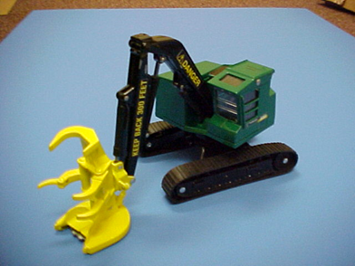
The assignment
First get in groups of 3-4 people.
Divide work up evenly among group members.
Do Not just say each person does one assembly.
You will be recreating this toy in Solidworks and printing it out turning in part drawings, A BOM (build of materials), Assembly drawings and the finished product.

Slide 29
What you will complete.
All parts will need to be designed and made in 4 sub assemblies being the Housing, the drive system, the actuating arm, and the end factor tool. A final assembly will be made as well with all parts together.
A part drawing made with your team's title block will be made for each individual part.
4 sub assembly drawings will be made to show how it's all connected.
The full assembly will be made as your project cover.
A BOM will also be included as an excel document. Based on a material(s) you choose to make the product on.
And the final product 3D printed.
For EC: An individual can to make an alternate end factor and produce all the necessary documents with it.

Slide 30
Final Project
If someone can perfectly recreate your product from all the drawings without question then you have succeeded. You will also need to turn in all the part files.
Organize your project like a book:
Cover sheet
BOM
Sub assembly 1, Followed by Each part of the assembly in order.
Sub assembly 2, Followed by Each part of the assembly in order.
Sub assembly 3, Followed by Each part of the assembly in order.
Sub assembly 4, Followed by Each part of the assembly in order.

Slide 31
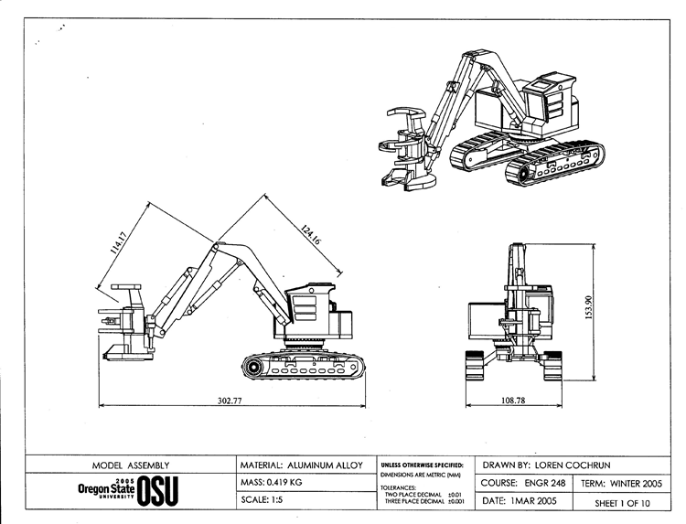

Slide 32
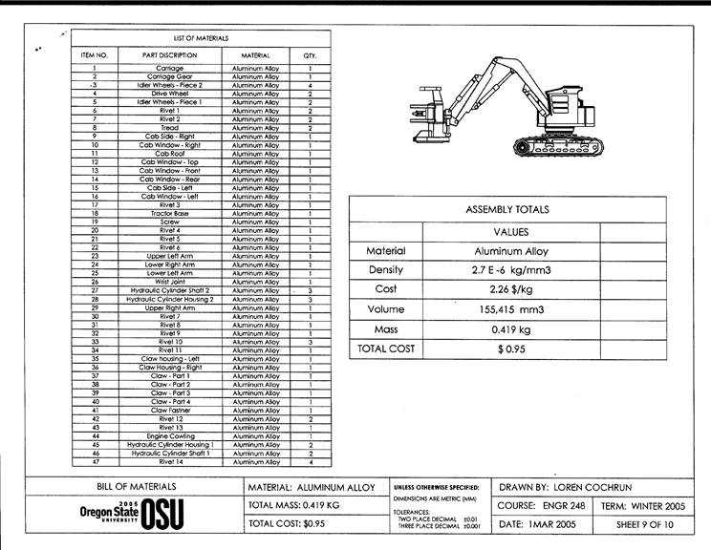

Slide 33
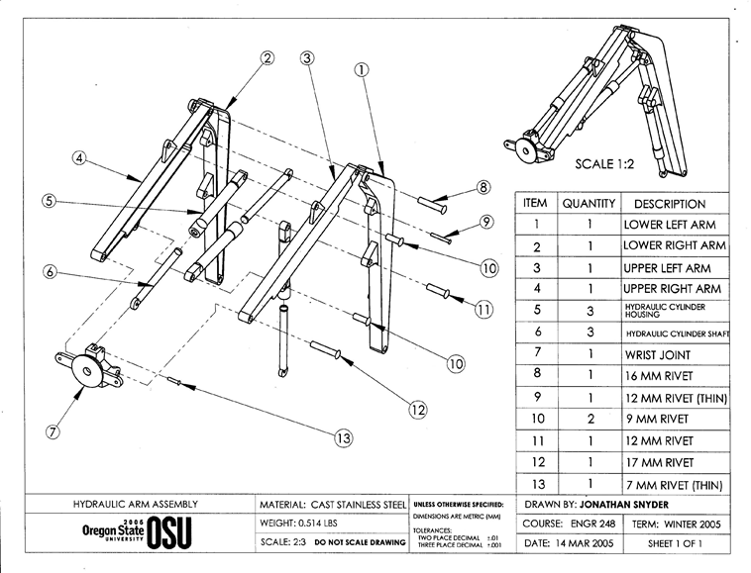

Slide 34
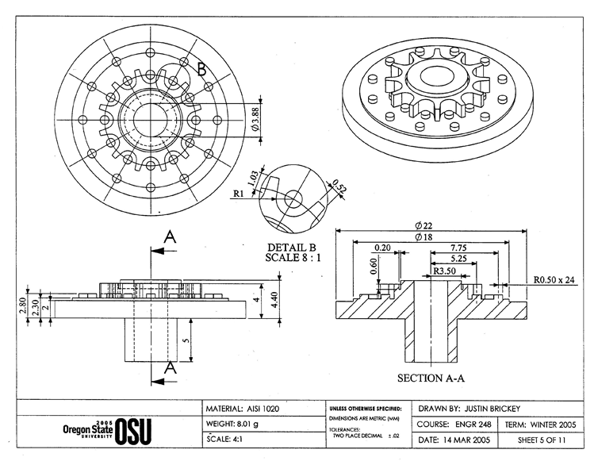

Slide 35
Turning in your final project.
-Open the F: drive from your computer
-Go to the folder labeled tmpfiles
-Go to the folder labeled IENG 248 Term Projects
-Create/find the folder with your team name, and open it
-Copy all of the following files into the folder:
-Each individual part file
-Each individual drawing file
-Any assembly file(s)
-Any other files that your team wishes to submit for grading
-Send an E-mail to the instructor with the following subject:
IENG Final Project – and add your team name at the end
-In the body of the e-mail text:
-List each team member and the part files / drawings / etc. that they created for the project – one student per line.
-Hit the send button
Go enjoy your break!

